Slide 1

Practical Python For Tensorflow
Tony Xu
11/11/2017

Slide 2
Some Python Packages Based on Tensorflow
Slim: a lighter weight lib
import tensorflow.contrib.slim as slim #light weighted lib
Keras: is much better choice now since Google supports that.
Estimator
Import tf.estimator.Estimator

Slide 3
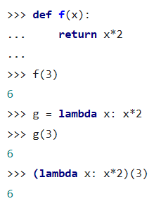
Lambda
Lambda: anonymous function is a function that is defined without a name.
Syntax : lambda arguments: expression
Examples:

Slide 4
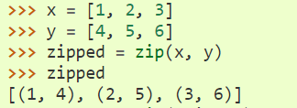

Revisit Zip
We shall be able to use zip
When in conjunction with the * operator = unzip a list

Slide 5
Revisit Tensorflow Variable
Variable: Internally, a tf.Variable(class) stores a persistent tnesor. Specific ops allow you to read and modify the values of this tensor.
The best way to create a variable is to call tf.get_variable function, which allows you to reuse a previously created variable.
My_variable = tf.get_variable(“my_variable”, [1,2,3])
Variable is a [1,2,3] shape.
Device placement: create a variable on GPU 1.
With tf.device(“/device:GPU:1”):
V = tf.get_variable(“v”, [1])

Slide 6
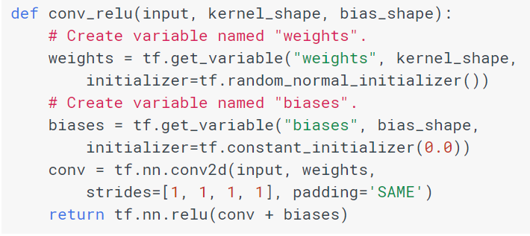
Sharing Variables
Explicitly passing Variable objects around
Implicitly wrapping Variable objects within a scope

Slide 7
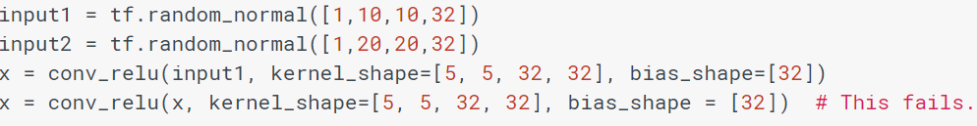
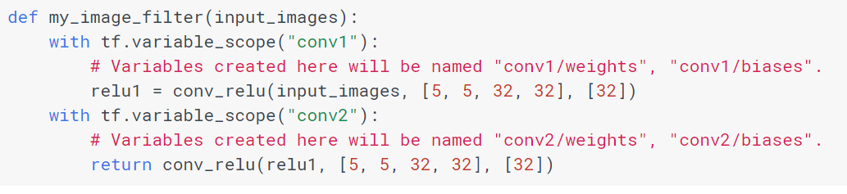
How to Use Scope
If we do that following, it fails:
If we define a scope for variables, it works.

Slide 8
TFRecods
TensorFlow standard data format
two options to use input data:
To feed the data into out Tensorflow program: loading the data using pure python code at each step and feed it into a computation graph.
To use an input pipeline which takes a list of filenames (any supported format), shuffle them (optional), create a file queue, read, and decode the data.

Slide 9
To Create a TFRecords
Features (bytes, int64, float)
Protocol Buffer(Example)
Serialization is the process of converting an object into a stream of bytes in order to store the object or transmit it to memory, a database, or a file.
File

Slide 10
Steps To Create a TFRecords(convert2tfrecord.py)
Open a TFRecords file using tf.python_io.TFRecordWriter
Convert your data into the proper data type of the feature using tf.train.Int64List, tf.train.BytesList, or tf.train.FloatList
Create a feature using tf.train.Feature and pass the converted data to it
Create an Example protocol buffer using tf.train.Example and pass the feature to it
Serialize the Example to string using example.SerializeToString()
Write the serialized example to TFRecords file using writer.write

Slide 11
Read From TFRecords(read_data.py)
Create a list of filenames and create a queue to hold them.
use tf.train.string_input_producer function holds filenames in a FIFO queue.
num_epochs :indicates the number of epoch you want to load the data
shuffle: the filenames in the list or not. It is set to True by default.
Define a reader:
Define: reader = tf.TFRecordReader().
Read next record: reader.read(filename_queue)
Define a decoder:
features = tf.parse_single_example(serialized_example, features=feature)
Convert the data from string back to the numbers:
tf.decode_raw(bytes, out_type) converts a string Tensor string typeout_type.
for labels to cast them using tf.cast(x, dtype)
Reshape data into its original shape: image = tf.reshape(image, [224, 224, 3])
Batching: You can create the batch queue using tf.train.shuffle_batch([image, label], batch_size=10, capacity=30, num_threads=1, min_after_dequeue=10) where capacity is the maximum size of queue, min_after_dequeue is the minimum size of queue after dequeue, and num_threads is the number of threads enqueuing examples. Using more than one thread, it comes up with a faster reading. The first argument in a list of tensors which you want to create batches from.

Slide 12




Softmax
"Euler's number“ (2.71828)
Events’ scores
z = [1.0, 2.0, 3.0, 4.0, 1.0, 2.0, 3.0]
= [2.72, 7.39, 20.09, 54.6, 2.72, 7.39, 20.09]
Add up to 1
= 114.8
= [0.024, 0.064, 0.175, 0.475, 0.024, 0.064, 0.175]

Slide 13


Softmax Classifier
It is loss function
Another equitation:
Please use: tf.nn.softmax_cross_entropy_with_logits

Slide 14
Initialization of Input Images
per_image_standardization(image)
Linearly scales image to have zero mean and unit norm.
computes (x - mean) / adjusted_stddev, adjusted_stddev = max(stddev, 1.0/sqrt(image.NumElements())).
stddev is the standard deviation of all values in image. It is capped away from zero to protect against division by 0 when handling uniform images.
tf.map_fn(lambda frame: tf.image.per_image_standardization(frame), frames)

Slide 15
LeNet Layers
def lenet(images, num_classes, is_training=False, dropout_keep_prob=0.5, scope='LeNet'): with tf.variable_scope(scope, 'LeNet', [images, num_classes]): net = slim.conv2d(images, 32, [5, 5], scope='conv1') net = slim.max_pool2d(net, [2, 2], 2, scope='pool1') net = slim.conv2d(net, 64, [5, 5], scope='conv2') net = slim.max_pool2d(net, [2, 2], 2, scope='pool2') net = slim.flatten(net) net = slim.fully_connected(net, 1024, scope='fc3') net = slim.dropout(net, dropout_keep_prob, is_training=is_training, scope='dropout3') logits = slim.fully_connected(net, num_classes, activation_fn=None, scope='fc4') return logits

Slide 16
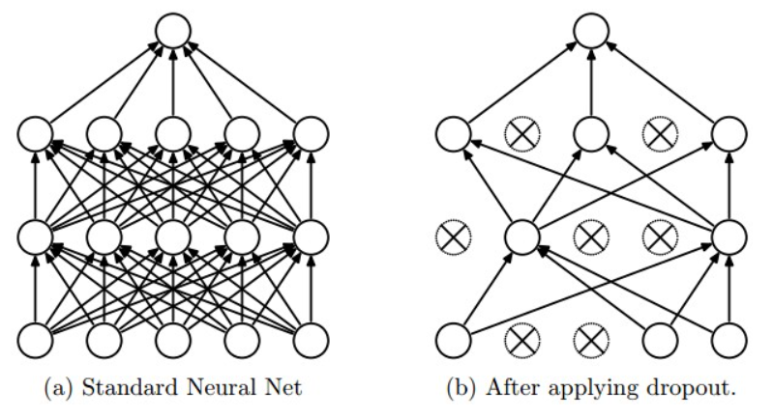
Dropout
A Simple Way to Prevent Neural Networks from Overﬁtting

Slide 17
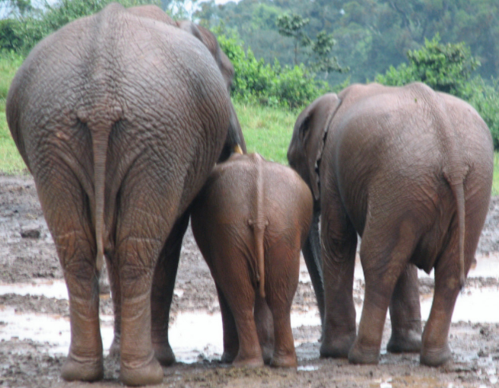
The End

