Slide 1
102-object-tracker-HL-2020-4-16.odp
Version: x0.1 (Alpha)
Date: Mar 6, 2020
Project Lead: Harry Li, Ph.D.
Team members:
Minh Duc Ong
Notes:
<number>
<number>

Slide 2
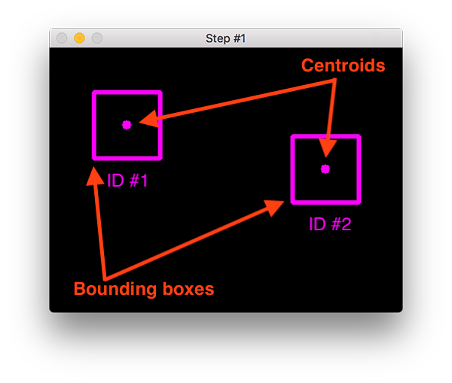
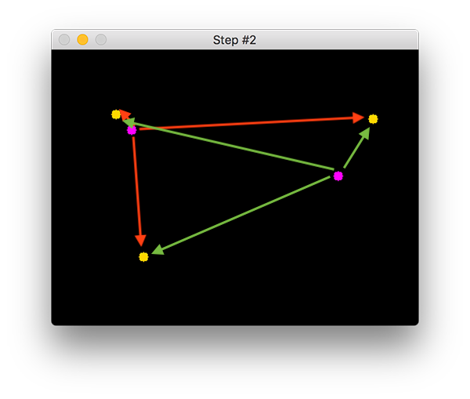
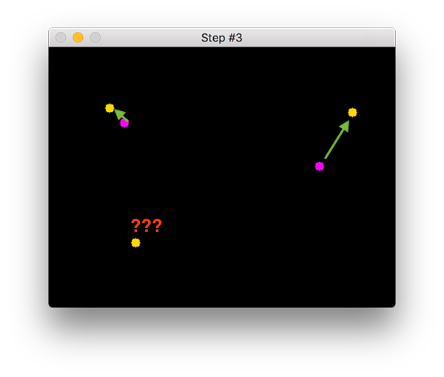
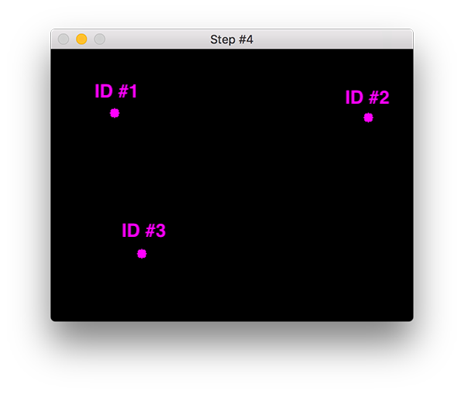
ObjectID Tracker
https://www.pyimagesearch.com/2018/07/23/simple-object-tracking-with-opencv/
The Process of Object ID tracking is:
Taking an initial set of object detections (such as an input set of bounding box coordinates).
Creating a unique ID for each of the initial detections.
And then tracking each of the objects as they move around frames in a video, maintaining the assignment of unique IDs.
Algorithm:
Accept bounding box coordinates and compute centroids of each face object
Compute Euclidean distance between new bounding boxes and existing objects
Update (x, y)-coordinates of existing object
Register new objects
Deregister old objects

Slide 3
Step 0. Compute Bounding Box
These bounding boxes can be produced by object detector of your choice:
1. color thresholding + contour extraction;
2. Haar cascades;
3. HOG + Linear SVM; (HOG: Histogram of Oriented Gradient, https://www.learnopencv.com/tag/hog/ )
4. SSDs; (single shot detection https://honingds.com/blog/ssd-single-shot-object-detection-mobilenet-opencv/ )
5. Faster R-CNNs;
6. Yolo (you look only once).
They are computed for every frame in the video.

Slide 4
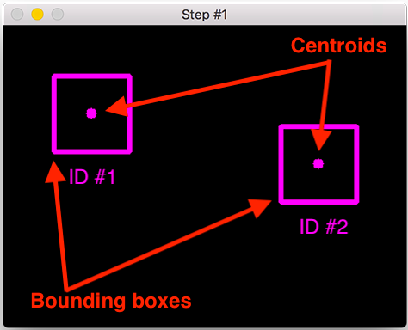
Step 1. Compute Centroid
The algorithm:
1. Compute centroids, computation is given in my lecture on binary image processing and moments computation
2. Assign ID to each centroid (box)

Slide 5
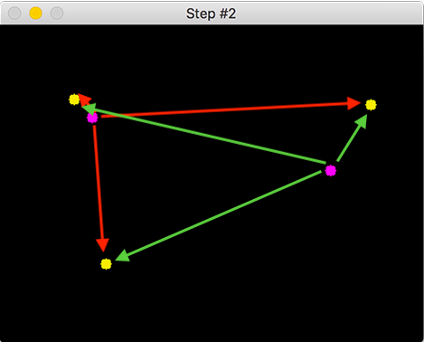
Step 2. Compute Distance Between Boxes
Original: pink (from previous frame)
New: yellow (the current frame)
Algorithm: compute distance between each pair
O1
O2

Slide 6
Step 3. Compute Distance Between Boxes
Original: pink (from previous frame)
New: yellow (the current frame)
Algorithm: compute distance between each pair
N2
N1
O1
O2
N3

Slide 7
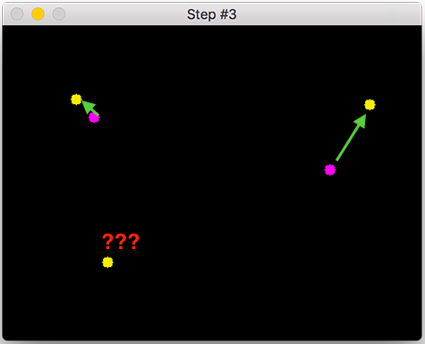
Step 4. Update Box ID with Shortest Distance
Original: pink (from previous frame)
New: yellow (the current frame)
Algorithm: find shortest distance to match the pair.
Example:
O1 > N1
O2 > N2
And New N3 appeared on this frame
N1
N2
O1
O2
N3

Slide 8
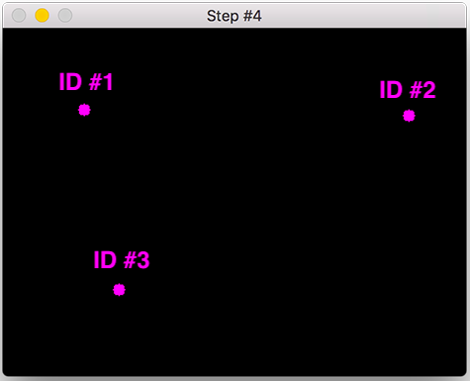
Step 5. Add New Object ID then Back to Step 2
Algorithm: add ID to the new object, e.g., register the new object ID.
Example:
Object 1, with ID O1
Object 2, with ID O2
And New object ID: O3
Registration table
Object 1. O1 x1-bar, y1-bar
Object 2. O2 x2-bar, y2-bar
Object 3. O3 x3-bar, y3-bar

Slide 9
Step 6. Remove Object ID in N Frames
Object tracking needs to be able to handle when an object has been (1) lost, (2) disappeared, or (3) left the field of view.
e.g. will deregister old objects when they cannot be matched to any existing objects for a total of N subsequent frames.
Update the Registration table
Object 1. O1 x1-bar, y1-bar
Object 2. O2 x2-bar, y2-bar
Object 3. O3 x3-bar, y3-bar
N frames later, this disappeared object is removed from the registration table

Slide 10
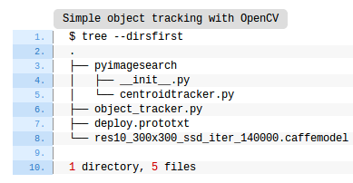
Sample Code
https://www.pyimagesearch.com/2018/07/23/simple-object-tracking-with-opencv/
Structure of the distribution files
You can replace the centroid tracker based on the techniques in ROI localization
The remaining .prototxt and .caffemodel
files are part of the OpenCV deep learning face detector. They are necessary for today’s face detection + tracking method, but you could easily use another form of detection (more on that later).

Slide 11
ObjectID Tracker Algorithm
https://www.pyimagesearch.com/2018/07/23/simple-object-tracking-with-opencv/
An ideal object tracking algorithm will:
1. Only require the object detection phase once (i.e., when the object is initially detected)
2. Will be extremely fast — much faster than running the actual object detector itself
3. Be able to handle when the tracked object “disappears” or moves outside the boundaries of the video frame
4. Be robust to occlusion
5. Be able to pick up objects it has “lost” in between frames

Slide 12

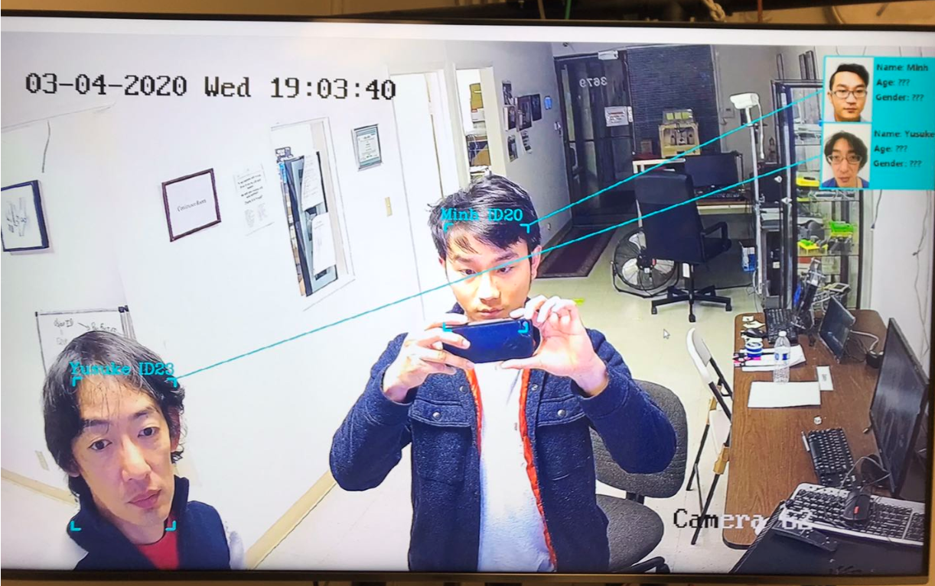
DeepFace+ObjectID Tracker
Algorithm:
Use DeepFace training model to recognize and classify new faces. (new Face ID)
Use ObjectID Tracker to assign ID to each face object (Object ID)
Assign Face ID to each Object ID
Deregister Object ID and FaceID when person move out of the frame.
new person come inside the frame
Fig4. Result of FaceID + ObjectID with frame rate is 20 frames/s

