Slide 1

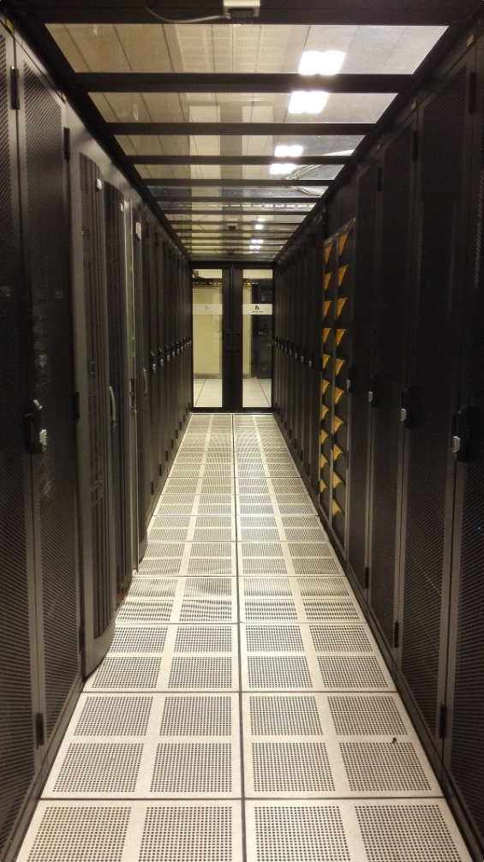
Redis & Spring Data Redis: An Introduction
Redis is a powerful in-memory data store used for building high-performance, scalable applications. Spring Data Redis simplifies the process of integrating Redis into your Spring applications.
by Abhijith H

Slide 2

Redis: The In-Memory Key-Value Store
Key-Value Pairs
In-Memory Storage
Redis stores data as key-value pairs. The key is a unique identifier for the data, and the value can be a string, list, set, hash, or sorted set.
Redis stores all data in memory, which provides extremely fast read and write operations.
Persistence
Redis can be configured to persist data to disk, ensuring that data is not lost even if the server restarts.

Slide 3

The Advantages of Redis
1
High Performance
2
Scalability
Redis's in-memory storage makes it significantly faster than traditional disk-based databases.
Redis can be easily scaled horizontally by adding more servers to a cluster.
3
Flexibility
4
Reliability
Redis offers a wide range of data structures to meet the needs of various applications.
Redis offers features like persistence and replication to ensure data durability and availability.

Slide 4
Redis: Use Cases in Action
Caching
Leaderboards
Redis can be used to store frequently accessed data in memory, reducing the need to query the database, resulting in faster response times for users.
Redis can be used to track and display rankings, such as high scores in games or the most popular products on an e-commerce website.

Slide 5


Spring Data Redis: Simplifying Your Life
Spring Data Redis offers a simple and efficient way to integrate Redis into your Spring applications, providing a higher level of abstraction.

Slide 6

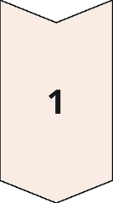
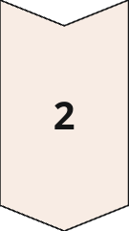
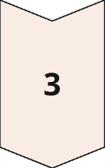
Spring Data Redis: Key Features
Repositories
Spring Data Redis provides a repository abstraction that allows you to interact with Redis data using familiar CRUD operations.
Data Structures
Spring Data Redis supports all of Redis's built-in data structures, allowing you to leverage their functionality within your Spring applications.
Annotations
Spring Data Redis provides annotations for configuring Redis connections, caching, and other features.

Slide 7

Connecting to Redis with Spring Data Redis
Connecting to Redis with Spring Data Redis is straightforward. Simply configure the Redis connection in your application context and use the provided annotations to define your Redis entities.

