Slide 1

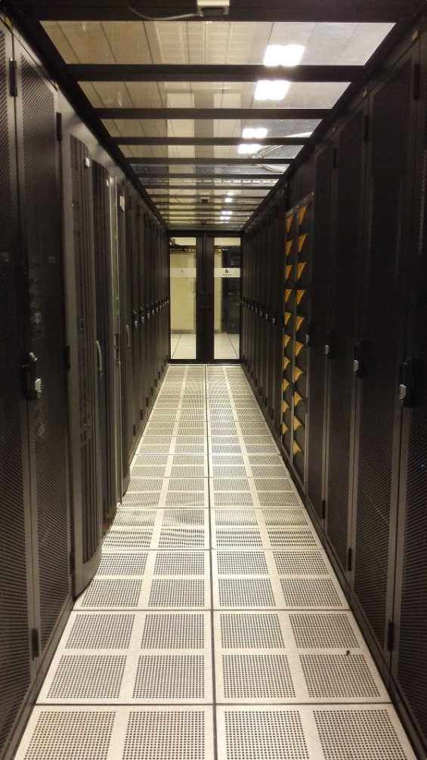
Redis & Spring Data Redis: An Introduction
Redis is a powerful in-memory data store used for building high-performance, scalable applications. Spring Data Redis simplifies the process of integrating Redis into your Spring applications.
by Abhijith H

Slide 2

Redis: The In-Memory Key-Value Store
Key-Value Pairs
In-Memory Storage
Redis stores data as key-value pairs. The key is a unique identifier for the data, and the value can be a string, list, set, hash, or sorted set.
Redis stores all data in memory, which provides extremely fast read and write operations.
Persistence
Redis can be configured to persist data to disk, ensuring that data is not lost even if the server restarts.

Slide 3

The Advantages of Redis
1
High Performance
2
Scalability
Redis's in-memory storage makes it significantly faster than traditional disk-based databases.
Redis can be easily scaled horizontally by adding more servers to a cluster.
3
Flexibility
4
Reliability
Redis offers a wide range of data structures to meet the needs of various applications.
Redis offers features like persistence and replication to ensure data durability and availability.

Slide 4
Redis: Use Cases in Action
Caching
Pub/Sub
Leaderboards
Redis can be used to store frequently accessed data in memory, reducing the need to query the database, resulting in faster response times for users.
Redis can be used to build real-time messaging systems, where clients can subscribe to channels and receive notifications when new data is published.
Redis can be used to track and display rankings, such as high scores in games or the most popular products on an e-commerce website.

Slide 5


Spring Data Redis: Simplifying Your Life
Spring Data Redis offers a simple and efficient way to integrate Redis into your Spring applications, providing a higher level of abstraction.

Slide 6

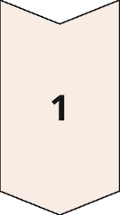
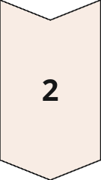
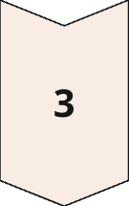
Spring Data Redis: Key Features
Repositories
Spring Data Redis provides a repository abstraction that allows you to interact with Redis data using familiar CRUD operations.
Data Structures
Spring Data Redis supports all of Redis's built-in data structures, allowing you to leverage their functionality within your Spring applications.
Annotations
Spring Data Redis provides annotations for configuring Redis connections, caching, and other features.

Slide 7

Connecting to Redis with Spring Data Redis
Connecting to Redis with Spring Data Redis is straightforward. Simply configure the Redis connection in your application context and use the provided annotations to define your Redis entities.

Slide 8

Caching with Redis and Spring Data Redis
Caching Data
Redis is a powerful tool for implementing caching, reducing the number of times your application needs to query the database.
Spring Data Redis Integration
Spring Data Redis provides annotations to easily configure caching and manage cache evictions.
Enhanced Performance
Caching improves application performance by reducing database load and speeding up response times.

Slide 9





Redis Data Structures: Beyond the Basics
Lists
Sets
Hashes
Sorted Sets
Lists are ordered collections that allow you to store elements in a specific sequence. They are useful for implementing queues, stacks, and other ordered data structures.
Sets are unordered collections of unique elements. They are useful for implementing operations like union, intersection, and difference.
Hashes are key-value pairs that allow you to store complex data objects in a structured way.
Sorted sets are similar to sets, but elements are sorted based on a specified score. They are useful for implementing leaderboards and other ranked data structures.

Slide 10

Redis and Spring Data Redis: Why They Matter
Redis and Spring Data Redis offer a powerful combination for building high-performance and scalable applications. By leveraging the power of Redis, you can achieve improved performance, increased scalability, and enhanced flexibility in your applications.

