Slide 1
NOVACHAT
PRESENTED BY:BHAVSAGAR
REG.NO:12200206
PROGRAM:B.TECH(CA &AI)
PRESENTED TO :MR SANJEEV DHIMAN

Slide 2
Table of content
INTRODUTION
OBJECTIVES
SYSTEM ARCHITECTURE
WORK FLOW
TECHNOLOGIES USED
APPLICATIONS
CONCLUSIONS

Slide 3
INTRODUCTION
NovaChat – A free, all-in-one AI chat app that lets you talk naturally, create stunning images from text, and get instant descriptions of any photo you upload. Everything (messages + images) is saved forever, works instantly as guest or with login, runs on any device, and costs nothing.

Slide 4
OBJECTIVES
Create a unified multimodal AI assistant
Support text chat, image generation, and image captioning
Maintain stateful conversations
Allow user authentication & profile management
Store full chat history (messages + images) using SQLite

Slide 5
System Architecture
Client Layer (Presentation Layer)
User Interface
Chat layout, sidebar, dialogs
Mode selection
Application Layer (Backend Logic)
LangGraph-Based Stateful Conversation Engine
Multimodal AI Processing
Thread & Message Management
Authentication & User Logic

Slide 6
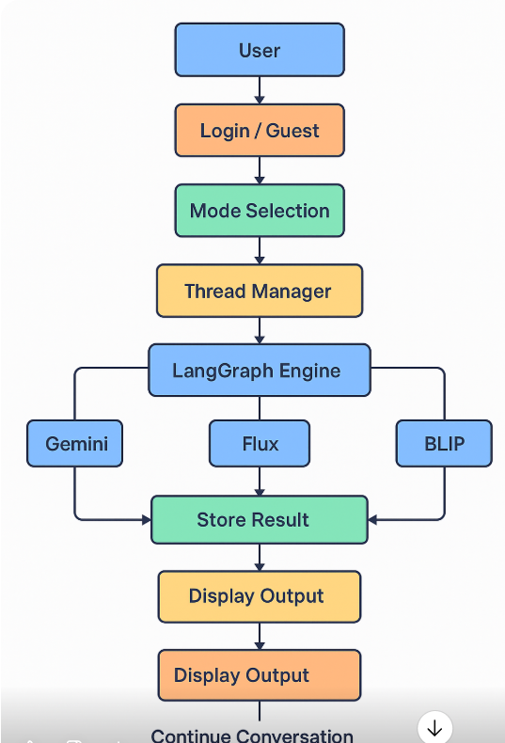
WORK FLOW DIAGRAM

Slide 7

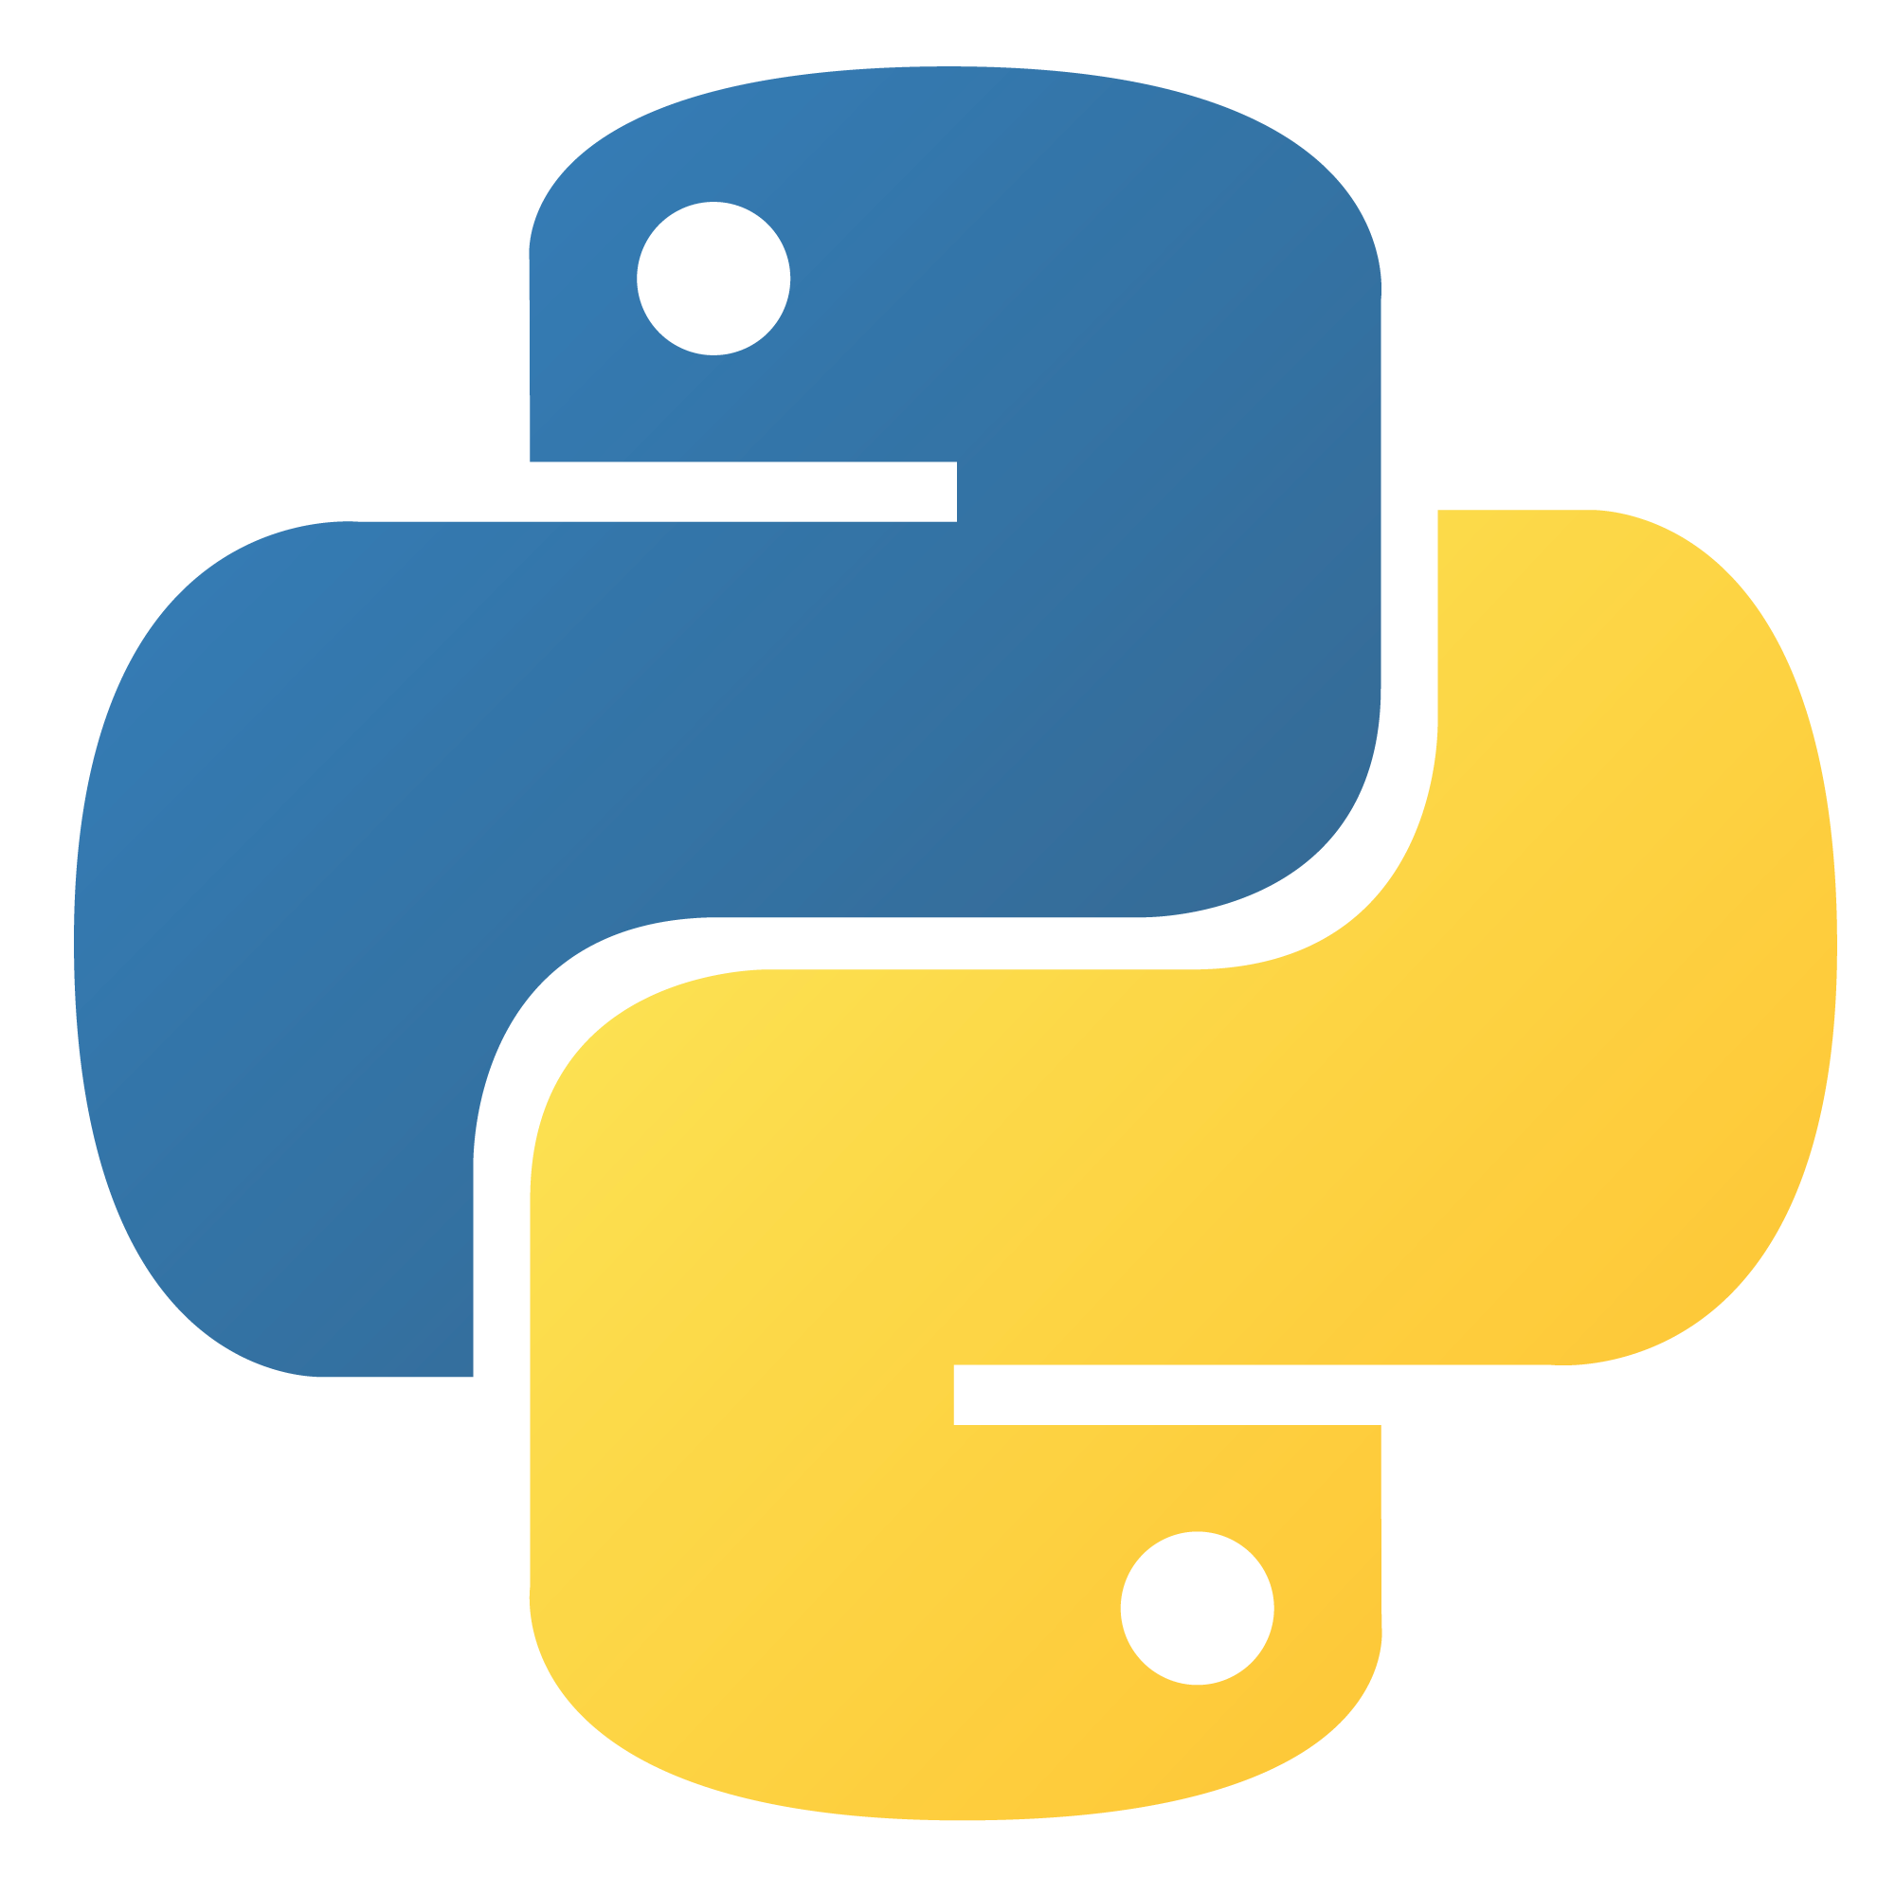



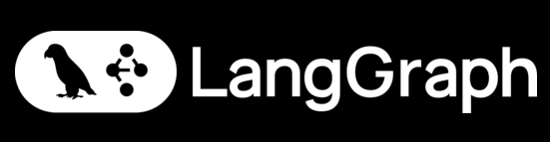
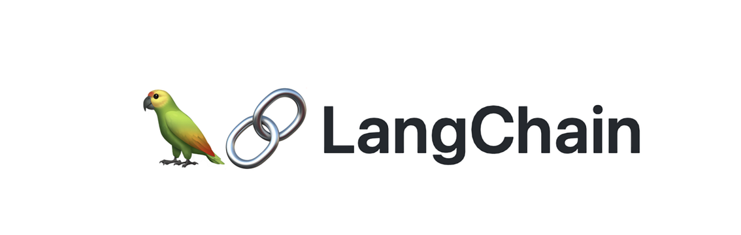
Technologies Used

Slide 8
APPLICATIONS
Content Creation
Education Tech
Healthcare Assistants
Virtual Guidance
Personal Assistants

Slide 9
CONCLUSION
Unified Platform
Multimodal AI
Smart Memory
Fast Processing
User Friendly
Real-Time Output
Effective Performance

Slide 10
THANK YOU

