Slide 1

Real-time Mesh Utilities
Blerta Hamzallari Felix Griesau Julius Lerm Lars Debor
Marco Klemke Simon Heinke Sugandha Sachdeva Petros Simidyan
02.05.2017
Seite <Foliennummer>
www.tu-ilmenau.de

Slide 2
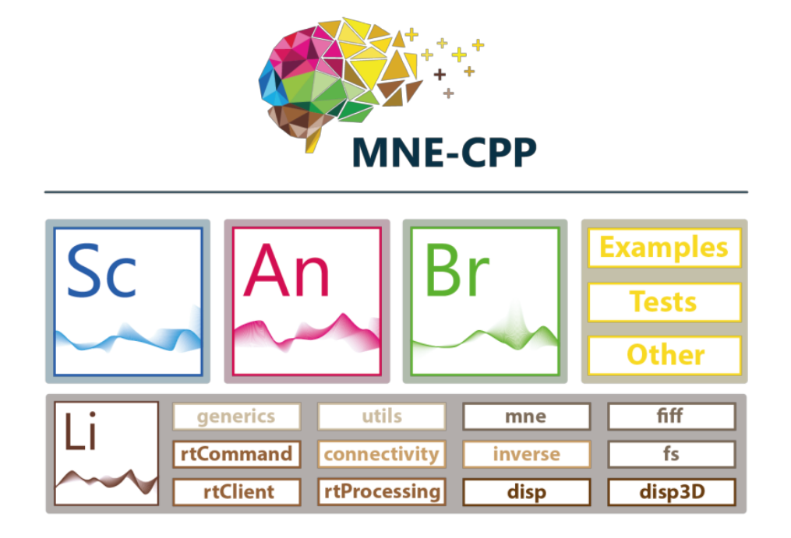

MNE-CPP
MNE-CPP is a framework of tools and programs
Provides an Open-source cross-platform library to process different neuroscientific file formats
MNE-CPP Framework includes applications such as MNE Scan, MNE Analyze, MNE Browse

Slide 3
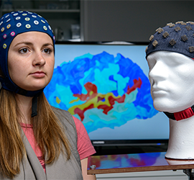
Aim of the Project
Real-time 3D visualisation of EEG and MEG Sensor-data
Integration of the feature into the existing Software Framework
The framework should run on Windows,Linux and Mac

Slide 4

Functional Requirements
• Surface Constrained Distance Calculation
Sensor-to-Mesh mapping
Interpolation algorithm
Integration in Disp3D GUI

Slide 5
Non-Functional Requirements
For introduction purposes, a product video has to be created and published on the MNE-CPP website
The software must be integrable into MNE Scan
Optional
Multiple methods for calculating the weight matrix for interpolation
One interpolation cycle should take less than 17ms

Slide 6
Preliminary Design
SCDC
1. Input: mesh data set
2. Full distance table calculation
3. Output: distance matrix
Projecting
1. MEG/EEG - sensors mapping
2. EEG: nearest neighbor algorithm
3. Output: array of indices( mesh vertices)
Interpolation
1. Input: distance table,sensors mapping, sensor input
2. Recorded brain activity: MEG/EEG Scan or prerecorded data set
Disp3D
1. New function added to tree model

Slide 7
Technologies and development tools
Language C++
Libraries Qt, Eigen
IDE QtCreator
Tools Git: Version control
Jira: Bug tracking
Doxygen: Documentation
Dropbox: File sharing
Visual Paradigm: Diagrams
LaTeX: Editing review documents

Slide 8
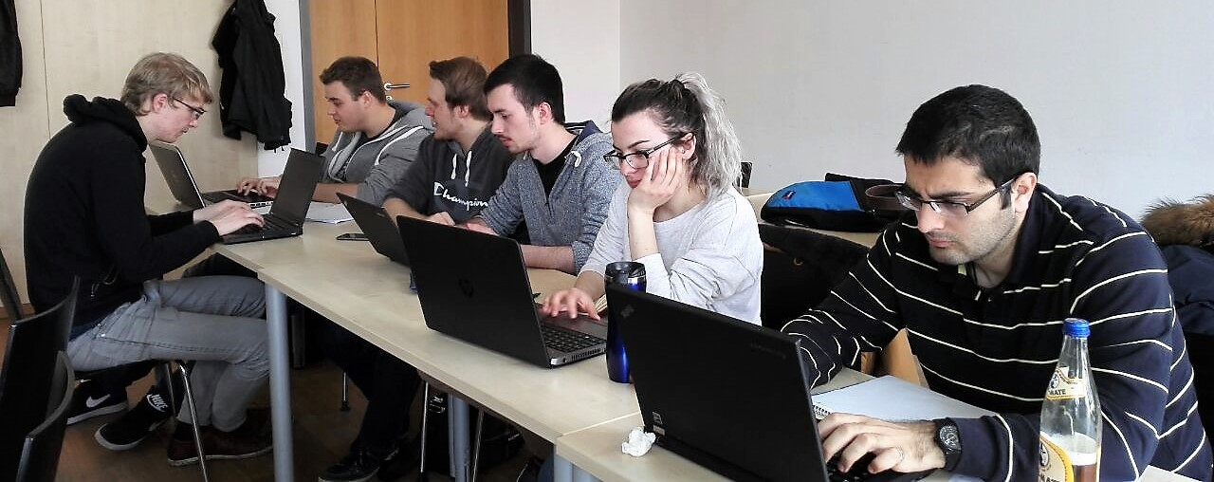
Agile Development Model: SCRUM
Product Owner Thomas Jochmann, Lorenz Esch
Scrum Master Simon Heinke
User Clients of the MNE-CPP Project of Boston
Children‘s Hospital
Development Team
Blerta Hamzallari, Lars Debor,
Felix Griesau, Simon Heinke,
Julius Lerm, Sugandha Sachdeva, Marco Klamke, Petros Simidyan

Slide 9
Milestones
Phase 1
Phase 2
Phase 3
Functional Specification
♦
Preliminary Design
♦
Review Documents
♦
Executable
♦
Implementation
♦
Presentation
SCDC: executable
♦
Projecting: executable
♦
Interpolation: executable
♦
Integration in Disp3D
♦
Review Documents
♦
Final Design
♦
Presentation
porting to MNE-Scan
♦
SCDC (tested)
♦
Projecting (tested)
♦
Interpolation (tested)
♦
Review Documents
♦
Presentation

Slide 10
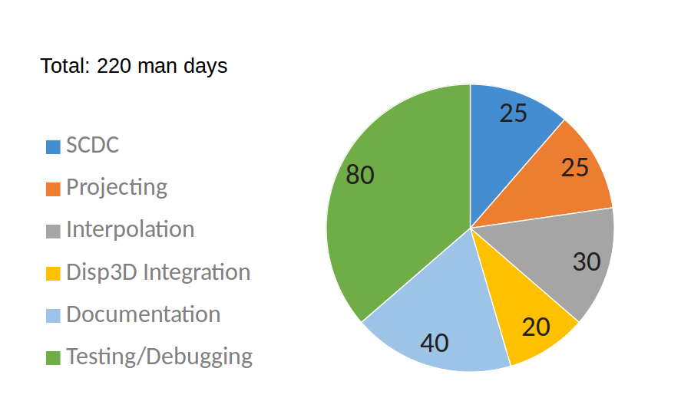
Effort Estimate

Slide 11
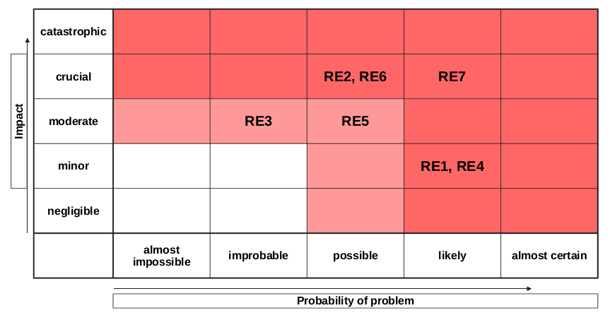
Risk Analysis
RE1: Communication problems in the team
RE2: Coverage is too extensive
RE3: Framework does not provide the needed functionality
RE4: The resource bottleneck derived from team members absence
RE5: Change of the requirements due to miscommunication with the product owner
RE6: Hidden complexity
RE7: An acceptable computation time takes a lot more eﬀort to be achieved, than expected

Slide 12
Internal Communication and Meeting
Communication Telegram, Jira, Skype, Dropbox
Internal team meetings Twice a week
External team meetings Once a week
Meetings of Sub-Groups As needed

Slide 13
Status of the Project
Functional specification
Preliminary design
Implementation: First executable prototype
Planning: Milestones for the next iteration declared

Slide 14
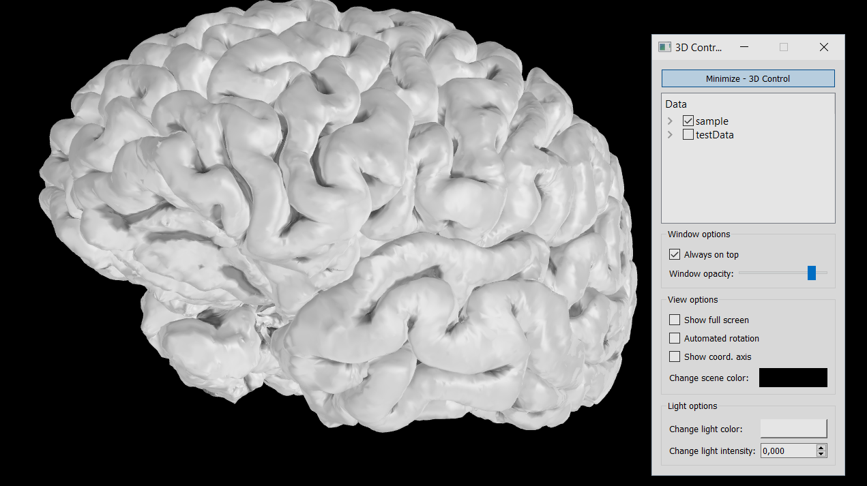
Introduction of the first Prototype

