Slide 1
Real-time Mesh Utilities
Blerta H. Felix G. Julius L. Lars D.
Marco K. Simon H. Sugandha S. Petros S.
30.04.2017
Seite <Foliennummer>
www.tu-ilmenau.de

Slide 2
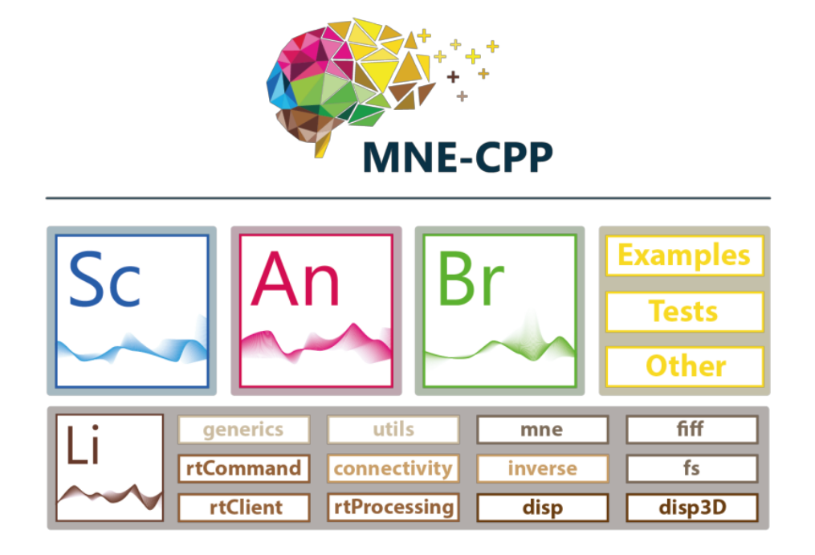
MNE-CPP
MNE-CPP is a framework of tools and programs
Provides an Open-source cross-platform library to process different Neuroscience file formats
Can be used to build software applications for a number of neuroscientific tools
MNE-CPP Framework includes applications such as MNE-Scan, MNE-Analyze, MNE-Browse

Slide 3
Aim of the Project
Real-time 3D visualisation of EEG and MEG Sensor-data
Integration of the feature into the existing Software Framework
The framework should run on Windows and Linux

Slide 4
Product Environment
Software
Framework
Frontend: MNE Scan, MNE Browse and MNE Analyze applications
Backend: Library layer
Integration of the new feature: Library layer
System
Compatible with: Windows and Linux
Requirement: OpenGL compatibility
Dependency: Qt libraries
Hardware
Input from: A BCI-system
#TODO: The program should run on
most modern computers with enough
performance to handle it.

Slide 5
Functional Requirements
• Surface Constrained Distance Calculation
Sensor-to-Mesh Mapping
Interpolation Algorithm
Integration in Disp3D GUI

Slide 6
Non-Functional Requirements
• The Software must run on latest versions of Linux and Windows
For introduction purposes, a product video has to be created and published on the MNE-CPP website
The software must integratable into MNE-Scan
Fast: Low Computation Time
Multiple methods for calculating the weight matrix for Interpolation
One interpolation cycle should take less than 17ms
• The Software must run on latest versions of Linux and Windows
For introduction purposes, a product video has to be created and published on the MNE-CPP website
The software must integratable into MNE-Scan
Fast: Low Computation Time
Multiple methods for calculating the weight matrix for Interpolation
One interpolation cycle should take less than 17ms

Slide 7
Result of Requirement Analysis
TODO

Slide 8
Preliminary Design
TODO
Interface:
Surface Constrained Distance Calculation:
Input:
Output:
• Grobkonzept und grundlegende Softwarearchitektur
• hauptsächlich sequentiell (einen Algo nach dem anderen)
• Einbau in Klassen GeometryInfo / Interpolation
• Aber: wird in existierendes Framework eingepflegt
• => groben Aufbau von MNE-CPP erklären
• Schnittstellen: rel. einfach (Parameterübergabe der einzelnen Algos)
• UML-Modell: Klassendiagramm:Frage wie groß -> gesamtes MNE-CPP Orjekt oder nur unser Kram ?
•

Slide 9
Technologies and development tools
Language C++
Libraries Qt, Eigen, OpenGL
IDE QtCreator
Tools Git: Version control
Jira: Bugtracking
Doxygen: Documentation
Dropbox: File sharing
Visual Paradigm: Diagrams
Latex: Editing review documents and Documentation

Slide 10
Development Model
Agile Development: Iterative and Incremental, Requirements might change over time
SCRUM
Each Sprint over a duration of 2 Weeks

Slide 11
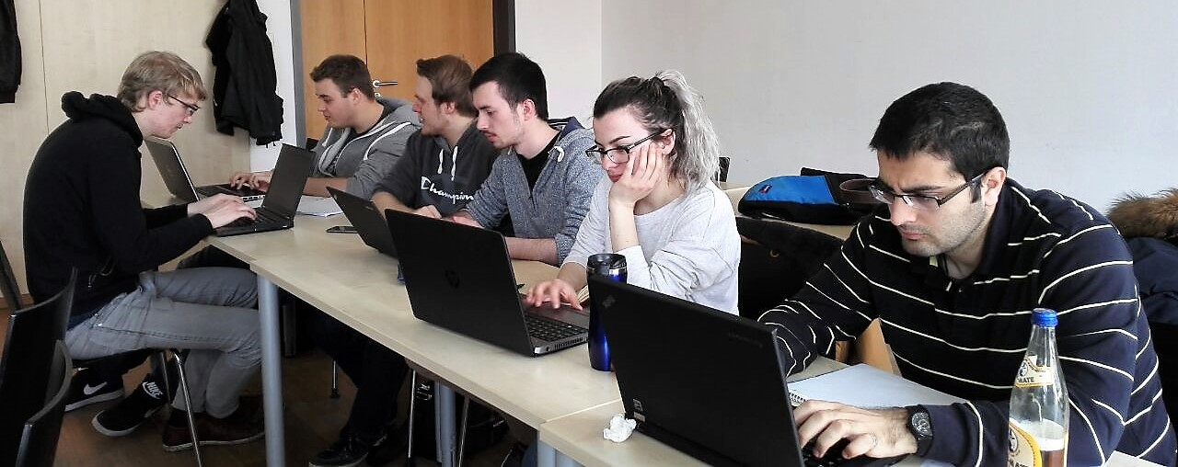
Agile Development Model: SCRUM
Product Owner Thomas Jochmann, Lorenz Esch
Scrum Master Simon Heinke
User Clients of the MNE-CPP Project of Boston
Children‘s Hospital
Development Team
Blerta Hamzallari, Lars Debor,
Felix Griesau, Simon Heinke,
Julius Lerm, Sugandha Sachdeva, Marco Klamke, Petros Simidyan

Slide 12
Milestones
Phase 1
Phase 2
Phase 3
Functional Specification
♦
Preliminary Design
♦
Review Documents
♦
Executable
♦
Implementation
♦
Presentation
SCDC: executable
♦
Projecting: executable
♦
Interpolation: executable
♦
Integration in Disp3D
♦
Review Documents
♦
Final Design
♦
Presentation
porting to MNE-Scan
♦
SCDC (tested)
♦
Projecting (tested)
♦
Interpolation (tested)
♦
Review Documents
♦
Presentation

Slide 13
Guidelines and Principals of the Team
• Test-oriented development
Customer Involvement at every Step
Courage and Openess for Changes more important than following a fixed plan
Collective Possession of the Code
Pair-Programming
Good Communikation

Slide 14
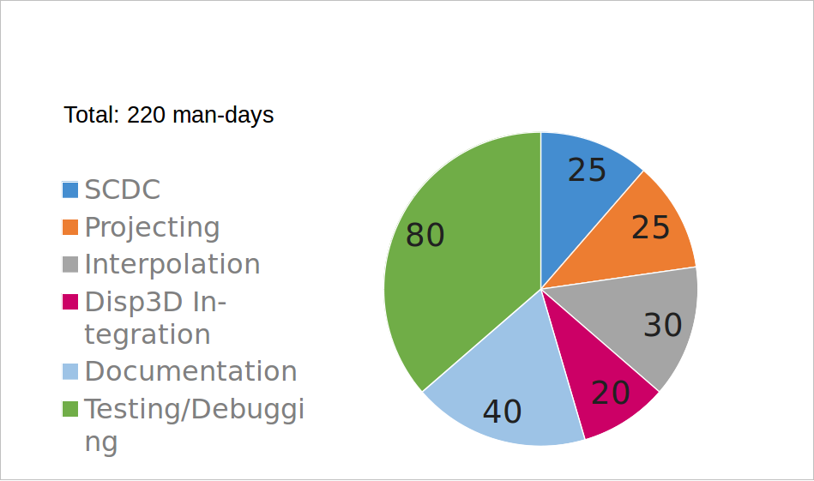
Effort Estimation

Slide 15
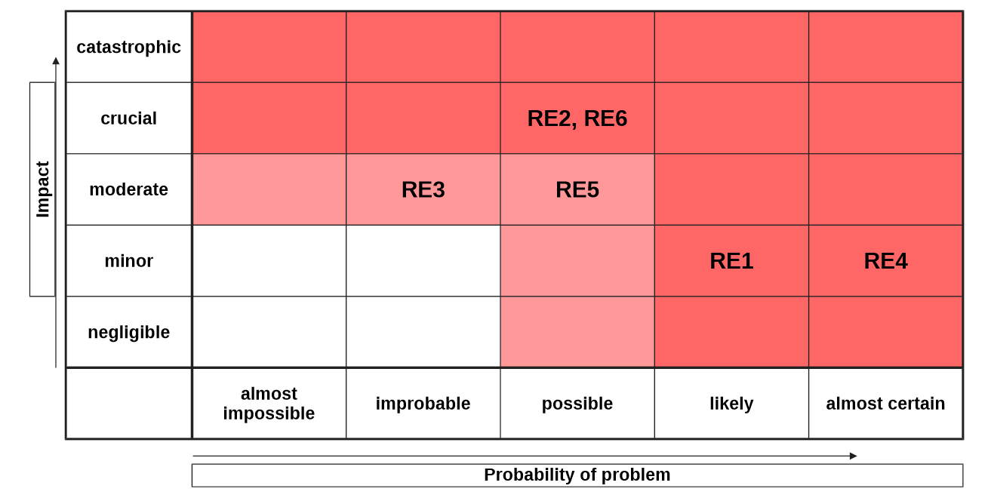
Risk Analysis
RE1: Communication problems
RE2: Coverage is too extensive
RE3: Framework does not provide the needed functionality
RE4: Absence of the team members
RE5: Change of the requirements due to miscommunication with the product owner
RE6: Hidden complexity

Slide 16
Internal Communication and Meeting
Communication Telegram, Jira, Team Meetings, Skype, Dropbox
Internal team meetings Twice in a Week
External team meetings Once in a Week
Meetings of Sub-Groups As needed

Slide 17
Internal Team Organisation
Supervisors Thomas Jochmann, Lorenz Esch
Team Leader Simon Heinke
Build Master Lars Debor
Version Management Felix Greisau

Slide 18
Status of the Project
Functional specification
Preliminary design
Implementation: First executable prototype
Planning: Milestones for the next iteration declared

Slide 19
Introduction of the First Prototype

Slide 20
Tasks for the next Iteration
Refining the preliminary design
Implementation of product requirements and Algorithm Development:
SCDC, Interpolation, Projection, Integration in Disp3D
Documents

