Slide 1

Real-Time Mesh Utilities
Blerta Hamzallari Felix Griesau Julius Lerm Lars Debor
Marco Klamke Simon Heinke Sugandha Sachdeva Petros Simidyan

Slide 2
Outline
- Assignment / Task
- Preliminary Design
- Detailed Design
- Status
- Outlook
- Questions

Slide 3
Assignment / Task
Final goal: Real-time visualization of EEG/MEG Data
d
Todo: Insert pic of EEG/MEG
Utilities for real-time capable interpolation and visualization of MEG/EEG sensor data

Slide 4
Input/Output
Input:
Mesh:
-vertices (x,y,z)
-neighbours
Sensor points (x,y,z)
Sensordata (1000hz)
Output:
Matrix containing intensities for every vertex

Slide 5

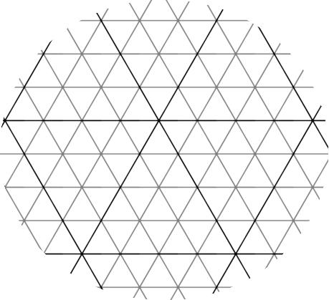
Assignment / Task
?
?
?
s1
s2

Slide 6
Sensor Mapping
Feature 1
- sensors do not touch head
- relative position on surface unknown
→sensor mapping needed

Slide 7
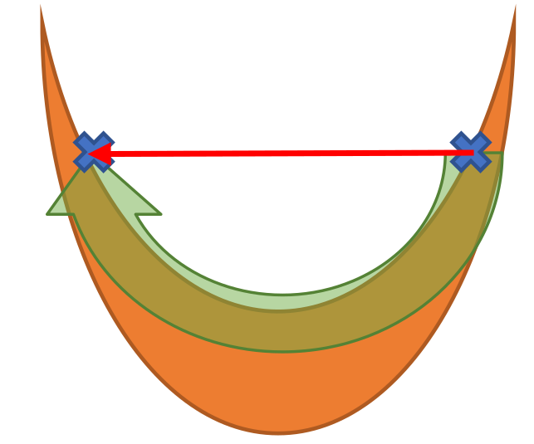
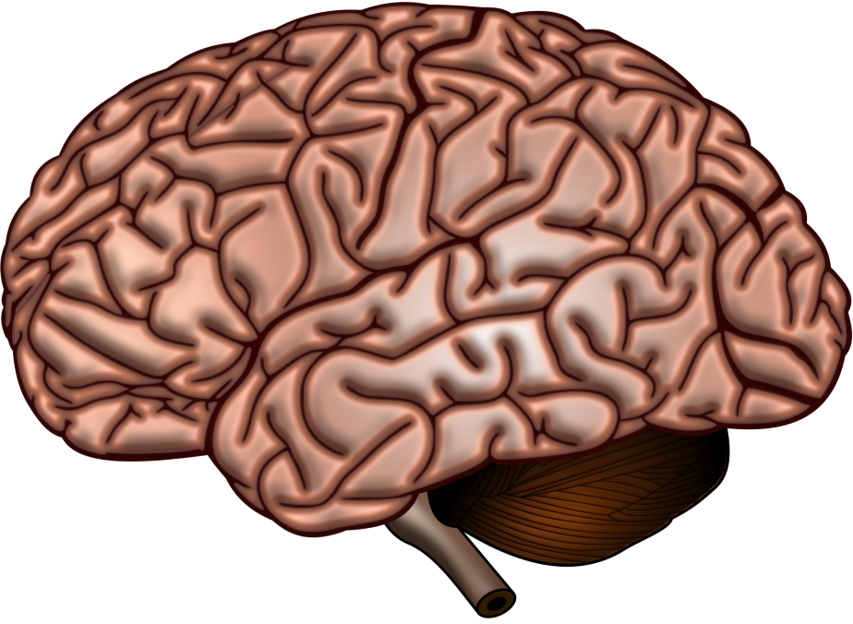
Distances
Feature 2
- folded surface
- distance between 2 vertices ?
- euclidian distance inaccurate
→Surface Constrained Distance Calculation (SCDC)

Slide 8
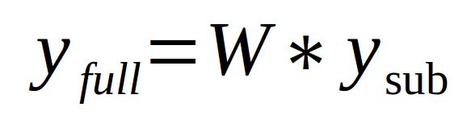
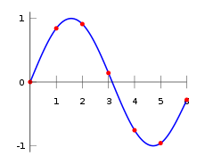
Interpolation
Feature 3
1. position of sensors
- already known:
2. distances between vertices
- activity levels between sensors?
Known sensor point
Interpolated values

Slide 9
Preliminary Design /
Conceptual Design
Sensors
Mesh
Sensor
Mapping
Sensors on
Mesh
Mesh
SCDC
Distance
Table
Function
Interpolation
Weight matrix
Signal
Interpolation

Slide 10
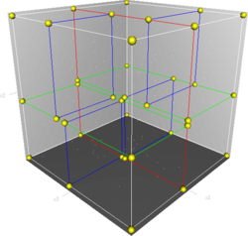
Detailed Design
Feature 1: Sensor Projecting
- fast 3D lookups: KD Tree
- unbalanced building
- limited computation time
→ multithreaded linear search

Slide 11
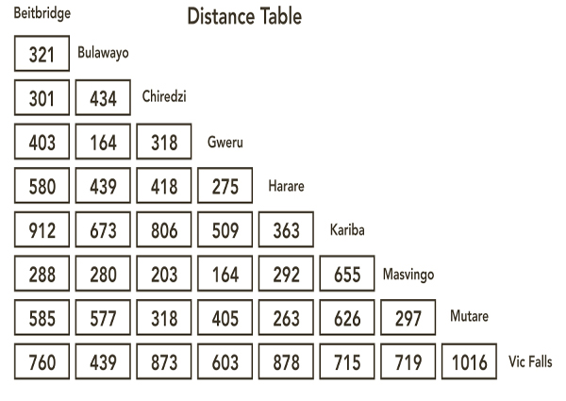
Detailed Design
Feature 2: SCDC
- distances: precise vs. approximated
- solving (All) Pairs Shortest Path Problem
- limited memory: shrink problem
→ subset of vertices
- limited computation time
→ distance threshold

Slide 13
Choice of Algorithm
- Pettie and Ramachandran: O(m*n*log(α(m, n)))
- Thorup: O(m*n)
- iterative Dijkstra: O(n’ * (m + n log n))

Slide 14
Iterative Dijkstra
} Core 0
} Core 1
} Core 2
Subset of
vertices
Core x
} Core 3
...
} ...

Slide 15
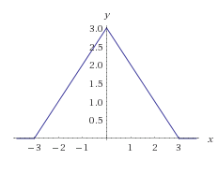
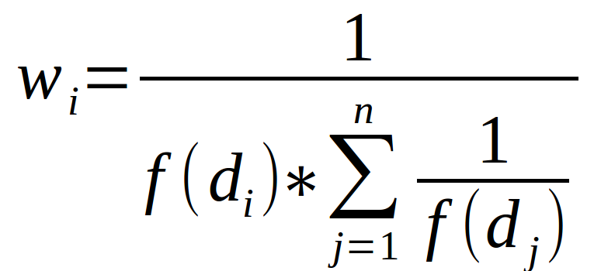
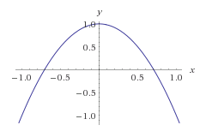
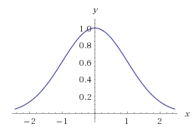
Detailed Design
Feature 3: Interpolation
- how to calculate weight matrix W ?
→ different functions
Sicherstellen, dass zeilensumme = 1
SparseMatrizen weil viele Nullen (cancelDist bedingt, 97%)

Slide 16

Status
- features 1, 2 and 3 implemented and operational
- computation already fast
- missing integration into existing project
→ only part of library
→ not really used yet

Slide 17
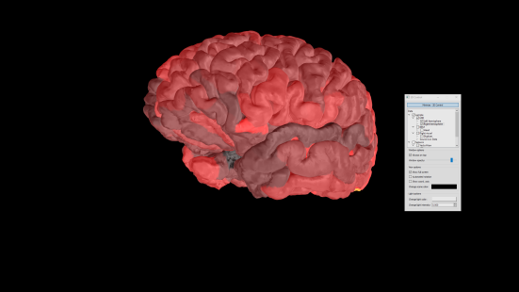
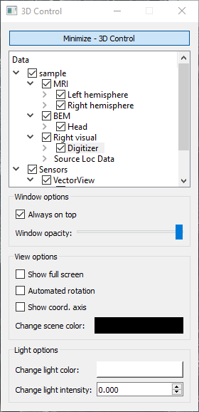
Outlook
Tasks for next phase:
- complete integration into Disp3D
- optimization of features
- compute interpolation on GPU (optional)
- further integration into MNE Scan (optional)
- live measurements (optional)
Disp3D

Slide 18
Thank you!
Questions?

