Slide 1

Real-Time Mesh Utilities
Blerta Hamzallari Marco Klamke
Felix Griesau Simon Heinke
Julius Lerm Sugandha Sachdeva
Lars Debor Petros Simidyan
Notes:
1

Slide 2
Outline
Assignment / Task
Features
Software Demonstration
Status
Outlook
Slide 2
Notes:
2

Slide 3
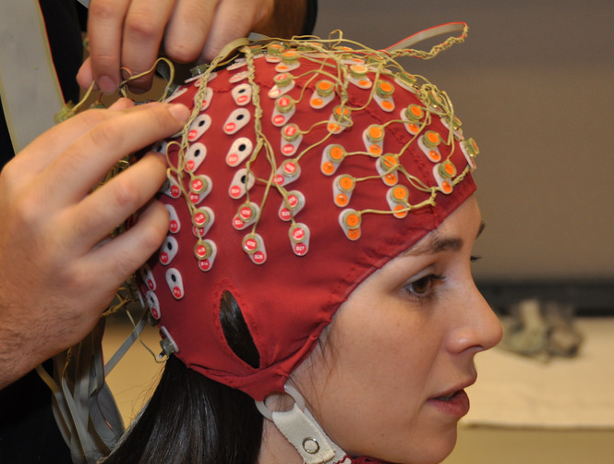
Assignment/Task
Goal: Utilities for real-time capable interpolation and visualization of MEG/EEG sensor data
Slide 3
Notes:
3

Slide 4
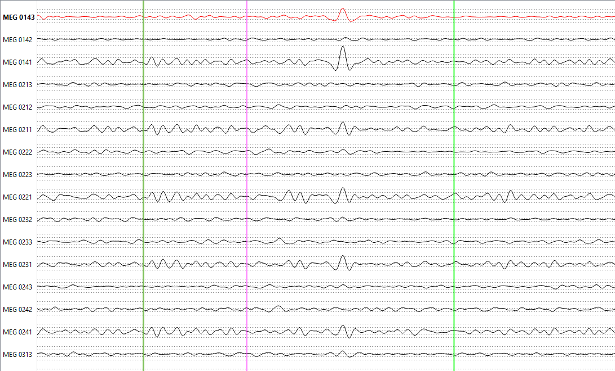
Standard Visualization
Slide 4

Slide 5
3D Visualization
Todo insert screenshot of disp3D
Slide 5

Slide 6

Input/Output
MNE-CPP
Input:
vertices (x, y, z)
Neighbour-relationships
Sensor points (x, y, z)
Sensordata (1000hz)
Output:
Matrix containing intensities for every vertex
Features
Slide 6

Slide 7
Features
Sensors
Mesh
Sensor Mapping
Slide 7
Notes:
7

Slide 8
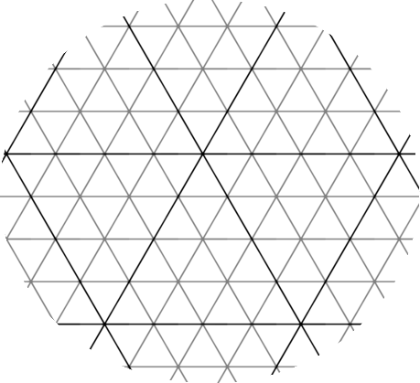
Sensor Mapping
Feature 1
Sensorpoints are not part of the mesh
relative position on surface unknown
Multithreaded linear search
TODO: Julius macht nen kopf als mesh
Slide 8
Notes:
8

Slide 9
Features
Sensors
Mesh
Sensor Mapping
Sensors on
Mesh
Mesh
SCDC
Slide 9
Notes:
9

Slide 10
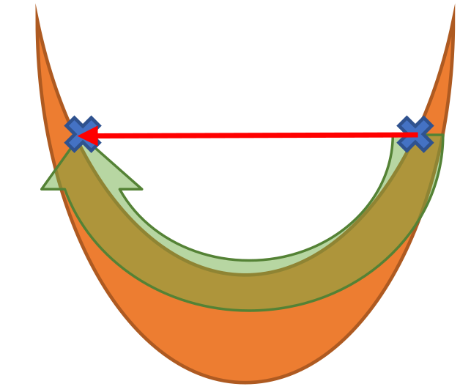
SCDC
Feature 2
Folded surface
Distance between 2 vertices?
Euclidian distance inaccurate
Multithreaded iterative Dijkstra
Todo insert cool images
Slide 10
Notes:
10

Slide 11
Features
Sensors
Mesh
Sensor Mapping
Sensors on
Mesh
Mesh
SCDC
Distance
Table
Function
Interpolation
Slide 11
Notes:
11

Slide 12
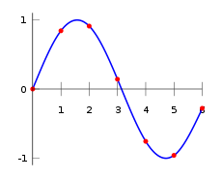
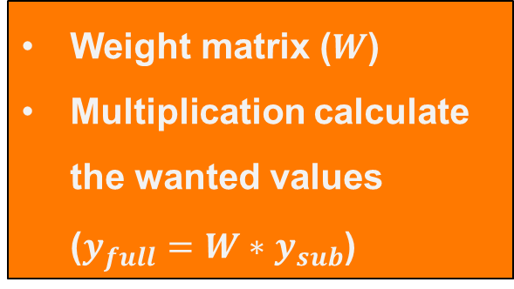
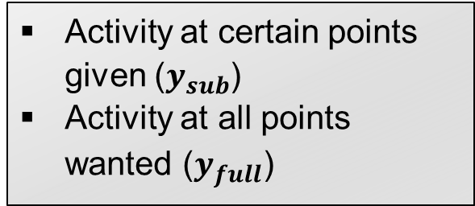
Interpolation
Feature 3
Todo insert cool images
Activity at certain points given ($y_{sub}$)
Activity at all points wanted ($y_{full}$)
Weight matrix ($W$)
Multiplication calculate the wanted values ($y_{full}=W∗y_{sub}$)
Slide 12
Notes:
12

Slide 13
Features
Sensors
Mesh
Sensor Mapping
Sensors on
Mesh
Mesh
SCDC
Distance
Table
Function
Interpolation
Weight matrix
Signal Interpolation
Slide 13
Notes:
13

Slide 14
SensorDataTreeItem
Feature 4
Todo insert basic tree
Plus veranschaulichung der Datenströme

Slide 15
Features
Tree-Item
Sensors
Mesh
Sensor Mapping
Sensors on
Mesh
Mesh
SCDC
Distance
Table
Function
Interpolation
Weight matrix
Signal Interpolation
Slide 15
Notes:
15

Slide 16
Software Demonstration

Slide 17
Status
features 1, 2, 3 and 4 implemented and operational
computation fast
integrated into existing project
Slide 17
Notes:
17

Slide 18
Review

Slide 19
Outlook
MNE-CPP is an Open-Source project
therefore further development
the generic features (SCDC, projecting, interpolation) will be used in other functionalities
the code is documented as required by the project, it fits in seamlessly
Slide 19
Notes:
19

Slide 20
Thank you for your attention!
Blerta Hamzallari Marco Klamke
Felix Griesau Simon Heinke
Julius Lerm Sugandha Sachdeva
Lars Debor Petros Simidyan
Notes:
20

