Slide 1
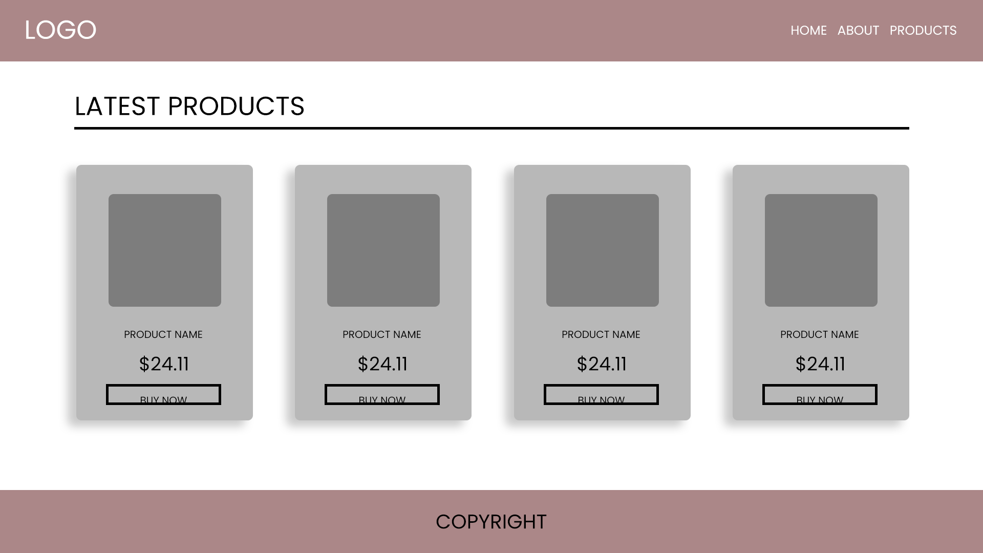
1 DESIGN AS CLIENT WANTED
In this the color scheme is not good as per the brand and in this the layout is bit off

Slide 2
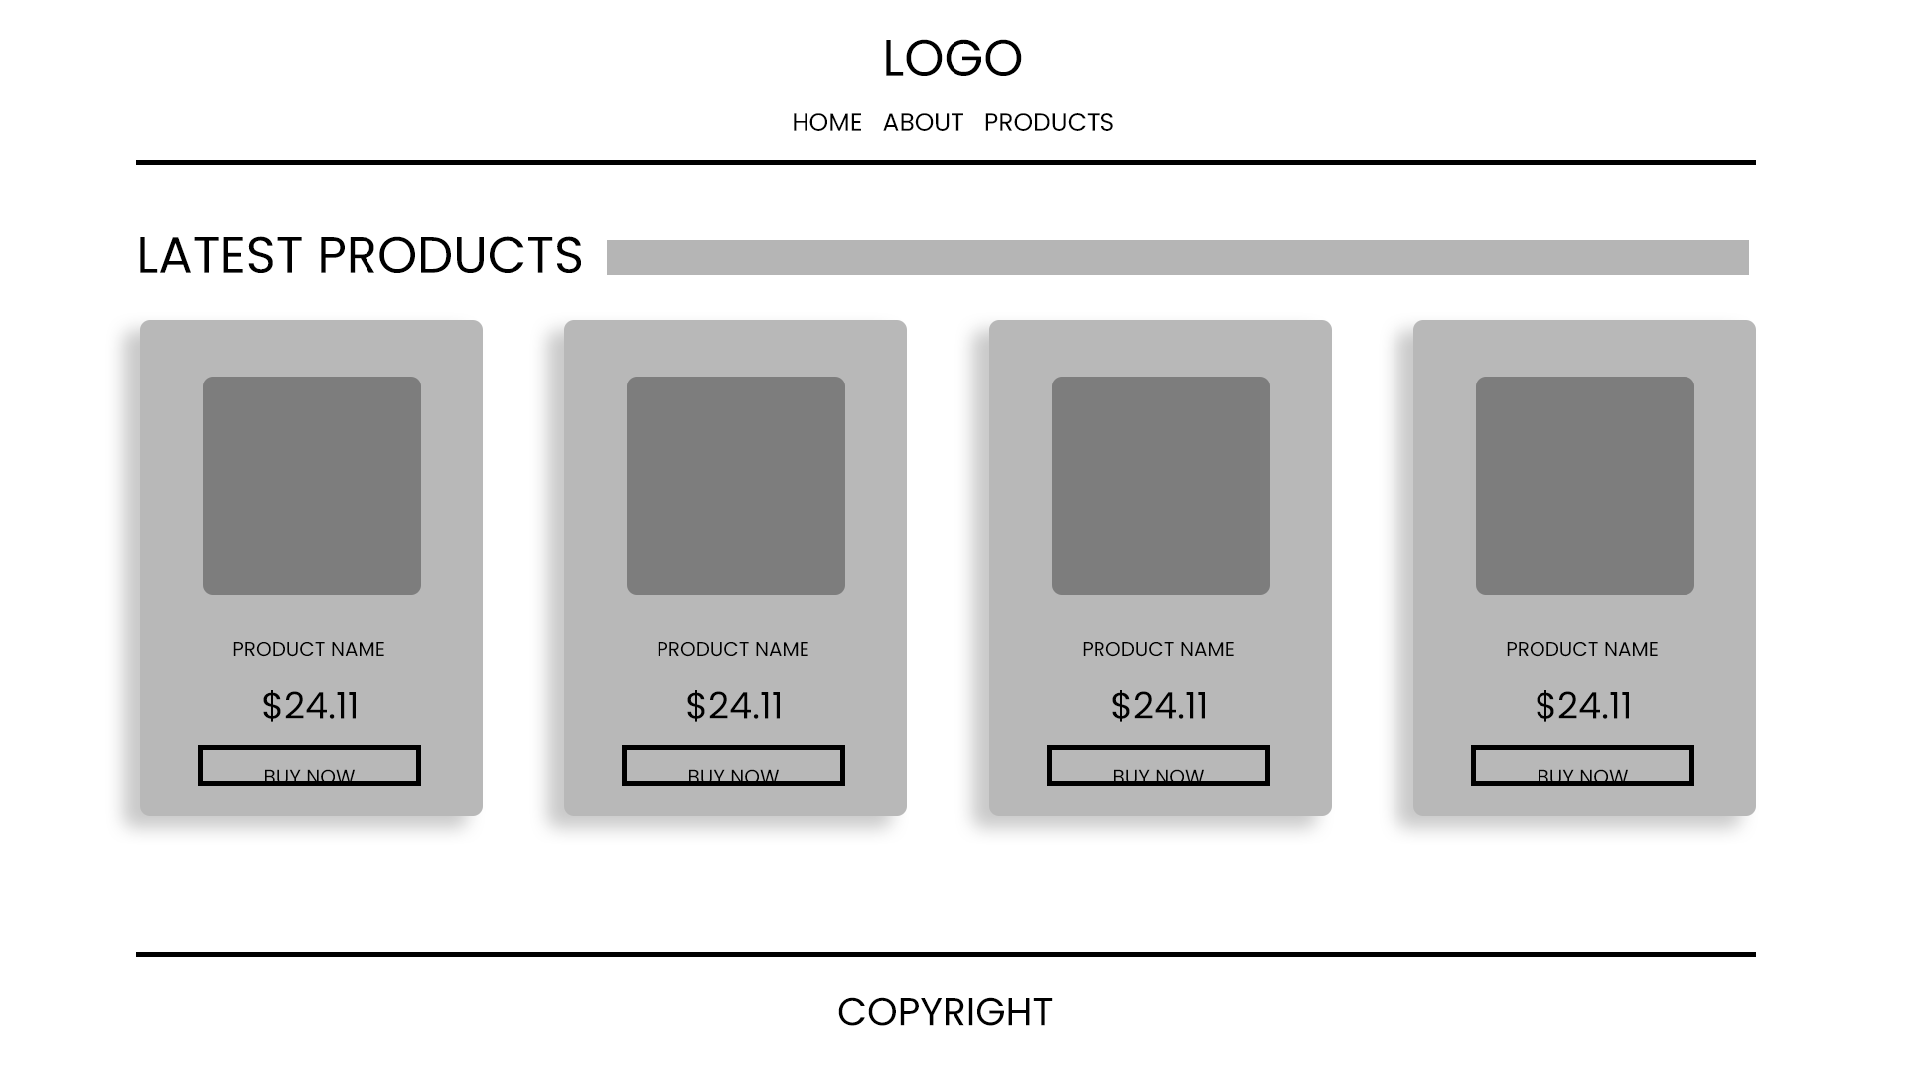
Design to approve
This is a perfect design as all the elements are based on the theme of the brand and very minimalistic design

Slide 3
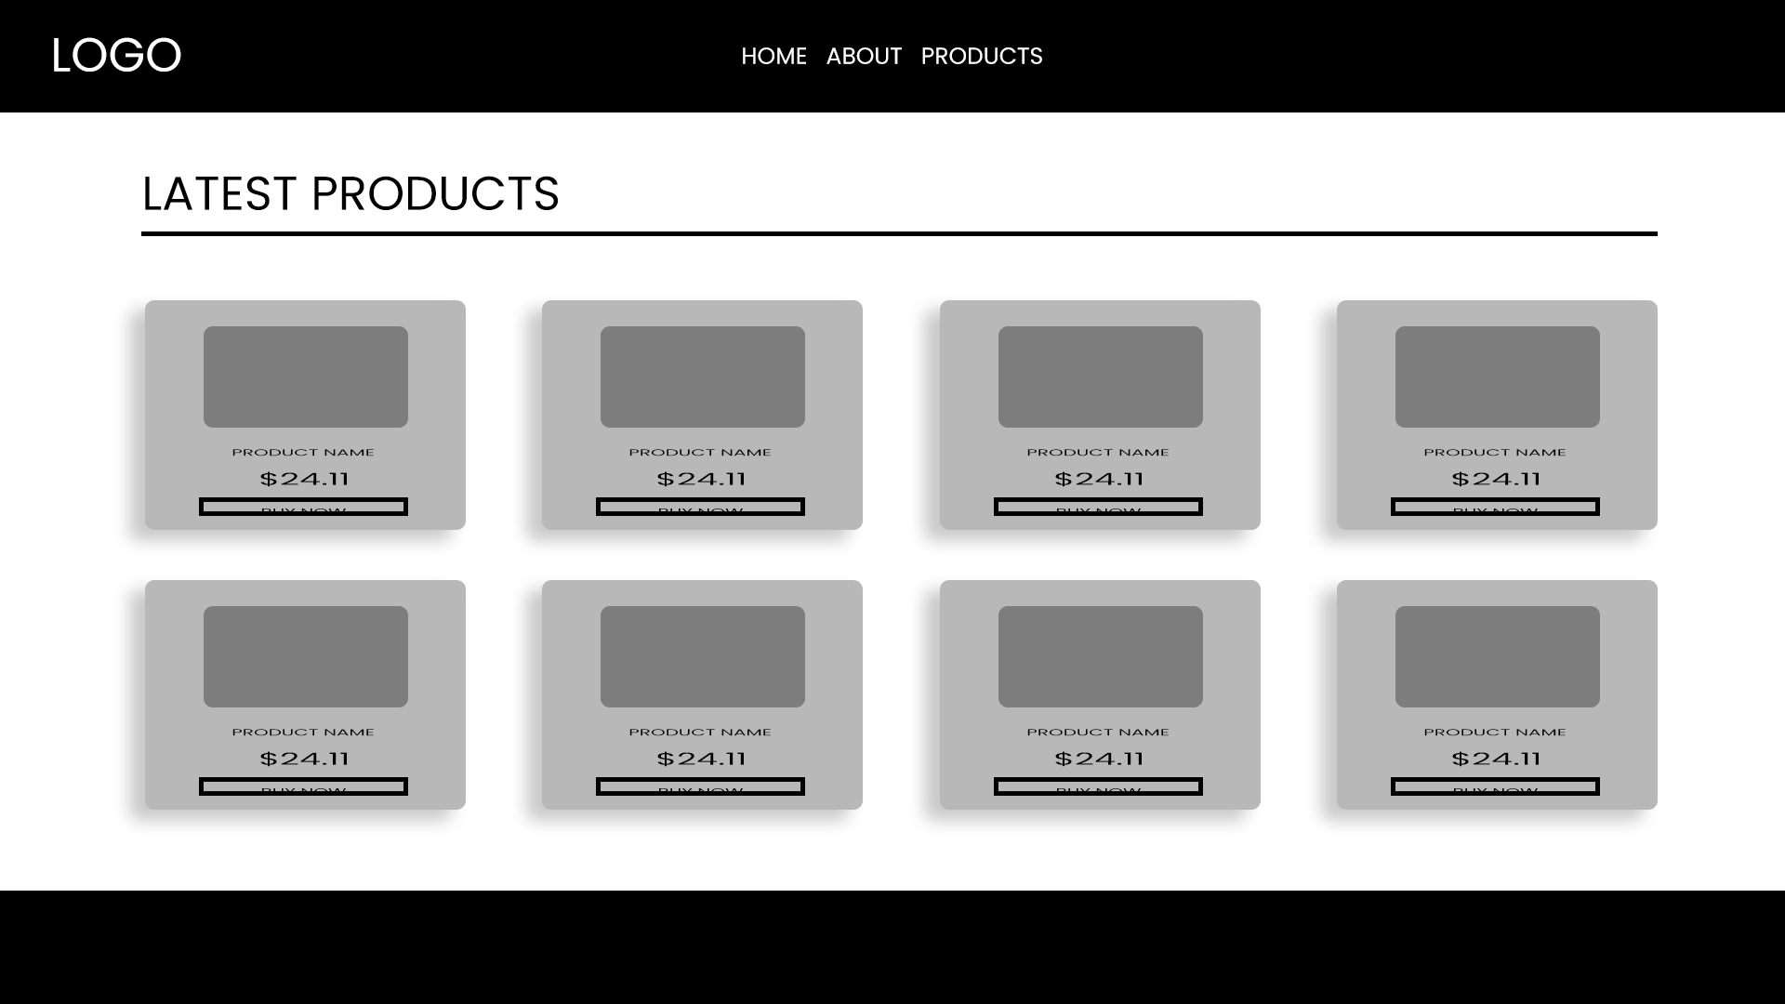
Design 3

Slide 4
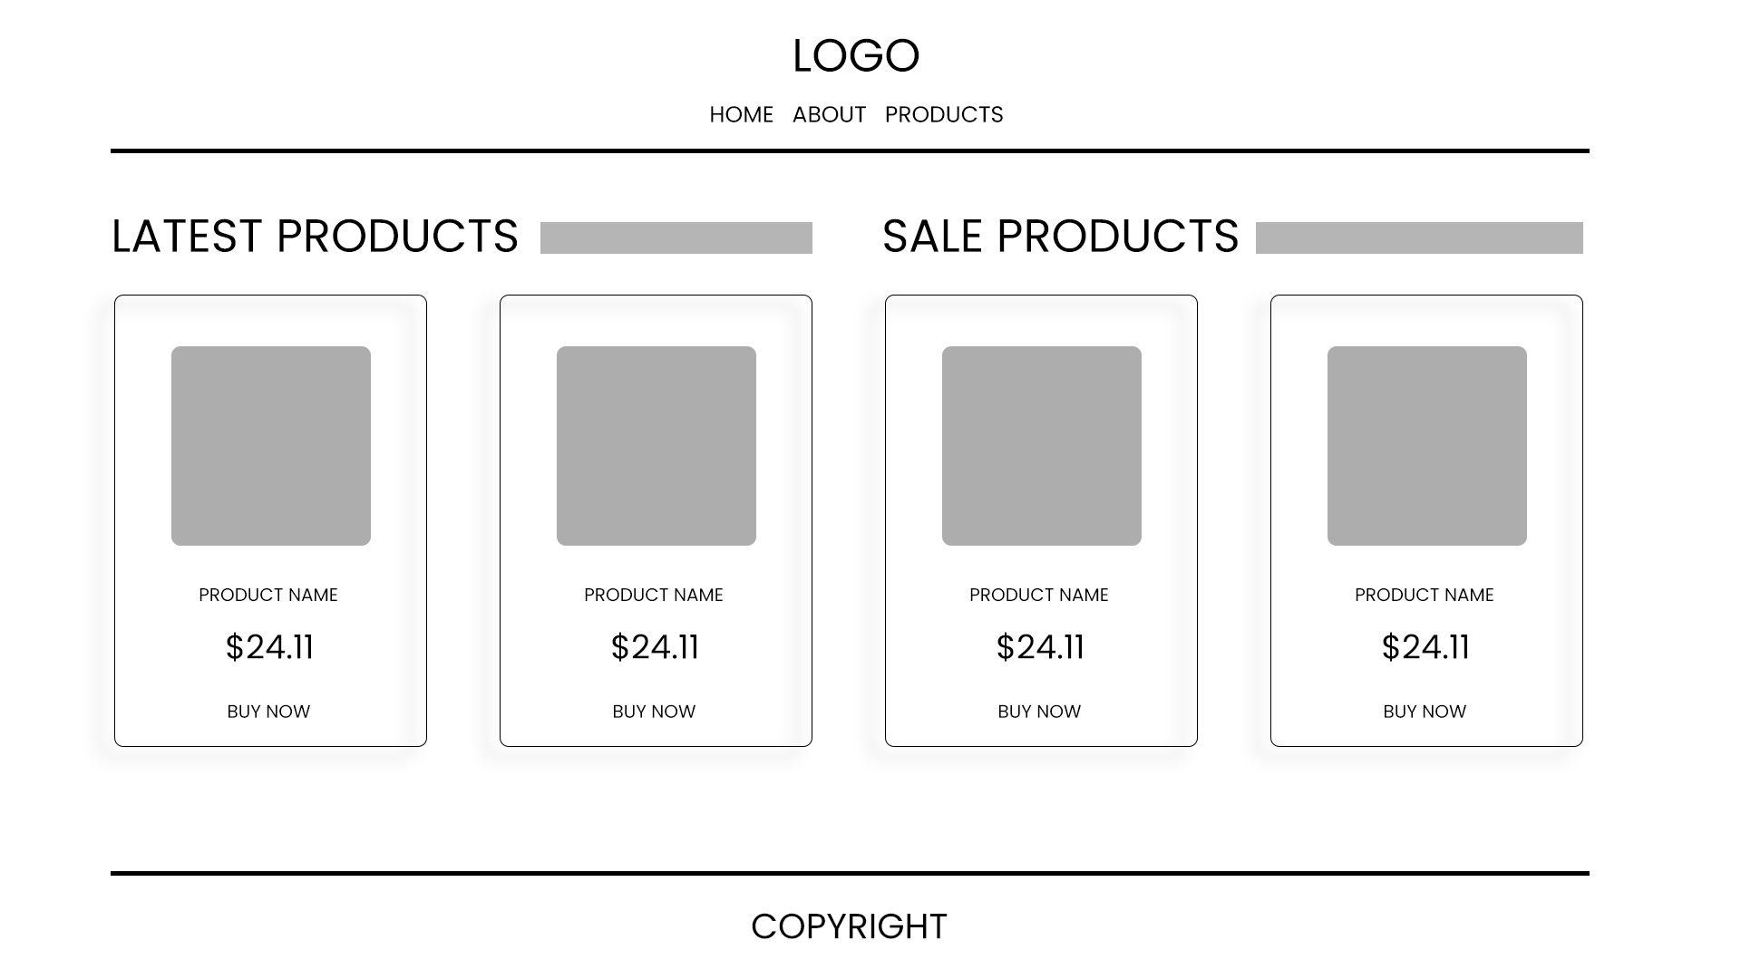
Design 4

