Slide 1
Sentiment Analysis Project
Team: Karthik ND, Preethu Gowda, Kiran, Aditya, Gajanan, Mohd Abid Hussain
Coordinator: Bapuram Pallavi

Slide 2
Business Objective
To analyze customer sentiments from product reviews using Natural Language Processing (NLP) and Machine Learning (ML) techniques.
Goal: Classify reviews as Positive or Negative to aid in product improvement and customer satisfaction.

Slide 3
Problem Statement
E-commerce platforms receive vast amounts of customer reviews.
Manual analysis is inefficient and prone to bias.
Solution: Automate sentiment classification using ML models to derive actionable insights.

Slide 4
Dataset Description
- Source: Amazon product reviews
- Size: 10,000 reviews
- Features: 'Review Text', 'Sentiment'
- Classes: Positive, Negative

Slide 5
Data Preprocessing
- Lowercasing
- Removing punctuation, stopwords
- Tokenization
- Lemmatization
- Vectorization using TF-IDF

Slide 6
Feature Engineering
- TF-IDF Vectorizer used for transforming text into numerical features
- Max Features: 5000
- N-grams: Unigram & Bigram

Slide 7
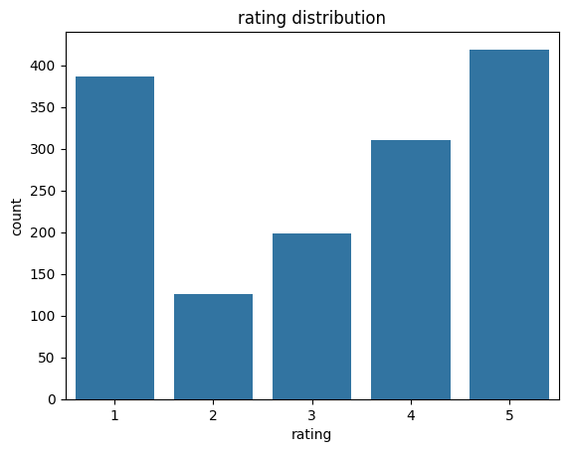
Visualization: Most Common Words

Slide 8
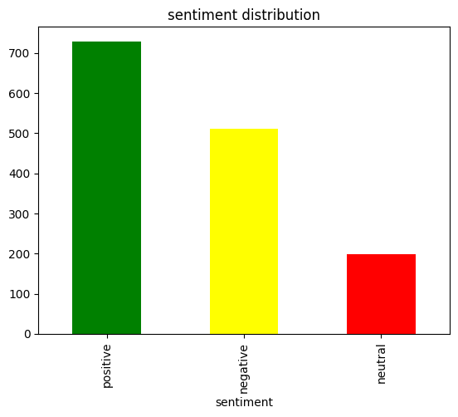
Visualization: Sentiment Distribution

Slide 9
Model 1: Logistic Regression
- Accuracy: 85%
- Interpretable and fast
- Good baseline model
- Balanced performance across precision and recall

Slide 10
Model 2: Naive Bayes
- Accuracy: 82%
- Fast, suitable for text classification
- Performs well with smaller datasets

Slide 11
Model 3: SVM
- Accuracy: 88%
- Best performer in this analysis
- Effective in high-dimensional spaces
- High precision and recall

Slide 12
Model 4: Random Forest
- Accuracy: 86%
- Ensemble method
- Handles overfitting well
- Robust but slower than simpler models

Slide 13
Model Comparison
Performance Overview:
- Logistic Regression: 85%
- Naive Bayes: 82%
- SVM: 88%
- Random Forest: 86%
Conclusion: SVM is the best model.

Slide 14
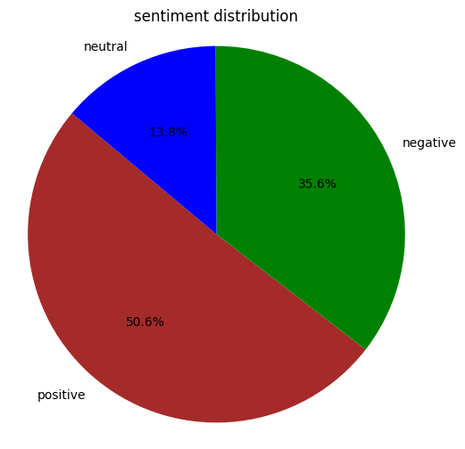
Pie chart Visualization

Slide 15
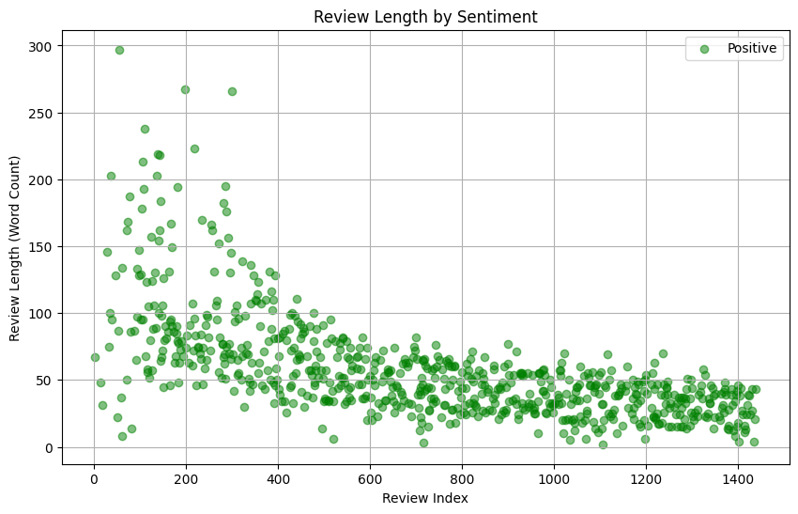
Scatter Plot Visualization

Slide 16
Challenges Faced
- Handling imbalanced data
- Dealing with noisy and inconsistent text data
- Choosing the right model and parameters
- Ensuring good generalization to new data

Slide 17
Future Work
- Implement deep learning models (LSTM, BERT)
- Extend analysis to multilingual reviews
- Deploy model using web-based application (e.g., Streamlit)

Slide 18
Deployment Overview
- Frontend: Streamlit App
- Backend: Python, Scikit-learn
- Input: User-provided review text
- Output: Predicted sentiment with probability

Slide 19
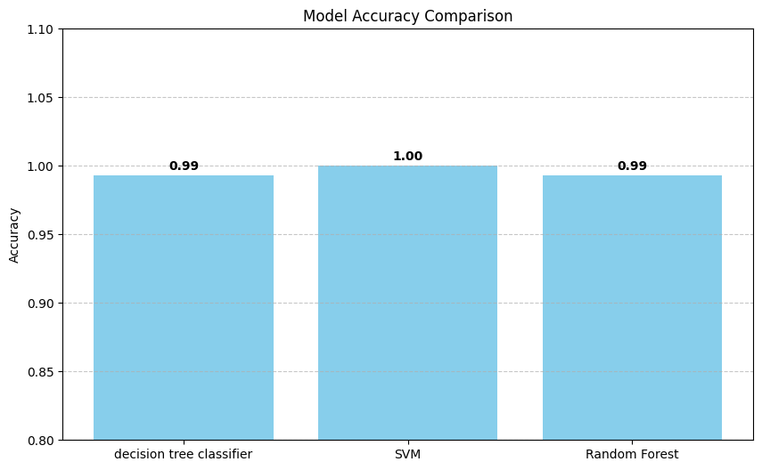
App Screenshot: Sentiment Prediction Interface

Slide 20
Key Learnings
- End-to-end ML workflow from data preprocessing to deployment
- Importance of data cleaning and feature engineering
- Comparative analysis of models
- Real-world application of NLP

Slide 21
Team Contributions
- Data Collection: Preethu Gowda, Kiran
- Data Cleaning: Aditya, Gajanan
- Model Development: Karthik ND, Mohd Abid Hussain
- Deployment: Karthik ND
- Coordination: Bapuram Pallavi

Slide 22
Summary
- Built a sentiment analysis system
- Evaluated 4 ML models
- SVM performed best
- Deployed as a web app
- Real-world applicable insights

Slide 23
Acknowledgements
We thank our project coordinator Bapuram Pallavi for her guidance and support.
Special thanks to our peers and mentors for their feedback.

Slide 24
Questions?
Feel free to ask any questions.
Thank you for your attention!

