Slide 1
WAREHOUSE INVENTORY & OUTBOUND ORDER READINESS
DECISION QUESTION
Will enough inventory exist for each outbound order—and if not, when will it become available?
A scalable Spark and AWS system for identifying pallet shortages before loading
Shuhao Lin • CS-675 Big Data Management
Notes:
Good afternoon. My final project is a Warehouse Inventory and Outbound Order Readiness Analysis System. It combines warehouse operations knowledge with Spark, SQL, AWS, and reproducible infrastructure.

Slide 2
BUSINESS PROBLEM
Inventory on hand is only part of the answer
Current inventory
Future events
Operational decision
Completed receipts, shipments, transfers, and adjustments establish the as-of balance.
Scheduled inbound and outbound quantities change the projected balance chronologically.
Flag the order, quantify missing pallets, and estimate the first available date.
PROJECT QUESTION
Will the warehouse have enough inventory to complete each upcoming outbound order?
If not: how many pallets are missing, and when is inventory expected to become available?
CS-675 Big Data Management | Shuhao Lin
2
Notes:
Warehouses must consider timing, not only the current balance. An order can look short today but become ready after an inbound receipt—or look ready until an earlier outbound consumes the stock.

Slide 3
DATA MODEL
Three related datasets create an event-level inventory view
PRODUCT REFERENCE
SHIPMENT SCHEDULE
INVENTORY TRANSACTIONS
product_id • category • packaging • units/pallet • storage area • safety stock
shipment_id • product_id • warehouse_id • scheduled date • planned/actual pallets • type • status
transaction_id • shipment_id • product_id • warehouse_id • date • type • signed pallet quantity
JOIN KEYS
product_id + warehouse_id + shipment_id + date
• Synthetic records protect customers, employees, products, and shipment details.
• The same schema supports a 25,000-row demo and a 100-million-record cloud test.
CS-675 Big Data Management | Shuhao Lin
3
Notes:
The design separates product master data, shipment plans, and executed inventory events. Product ID and warehouse ID connect the tables; shipment ID links scheduled shipments to completed movements.

Slide 4
CORE CALCULATION
Projected inventory is calculated in event order
Projected inventory
= current inventory + cumulative inbound − cumulative outbound
TODAY
OUTBOUND: 15
INBOUND: 10
OUTBOUND: 18
→
→
→
20 pallets available
5 pallets remain
15 pallets available
Short by 3 pallets
Missing pallets = max(order quantity − inventory available before order, 0)
CS-675 Big Data Management | Shuhao Lin
4
Notes:
For each product and warehouse, I calculate current inventory from completed transactions, then apply future inbound and outbound events by date. Inbound is processed before outbound on the same date.

Slide 5
DECISION LOGIC
Every outbound order receives an actionable status
READY
AT RISK
Enough inventory exists and the remaining balance stays at or above safety stock.
The order can be filled, but remaining inventory falls below the product safety-stock threshold.
WAITING FOR INBOUND
SHORT
The order is short on its scheduled date, but a later planned inbound is expected to cover it.
The order lacks inventory and no known inbound covers the shortage within the planning horizon.
The earliest-available date is an expectation—not a guarantee—because inbound shipments can be delayed.
CS-675 Big Data Management | Shuhao Lin
5
Notes:
The status is designed for supervisors and planners. Ready and At Risk distinguish healthy orders from orders that leave little safety stock. Waiting for Inbound separates timing issues from unresolved shortages.

Slide 6
PROCESSING PIPELINE
Spark converts raw records into trusted analytical data
1 INGEST
2 VALIDATE
3 DEDUPLICATE
4 JOIN
5 WINDOW
6 PUBLISH
Explicit CSV schemas
→
Keys, dates, quantities
→
Transaction & shipment IDs
→
Products, balances, schedule
→
Cumulative event inventory
→
Partitioned Parquet
• Invalid and unrealistic rows are written to quarantine rather than silently discarded.
• Adaptive query execution and partitioned output support scale without changing business logic.
• Parquet with Snappy compression reduces scan size for Spark and Athena.
CS-675 Big Data Management | Shuhao Lin
6
Notes:
The Spark job reads explicit schemas, applies data-quality rules, calculates current inventory, orders future events with window functions, assigns readiness status, and writes partitioned Parquet.

Slide 7
PLATFORM ARCHITECTURE
Local development and AWS use the same pipeline
Synthetic data
Amazon S3
EMR Serverless
Amazon S3
Amazon Athena
Dashboard
CSV partitions
→
Raw zone
→
Apache Spark
→
Curated Parquet
→
SQL analysis
→
Operational KPIs
Terraform provisions the S3 bucket, Glue database, Athena workgroup, IAM role, and EMR Serverless application.
Local: Docker + Spark | Cloud: S3 + EMR Serverless + Glue/Athena | Format: Snappy Parquet
CS-675 Big Data Management | Shuhao Lin
7
Notes:
I first test the logic locally with Docker and a smaller dataset. The cloud version stores raw and curated zones in S3, runs Spark on EMR Serverless, and exposes results through Athena.

Slide 8
SYNTHETIC DATA
The reproducible sample demonstrates the full workflow
25,000
3,125
200
3
inventory transactions
scheduled shipments
products
warehouses
• Historical completed shipments create the current inventory balance.
• Future scheduled and delayed shipments create the planning horizon.
• Opening balances and adjustments make shortage scenarios realistic without exposing company data.
• A command-line row-count parameter supports the 100-million-record requirement.
CS-675 Big Data Management | Shuhao Lin
8
Notes:
The included sample uses a fixed random seed and an as-of date of August 1, 2026. It represents three warehouses and realistic inbound, outbound, transfer, put-away, adjustment, and delay patterns.

Slide 9
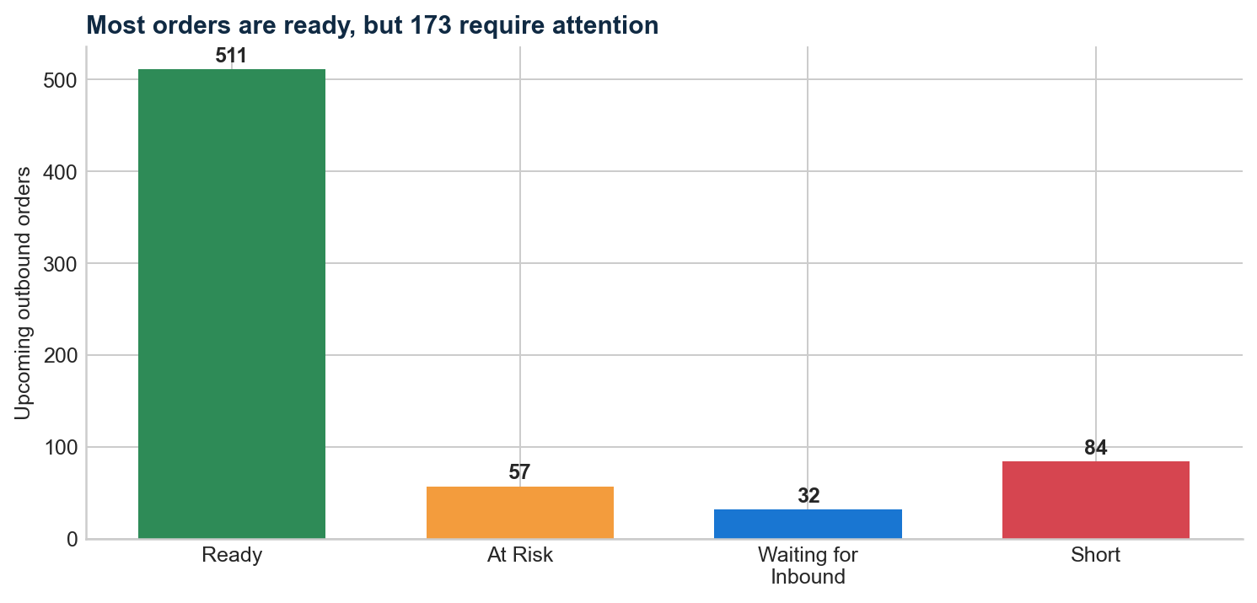
DEMONSTRATION RESULTS
The sample identifies 173 orders requiring attention
ORDERS EVALUATED
684
NEED ATTENTION
173
MISSING PALLETS
2,288
Synthetic proof-of-concept results
CS-675 Big Data Management | Shuhao Lin
9
Notes:
Of 684 upcoming outbound orders, 511 are ready. The remaining 173 are at risk, waiting for inbound, or short. Total modeled shortage exposure is 2,288 pallets.

Slide 10
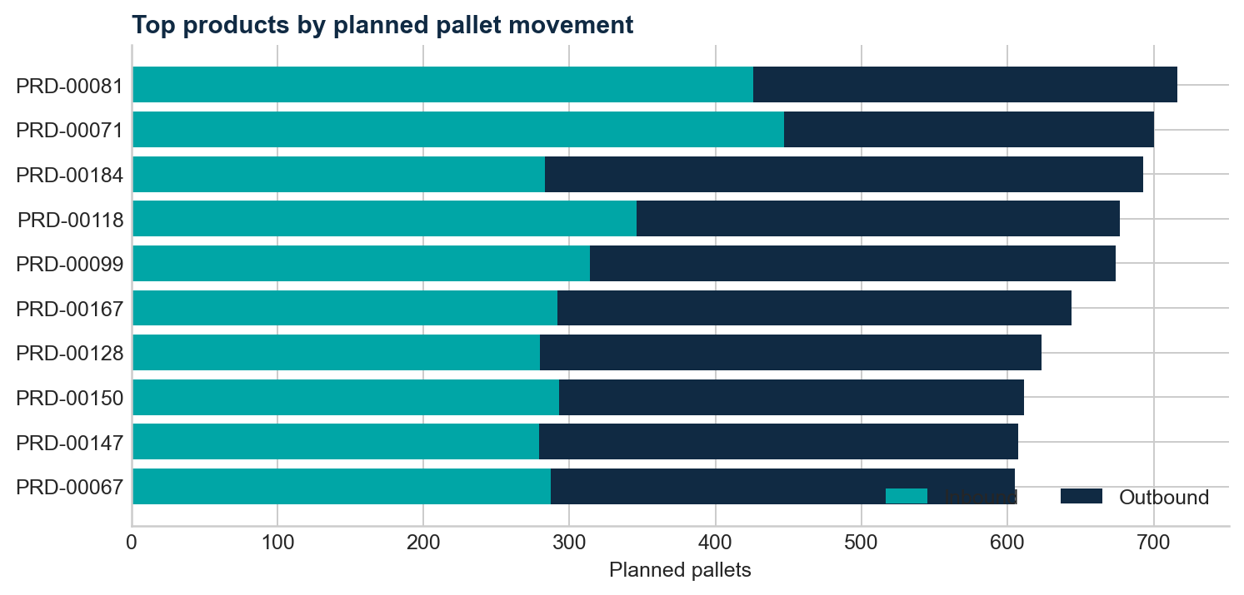
ANALYTICS
Athena answers operational questions without rescanning CSV
• Which orders are short or waiting for inbound?
• How many pallets are missing by warehouse?
• What is the first expected availability date?
• Which products drive the most inbound and outbound volume?
• Which products experience the most adjustments and delays?
Partition pruning + columnar storage = lower query cost and faster dashboards
CS-675 Big Data Management | Shuhao Lin
10
Notes:
The curated tables support daily exception reporting and broader product analysis. These example results are produced from the same synthetic schedule included with the project.

Slide 11
BIG-DATA STRATEGY
The design scales to 100 million records
GENERATE IN PARTS
DISTRIBUTE BY KEY
STORE COLUMNAR
Create deterministic partitions so generation can restart and parallelize.
Repartition calculations by warehouse and product; avoid collecting data to the driver.
Write Snappy Parquet partitioned by warehouse and event month.
• Use Spark window functions for chronological balances.
• Enable adaptive query execution to improve shuffle plans.
• Inspect row counts, rejected records, partition sizes, and data skew.
• Use Athena workgroup controls and S3 lifecycle policies to manage cost.
CS-675 Big Data Management | Shuhao Lin
11
Notes:
The large test uses the same schemas and logic, but generates partitioned files and distributes processing across Spark executors. The goal is to demonstrate volume, distributed computation, and efficient query storage—not merely create one oversized CSV.

Slide 12
CONCLUSION
The project turns warehouse events into early action
OPERATIONAL VALUE
TECHNICAL VALUE
NEXT STEPS
Earlier shortage visibility • quantified pallet gaps • clearer inbound dependency
Spark windows • Parquet • Athena SQL • Terraform • reproducibility
Run the 100M test • capture performance metrics • connect a dashboard
Warehouse Inventory and Outbound Order Readiness
Identify the shortage before the loading appointment.
Thank you — Questions?
CS-675 Big Data Management | Shuhao Lin
12
Notes:
The expected result is a practical analytics system that finds inventory constraints before orders are loaded. It demonstrates data modeling, quality controls, distributed processing, cloud design, SQL analytics, and business interpretation.

