Slide 1
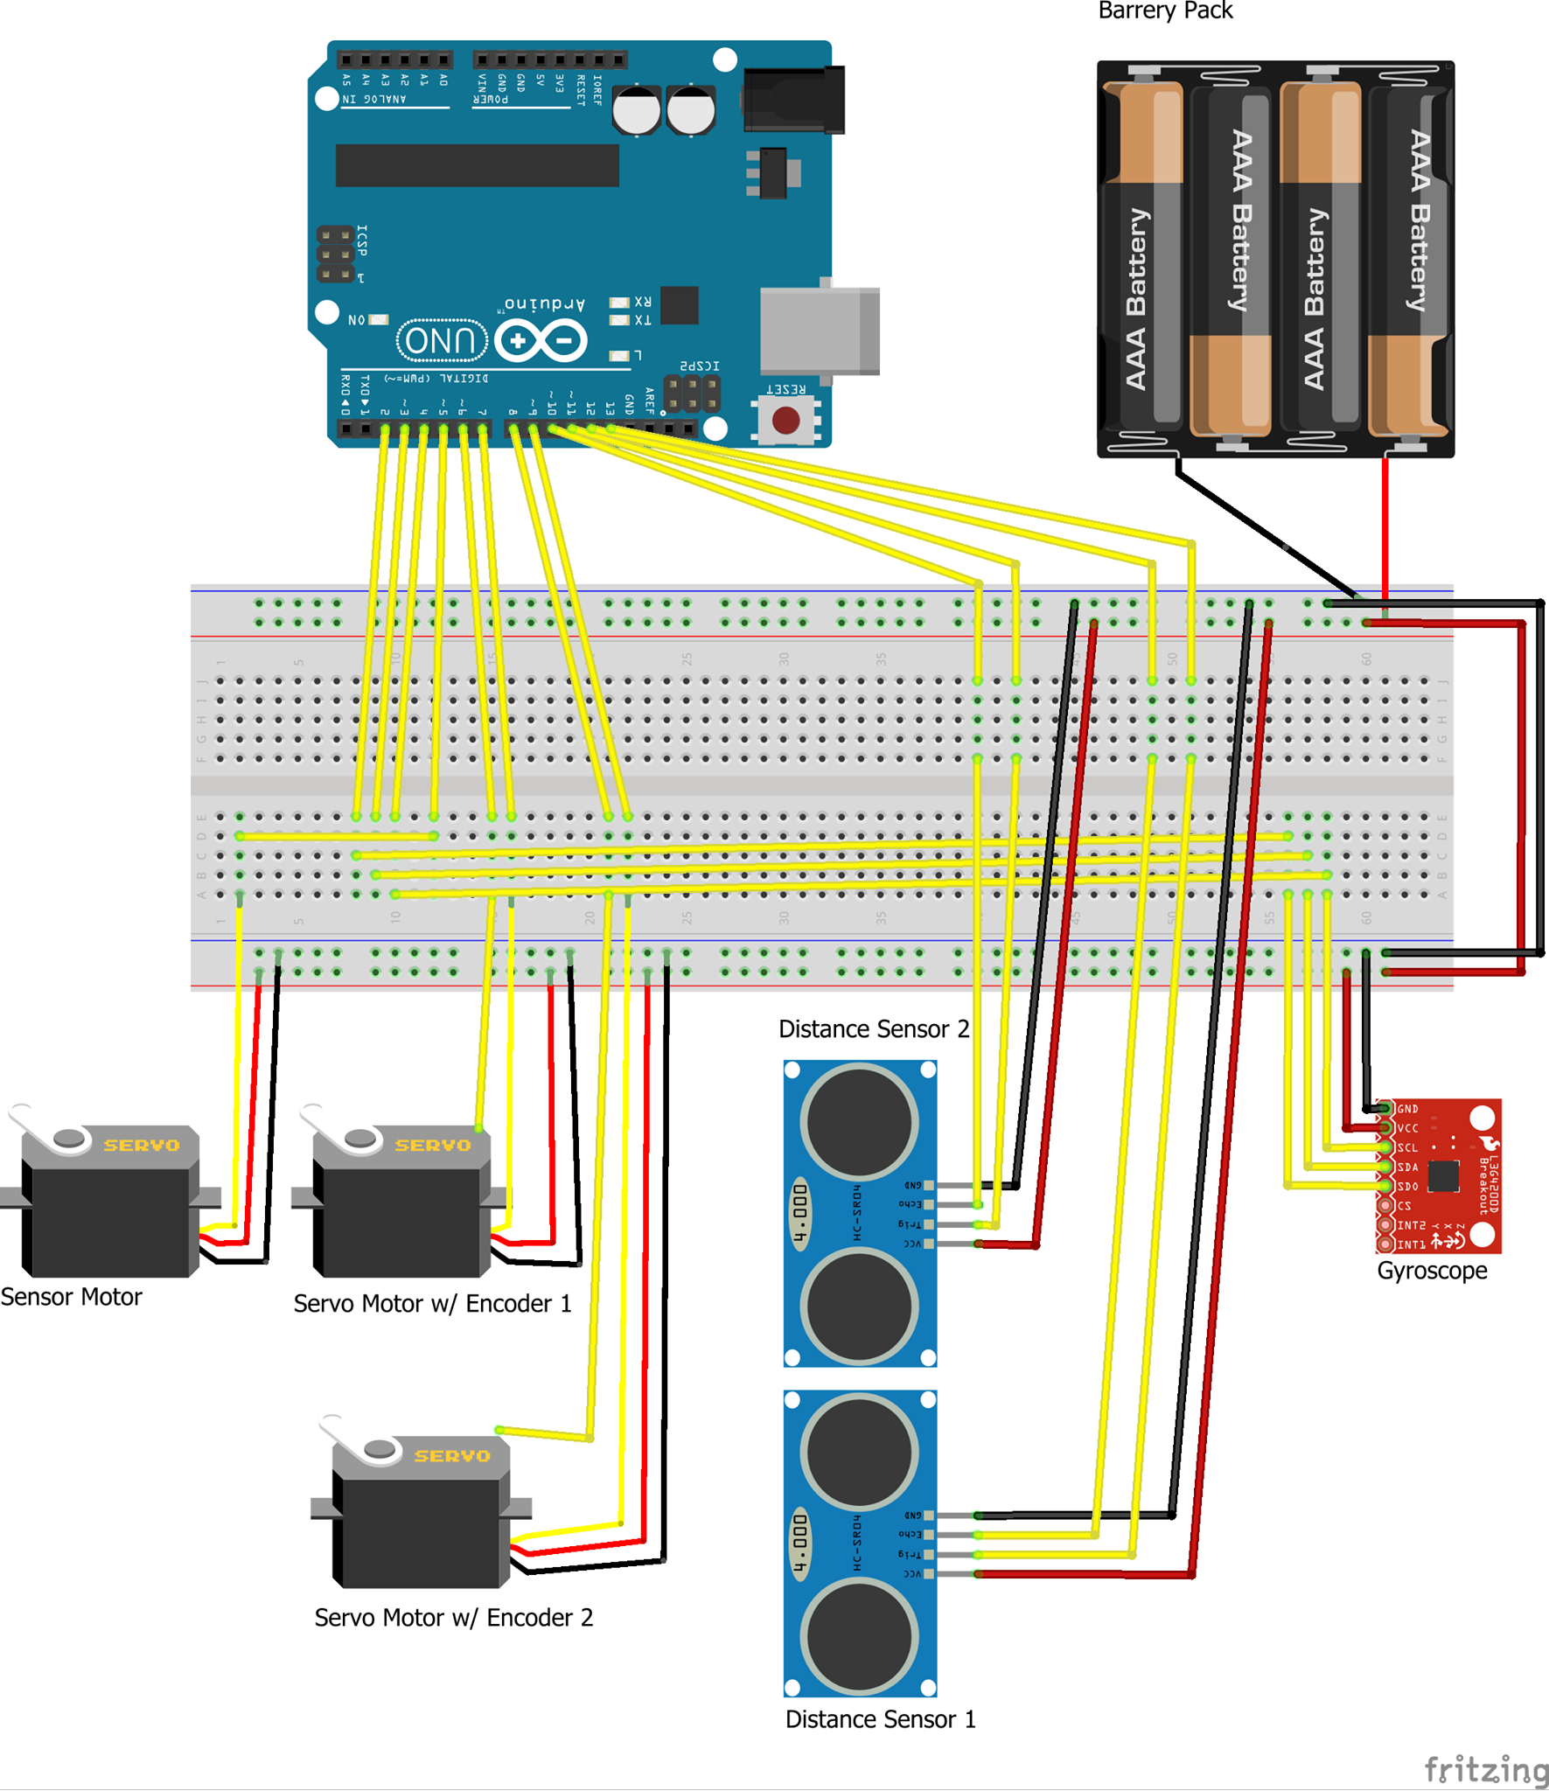
Autonomous Snow Plow
Group #26: Connor Macdonald, Paritosh Arya, Stephen Boyd, Matthew Tigwell, Garrett Richardson
Faculty Supervisor: Dr. Naraig Manjikian
Routing Algorithm #1
Start
Snow Buildup
Routing Algorithm #2
Start
Snow Buildup
How it works:
Powered by a DE10-Nano FPGA board
Flexibility of the FPGA allowed us to use a diverse range of I/O modules
Contains two ultrasonic distance sensors placed perpendicular to each other to calculate 2D position relative to its environment
Subsequent action determined by current position according to routing algorithm
Gyroscope and servo used to ensure the ultrasonic sensors are always facing in a direction perpendicular to the edge of the driveway
Custom web interface allows for users to communicate with the robot by setting input parameters such as driveway size, plow frequency, and when to leave the driveway to allow for vehicular access

Slide 2
INTRODUCTION
DESIGN PROCESS
Living in Canada comes with its challenges and benefits. One challenge that affects the majority of Canadians is frequent snow removal in the winter. To solve this problem we have constructed an autonomous vehicle to clear the snow off of driveways, removing the risks, and costs associated with other snow removal methods.
Shoveling snow may result in injury. This risk is increased in the elderly population and individuals with health conditions.
Other methods of clearing snow that don't require a great amount of time or physical exertion are financially expensive.
An automated snow plow removes the need for physical exertion and cuts the financial cost to a one time fee.
We have developed a small scale autonomous plow capable of effectively removing snow from a scale driveway.
Challenges
The main challenge associated with this project was the hardware chosen. Our team was unfamiliar with the hardware and a steep learning curve was required to bring this project to fruition.
Topology
Hardware requirements were determined and all required components were ordered
Interfaces were written in Verilog code to read and write PWM signals to sensors and servo outputs
Instances of these interfaces were created for each component and mapped to their associated “Arduino” pin
The plow was assembled using a wood frame, I/O hardware, power source, and FPGA board
C code written to determine the vehicle’s position, make driving decisions, and calculate the most efficient snow clearing route
Web Interface created to allow for users to communicate with the plow
Winter conditions globally cause large amount of snow to accumulate onto millions of driveways and walkways. We developed a small scale version of an autonomous snow plow to clear driveways of snow. To bring this to market for real world applications, more research would have to be done into:
Routing around cars and other obstacles present on a driveway
Scaling the vehicle to account for the weight of the snow being plowed
Adjusting the components of the car to handle freezing cold temperatures
Programming the plow to react to physical human intervention
Generating enough force to push snow in low traction situations
Detecting between driveway and non-driveway in suboptimal conditions
Robot response when sensors are covered in snow or fogged up
REFERENCES
DE10-Nano User-Manual
CONCLUSIONS AND RECOMMENDATIONS
Routing and Movement
Determining the route based on the 2D position
Executing the route
Sensor Module
Calculating 2D position from distance sensor data
Reads
Writes
Sensor Positioning
Reads gyroscope data
Maintain the position of the sensors based
2D Position
Shared memory of 2D position

