Slide 1

GLA UNIVERSITY • DEPARTMENT OF CSE • 2025–26
AutoCEO
An Autonomous Multi-Agent System for Enterprise Business Decision-Making
Prakhar Kulshreshtha | UR:241500343 · Ananya Awasthi | UR:2415500067· Palak Singh| UR:2415500326
Mentor:Govind Gupta

Slide 2
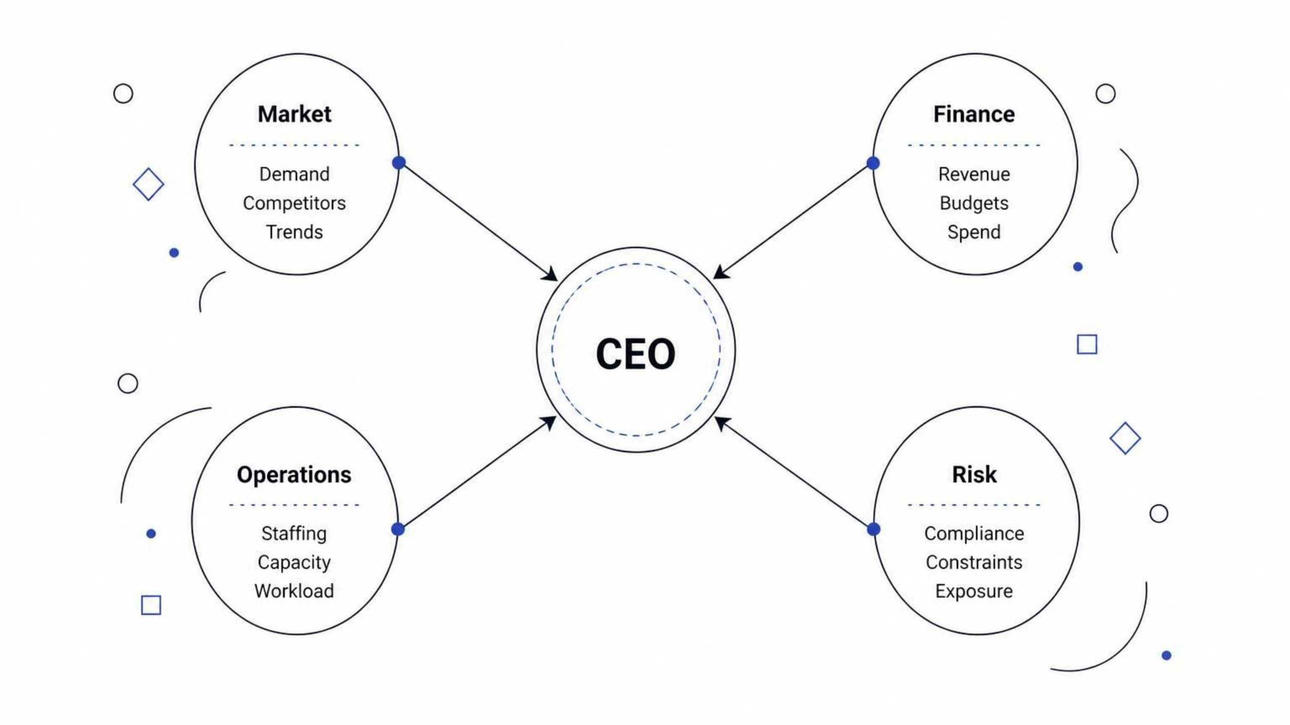
02 • THE PROBLEM
The Decision Overload Problem
A CEO receives data from 4 departments simultaneously and has minutes — not hours — to decide. Something always gets missed.
Existing tools show the data. They do not reason across it.

Slide 3
03 • THE GAP
Existing Tools Are Not Enough
1
2
3
Dashboards
Enterprise AI
The Gap
Present data. Don't reason over it.
Copilot Studio — $200/mo · IBM watsonx — $530+/mo. No explainability. No audit trail.
No free, explainable, multi-domain autonomous decision system exists.
Today
AutoCEO
DATA → DASHBOARD → HUMAN INTERPRETATION
DATA → AI AGENTS → REASONING → DECISION

Slide 4

04 • OUR SOLUTION
Introducing AutoCEO
5 specialized AI agents that analyze, coordinate, and explain every business decision — for free.
Data Sources
4 Specialist Agents
Executive Agent
Decision + Explanation
4 Specialist Agents
1 Executive Agent
Complete Audit Trail

Slide 5
05 • REAL SCENARIO
AutoCEO in Action
Scenario: Competitor drops prices 30%
1
2
Market
Finance
Detects demand shift and falling confidence
Checks: Can we afford a 15% price cut?
3
4
Operations
Risk
Confirms team has capacity to execute
Flags: Cut cannot exceed 20% per compliance rules
5
6
Executive
Log
DECISION: Reduce price 15% + reallocate $10k to marketing
Full reasoning saved to audit trail
Every step is logged, validated, and explainable.

Slide 6
06 • AGENTS
Five Specialized Agents, One Decision
[M] | Market Intelligence | Market / sector data | Trend · demand direction · confidence score
[$] | Finance | Budget / revenue data | Financial health · safe spend range
[O] | Operations | HR roster | Capacity status · staffing recommendation
[!] | Risk & Compliance | All agent outputs | Violations · risk level
[E] | Executive Reasoning | All four agent outputs | Final decision · written rationale + re-evaluation trigger

Slide 7
07 • COMPETITOR ANALYSIS
How AutoCEO Compares to the Market
Tool | Cost | Explainability | Multi-domain | Free Tier
Microsoft Copilot Studio | $200/month | None | No | No
Salesforce Agentforce | $0.10/action | None | No | No
IBM watsonx Orchestrate | $530+/month | Partial | Partial | No
CrewAI Enterprise | $60K–$120K/year | None | Yes | No
AutoCEO (our system) | Free | Complete audit trail | Yes | Yes
AutoCEO is the only free, fully explainable, multi-domain agent decision system.

Slide 8
08 • RESEARCH
What We Found When We Actually Tested It
Prompt Validation
Consistency Finding
All 5 agent prompts tested in Google AI Studio. Valid structured JSON confirmed from Gemini 2.5 Flash on every run.
Temperature=1 caused different outputs each run. Fixed: lowered to 0.2 + enabled Structured Outputs. Now consistent.
Free Tier Confirmed
Data Strategy
Gemini free tier = 1,500 requests/day. Sufficient for full 5-agent pipeline testing without any cost.
Synthetic CSV data + real yfinance market data combined. Reliable, repeatable demo scenarios ready.

Slide 9
09 • TECHNOLOGY STACK
Built Entirely on Free-Tier Tools
Core Stack
Why Free Matters
Gemini 2.5 Flash — LLM reasoning engine
LangGraph — Multi-agent orchestration
FastAPI — Async backend API
HTML,CSS,JS— Web dashboard
SQLite — Decision log storage
Render or Versel— Free deployment
Zero cost to build, test, and deploy. Live demo link accessible to any evaluator. No credit card. No enterprise license.
Gemini → LangGraph → FastAPI → Frontend→ SQLite → Deployed

Slide 10




10 • TIMELINE & STATUS
4-Month Roadmap — Week 1 in Progress
Phase 1 · Weeks 1–4
Phase 2 · Weeks 5–8
Architecture + Synopsis
Full agent pipeline + explainability
Phase 3 · Weeks 9–12
Phase 4 · Weeks 13–16
Dashboard + deployment
Testing + documentation + final report
Current Status
Next Milestone
Completed this week:
Single working agent prototype by end of this week.
Architecture finalized
All 5 agent prompts tested in AI Studio
Data schemas designed
GitHub repository initialized

