Slide 1
Number Plate Recognition
A Project By:
PRACHI KELKAR (4520)
AYUSHEE SHAH (4552)
SHIVANG SHARMA (4555)

Slide 2
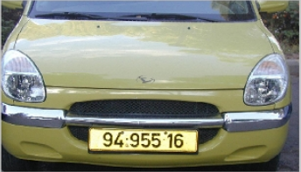
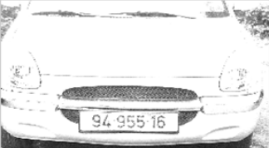
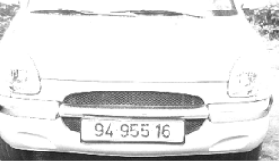

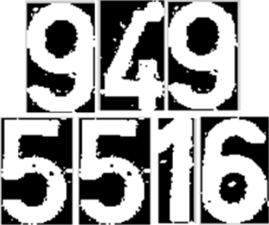
Input Database Image
Input Vehicle Image
Gray Conversion
Gray Conversion
License Plate Extraction
License Plate Extraction
Opening and Closing Operations
Opening and Closing Operations
Character Segmentation
Character Segmentation
Feature Extraction and Recognition
Neural Networks
Training
BLOCK DIAGRAM
Output

Slide 3
Hardware and software required
Hardware
Raspberry Pi
Software
MATLAB (R2011a)
NI LabVIEW 2013 (64 bit)

Slide 4
Project execution plan for academic year
STEP 1 (July) | Finalization of project domain and project Topic. Design of block diagram and plan for project Execution.
STEP 2 (August) | Preparation of Synopsis and Pre-project seminar. Design of final Block Diagram of system.
STEP 3 (September) | Study of IEEE papers on related subjects. First Assessment submission.
STEP 4 (October) | Study of character recognition. Preparation & submission of seminar report.
STEP 5 (December) | Testing and Implementation of design model Study of Neural Network
STEP 6 (Jan-Feb) | Completion of implementation of project hardware. Casing for hardware.
STEP 7 (Feb-March) | Submission of second Assessment. Testing of project hardware.
STEP 8 (April) | Preparation and writing of final project report. Checking and Printing of project report.
STEP 9 (May) | Submission of final project report.

Slide 5
References
[1] Rafael C. Gonzlez and Richard E. Woods, “Digital Image Processing,” Pearson Education International, Third Edition, pp. 652-660.
[2] Shan Du, Mahmoud Ibrahim, Mohamed Shehata and Wael Badawy, “Automatic License Plate Recognition (ALPR): A State-of-the-Art Review,” in IEEE transactions on circuits and systems for video technology, vol. 23, no. 2, February 2013.
[3] Christos-Nikolaos E. Anagnostopoulos, Loannis E. Anagnostopoulos, Loannis D. Psoroulas, Vassili Loumos, and Eleftherios Kayafas, “License Plate Recognition From Still Images and Video Sequences: A Survey,” IEEE Transaction on Intelligence Transportation Systems, vol. 9, no. 3, September 2008.
[4] Shyang-Lih Chang, Li-Shien Chen, Yun-Chung Chung, and Sei-Wan Chen, “Automatic License Plate Recognition ,” IEEE Transaction on Intelligence Transportation Systems, vol. 5, no. 1, March 2004.
[5] Christos Nikolaos E. Anagnostopoulos, Ioannis E. Anagnostopoulos, Vassili Loumos, and Eleftherios Kayafas, “A License Plate-Recognition Algorithm for Intelligent Transportation System Applications ,” IEEE Transaction on Intelligence Transportation Systems, vol. 7, no. 3, September 2006.

