Slide 1
Number Plate Recognition
A Project By:
PRACHI KELKAR (B120053106)
AYUSHEE SHAH (B120053194)
SHIVANG SHARMA (B120053205)

Slide 2
INTRODUCTION
Automatic number plate recognition is a mass surveillance method that uses optical character recognition on images to read vehicle registration plates.
License Plate Recognition uses three basic steps as follows:
License plate extraction
Character segmentation
Character recognition

Slide 3
Desirable features
The high recognition accuracy.
The fast processing speed.
The wide variety of number plate recognition.
The wide range of picture quality.
Most tolerant against distortions of input data.

Slide 4
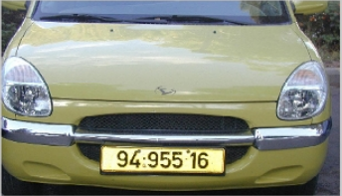
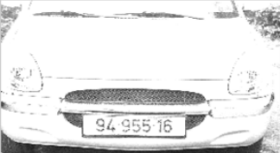
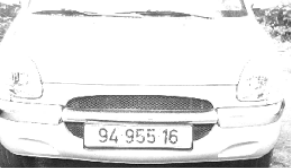

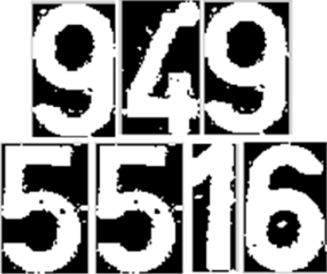
Input Database Image
Input Vehicle Image
Gray Conversion
Gray Conversion
License Plate Extraction
License Plate Extraction
Opening and Closing Operations
Opening and Closing Operations
Character Segmentation
Character Segmentation
Feature Extraction and Recognition
Neural Networks
Training
BLOCK DIAGRAM
Output

Slide 5
Input Vehicle image
The input image may vary with respect to the types of plate which are to be recognized and also due to the environment in which they are taken.
They are summarized as follows:
Plate variations
Environmental factors

Slide 6
License Plate Extraction
Extraction of number plate is a difficult task because of the inaccuracies involved during capturing of an image.
The goal of this phase, given an input image, is to produce number of regions, with high probability of containing number plate and validate for true number plate.

Slide 7
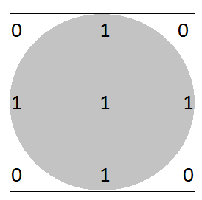
Structural Element
Two-dimensional, or flat, structuring elements consist of a matrix of 0's and 1's, typically much smaller than the image being processed.
The center pixel of the structuring element, called the origin, identifies the pixel of interest the pixel being processed.
The pixels in the structuring element containing 1's define the neighborhood of the structuring element.
These pixels are also considered in the dilation or erosion processing.
Origin
Structural Element

Slide 8

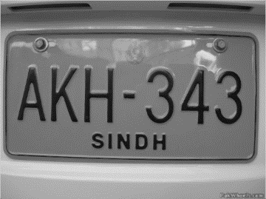
Erosion
The erosion of a binary image f by a structuring element s (denoted by f s) produces a new binary image g = f s with ones in all locations (x,y) of a structuring element's origin at which that structuring element s fits the input image f, i.e. g(x,y) = 1 is s fits f and 0 otherwise, repeating for all pixel coordinates (x,y).
Erosion is mainly used for eliminating the irrelevant details of an image.
Original Image
Eroded Image

Slide 9
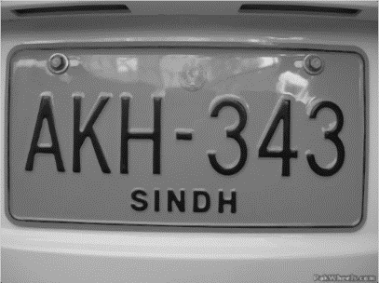

Dilation
The dilation of an image f by a structuring element s (denoted f s) produces a new binary image g = f s with ones in all locations (x,y) of a structuring element's origin at which that structuring element s hits the input image f, i.e. g(x,y) = 1 if s hits f and 0 otherwise, repeating for all pixel coordinates (x,y).
Dilation has the opposite effect to erosion it adds a layer of pixels to both the inner and outer boundaries of regions.
Dilation is mainly used to enclose holes in a single region, reduce the gaps between different regions and to fill the intrusions into boundaries of a region.
Original Image
Dilated Image

Slide 10

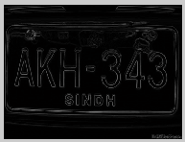
Boundary Extraction
In this step, the eroded image is subtracted from the dilated image to obtain the boundaries of the characters.
After boundary extraction, unwanted horizontal lines are again eroded using a structural line element for extracting the dimensions of the number plate.
Original Image
Boundary extracted image

Slide 11
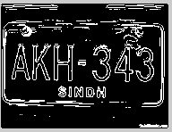
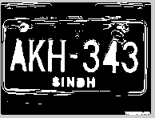
Region Fill
Next step is to develop a simple algorithm for region filling based on set dilations, complementation, and intersections.
Beginning with a point p inside the boundary, the objective is to fill the entire region with ‘black’.
If we adopt the convention that all non-boundary (background) points are labeled ‘white’, then we assign a value of ‘black’ to p to begin.
Original Image
Image after region filling

Slide 12
Thinning Operation
Thinning is a morphological operation that is used to remove selected foreground pixels from binary images, somewhat like erosion or opening.
It can be used for several applications. In this, it is used to tidy up the output of edge detectors by reducing all lines to single pixel thickness.
Thinning is normally only applied to binary images, and produces another binary image as output.
The thinned useless lines are later removed using erosion.

Slide 13
Segmentation
Segmentation is the process of partitioning a digital image into multiple segments.
The goal of segmentation is to simplify and/or change the representation of an image into something that is more meaningful and easier to analyse.
Segmentation can be performed using:
Template loading
Character Normalization
Template matching

Slide 14
Feature based character recognition
Feature Extraction serves two purposes.
One is to extract properties that can identify a character uniquely.
Second is to extract properties that can differentiate between similar characters.
A character can be written in a variety of ways, and yet can be easily recognized correctly by a human.
Thus, there exist a set of principles or logics that surpass all variation differences.
Thus, the features used by the system work upon such properties which are close to the psychology of the characters.

Slide 15
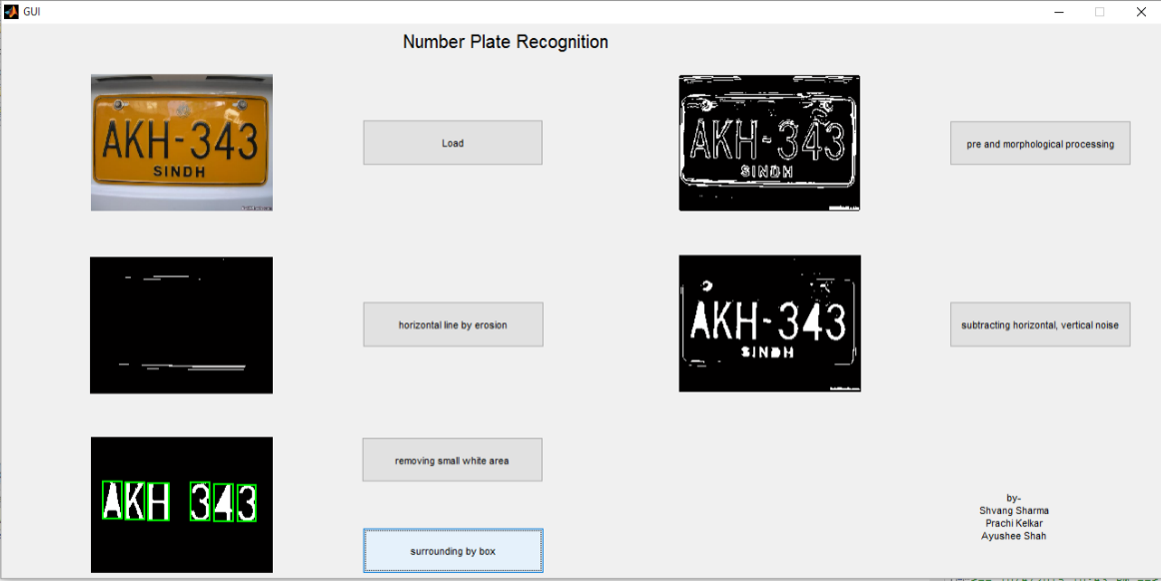
RESULTS

Slide 16
Future Plan
Implementing the neural network part.
Adding function for license plate extraction.
Optimizing the code to work with all kinds of images
Implementing it in real time.

Slide 17
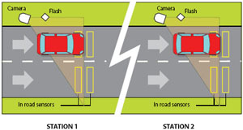
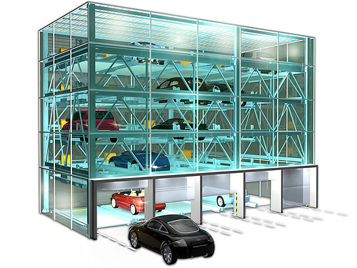
Possible applications of project
Averaging speed camera.
Revenue collection
Automated parking system
Search for stolen cars through data logging.

Slide 18
Difficulties
The quality of license plate recognition software with its recognition algorithm.
Quality of acquired image (lighting , focus, viewing angle).
Accuracy of the software.
Blur images, particularly due to motion.
Poor lighting and low contrast due to overexposure, reflection or shadows.
An object obscuring (part of) the plate, quite often a tow bar, or dirt on the plate.
Read license plates that are different at the front and the back because of towed trailers, campers, etc.
Vehicle lane change in the camera's angle of view during license plate reading.
A different font, popular for vanity plates.

Slide 19
Project execution plan for academic year
STEP 1 (July) | Finalization of project domain and project Topic. Design of block diagram and plan for project Execution.
STEP 2 (August) | Preparation of Synopsis and Pre-project seminar. Design of final Block Diagram of system.
STEP 3 (September) | Study of IEEE papers on related subjects. First Assessment submission.
STEP 4 (October) | Study of character recognition. Preparation & submission of seminar report.
STEP 5 (December) | Testing and Implementation of design model Study of Neural Network
STEP 6 (Jan-Feb) | Completion of implementation of project hardware. Casing for hardware.
STEP 7 (Feb-March) | Submission of second Assessment. Testing of project hardware.
STEP 8 (April) | Preparation and writing of final project report. Checking and Printing of project report.
STEP 9 (May) | Submission of final project report.

Slide 20
References
[1] Rafael C. Gonzlez and Richard E. Woods, “Digital Image Processing,” Pearson Education International, Third Edition, pp. 652-660.
[2] Shan Du, Mahmoud Ibrahim, Mohamed Shehata and Wael Badawy, “Automatic License Plate Recognition (ALPR): A State-of-the-Art Review,” in IEEE transactions on circuits and systems for video technology, vol. 23, no. 2, February 2013.
[3] Christos-Nikolaos E. Anagnostopoulos, Loannis E. Anagnostopoulos, Loannis D. Psoroulas, Vassili Loumos, and Eleftherios Kayafas, “License Plate Recognition From Still Images and Video Sequences: A Survey,” IEEE Transaction on Intelligence Transportation Systems, vol. 9, no. 3, September 2008.
[4] Shyang-Lih Chang, Li-Shien Chen, Yun-Chung Chung, and Sei-Wan Chen, “Automatic License Plate Recognition ,” IEEE Transaction on Intelligence Transportation Systems, vol. 5, no. 1, March 2004.
[5] Christos Nikolaos E. Anagnostopoulos, Ioannis E. Anagnostopoulos, Vassili Loumos, and Eleftherios Kayafas, “A License Plate-Recognition Algorithm for Intelligent Transportation System Applications ,” IEEE Transaction on Intelligence Transportation Systems, vol. 7, no. 3, September 2006.
[6] Michael A.Nielsen, “Neural Networks and Deep Learning”: http://neuralnetworksanddeeplearning.com, Determination Press, 2015.

