Slide 1

Mini Project
Name : Praveen Kumar
Sec : F
ID : 200111214
University roll no. : 2018567
Semester : 3rd
Teacher : Dr. Mahesh Manchanda

Slide 2
Introduction :
The report has been written as a requirement to complete the mini project for Automation of Mail Sending using Python. The objective of the project is to make a GUI to send a automated mail. And It is asked to use Python programming language. Python has a lot of libraries to help in making of the project.
The application I made sends a automated mail after 10 seconds, everytime we send a mail to someone. My thinking of sending mail is that, We sell pictures and when someone buys pictures from us we send those (best quality) in their mail and after 10 seconds the app we use to send mail it automatically sends another mail which contains our top rated pictures.

Slide 3
Objectives :
# Gathering all the information and writing the code
# Designing the GUI
# Making it a ‘.exe’ application

Slide 4
About the project :
Libraries used
smtp : this library helps to logging in to the Email account and sending the mail
EmailMessage : this library helps to hold all the information in a single object.
tkinter : this library helps to create GUI
time : this library helps to slow down some process.
os : this library helps in using the environment variables

Slide 5
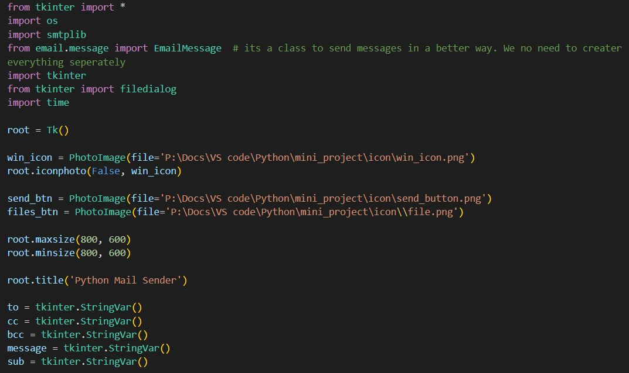
Code :

Slide 6
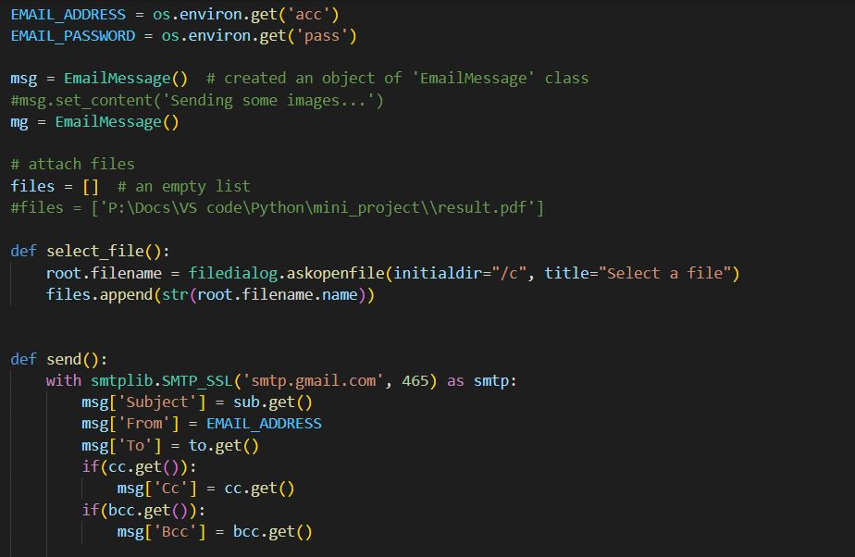

Slide 7
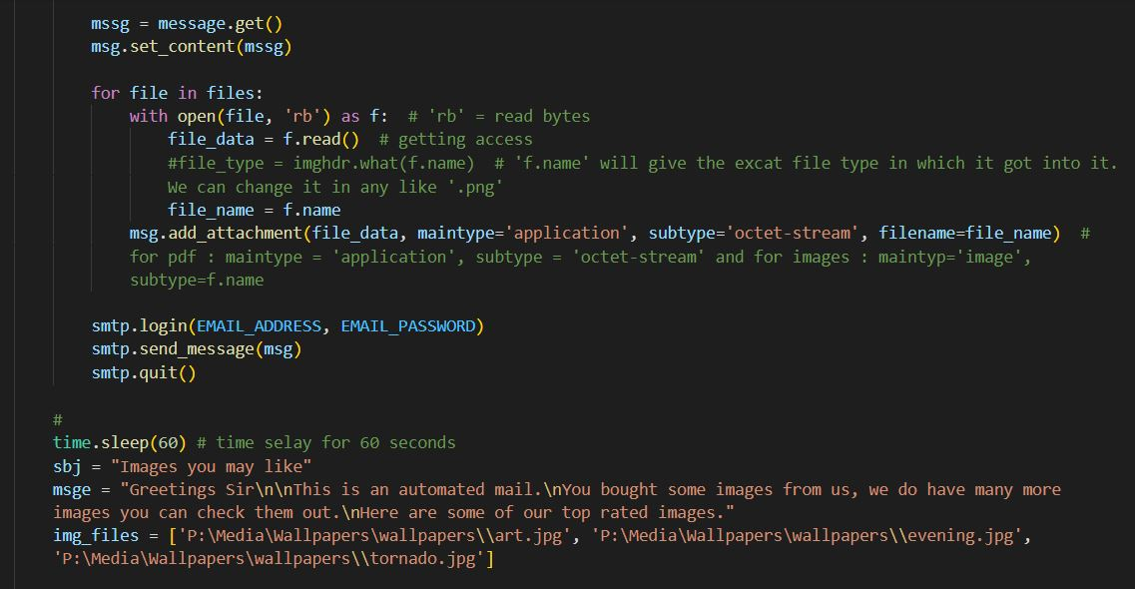

Slide 8
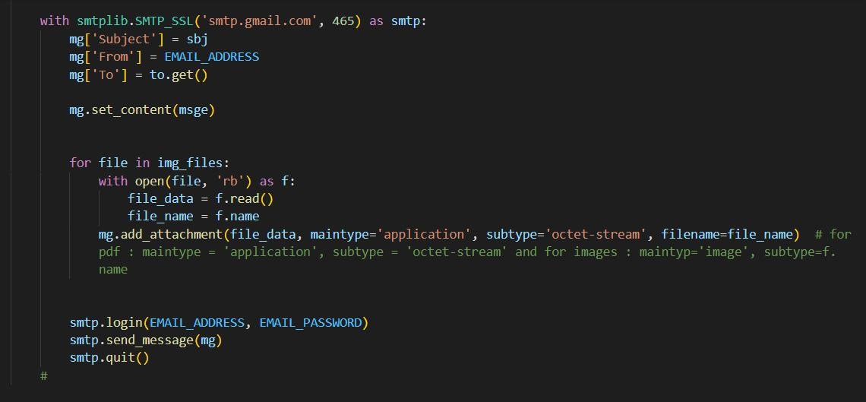

Slide 9
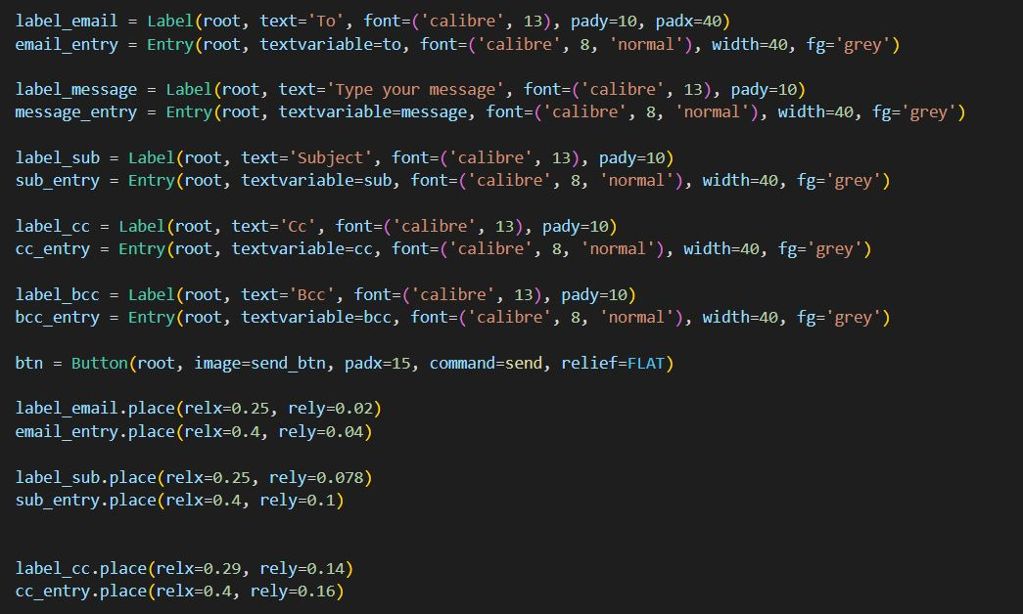

Slide 10
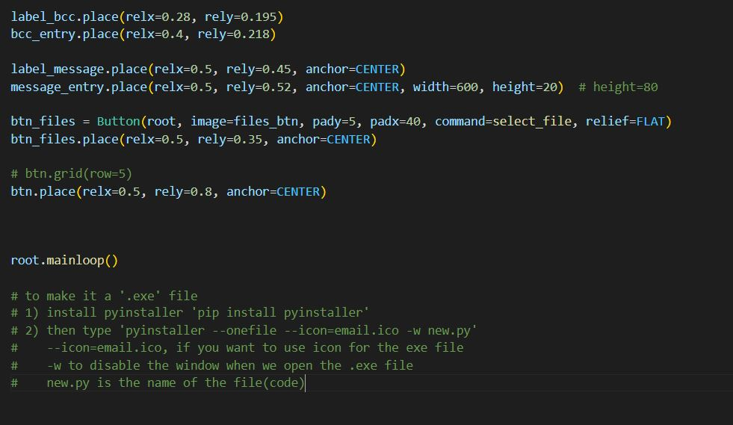

Slide 11
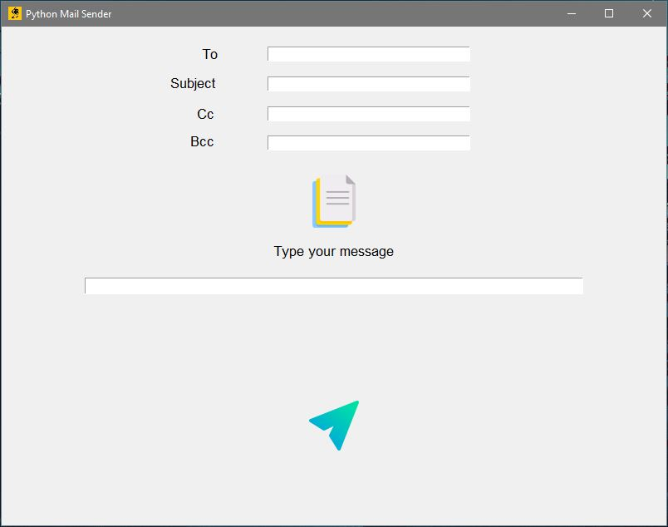
GUI :
Button for selecting files
Send button

Slide 12
Reference :
I made this mini project with the help of my project teacher Dr. Mahesh Manchanda and Internet.

