Slide 1
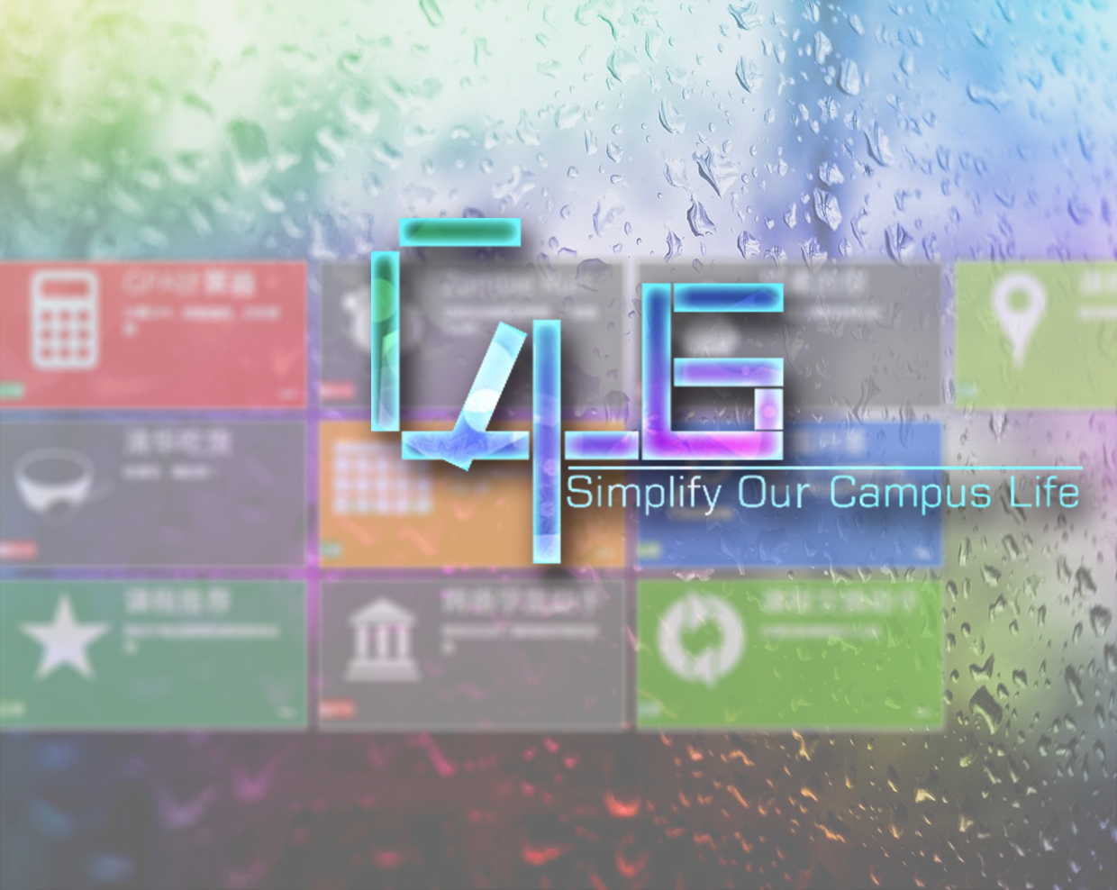
Lab μ

Slide 2
Caμs, history and future
Caμs was born in 2013, aiming at gathering scattered data located in different places in the campus network, and making the process of getting information easier by integrating them together.
Use data mining to make full use of all kinds of information which is ignored before.

Slide 3
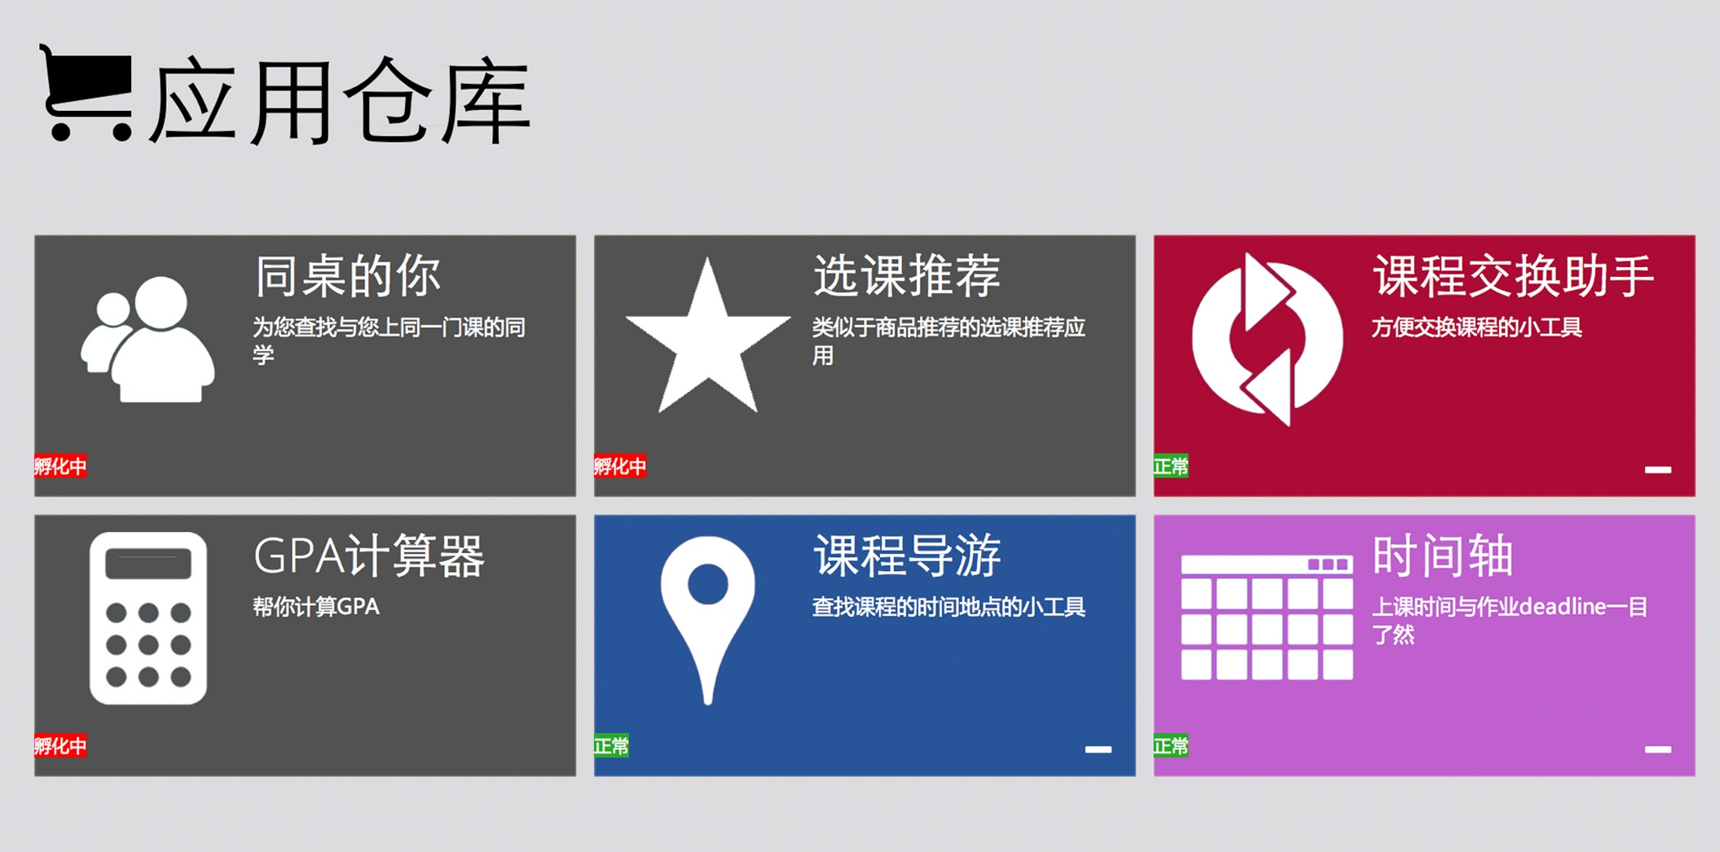
Caμs, history and future

Slide 4
Basic features

Slide 5
Integration
Integrate all your campus accounts
One notification center for news and notice in all platforms
Timeline for all coming activities and assignments

Slide 6
Reminding
Push notifications to your mobile phone
Alert you on the web app

Slide 7
Analysis
Arrange schedule for you based on your daily activities
Analyze you grade and visualize it
Course recommendation

Slide 8
Social & share
Get the location of one course if someone share it
Suggestion on selecting courses based on others evaluation
Know others who take the same class with you
Get more information from others sharing

Slide 9
Information Generation
Cloud note, cooperate with others
Comment on the canteen, know where the

Slide 10
More Interesting?
Have something interesting want to share with others?
Learning by gaming and achievement?
Location based socializing?
Gaming with your friend?

Slide 11
These are not the whole story…
With all the data we provide, more interesting applications can be developed

Slide 12
Structures

Slide 13
Structures
UI
Apps
Open Platform

Slide 14
Structures
RenRen
Info
Data
Other Platforms
Web Learn
Apps

Slide 15
More data means more possibility！

Slide 16
And we need your ideas…
Together to make our campus life better!

Slide 17
Thank you！

