Slide 2
What is a Good Game?

Slide 3
IndieToPlay.com Indie-game recommending system
Group 1
Shing Hin LI 101470576
Chi Ngai TSE 101471429
Lok Yi CHANG 101494624
Ho Lai Henry LAM 101471413

Slide 4
Agenda
Background
Problem Statement
Assumption
Literature Review
Project Definition
Benefit
Risks
Project Implement Plan
Financial Analysis
ML Canvas
Model Benchmark
Deployment
Technical Challenge
Demo

Slide 5
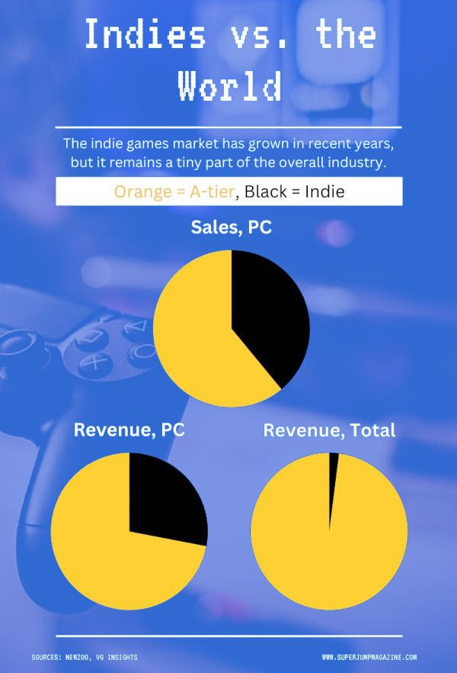
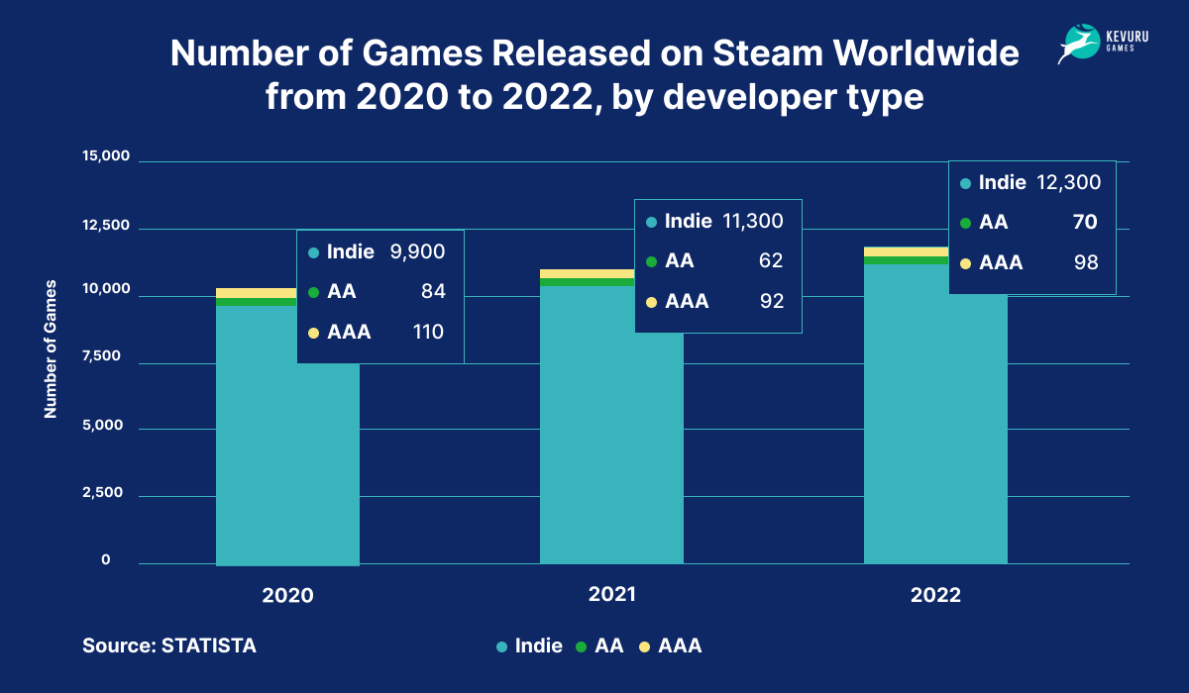
Background
Indie games only get 40% of the whole market share with 12300 games
PC games market worth USD 30B by 2023, while Steam takes up estimated 70% of the sales

Slide 6
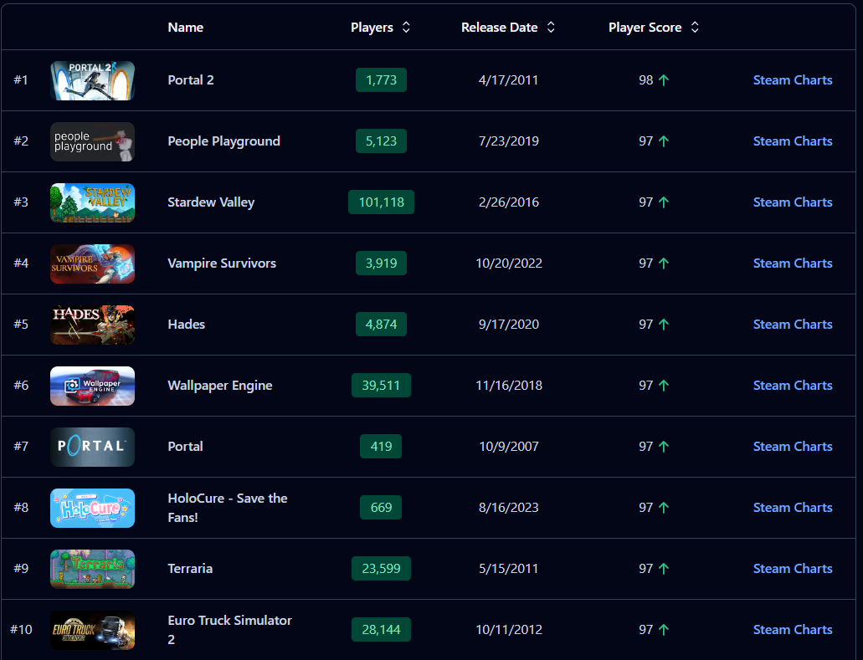
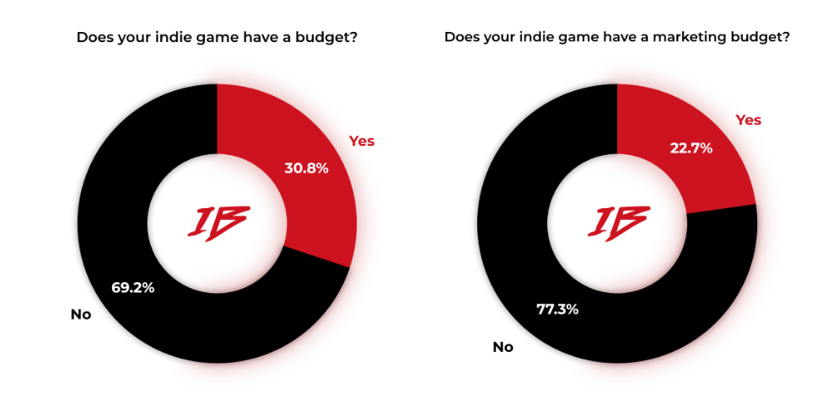
Background
About 80% of independent games developer teams have no budget for marketing.
8 of Top 10 games with highest review score on steam are from independent developers or publishers
Low budget =/= Big Quality
https://www.superjumpmagazine.com/the-state-of-indie-games-in-2023-and-beyond/
https://steambase.io/games/best-rated-steam-games
Notes:
AAA dominating the whole market
No money to promote, doesn’t mean that it has bad quality.

Slide 7
Problem Statement
Players tend to stick with famous genres & IP, limiting their exploration of new games.
Current game recommendation algorithm create exposure blockades to game with low marketing budget.
Indie games struggles to enter market

Slide 8
Assumption
Project supported by Steam
Independent web platform
Target for Indie Game Developers and Publishers

Slide 9
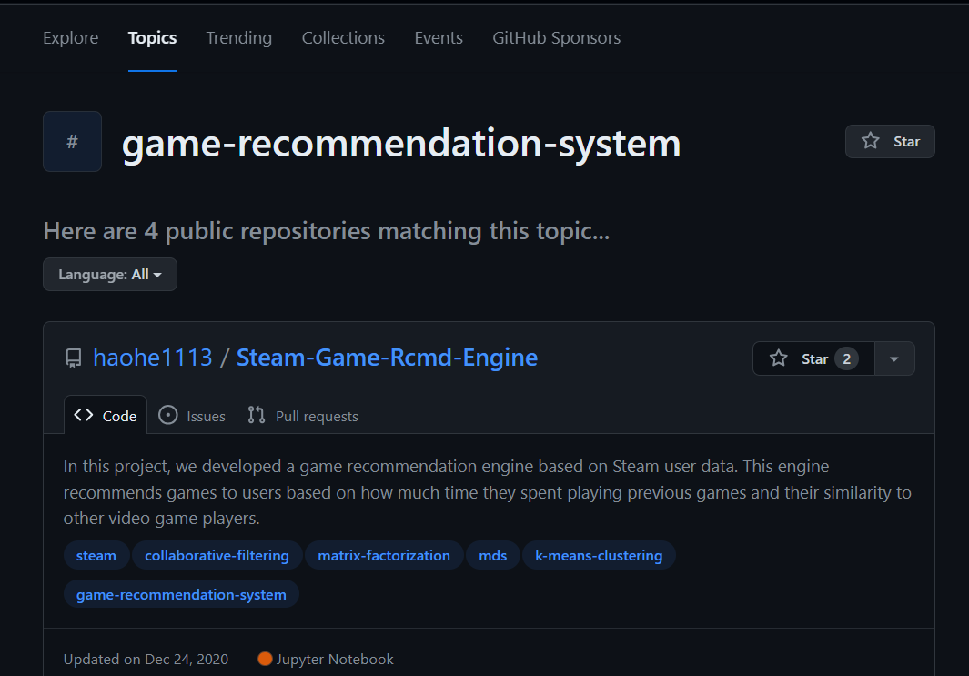
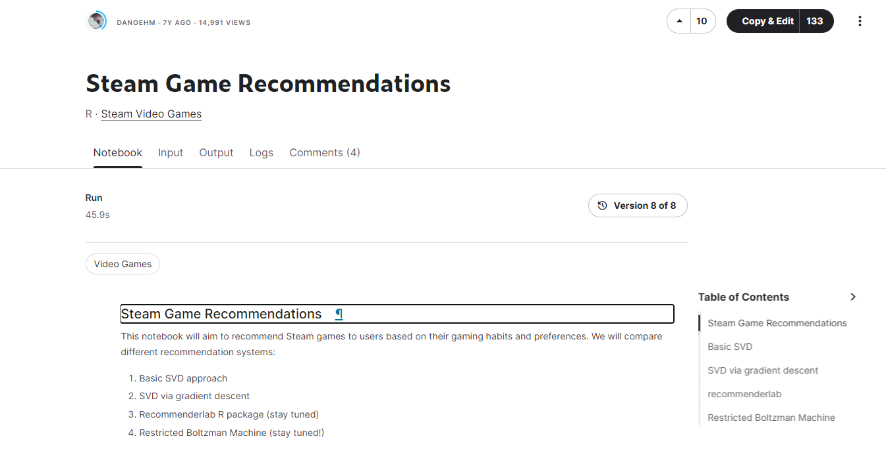
Literature Review
Business competitors:
Epic Game Store, Xbox, itch.io
Technical:
Content base / User base only
Lack of hybrid filtering technique
https://www.kaggle.com/code/danieloehm/steam-game-recommendations#Steam-Game-Recommendations
https://github.com/topics/game-recommendation-system
Notes:
different retailers that might use exclusive games to attract games migrate to their platform including Play Station Network, and Nintendo online Store.
Currently, most of the game recommendation systems on github and kaggle are using either content base or user base recommendations, they never mix them up and perform hybrid filtering on, which will be the main goal of our project in technical part.

Slide 10
Project Definition
A Web-based Independent Game Recommendation Platform
Introduces a user review-based recommendation system to encourage gamers to explore more games
We aim to enhance gaming industry environment and diversify gamers' preferences
Notes:
Introduces a user review-based recommendation system to encourage gamers to explore games they might not otherwise consider.

Slide 11
Benefit (Significance)
Extend the spectrum of consumer habits
Encourage consumers to explore more potential choices
Help boost low budget game sales
A place for games with little budget on marketing
Alternative Marketing Platform
Marketing on Steam depends on the platform’s algorithm which favors games with huge population, we can provide an alternate low-cost solution
Enhance the diversity of the industry
Reduce sales barricade for the minorities

Slide 12
Risks
Developer shift focus to mobile gaming
Reduced number of Independent PC games
Concerns from well-established developers
Lack of inclusion and missed market opportunities
Unattractive to consumers
Requires a strong initiatives
Lack of user feedback
Review based system needs user comments

Slide 13
Project Implement Plan – Phase & Timeline
Phase 1
Planning and Requirements Gathering
Phase 2
Design and Prototyping
Phase 3
Data Collection and Preparation
Model Development and Training
Phase 4
2 weeks
1 month
Post-Launch Support and Optimization (Ongoing)
Phase 5
Backend and Frontend Development
Phase 6
Integration and Testing
Phase 7
Deployment and Launch
Phase 8
3 months
1 month

Slide 14
Financial Analysis
Estimated Monthly Cost
Subject | Details | Sub Total
Computational Resource | VM + Domain | $100
Human Resource | 4 Full time | $20,000
Promotion Cost | Google Ads | $1,000
Estimated Monthly Cost:$21,100
Estimated Breakeven
Subject | Details | Calculation | Sub Total
New Game Sold | Game Sold * Commission * Average Game Cost | 12,323*10%*$15.5 | $19,100
Advertisement Income | $100 per game boost | $100 * 20 | $2,000
Estimated Breakeven: 12,323 Sales Per Month

Slide 15
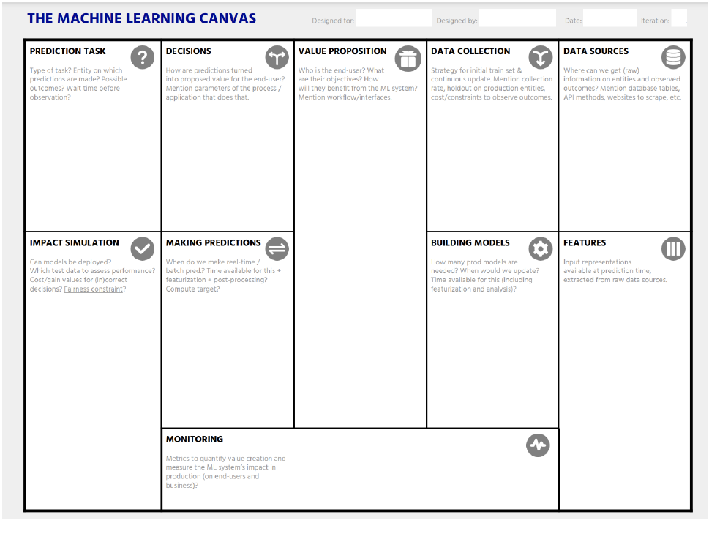
ML Canvas
Recommendation
Convert User input to latent matrix
Calculate cosine similarity with content based latent matrix
Input top 10 output in content based to user based
Calculate the hybrid score
End User: Gamers
User Objective:
Find some good indie games
Get extra discount
Workflow:
Gamers input the features that the game obtain.
The ML system will reply top 10 of recommendation game
Gamer can click the recommended game to get extra offer.
Scarped on
monthly basis with Steam API
For the newly available games
Kaggle,
Steam API,
The model could be deployed.
Test data will be internally testing and invitation to individuals testing.
The Cost/Gain values depends on whether users satisfied with the result.
Fairness constraint, will be:
excluding the games not published between 2022 to 2014
only the games are on Steam platform
Content based:
The 'Name', 'Supported languages', 'Windows', 'Mac', 'Linux', 'Categories', 'Tags', 'Genres’ of the game.
User Based:
Playing hours on the target game
The Recommendation is made when the user input the prompt.
The processing time is around 10 seconds.
3 strategies is in our proposal:
1.Content based
2.User review based
3.Hybrid
We will invite several users with different levels of gaming knowledge to test our product, and at the end we ask some questions regarding the satisfaction with our recommendation as an indicator.

Slide 16
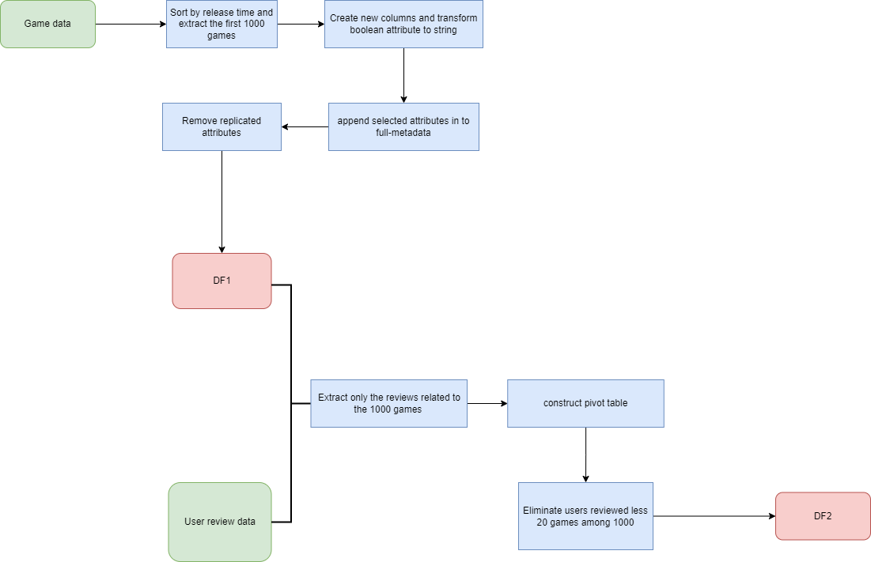
Data Preprocessing

Slide 17
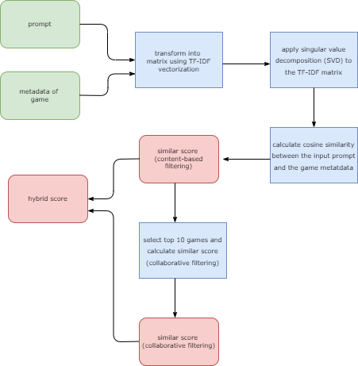
Model Benchmark
Hybrid Score
Content-based filtering
Scores are computed using cosine similarity
Weight 0.5
Collaborative filtering
Top 10 recommended games from the content-based filter stage
Scores are computed with varying weights based on their rankings
Weight 0.5

Slide 18
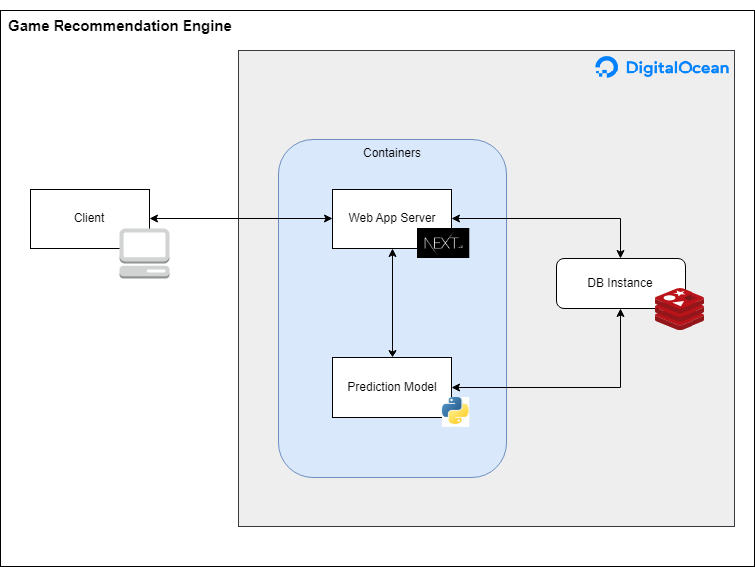
Deployment

Slide 19
Technical Challenge
Prediction Architecture
Dimension increase as games and categories
Lack of data to clearly identify categories of games
Correlation between games are heavily depends on scraped information
Limited APIs for scraping
User comments on games requires external way to scrape
Content-based Approach
Lack a game review focused NLP

Slide 20
Reference
https://www.forbes.com/sites/mitchwallace/2023/10/13/yes-a-digital-only-gaming-future-is-coming-and-we-cant-stop-it/?sh=7a869c2973bd

