Slide 1
Bootstrap 5
最受歡迎的 HTML、CSS 和 JS 範本 (free)，用於開發自適應網頁並且適合行動設備及跨Browser的網頁設計
Bootstrap 5 (released 2021) is the newest version of Bootstrap (released 2013)
Bootstrap was developed by Mark Otto and Jacob Thornton at Twitter

Slide 2
Bootstrap 優勢
易用
響應式(Responsive)網頁
行動設備
跨瀏覽器: 相容性
Bootstrap 5 不支援 IE10、11

Slide 3
安裝Bootstrap 4
<!-- Latest compiled and minified CSS --> <link rel="stylesheet" href="https://maxcdn.bootstrapcdn.com/bootstrap/4.5.2/css/bootstrap.min.css"> <!-- jQuery library --> <script src="https://ajax.googleapis.com/ajax/libs/jquery/3.5.1/jquery.min.js"></script> <!-- Popper JS --> <script src="https://cdnjs.cloudflare.com/ajax/libs/popper.js/1.16.0/umd/popper.min.js"></script> <!-- Latest compiled JavaScript --> <script src="https://maxcdn.bootstrapcdn.com/bootstrap/4.5.2/js/bootstrap.min.js"></script>

Slide 4
安裝 Bootstrap 5
<!-- Latest compiled and minified CSS --> <link href="https://cdn.jsdelivr.net/npm/bootstrap@5.1.1/dist/css/bootstrap.min.css" rel="stylesheet"> <!-- Latest compiled JavaScript --> <script src="https://cdn.jsdelivr.net/npm/bootstrap@5.1.1/dist/js/bootstrap.bundle.min.js"></script>
Bootstrap 5 不使用Jquery 程式庫
Bootstrap 5 只支援 Html 5

Slide 5
行動設備優先Mobile-first
<meta name="viewport" content="width=device-width, initial-scale=1">
其中 width=device-width 指定自動根據行動設備的顯示器寬度決定網頁寬度，
initial-scale=1 指定初次載入時縮放比例

Slide 6
Container
兩種容器類別 container class:
.container
provides a responsive fixed width container
.container-fluid
provides a full width container, spanning the entire width of the viewport

Slide 7
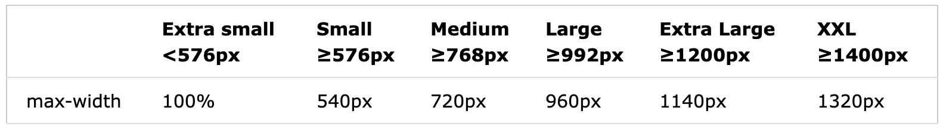
Container 最大寬度
max-width: change on different screen sizes:
xs sm md lg xl xxl

Slide 8
First example
<div class="container"> <h1>My First Bootstrap Page</h1> <p> The .container class provides a responsive fixed width container.</p>
<p> Resize the browser window to see that the container width will change at different breakpoints. </p> </div>
class 改用container-fluid

Slide 9
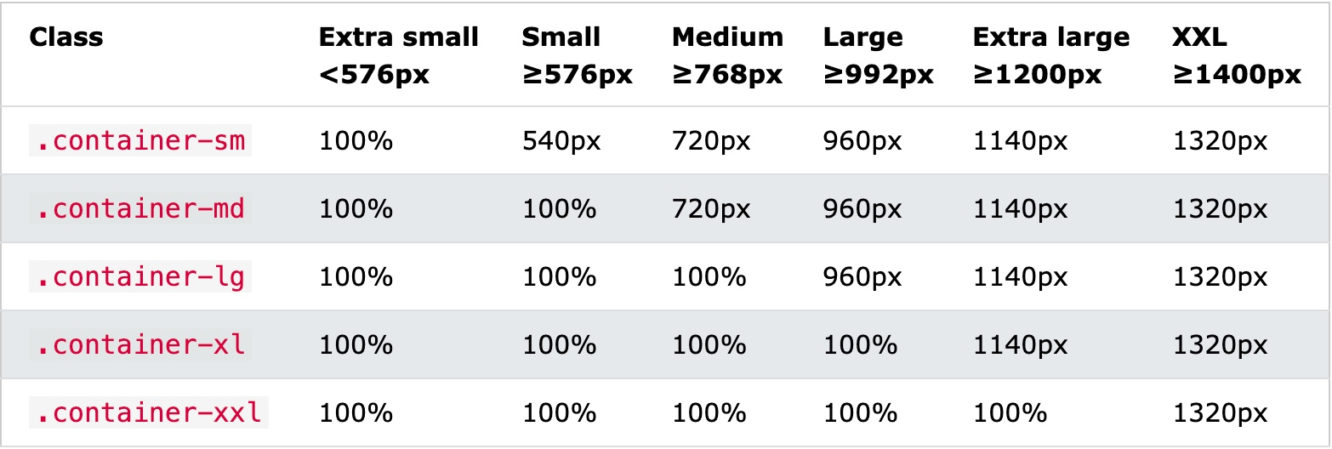
Responsive container
W3school Example

Slide 10
Padding & margin
m - sets margin
p - sets padding
可與下列組合
t - sets margin-top or padding-top
b - sets margin-bottom or padding-bottom
s - sets margin-left or padding-left
e - sets margin-right or padding-right
x - sets both padding-left and padding-right or margin-left and margin-right
y - sets both padding-top and padding-bottom or margin-top and margin-bottom

Slide 11
Padding & margin
size is one of:
0 - sets margin or padding to 0
1 - sets margin or padding to .25rem
2 - sets margin or padding to .5rem
3 - sets margin or padding to 1rem
4 - sets margin or padding to 1.5rem
5 - sets margin or padding to 3rem
auto - sets margin to auto
Ex: pt-5 設top-padding 為 3rem
rem：相對單位，每個元素透過「倍數」乘以根元素的 px 值。
根元素指的是 html 的 font-size，預設為 16px

Slide 12
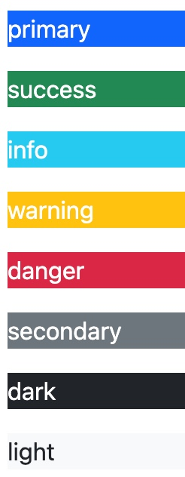
Border & bg color
<div class="container p-5 my-5 border"></div> <div class="container p-5 my-5 bg-dark text-white">
</div>

Slide 13
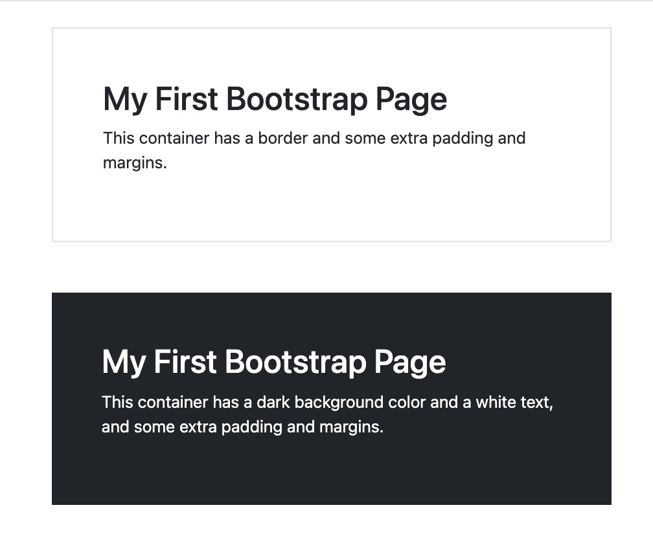
Exercise
padding
margin
border

Slide 14
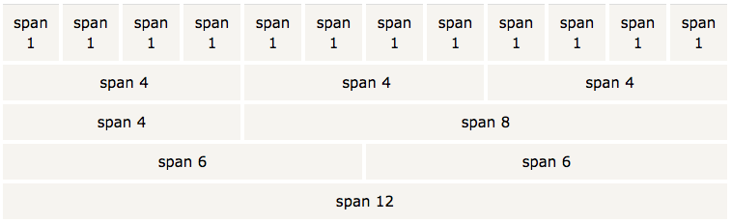
12欄佈局(grid)
1 列 (row) 可切成 12 欄 (col)

Slide 15
依設備指定佈局欄的寬度
The Bootstrap 5 grid system has six classes:
.col- (extra small devices - screen width < 576px)
.col-sm- (small devices - screen width >= 576px)
.col-md- (medium devices - screen width >=768px)
.col-lg- (large devices - screen width >= 992px)
.col-xl- (xlarge devices - screen width >= 1200px)
.col-xxl- (xxlarge devices - screen width equal to or greater than 1400px)

Slide 16
佈局欄的定義結構
2欄
<div class="row"> <div class="col-*-*"></div> <div class="col-*-*"></div> </div> <div class="row"> <div class="col-*-*"></div> <div class="col-*-*"></div> <div class="col-*-*"></div> </div>
3欄

Slide 17
exercise

Slide 18
表格
Basic Table
斑馬線 Striped Rows
Bordered Table
Hover Rows
扼要式Condensed Table
Contextual Classes (動態樣式)

Slide 19

image
Rounded Corners
Circle
Thumbnail
Responsive Images

Slide 20
Carousel
<div id="myCarousel" class="carousel slide" data-ride="carousel">
<!-- Indicators -->
<!-- Items-->
<!-- Left and right controls -->
</div>

Slide 21
Modal
The Modal plugin is a dialog box/popup window that is displayed on top of the current page

Slide 22
其他
Navibar
Collapse
Tabs/Pills
Tooltip
Popover
https://www.w3schools.com

