Slide 1
REPORT
NGUYEN NGOC PHUONG NAM

Slide 2
CONTENT
CI 3
Smarty
Web App
HMVC CI – Smarty
Database

Slide 3
I. CI v3
Structure
Usage
Integrate 3rd party

Slide 4
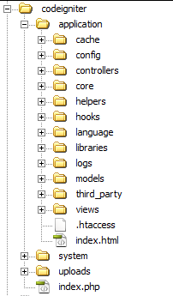
I.I. CI - Structure
Application
System
User guide

Slide 5
I.I. CI – Application Folder
Contains all the code of your application and where you will develop your project.
Cache − contain all the cached pages of your application. These cached pages will increase the overall speed of accessing the pages.
Config − contain various files to configure the application.
autoload.php: load libraries, helpers, models… automatically when a controller is initialized
config.php: set base_url,…
routes.php: set default_controller, re-map url
database.php: Setup needs to connect to the database
Controllers − This folder holds the controllers of your application. It is the basic part of your application
Core − contain your own custom base classes.
Helpers − store helper functions.
Hooks
Language − contain language files, support multi-languages.
Libraries − contain files of the class libraries developed of you.
Logs − contain files related to the log of the system.
Models − the database access files will be placed in this folder.
Third_party − store any plugins, which will be used for your application.
Views − application’s GUI files that will render to user.

Slide 6
I.I. CI – System Folder
Contains CodeIgniter core codes, libraries, helpers and other files.
Core − contains CodeIgniter’s core class: Loader, Controller, Router, Output,…
Database − contains core database drivers and other database utilities.
Fonts − contains font related information and utilities.
Helpers − contains standard CodeIgniter helpers (such as date, cookie, and URL helpers).
Language − contains language files.
Libraries − contains standard CodeIgniter libraries (e-mail, calendars, file uploads, and more).
NOTE:
You can custom CI core classes by putting them into application/core and name them with prefix MY_ (can custom in config.php file).
You can create your own libraries or extend standard ones, those will be saved in the application/libraries directory.

Slide 7
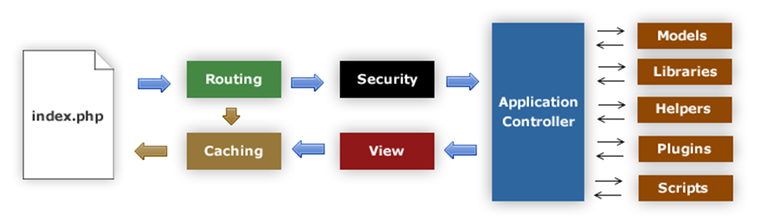
I.II. CI - Usage
Notes:
1. The index.php serves as the front controller, initializing the base resources needed to run CodeIgniter.
2. The Router examines the HTTP request to determine what should be done with it.
3. If a cache file exists, it is sent directly to the browser, bypassing the normal system execution.
4. Security. Before the application controller is loaded, the HTTP request and any user submitted data is filtered for security.
5. The Controller loads the model, core libraries, helpers, and any other resources needed to process the specific request.
6. The finalized View is rendered then sent to the web browser to be seen. If caching is enabled, the view is cached first so that on subsequent requests it can be served.

Slide 8
I.II. CI - Usage
Route: domain/[controller]/[action]/[params]
Always extends CI_Model/CI_Controller for your own custom models/controllers
Use model in controller:
$this->load->model(name_of_model);
$this->name_of_model->method();
Use library in controller:
$this->load-> library(name_of_library);
$this->name_of_library-> method();
Use helper in controller:
$this->load-> helper(name_of_helper);
function_helper();
Load view in controller:
$this->load->view(name_of_ view, data_array);

Slide 9
I.III. CI - Integrate 3rd party
Download and install manually
Copy folder 3rd party library and put into application/third_party.
Can create a library (in application/libraries) that is used to connect this 3rd party with CI:
require_one APPPATH./path_to_3rd_party_library;
Class [library] extends [3rd_party_library] {...}
Using 3rd party library like library in core CI:
$this->load->library(name_of_library);
Using composer require package
Install through composer
composer require [name_of_package]
Require vendor/autoload.php into file need to use classes/entities in this package
Can make your own class to connect like method 1 step 2

Slide 10
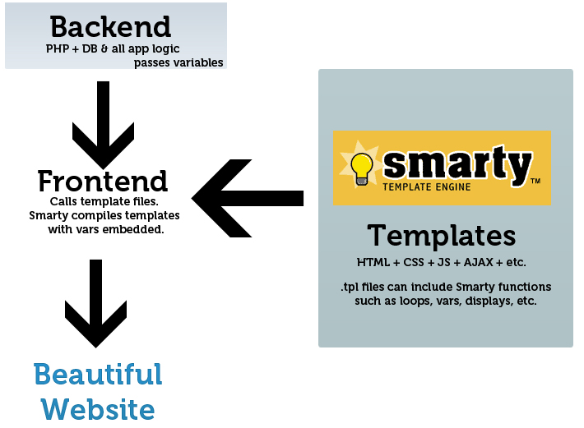
II. Smarty – P1
Template engine for PHP
Separate of presentation
(HTML/CSS) from application logic
Smarty compiles copies of the
templates as PHP scripts. Compilation
happens once when each template
is first invoked

Slide 11
II. Smarty – P2
Smarty requires four folders which are by default named as templates, templates_c, configs and cache corresponding to Smarty class properties $template_dir, $compile_dir, $config_dir and $cache_dir.
$template_dir - Default template directory which stores .tpl file for rendering.
$compile_dir - Directory where compiled files are located.
$cache_dir - Directory where file caches are stored.
$config_dir – Contains file configuration for smarty.

Slide 12
III. Web app
Web app
Web database
CDN
Header status code

Slide 13

III.I. Web app

Slide 14
III.II. Web database
Database application designed to be managed and accessed through the Internet
MySQL
relational database management system
programming language

Slide 15
III.III. CDN - Overview
Content Delivery Network is a system of distributed servers
Stores a cached version of website content in multiple geographical locations (points of presence, or PoPs)
Quick transfer of assets needed for loading Internet content including HTML pages, javascript files, stylesheets, images, and videos
Building blocks
PoPs (points of presence) - contains numerous caching servers
Caching servers - the storage and delivery of cached files
SSD/HDD + RAM
Notes:
- Content Delivery Network (mạng phân phối nội dung)
- Giải pháp tiết kiệm băng thông máy chủ và tăng tốc độ website
- Lưu bản sao (cache) của các nội dung tĩnh bên trong website tại nhiều địa điểm khác nhau (thường được gọi là PoP – Point of Presence) và từ các PoP đó nó sẽ gửi tới cho người dùng khi họ truy cập vào website.

Slide 16
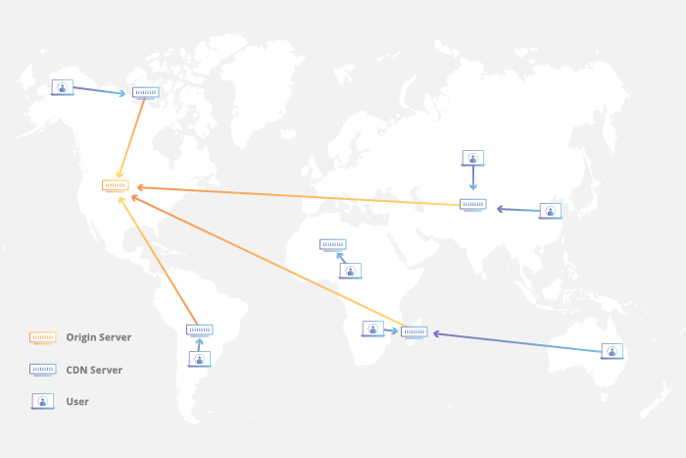
III.III. CDN – How It Work?

Slide 17
III.III. CDN – Types
Pull http/static - PoPs automatically access website and save the content within the website
Post/push - Upload content need to be distributed via CDN to their server by FTP/HTTP protocols
Streaming - Video streaming support

Slide 18
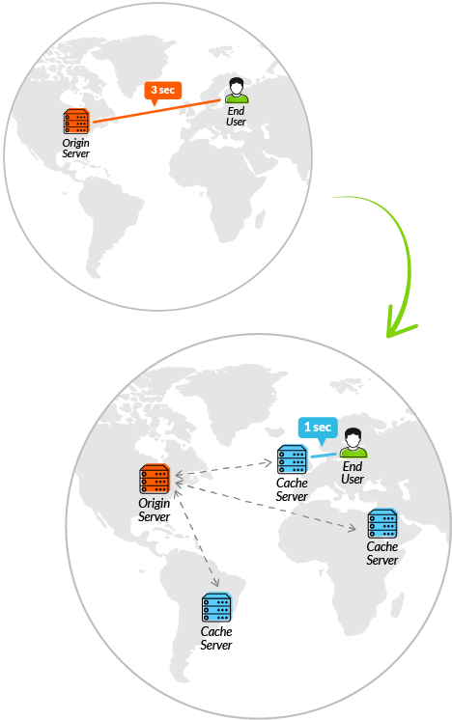
III.III. CDN - Benefit
Improve website load times
Reduce bandwidth costs
Load balance between multiple servers
Protect your website from DDoS attacks
Notes:
DDoS: tấn công từ chối dịch vụ (tấn công DoS - viết tắt của Denial of Service) là một nỗ lực làm cho những người dùng không thể sử dụng tài nguyên của một máy tính.

Slide 19
III.VI. Header status code
1xx – Informational responses
2xx – Success
200 – OK
201 – Created
3xx – Redirect
301 – Moved Permanently
4xx – Client errors
400 – Bad request
401 – Unauthorized
403 – Forbidden
404 – Not found
5xx – Server errors
500 – Internal Server Error
501 – Not Implemented
502 – Bad Gateway
503 – Service Unavailable
504 – Gateway timeout

Slide 20
VI. Integrate HMVC CI - Smarty
Integrate HMVC CI - Smarty
Structure
How it work?
Demo

Slide 21
VI.I. Integrate HMVC CI - Smarty
Implementing HMVC in CodeIgniter using Wiredesignz’s Modular Extensions
Extract the contents of wiredesignz-codeigniter-modular-extensions-hmvc.
Copy the contents of core directory into application/core directory.
Copy the MX folder into application/third_party directory.
Custom Smarty class if you want.
Create MY_Parser class used to pass data and render template smarty.

Slide 22
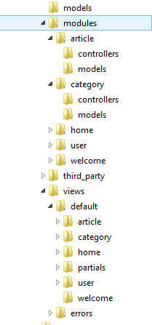
VI.II. Structure
Hierarchical Model View Controller.
It’s a design pattern that will make
CodeIgniter a modular MVC framework.
Mini MVC in modules directory.

Slide 23
VI.II. Structure
Output class
Send the finalized web page to the requesting browser. It is also responsible
for caching web pages.
This class is initialized automatically by the system so there is no need to do it manually.
Parser class
Can perform simple text substitution for pseudo-variables contained within your view files. It can parse simple variables or variable tag pairs.
Loader class
Used to load elements: Libraries, View files, Drivers, Helpers, Models, or your own files.

Slide 24
VI.III. How It Work?
Loader
Find & Add module paths
Autoload module
Index.php
Routing
Locate module

Slide 25
VI.III. How It Work?
Output->append_output
Pass content string
Find template file
Smarty->fetch
Create template object
Parser->parse
Render
Assign data to template
Caching
Compile

Slide 26
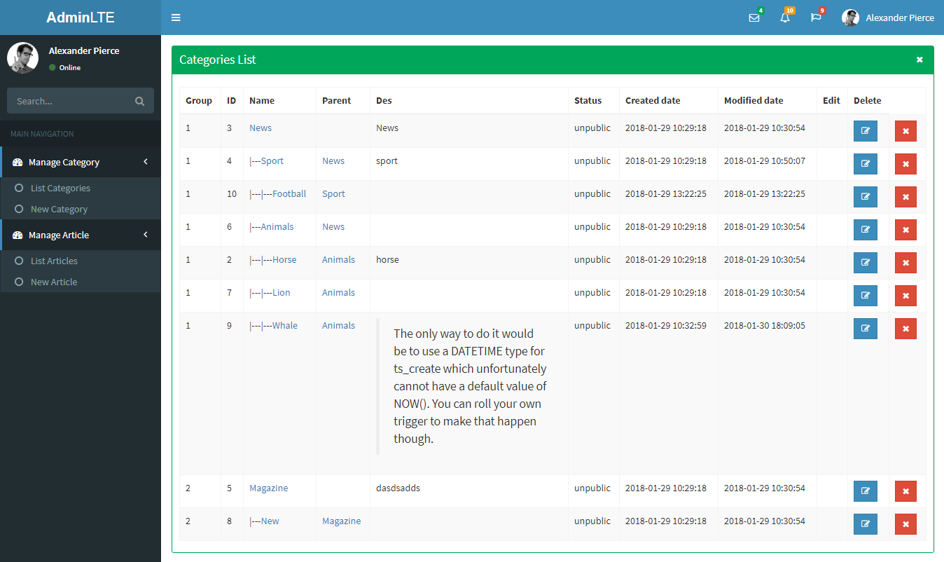
VI.IV. Demo

Slide 27

V. Database
InnoDB vs MyISAM
Full text search indexes

Slide 28
V.I. InnoDB vs MyISAM
InnoDB
Support transaction, foreign key,…
Suitable for insert/update/delete data
Data cache, row level locking
Just support Full text search indexes from version 5.6 beta
MyISAM
Query data faster than InnoDB, suitable for reading data frequently from the database
Full text search indexes
Database design simple, no foreign key
Notes:
Up to 64 index fields in 1 table

Slide 29
V.II. Full text search indexes
Definition
Syntax
Demo

Slide 30
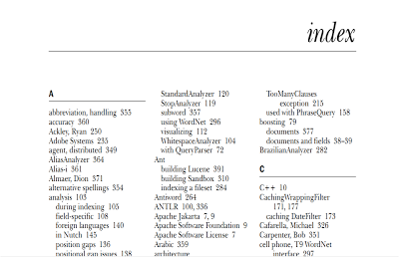
V.II.I. Definition
Full text search
Created on text-based columns (char, varchar, text)
Help speed up queries and DML operations
Index
A type of data structure that improves
the speed of data access
Increased data write time and
more storage space
Inverted Index
Full text index is an index of type FULLTEXT
Notes:
DML: data munipulation language: ngon ngu tinh toan du lieu: insert, update, delete data
Vd: đằng sau những quyển sách, đó là một danh sách cho phép người đọc dễ dàng tra cứu từ nào xuất hiện ở trang nào

Slide 31
V.II.I. Definition
BOOLEAN MODE
Search according to the words we put in
Can specify which keywords will appear, and which keywords do not appear in the results returned - Wildcard
Without default sorting in this mode
Stopwords - Ignore search if encountered
NATURAL LANGUAGE MODE
Search for relevant results (concept search)
NOTE: By default, MySQL FTS searches only words of at least 4 characters (global variable ft_min_word_len = 4)

Slide 32
V.II.II. Syntax
Add full text index column
CREATE INDEX [index_name] on [table](col1,col2,…)
OR
ALTER TABLE [table] ADD INDEX [index_name] (col1,col2,…)
Search syntax
MATCH (col1,col2,...) AGAINST (expr [search_modifier])
search_modifier
IN NATURAL LANGUAGE MODE
IN NATURAL LANGUAGE MODE WITH QUERY EXPANSION
IN BOOLEAN MODE
WITH QUERY EXPANSION

Slide 33
V.II.II. Syntax - Note
Wildcart in BOOLEAN MODE
Specify which keywords will appear or do not appear in the returned results
Syntax
+word – must have this word in retuned result
-word – returned result do not contain this word
~word – returned result can contain this word or not
word* - relate to words/wordy/wording/…
“some words” – find by phrase
Query expansion
Second search
Search the words that are most relevant to the original keyword

Slide 34
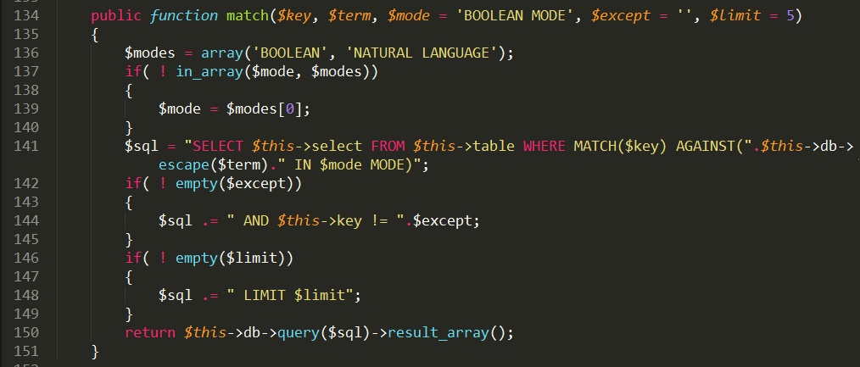
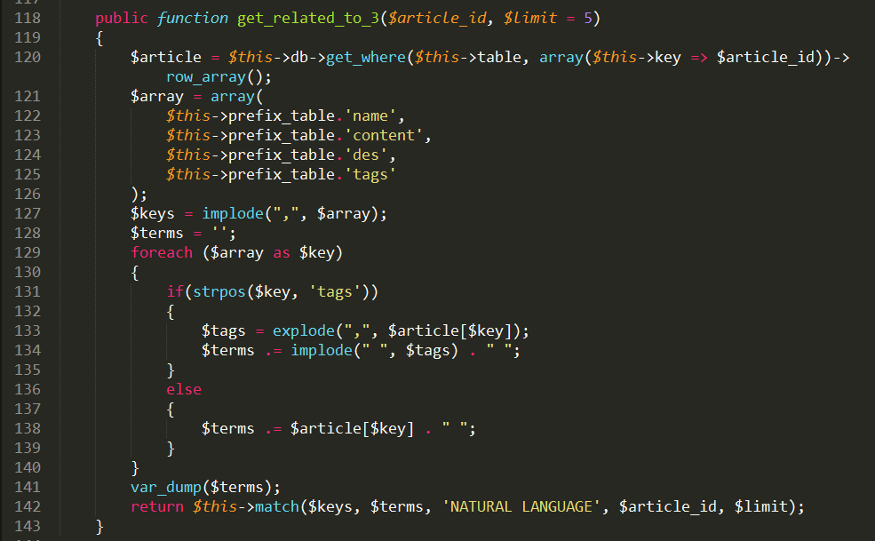
V.II.III. Demo – Search related articles

