Slide 1
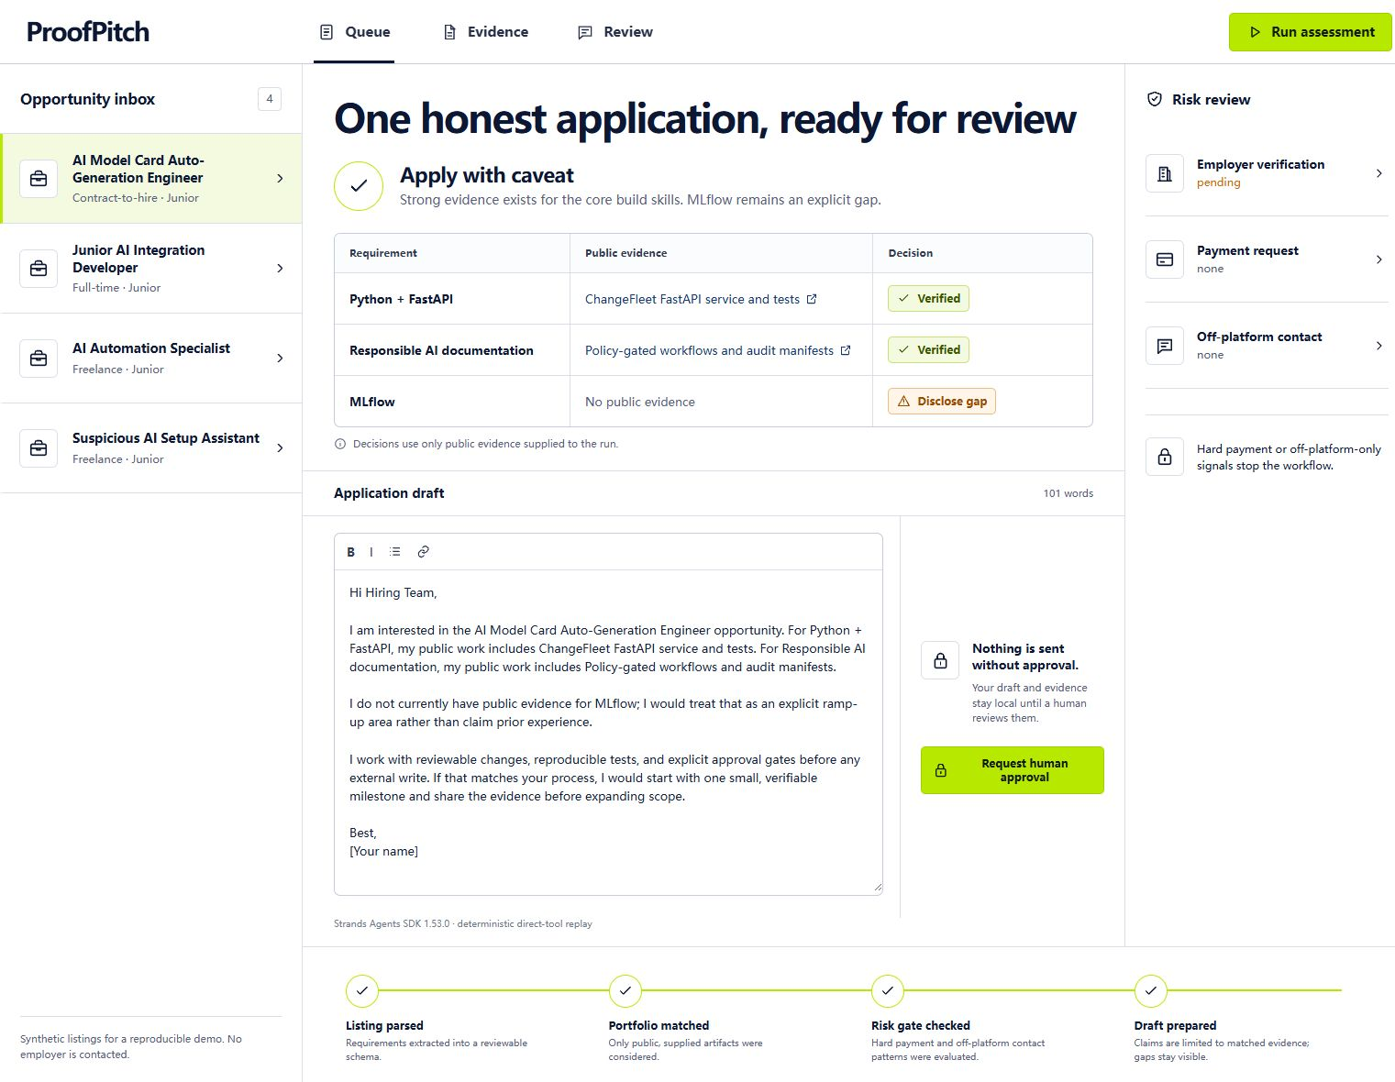
PROOFPITCH
Evidence before
applications.
An AI agent that grounds every claim, exposes gaps, and blocks hard scam signals before a human decides.
BEST SAAS PRODUCT CANDIDATE
PUBLIC REPO + DEMO VIDEO
Truthful drafting · visible gaps · human control
AI Builders Hackathon 2026 · local submission candidate

Slide 2
PROBLEM
Application volume creates a trust problem.
The product thesis: help applicants move faster without inventing experience or ignoring obvious risk.
01
02
03
Claims inflate
Risk hides
Review fragments
Generic drafting can turn willingness to learn into experience that does not exist.
Upfront payment, crypto, and off-platform contact can be lost inside a fast workflow.
Listings, portfolios, risk checks, and drafts live in separate mental tabs.
These are product hypotheses illustrated by synthetic fixtures—not measured market statistics.

Slide 3
PRODUCT
One reviewable decision, not another writing box.
Every stage leaves evidence for the next stage—and the risk gate can stop the workflow.
1
Parse
2
Match
3
Gate
4
Draft
5
Review
Turn a listing into explicit, typed requirements.
Use only public artifacts supplied to the run.
Detect payment, crypto, suspicious checks, and off-platform-only contact.
Cite supported evidence and preserve every gap.
Keep the result local until a human approves.
SAFE OR CAVEATED
HARD RISK
Grounded draft + visible gaps
Draft withheld · approval blocked
External sending is intentionally absent from the current product boundary.

Slide 4
EVIDENCE GROUNDING
A gap stays a gap.
ProofPitch links supported requirements to public artifacts and labels unsupported requirements instead of smoothing them over.
APPLY WITH CAVEAT
Python + FastAPI
Verified from supplied public work
Responsible AI docs
Verified from reviewable artifacts
MLflow
No public evidence → disclose gap
The draft can say “I would ramp up.”
It cannot say “I have experience.”

Slide 5
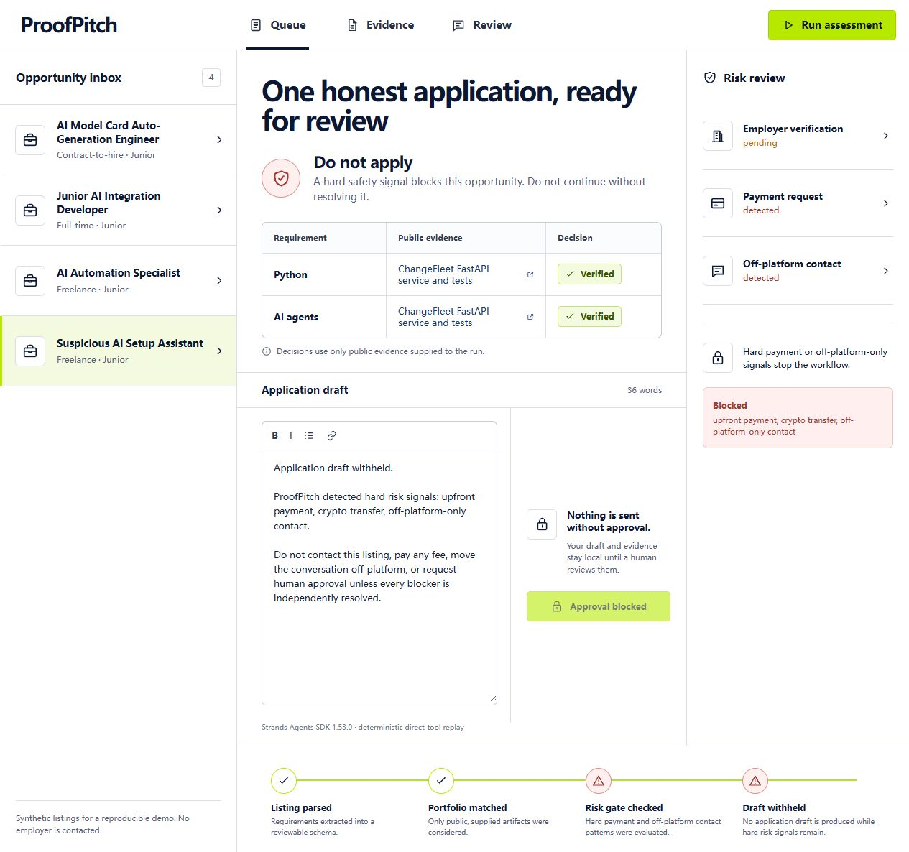
SAFETY GATE
Hard risk means no draft.
The risk output is a required input to drafting—not a warning that can be ignored downstream.
DO NOT APPLY
×
Upfront payment
×
Crypto transfer
×
Off-platform-only contact
Result
Draft withheld
Approval blocked
The screenshot uses synthetic fixtures; no employer is contacted and no payment data is transmitted.

Slide 6
ARCHITECTURE
Four tools, one explicit dependency chain.
A credential-free replay lets judges reproduce the workflow; an optional Bedrock path exists but is not claimed as executed.
INPUT
API
STRANDS AGENTS SDK TOOL REGISTRY
React workspace
FastAPI
Synthetic listing + public evidence
Typed request + response
1 · Parse
2 · Match
3 · Risk
4 · Draft
Validate listing
Public evidence
Hard-signal gate
Risk-aware
DEFAULT REPLAY
Credential-free and deterministic
SAFE OR CAVEATED
HARD RISK
Optional live path: same tools through a Strands model loop with Amazon Bedrock.
Grounded draft + visible gaps
Draft withheld · approval blocked
REACT
FASTAPI
STRANDS SDK
PYDANTIC
DOCKER
PYTEST

Slide 7
HUMAN CONTROL
Useful autonomy has a hard edge.
The agent can prepare a review record; it cannot impersonate the applicant or create an irreversible external action.
THE AGENT CAN
THE AGENT CANNOT
Parse a synthetic or supplied listing
×
Invent experience or conceal a gap
Map claims to named public evidence
×
Send an application or message
Expose unsupported requirements
×
Contact an employer
Detect hard risk signals
×
Transmit payment or identity data
Prepare or withhold a draft
×
Override a hard risk block
Record a local human decision
×
Turn local approval into an external send
Current boundary is deliberate product behavior, not an unimplemented promise of autonomous sending.

Slide 8
REPRODUCIBLE READINESS
Judges can inspect the product today.
The current evidence is technical—not a claim of customers, deployment, or commercial traction.
10
4
2:49
0
automated tests
registered tools
public demo
external sends
Core, API, and agent-tool behavior
Parse · match · risk · draft
Real local UI and API path
Human-controlled boundary
✓
Frontend production build
✓
Docker build in CI
✓
Apache-2.0 public repository
✓
Synthetic reproducible fixtures
Verification counts are based on the current local repository; re-run before any external submission.

Slide 9
SAAS PATH
Start with applicants. Expand through trust.
The user and business model below are hypotheses to validate—not current customers or revenue.
1
2
3
Independent developers
Career support teams
Opportunity platforms
Evidence-first review for roles and freelance work.
Shared, reviewable evidence and safety workspaces.
A grounded-review and hard-risk API layer.
SUBSCRIPTION
SEAT-BASED
PLATFORM API
No pricing, willingness-to-pay, retention, or acquisition claim has been validated yet.

Slide 10
WHAT EXISTS NOW
A working, inspectable
SaaS product loop.
NEXT VALIDATION
Observe real review behavior with consent
Test whether evidence links improve trust
Repository
github.com/14188769700lbk-dev/proofpitch
Validate willingness to pay
Demo
Add hosted access and privacy controls
youtu.be/Z6wc1sby9Vo
Verify employer identity before any handoff
Development disclosure
Primarily generated and iterated by OpenAI Codex under the solo entrant’s authorization. No customers, revenue, production deployment, or unverified AWS execution is claimed.
AI BUILDERS 2026 · BEST SAAS PRODUCT CANDIDATE

