Slide 1
39.线程有几种可用状态？

Slide 2
定义
进程是程序的一次执行过程，是系统运行程序的基本单位。进程是动态的，相对的，程序是静态的。
线程是一个比进程更小的执行单位。一个进程在其执行的过程中可以产生多个线程。
多个线程共享同一块内存空间和一组系统资源，所以系统在产生一个线程，或是在各个线程之间作切换工作时，负担要比进程小得多，也正因为如此，线程也被称为轻量级进程。

Slide 3
State
NEW A thread that has not yet started is in this state.
RUNNABLE A thread executing in the Java virtual machine is in this state.
BLOCKED A thread that is blocked waiting for a monitor lock is in this state.
WAITING A thread that is waiting indefinitely for another thread to perform a particular action is in this state.
TIMED_WAITING A thread that is waiting for another thread to perform an action for up to a specified waiting time is in this state.
TERMINATED A thread that has exited is in this state.

Slide 4
NEW
Thread state for a thread which has not yet started.

Slide 5
RUNNABLE
Thread state for a runnable thread. A thread in the runnable state is executing in the Java virtual machine but it may be waiting for other resources from the operating system such as processor.

Slide 6
BLOCKED
Thread state for a thread blocked waiting for a monitor lock. A thread in the blocked state is waiting for a monitor lock to enter a synchronized block/method or reenter a synchronized block/method after calling Object.wait.

Slide 7
WAITING
Thread state for a waiting thread. A thread is in the waiting state due to calling one of the following methods:
Object.wait with no timeout
Thread.join with no timeout
LockSupport.park
A thread in the waiting state is waiting for another thread to perform a particular action. For example, a thread that has called Object.wait() on an object is waiting for another thread to call Object.notify() or Object.notifyAll() on that object. A thread that has called Thread.join() is waiting for a specified thread to terminate.

Slide 8
TIMED_WAITING
Thread state for a waiting thread with a specified waiting time. A thread is in the timed waiting state due to calling one of the following methods with a specified positive waiting time:
Thread.sleep
Object.wait with timeout
Thread.join with timeout
LockSupport.parkNanos
LockSupport.parkUntil

Slide 9
TERMINATED
Thread state for a terminated thread. The thread has completed execution.

Slide 10
状态转换

Slide 11
不同的说法
就绪状态（Ready）：线程准备运行，不一定立马就能开始执行；
运行状态（Running）：正在执行的线程代码；
等待状态（Waiting）：线程处于阻塞状态，等待外部的处理结束；
睡眠状态（Sleeping）：线程被强制睡眠；
I/O阻塞状态（Blocked on I/O）：等待I/O操作完成；
同步阻塞状态（Blocked on Synchronization）：等待获取锁；
死亡状态（Dead）：线程完成了执行。

Slide 12
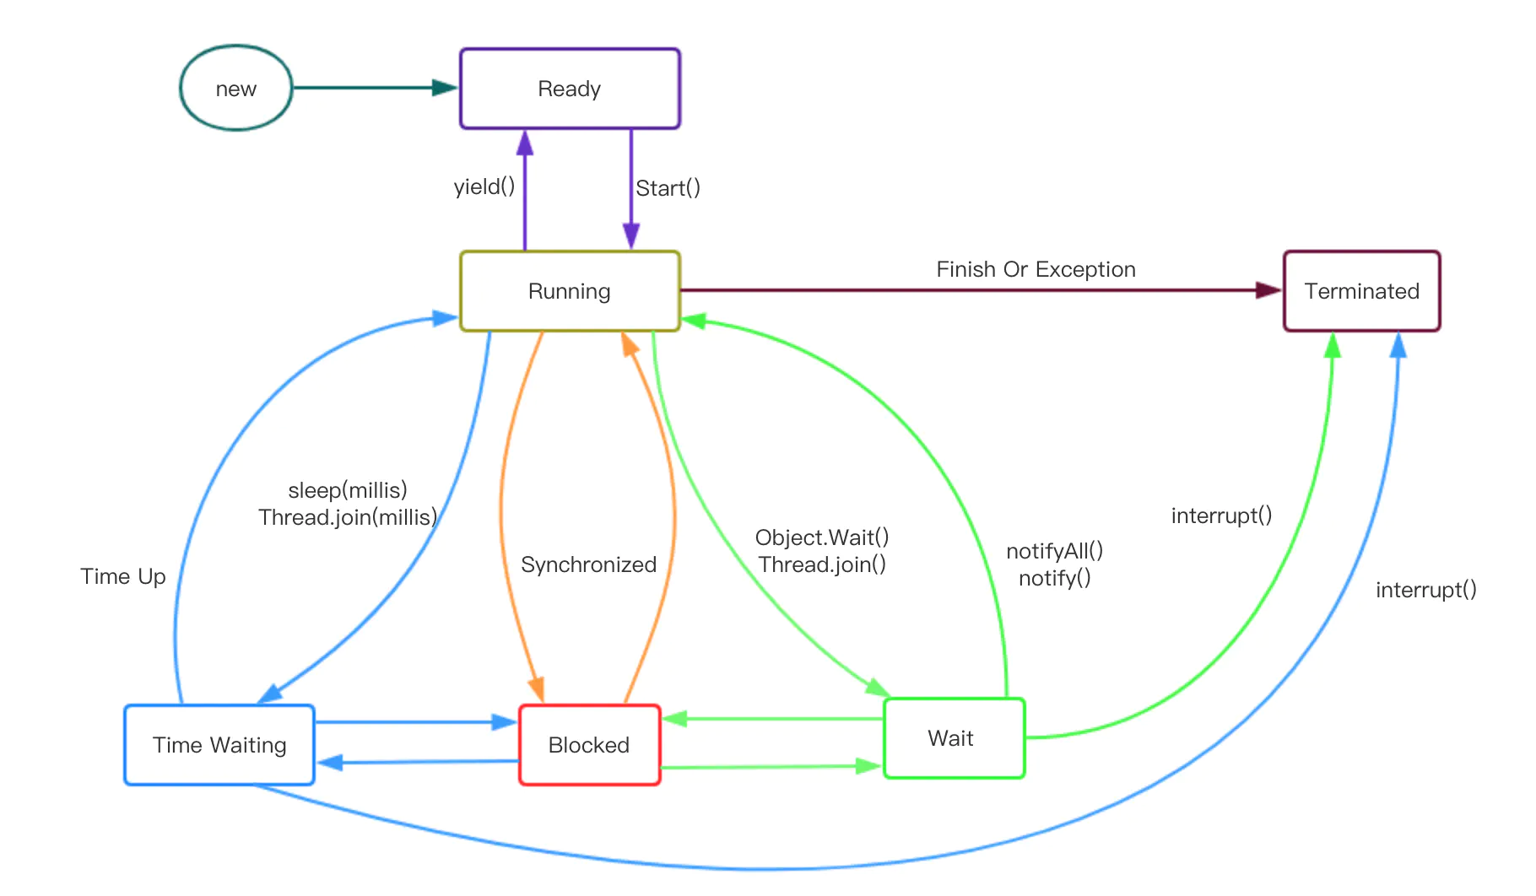
状态转移简图

Slide 13
等待队列同步队列

Slide 14
阻塞与等待的区别
“阻塞”状态是等待着获取到一个排他锁，进入“阻塞”状态都是被动的，离开“阻塞”状态是因为其它线程释放了锁，不阻塞了；
“等待”状态是在等待一段时间 或者 唤醒动作的发生，进入“等待”状态是主动的
如主动调用Object.wait()，如无法获取到ReentraantLock，主动调用LockSupport.park()，如主线程主动调用 subThread.join()，让主线程等待子线程执行完毕再执行
离开“等待”状态是因为其它线程发生了唤醒动作或者到达了等待时间

