Slide 1
Embed Tag
Md. Kamrul Hasan
Kibria Hossen Roni

Slide 2
What is the element ?
Tag: <embed>
Introduced in: HTML5
Backward compatibility: <object>

Slide 3

How does it work?
Purpose: Embeds external files directly into an HTML document.
Syntax: <embed src="URL" type="media_type" width="width" height="height">
Attributes:
src: Specifies the URL of the embedded content (e.g., video file, PDF).
type: Specifies the MIME type of the content, such as application/pdf for PDFs or video/mp4 for MP4 videos.
width and height: Control the dimensions of the embedded content.
Has no closing tags.

Slide 4
Sample code
<!DOCTYPE html>
<head>
<title>Embed tag</title>
</head>
<body>
<embed src="file.pdf" type="application/pdf" width="850" height="500">
<embed src="graphics.svg" type="image/svg+xml" width="850" height="500">
<embed src="video.mp4" type="video/mp4" width="850" height="500">
<embed src="embedded-page.html" width="850" height="500">
</body>
</html>

Slide 5
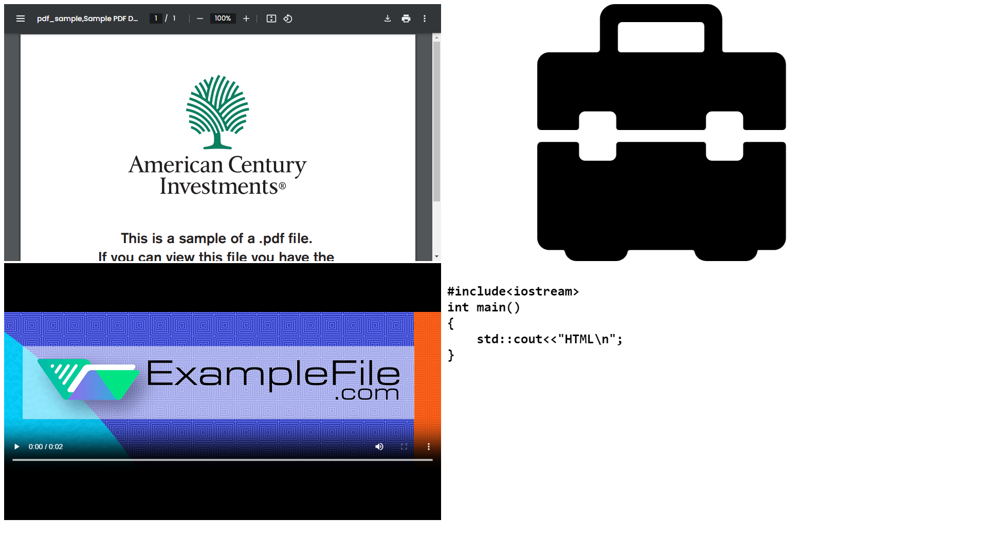

Slide 6
Backward compatibility
<!DOCTYPE html>
<head>
<title>Object tag</title>
</head>
<body>
<object data="file.pdf" type="application/pdf" width="850" height="500"></object>
<object data="graphics.svg" type="image/svg+xml" width="850" height="500"></object>
<object data="video.mp4" type="video/mp4" width="850" height="500"></object>
<object data="embedded-page.html" width="850" height="500"></object>
</body>
</html>

Slide 7
Thank You

