Slide 1
Software Project Lab -1

Slide 2
Building a C++ Chess Game

Slide 3
Project Title : Chess Game
Presented By:
Md. Kamrul Hasan
Roll : BSSE-1418
Supervised By:
Prof. Dr. Shariful Islam Sir
Professor , IIT , University of Dhaka

Slide 4
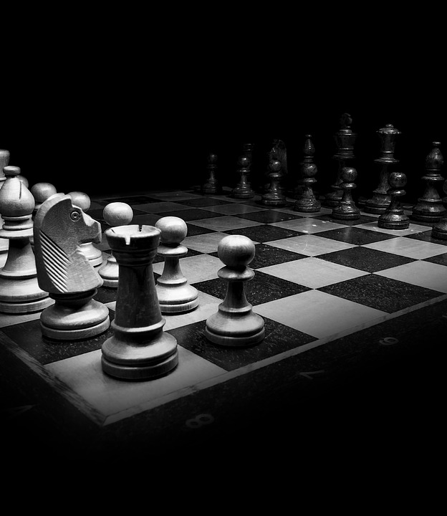
Introduction to Chess
Origin & Rules
Chess is a strategic game
that has been played for centuries.
It originated in India,
and spread to the world.

Slide 5
Designing the Chess Game Structure
Functional-Oriented Chess Game
The chess game structure is designed using functional-oriented programming principles.
There are variables and functions for the board, players, pieces, and moves.
Each piece has specific value and functions to handle different aspects of the game.
For example, the board stores the current state of the chessboard and allows for validating moves.

Slide 6
Implementing Chess Logic
Code Implementation Overview
Move validation and capturing are key aspects of chess logic, ensuring the game follows proper rules.
Checkmate detection is crucial to determine the end of a game, identifying the winning player.
The code implementation involves defining chess piece movements and their constraints, allowing for strategic gameplay.

Slide 7
Functional Approaches:
Main Function : Starts the game by calling start game function.
Game Loop : Handles flow of game.
User Interface: Works with user accordingly.
Console and chessboard: Sets the program as the user wants.
Game Mode : Lets the user to choose type of game.
AI implementation : Makes a basic minimax approach for chess.
Utility Functions: Works as wherever needed.

Slide 8
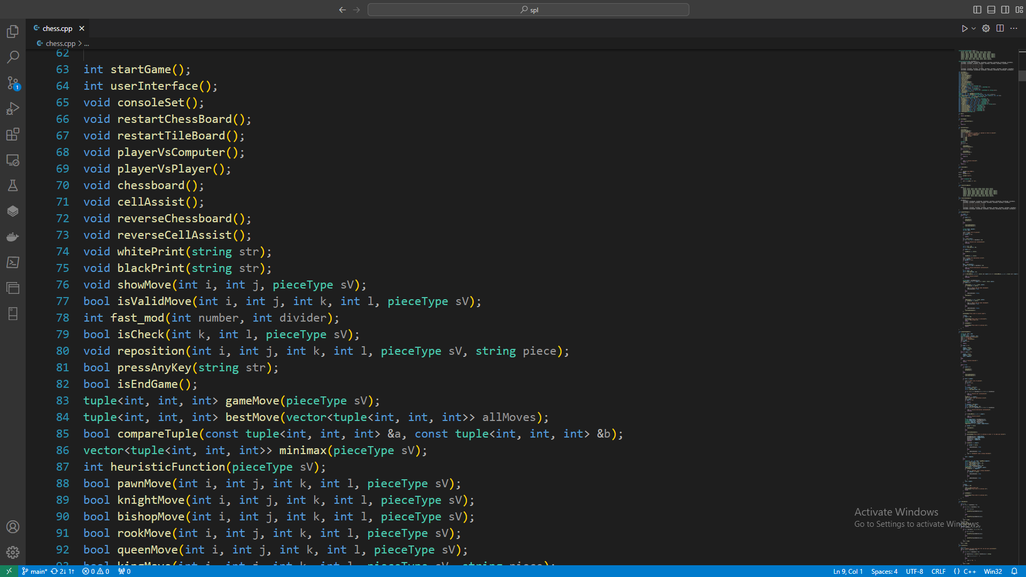

Slide 9
Understanding the Minimax Algorithm
Powerful Tool in Game Theory
The Minimax algorithm is used to find optimal moves in game theory.
It considers all possible moves and their consequences to determine the best move.
The algorithm works by minimizing the maximum possible loss.
For example, in chess, it can help a player choose the move that minimizes the opponent's maximum advantage.

Slide 10
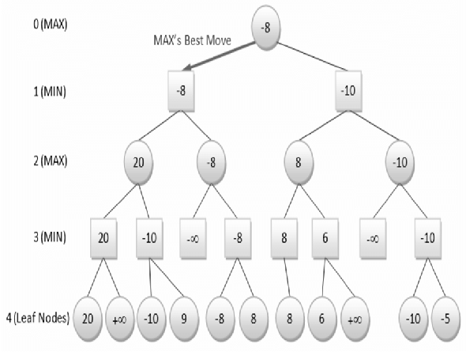
Minimax Algorithm

Slide 11
Applying Minimax to Chess
Intelligent Chess AI
The Minimax algorithm adapts to chess
Strategies for creating an intelligent AI
Implementing Minimax in chess engines
The time complexity of minimax is O(n^m) and the space complexity is O(n*m), where n is the number of legal moves at each point and m is the maximum depth of the tree.

Slide 12
Command Line based User Interface
Intuitive & Visually Appealing
Techniques for designing an intuitive interface involve minimizing clutter and providing clear navigation.
The interface should provide feedback to ensure players understand the game state and possible moves.

Slide 13
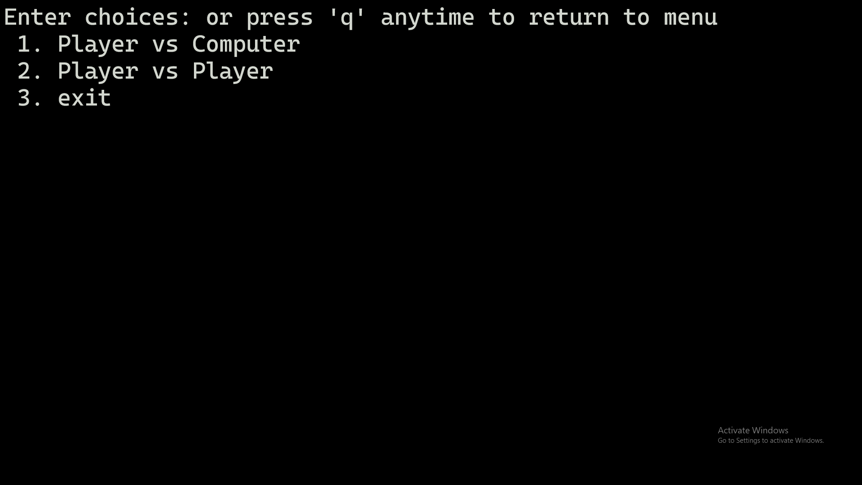

Slide 14
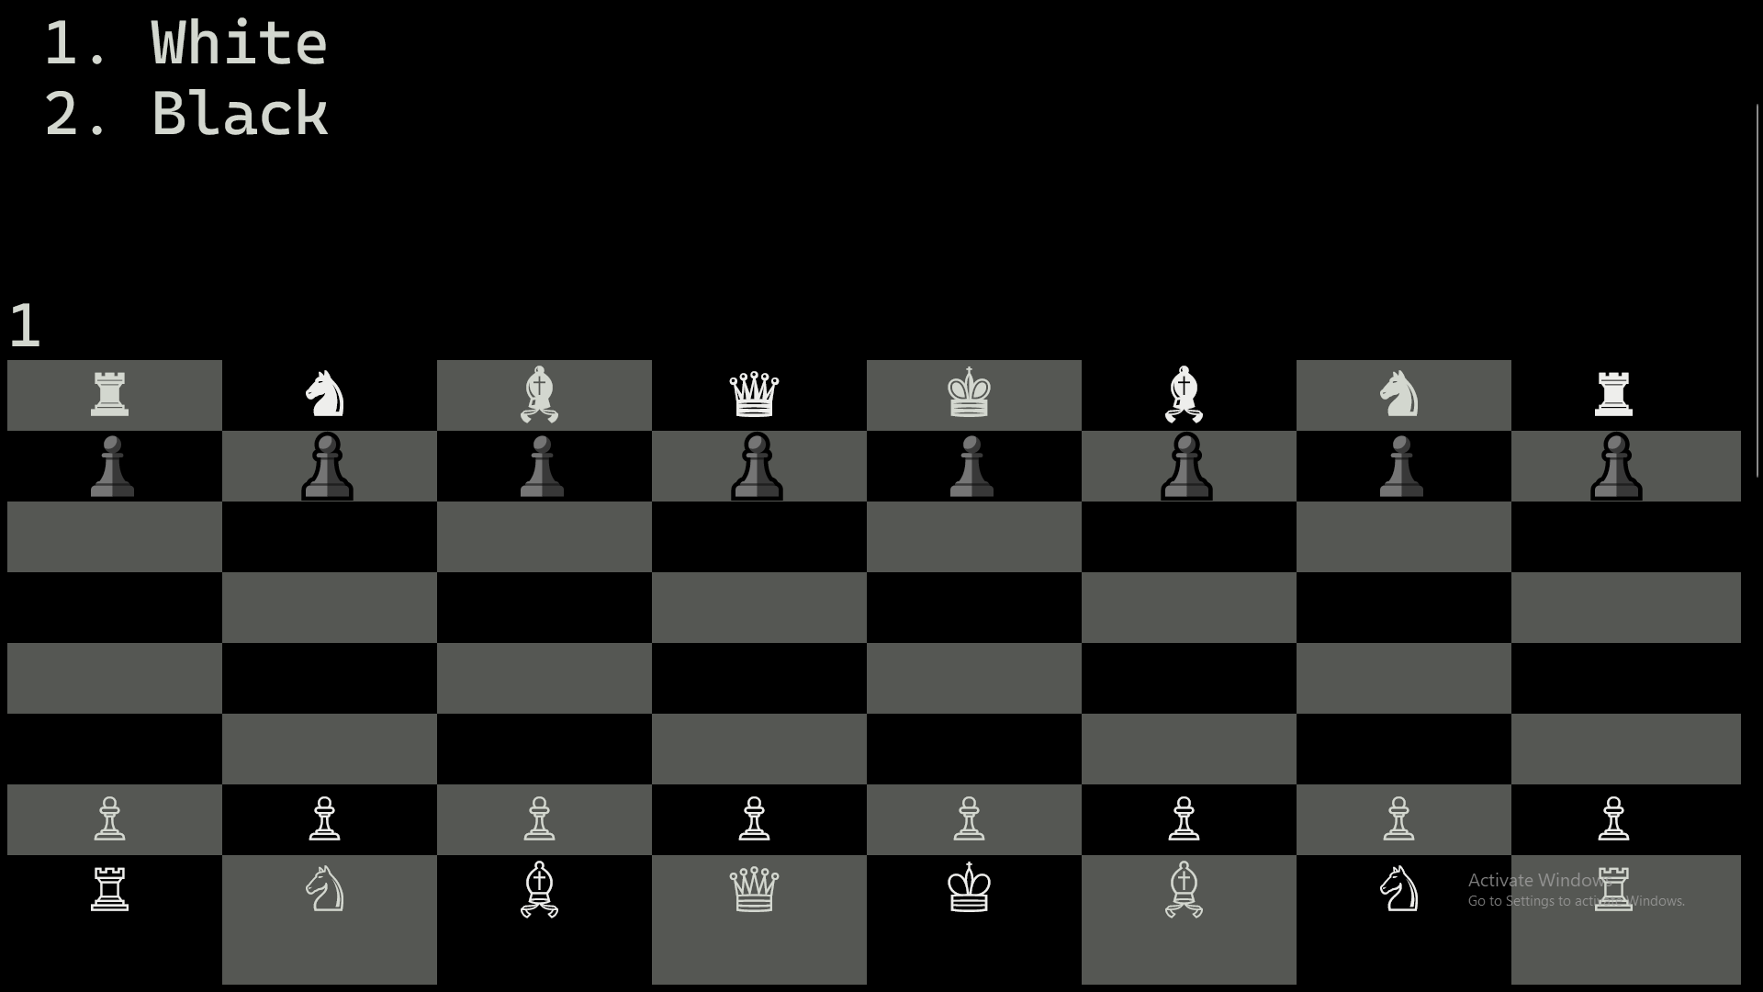

Slide 15
Features in the game
Command Line based user interface.
Basic chess board.
Different kind of moves for different pieces.
Conclusion based flow of the game.
Player vs Player mode.
Player vs Computer mode.

Slide 16
Testing and Debugging Chess Game
Strategies for Stability
Testing and debugging are crucial steps in ensuring the functionality and stability of the chess game.
Performing thorough testing helps identify and fix any issues or bugs that may arise during gameplay.
Debugging involves locating and fixing errors or faults in the code, ensuring smooth gameplay and preventing crashes or unexpected behavior.

Slide 17
Learnings from the project
Project planning.
Learning C++.
Algorithmic thinking.
User experience design.
Game development skills.
AI implementation.
Debugging and testing.
Surface of game theory.

Slide 18
Future Enhancements
Improvements and Optimizations
1. Implement additional game modes to provide more variety and challenges for players.
2. Optimize the AI algorithm to make it more intelligent and competitive.
3. Introduce a tutorial system to help new players learn the game and improve their skills.
4. Enhance the visual effects to create a more immersive gaming experience.
5. Introduce more advanced move .

Slide 19
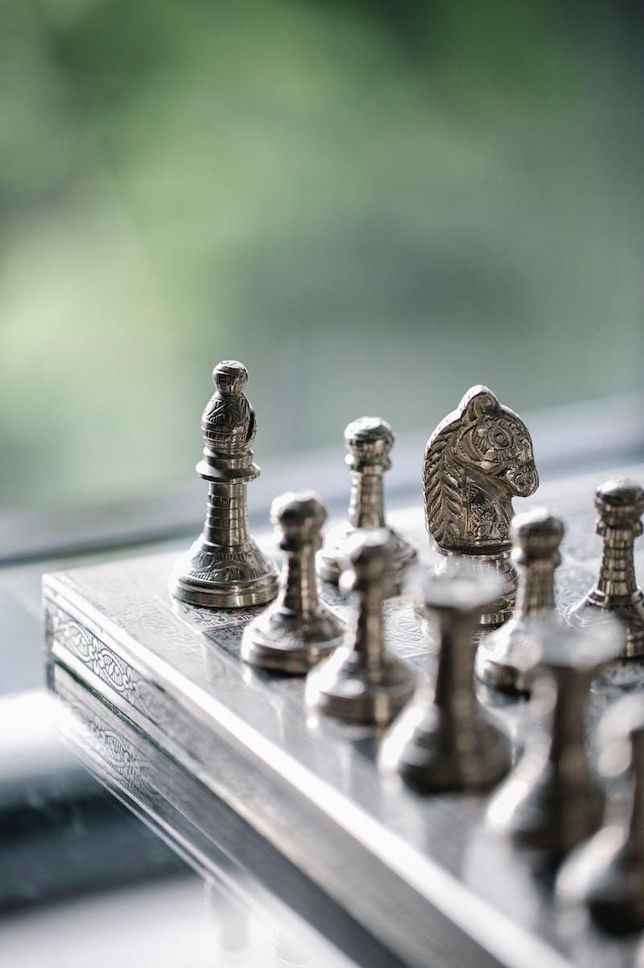
Conclusion
Playable Chess Game
The AI provides challenging gameplay.
The game supports multiple modes, including single-player against the computer. This ensures that players can enjoy the game however they prefer.
Overall, the developed chess game can captivate chess and introduce newcomers to the world of chess.

Slide 20
Thank you for your time and attention

