Slide 1
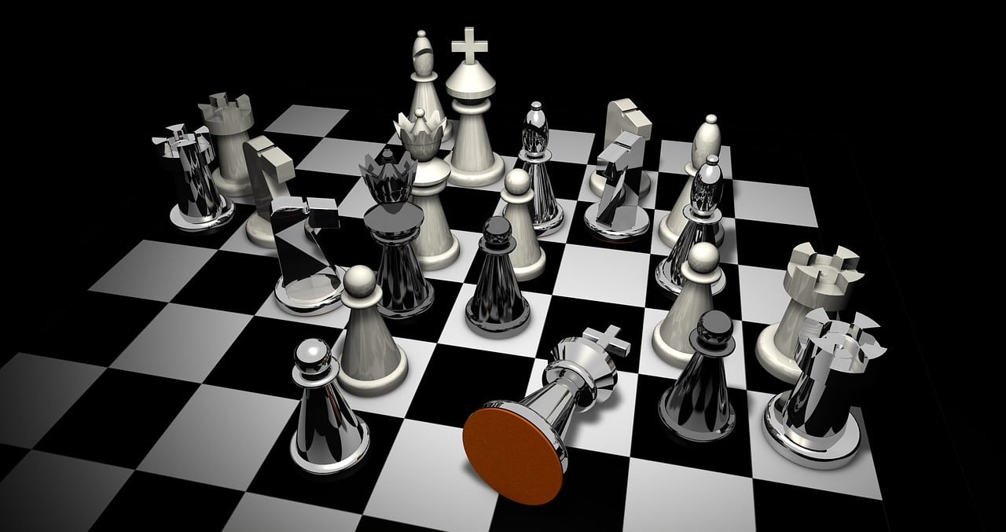
CHESS

Slide 2
About Chess
Chess is an abstract strategy game that involves no hidden information and no elements of chance. It is played on a chessboard with 64 squares arranged in an 8×8 grid. At the start, each player controls sixteen pieces: one king, one queen, two rooks, two bishops, two knights, and eight pawns. White moves first, followed by Black. The game is won by checkmating the opponent's king, etc. threatening it with inescapable capture. There are also several ways a game can end in a draw.

Slide 3
Why Chess ?
Being a gamer since childhood gave inspiration to make game in the project and no game is better for beginner than chess.

Slide 4
Feature
Board Representation:
A vector of vector to represent the chessboard and print it it accordingly.
Piece Movement:
Movement rules for each type of chess piece (king, queen, …., pawn) and validate move checking.
Turn Management:
Track of player's turn switch turns after each move.
Piece Capturing:
Remove captured pieces from the board.
Pawn Promotion:
Pawns to promote to other pieces if they reach the opponent's back rank.
Game State:
Track of the game's state, including whether it's ongoing, a draw, or checkmate.
Winning and Draw Conditions:
Checking for checkmate, stalemate, and the fifty-move rule.
User Interface (If enough time):
A text-based interface to facilitate user interaction.
AI Opponent (If enough time):
AI opponent for single-player mode using algorithms like mini-max or alpha beta pruning algorithm.

Slide 5
Current features:
Interface
There is a command line interface for the game.
Chessboard
Using a vector of vector a chessboard is visible.
Sides
Board will be represented by both sides.
Pawn
Pawns can move as their functionality in both sides.
Rook
Rooks can now partially move from one place to another.

