Slide 1
DIPLOMA THESIS
Capturing and Visualizing Provenance Information
Fenghong Zhang, Bsc.
Software Engineering and Internet Computing
e1425097@student.tuwien.ac.at
Notes:
<number>

Slide 2
Agenda
Introduction
Theoretical Basis
Reproducibility and Replication
Provenance and Ontology
Library Usages
Project Structure
Use Cases
Components
Sample Projects
Conclusion

Slide 3
Introduction – Motivation
Scientific workflows are clusters of computational tasks. The tasks of all the workflows sometimes need to be run several times due to various reasons. By using provenance we can capture all information of computational steps, and thus help scientists to discover and understand the reasons, why an experiment leads to inconclusive results.

Slide 4
Introduction—Current Situation
The Scientific workflow management tool, such as Taverna, Kepler, and VisTrails, if the workflows are appropriately designed, the provenance matches the experiment’s semantics quite good. However, they require a high learning effort and involve high adoption costs[1].
Noworkflow[2] is also a tool, which can systematically collects provenance from Python scripts, but it is a language related tool.

Slide 5
Introduction—Our Goal
Overcome the limitation such as high learning effort, high adoption costs and language related tool, and provide a stable and functionally enabled tool for scientific workflow provenance documentation.

Slide 6
Introduction—Research Questions
1. How to automatically track, monitor and capture system provenance information at a wide range and large scale.
2. How to transform the captured provenance data into provenance ontology.
3. How to present the structured ontology into a human-readable format with interaction possibilities.

Slide 7
Theoretical Basis—Reproducibility and Replication
Methods Reproducibility: Providing as much detail as possible about study procedure and enough data so the same procedures could theoretically or actually be exactly replicated.
Result Reproducibility: Receiving the same result form the execution of a separate study whose procedures closely match the original experiment. [3]

Slide 8
Theoretical Basis—Reproducibility and Replication
Reproducibility has the potential to serve as a minimum standard for judging scientific claims when fully independent replication of a study is not possible.[4]

Slide 9
Theoretical Basis—Provenance and Ontology
The tracking of the provenance metadata of the scientific workflows is starting at the point of their creation and ends with using the final results.

Slide 10
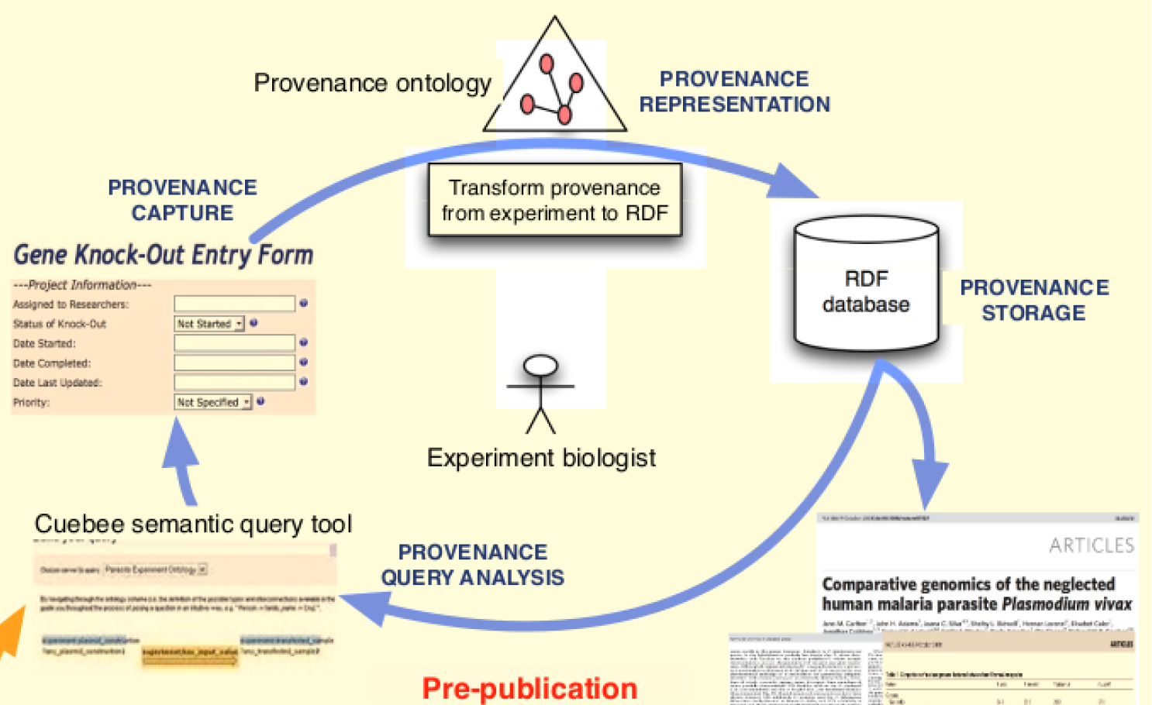
Theoretical Basis—Provenance and Ontology
Pre-publication is the state before the publication of the data and making the results publicly accessible by uploading it to a data repository.[5]

Slide 11
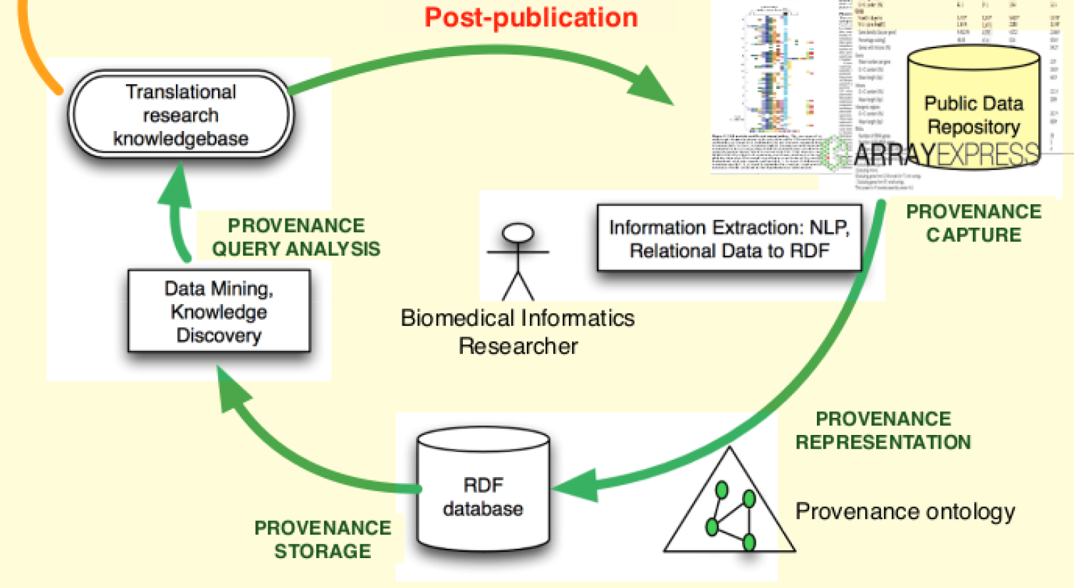
Theoretical Basis—Provenance and Ontology
Post-publication describes the phase, when the results are used for data mining or knowledge discovery.

Slide 12
Theoretical Basis—Provenance and Ontology
Before choosing which data has to be stored, we must define how data has to be structured so that they can be later recovered and understood. [6]
Computational ontologies are a means to formally model the structure of a system.

Slide 13
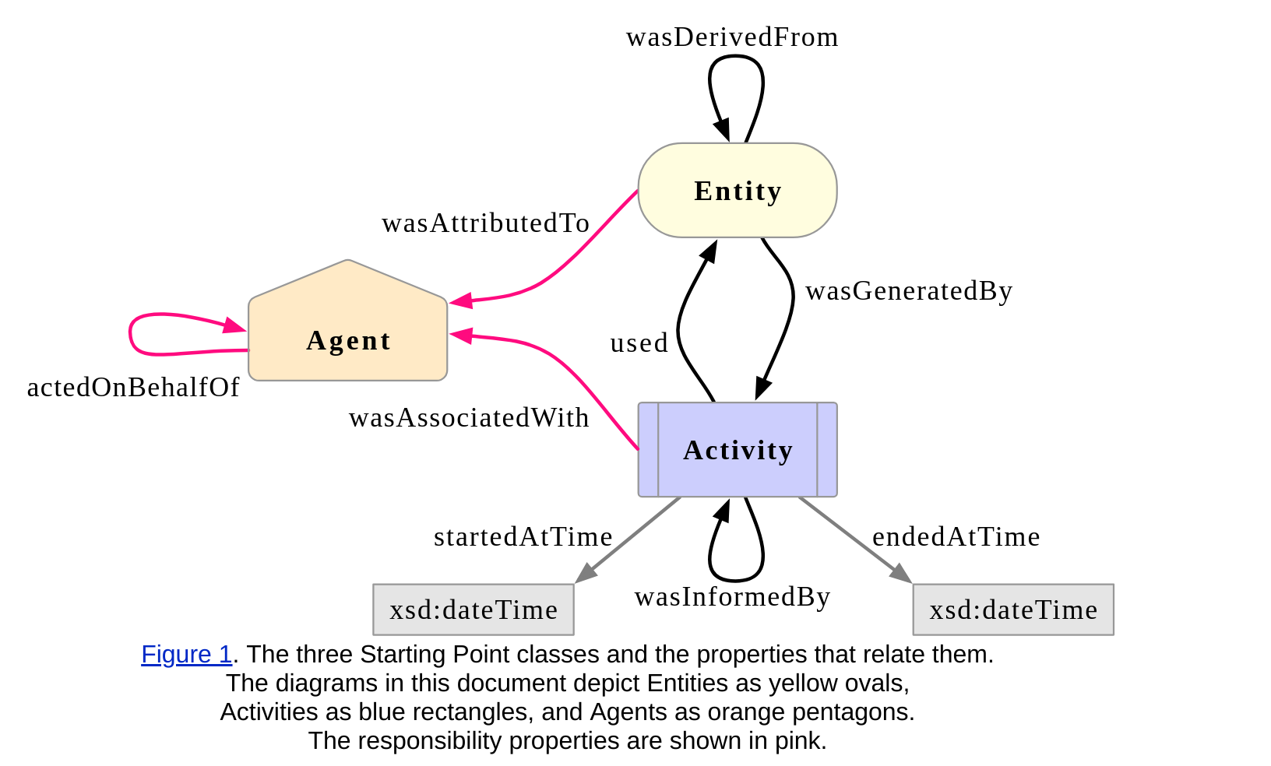
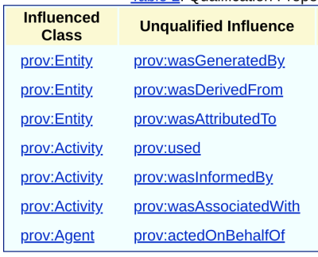
Theoretical Basis—Provenance and Ontology
Prov-o is provided by W3C with specifications as the first official standard for tracking provenance metadata.

Slide 14
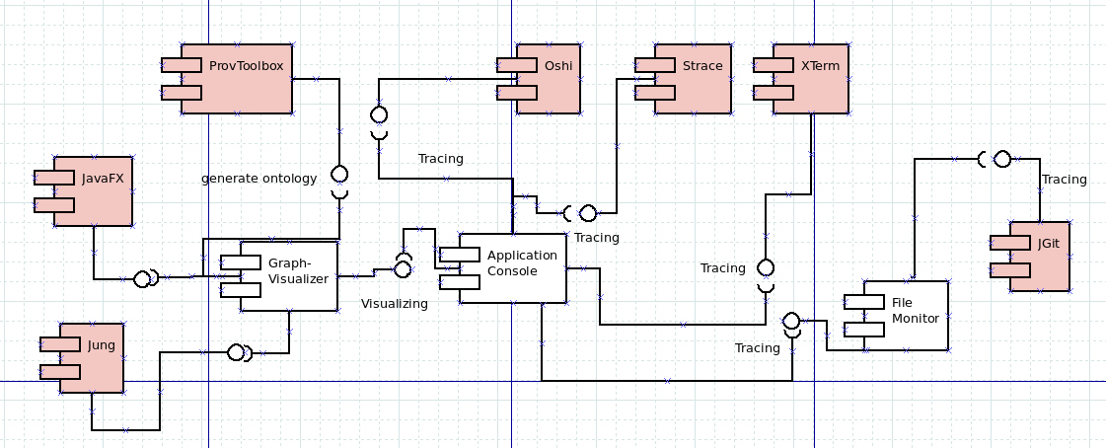
Library Usage

Slide 15
Library Usage
JGit is a Java framework with very few dependencies, and hence, it is becoming the appropriate API for embedding in any Java application.
ProvToolbox is a Java library to create Java representations of PROV-DM, and convert them between RDF, PROV-XML, PROV-N and PROV-JSON.
Strace is a diagnostic, debugging and instructional tool for Linux. It is used to monitor and control interactions between processes and the Linux kernel.
Oshi is a free Java API for collecting, retrieving and gathering information about the operating system and hardware.
Jung is an open-source Java library, it provides a common and extendable language for the modeling, analysis, and visualization of data that can be represented as a graph or network.

Slide 16
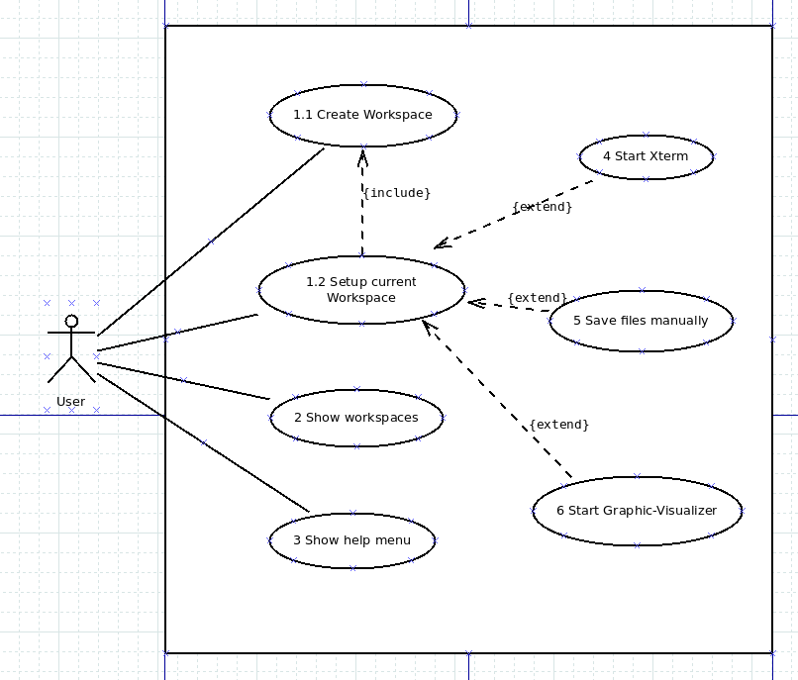
Project Structure—Use Cases

Slide 17
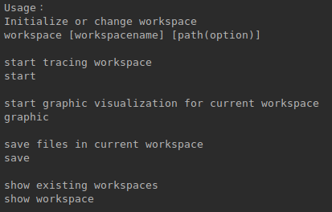
Project Structure—Components

Slide 18
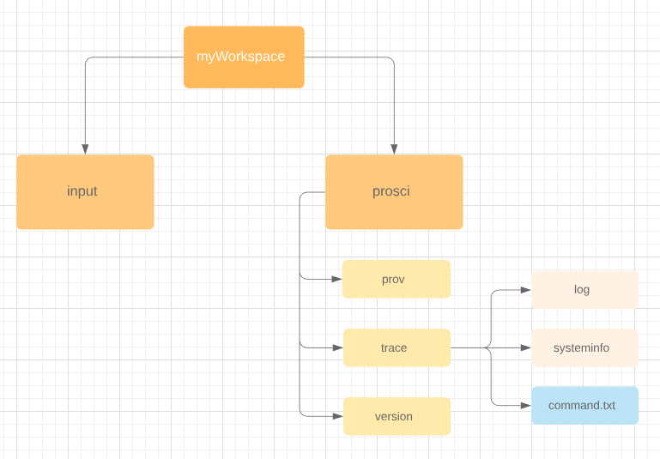
Project Structure—Components

Slide 19
Project Structure—Components
Functions:
1. Show the workflow of the experiment with the ontology structure in a diagram.
2. Reload the historical data.
3. Search for the element of the ontology presentation on the graph.

Slide 20
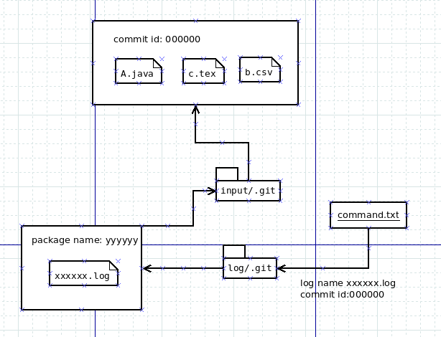
Project Structure—Components

Slide 21
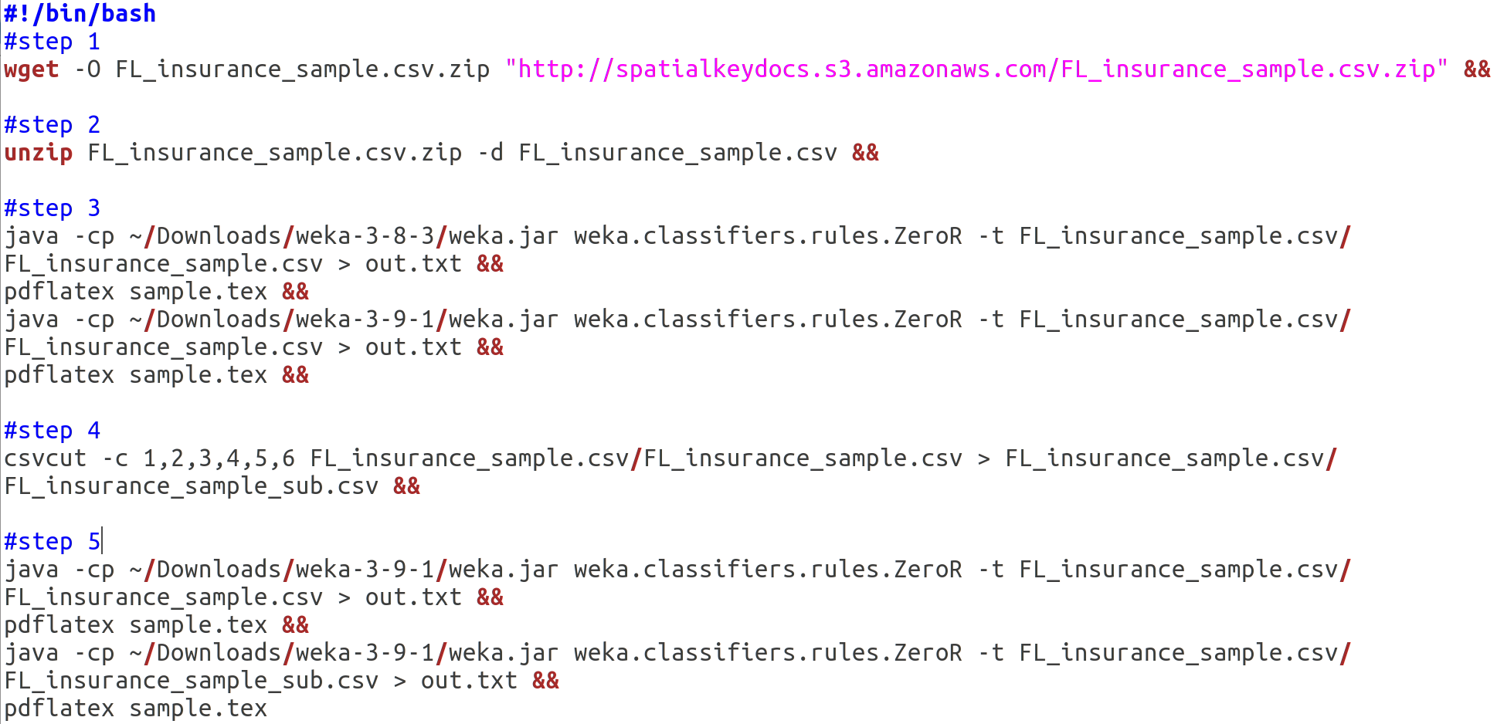
Sample Project

Slide 22
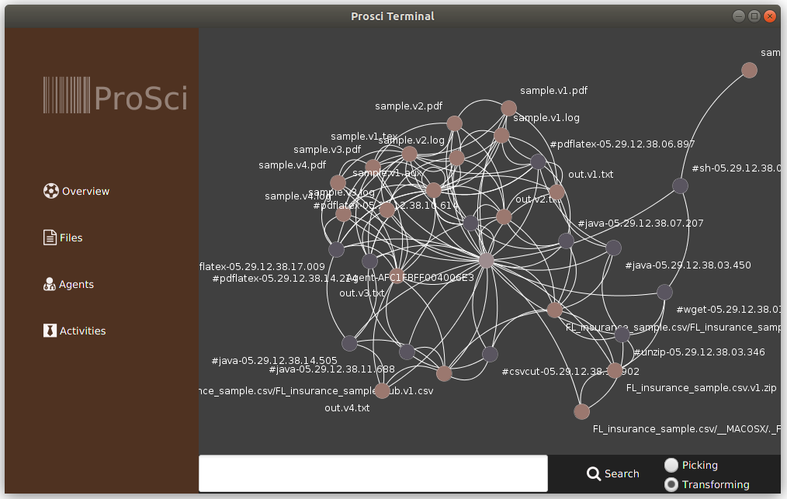
Sample Project

Slide 23
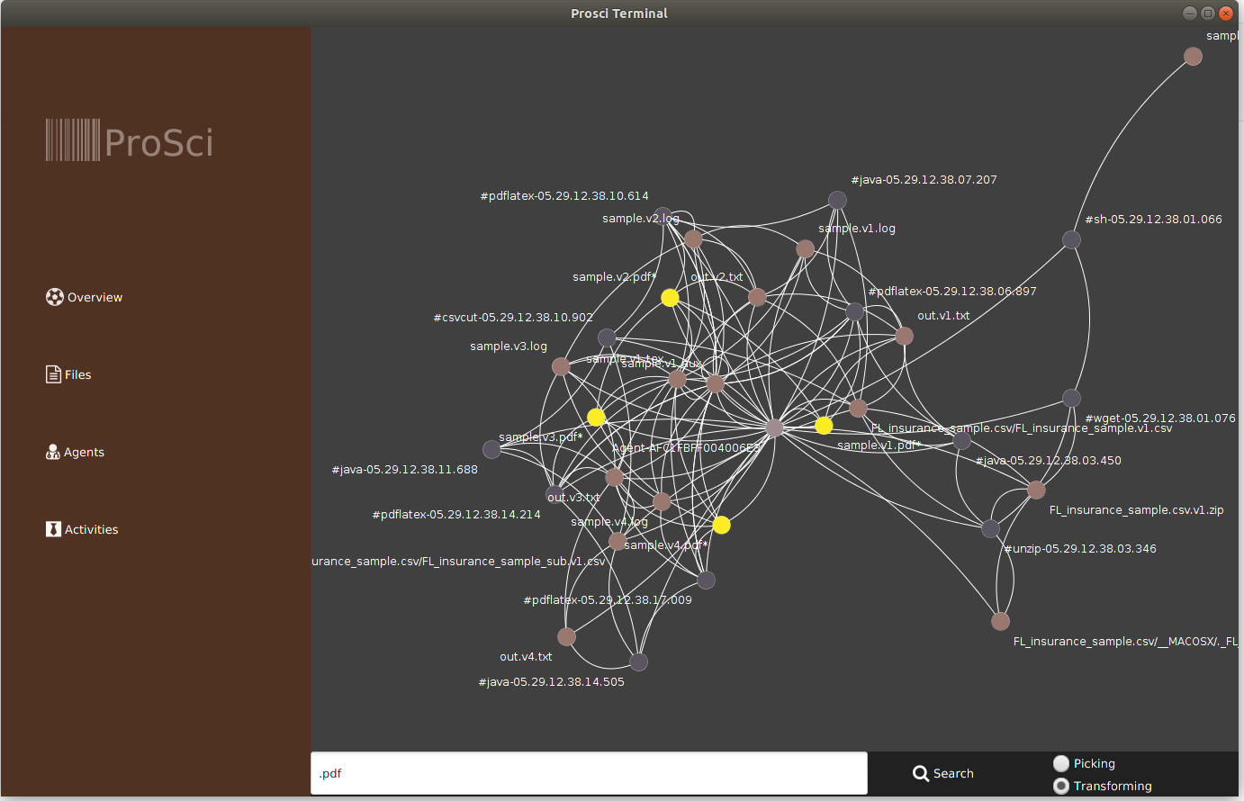
Sample Project

Slide 24
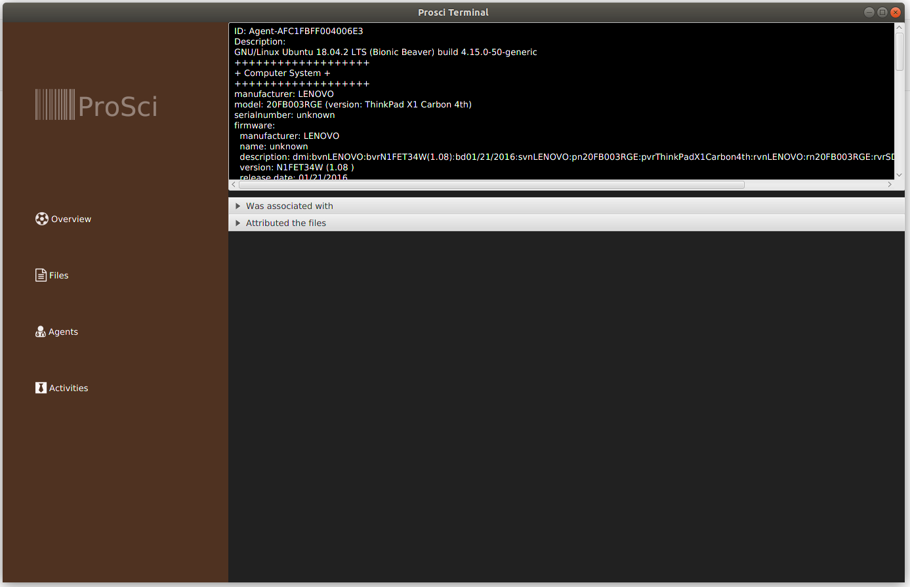
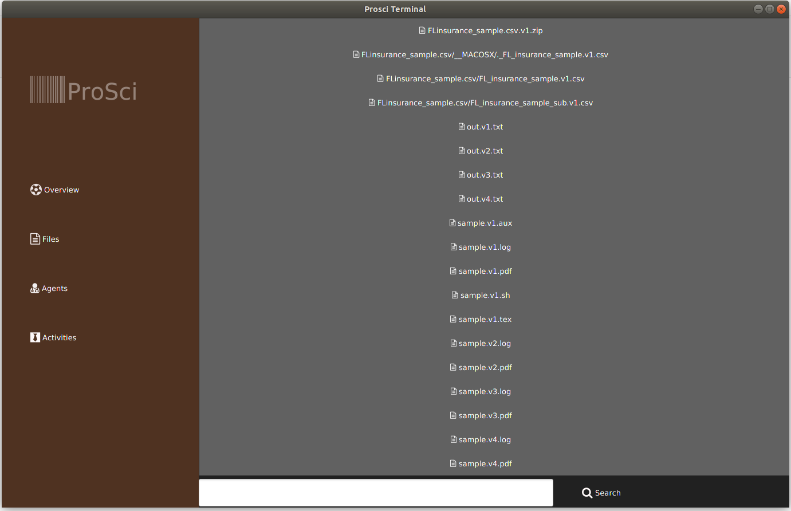
Sample Project

Slide 25
Conlusion
Recalling the research questions, we want to obtain provenance information without manual steps, and make it fully automatic. The solution to this requirement is a combination of Strace, JGit and Oshi.
By using ProvToolbox we are able to transform the provenance information into the W3C official standard.
The interaction possibility of the ontology is achieved by using JavaFX, Jung and Java DOM.

Slide 26
Conlusion
However the limitations of the project are listed as following:
1. the project is only supported on the Linux System.
2. the dependencies on external tools, such as Xterm and Strace limit the extensibility.
3. “command.txt” serves as a dictionary for pairing files and commands. The retrieving method can be improved.
4. no automated replication of scientific workflows is embedded.

Slide 27
Iterature
1. Carlos Scheidegger, Huy T. Vo, David Koop, Juliana Freire, and Claudio
Silva. Querying and re-using workflows with vstrails. pages 1251–1254, 01
2008.
2. João Felipe Pimentel, Leonardo Murta, Vanessa Braganholo, and Juliana
Freire. noworkflow: A tool for collecting, analyzing, and managing provenance
from python scripts. Proc. VLDB Endow., 10(12):1841–1844, August
2017.
3. Steven N. Goodman, Daniele Fanelli, and JohnP. A. Ioannidis. What does
research reproducibility mean? Science Translational Medicine, 8:341ps12–
341ps12, 2016.
4.Roger D. Peng. Reproducible research in computational science. Science,
334(6060):1226–1227, 2011.
5. Satya S Sahoo, Vinh Nguyen, Olivier Bodenreider, Priti Parikh, Todd
Minning, and Amit P Sheth. A unified framework for managing provenance
information in translational research. BMC bioinformatics, 12(1):461, 2011.
6. Renato de Paula, Maristela Holanda, Luciana S. A. Gomes, Sérgio Lifschitz,
and Maria Emilia Telles Walter. Provenance in bioinformatics workflows. In
BMC Bioinformatics, volume 14 Suppl 11, 2013.

