Slide 1
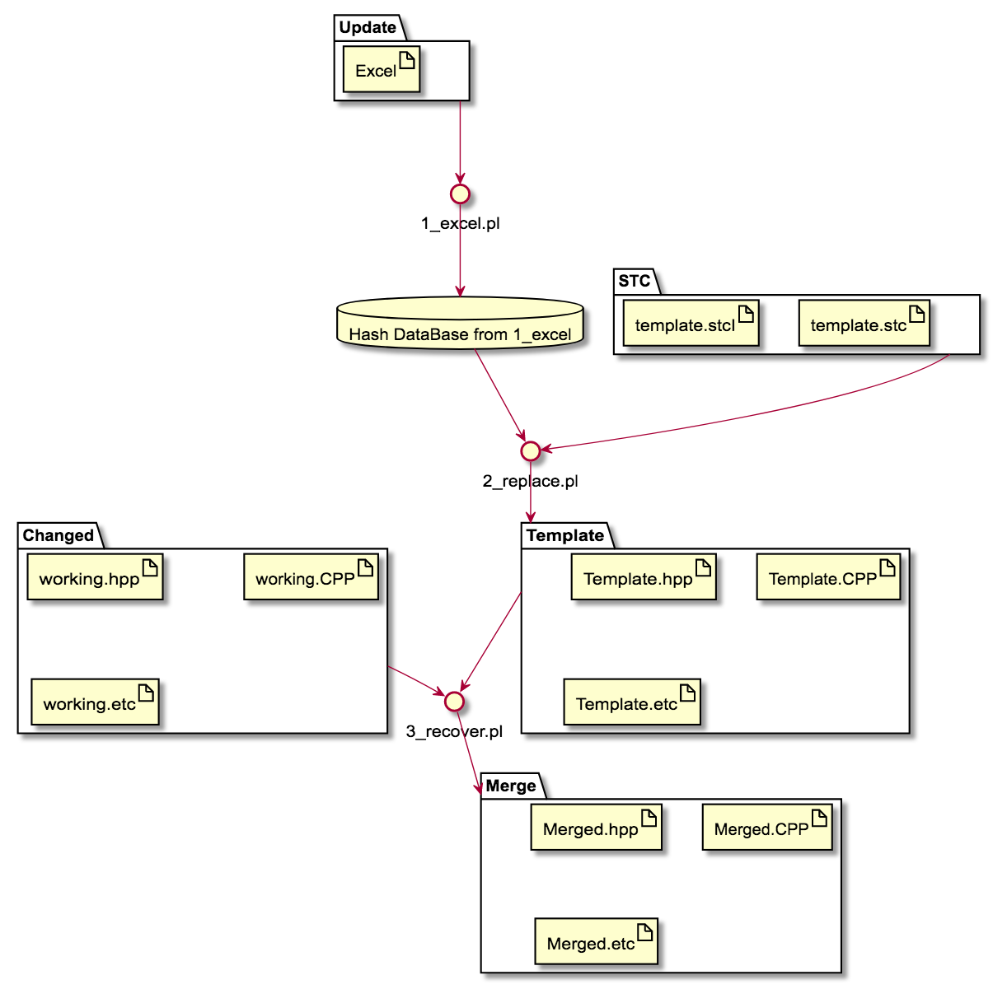
CGA_RDL Architecture

Slide 2
Syntax of stc (template)
Replacement Syntax : Print value of variable.
+<+$variable+>+
Example)
Database : $hash{“ABC”} = 123
Stc (Template file) :
printf(“%d”,+<+ $hash{“ABC”} +>+ );
Output :
printf(“%d”,123 );
Conditional Syntax : Print statements… if true , But print nothing if false.
IFEQUAL(+<+$Related_Manager{vif}{VALUE}+>+ eq "O") +{{+
statements….
+}}+
Example)
Database : $hash{“ABC”} = 123
Stc (Template file) :
IFEQUAL(+<+$hash{ABC}+>+ eq 123) +{{+
statements….
+}}+
Output :
statements

Slide 3
Syntax of stc (template)
Loop Syntax : replace hash key and value iterately
ITERATE %hash +<<+ ITKEY ITVALUE
statements….
+>>+
Database :
$MODULE{telltale}{LEFT}{MODULE} = telltale
$MODULE{telltale}{LEFT}{DPID} = LEFT
$MODULE{telltale}{LEFT}{duration} = 70
$MODULE{telltale}{LEFT}{x1} = 50
$MODULE{telltale}{LEFT}{y1} = 100
$MODULE{telltale}{RIGHT}{MODULE} = telltale
$MODULE{telltale}{RIGHT}{DPID} = RIGHT
$MODULE{telltale}{RIGHT}{duration} = 500
$MODULE{telltale}{RIGHT}{x1} = 4
$MODULE{telltale}{RIGHT}{y1} = 40
$MODULE{vif}{CAN}{MODULE} = vif
$MODULE{vif}{CAN}{DPID} = CAN
$MODULE{vif}{CAN}{duration} = 700
$MODULE{vif}{CAN}{x1} = 7
$MODULE{vif}{CAN}{y1} = 70
Stc (Template file) :
ITERATE %MODULE +<<+ ITKEY ITVALUE
ITKEY ->
ITERATE %MODULE{ITKEY} +<<+ IT2KEY IT2VALUE
IT2KEY
+>>+
+>>+
Output :
telltale ->
LEFT
RIGHT
vif ->
CAN

Slide 4
Syntax of stc (template)
Explanation of Loop Syntax
Database :
$MODULE{telltale}{LEFT}{MODULE} = telltale
$MODULE{telltale}{LEFT}{DPID} = LEFT
$MODULE{telltale}{LEFT}{duration} = 70
$MODULE{telltale}{LEFT}{x1} = 50
$MODULE{telltale}{LEFT}{y1} = 100
$MODULE{telltale}{RIGHT}{MODULE} = telltale
$MODULE{telltale}{RIGHT}{DPID} = RIGHT
$MODULE{telltale}{RIGHT}{duration} = 500
$MODULE{telltale}{RIGHT}{x1} = 4
$MODULE{telltale}{RIGHT}{y1} = 40
$MODULE{vif}{CAN}{MODULE} = vif
$MODULE{vif}{CAN}{DPID} = CAN
$MODULE{vif}{CAN}{duration} = 700
$MODULE{vif}{CAN}{x1} = 7
$MODULE{vif}{CAN}{y1} = 70
Database :
$MODULE{telltale}{LEFT}{MODULE} = telltale
$MODULE{telltale}{LEFT}{DPID} = LEFT
$MODULE{telltale}{LEFT}{duration} = 70
$MODULE{telltale}{LEFT}{x1} = 50
$MODULE{telltale}{LEFT}{y1} = 100
$MODULE{telltale}{RIGHT}{MODULE} = telltale
$MODULE{telltale}{RIGHT}{DPID} = RIGHT
$MODULE{telltale}{RIGHT}{duration} = 500
$MODULE{telltale}{RIGHT}{x1} = 4
$MODULE{telltale}{RIGHT}{y1} = 40
$MODULE{vif}{CAN}{MODULE} = vif
$MODULE{vif}{CAN}{DPID} = CAN
$MODULE{vif}{CAN}{duration} = 700
$MODULE{vif}{CAN}{x1} = 7
$MODULE{vif}{CAN}{y1} = 70
Database :
$MODULE{telltale}{LEFT}{MODULE} = telltale
$MODULE{telltale}{LEFT}{DPID} = LEFT
$MODULE{telltale}{LEFT}{duration} = 70
$MODULE{telltale}{LEFT}{x1} = 50
$MODULE{telltale}{LEFT}{y1} = 100
$MODULE{telltale}{RIGHT}{MODULE} = telltale
$MODULE{telltale}{RIGHT}{DPID} = RIGHT
$MODULE{telltale}{RIGHT}{duration} = 500
$MODULE{telltale}{RIGHT}{x1} = 4
$MODULE{telltale}{RIGHT}{y1} = 40
$MODULE{vif}{CAN}{MODULE} = vif
$MODULE{vif}{CAN}{DPID} = CAN
$MODULE{vif}{CAN}{duration} = 700
$MODULE{vif}{CAN}{x1} = 7
$MODULE{vif}{CAN}{y1} = 70
ITKEY will replace with $MODULE’s key -> telltale , vif
IT2KEY will replace with $MODULE{telltale} and $MODULE{vif}’s key -> LEFT RIGHT CAN
Stc (Template file) :
ITERATE %MODULE +<<+ ITKEY ITVALUE
ITKEY ->
ITERATE %MODULE{ITKEY} +<<+ IT2KEY IT2VALUE
IT2KEY
+>>+
+>>+
telltale ->
ITERATE %MODULE{telltale} +<<+ IT2KEY IT2VALUE
IT2KEY
+>>+
vif ->
ITERATE %MODULE{vif} +<<+ IT2KEY IT2VALUE
IT2KEY
+>>+
LEFT
RIGHT
telltale ->
LEFT
RIGHT
vif ->
CAN
CAN

Slide 5
How to map between excel and template file(.stc, .stcI)
Excel
First column decides the name of hash.
When this column includes [HEADER] , this column will be keys of multi-dimensional hash.
So it is more dimensional hash than 2.
[HEADER]MODULE | [HEADER]DPID | duration | x1 | y1
telltale | LEFT | 70 | 50 | 100
telltale | RIGHT | 500 | 4 | 40
vif | CAN | 700 | 7 | 70
Each Column name will be the last key of multi-dimensional hash
Database :
$MODULE{telltale}{LEFT}{MODULE} = telltale
$MODULE{telltale}{LEFT}{DPID} = LEFT
$MODULE{telltale}{LEFT}{duration} = 70
$MODULE{telltale}{LEFT}{x1} = 50
$MODULE{telltale}{LEFT}{y1} = 100
$MODULE{telltale}{RIGHT}{MODULE} = telltale
$MODULE{telltale}{RIGHT}{DPID} = RIGHT
$MODULE{telltale}{RIGHT}{duration} = 500
$MODULE{telltale}{RIGHT}{x1} = 4
$MODULE{telltale}{RIGHT}{y1} = 40
$MODULE{vif}{CAN}{MODULE} = vif
$MODULE{vif}{CAN}{DPID} = CAN
$MODULE{vif}{CAN}{duration} = 700
$MODULE{vif}{CAN}{x1} = 7
$MODULE{vif}{CAN}{y1} = 70

Slide 6
Summary of process
Database :
$MODULE{telltale}{LEFT}{MODULE} = telltale
$MODULE{telltale}{LEFT}{DPID} = LEFT
$MODULE{telltale}{LEFT}{duration} = 70
$MODULE{telltale}{LEFT}{x1} = 50
$MODULE{telltale}{LEFT}{y1} = 100
$MODULE{telltale}{RIGHT}{MODULE} = telltale
$MODULE{telltale}{RIGHT}{DPID} = RIGHT
$MODULE{telltale}{RIGHT}{duration} = 500
$MODULE{telltale}{RIGHT}{x1} = 4
$MODULE{telltale}{RIGHT}{y1} = 40
$MODULE{vif}{CAN}{MODULE} = vif
$MODULE{vif}{CAN}{DPID} = CAN
$MODULE{vif}{CAN}{duration} = 700
$MODULE{vif}{CAN}{x1} = 7
$MODULE{vif}{CAN}{y1} = 70
<input> Excel
[HEADER]MODULE | [HEADER]DPID | duration | x1 | y1
telltale | LEFT | 70 | 50 | 100
telltale | RIGHT | 500 | 4 | 40
vif | CAN | 700 | 7 | 70
<input> stc or stcI (template)
Stc (Template file) :
ITERATE %MODULE +<<+ ITKEY ITVALUE
ITKEY ->
ITERATE %MODULE{ITKEY} +<<+ IT2KEY IT2VALUE
IT2KEY
+>>+
+>>+
CGA_RDL
<output>
telltale ->
LEFT
RIGHT
vif ->
CAN

