Slide 1

Travelling Courier
The complete courier transfer partner

Slide 2

Project Demo

Slide 3

Team Lambda Members: Naveen Vemuri Ramyanath Chakraborty Ganesh Narayanan

Slide 4
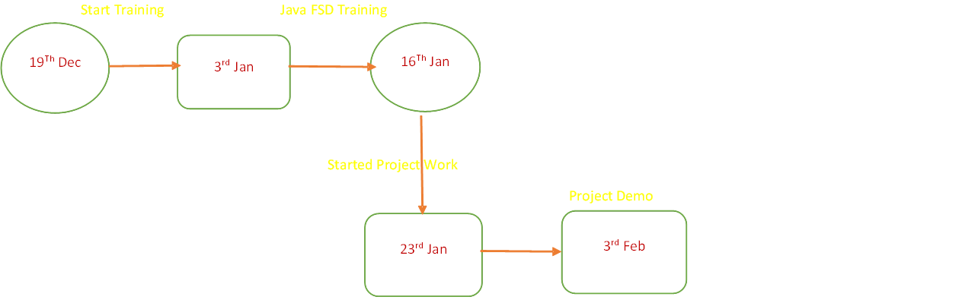
Travel Courier Service Journey

Slide 5

Learning Phase
Backend
Spring Boot
Microservices
DB
MySQL
Devops
Docker
Kubernetes
Cloud
AWS
Eks, Ecs,

Slide 6
Problem statement
This project aims to create an application that allows travelers to deliver items or packages on behalf of others while they are traveling from place A to place B.
Travelers can update their travel details, including the source, destination, date and time of departure and arrival, in the application.
If someone wants to deliver an item or package to the destination that the traveler is going to, they can contact the traveler and transfer the items to be delivered in the destination without depending on a courier company.

Slide 7

Tech Slack and Architecture

Slide 8





Backend & DB

Slide 9





DevOps/Cloud -AWS

Slide 10
Flow Diagram

Slide 11
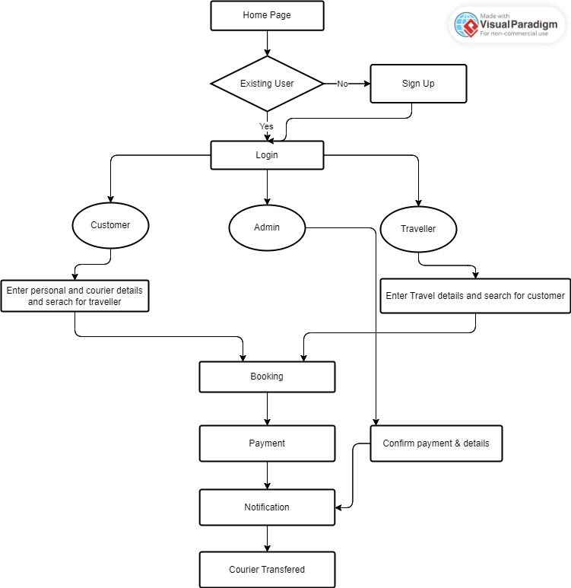

Slide 12

Backend Architecture Diagram

Slide 13
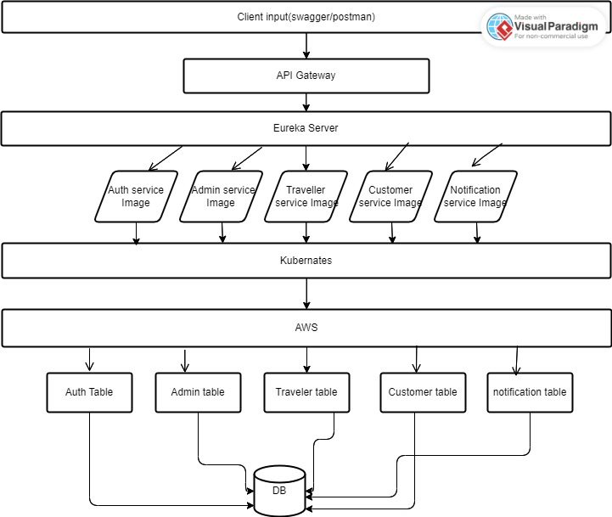

Slide 14

Db Details

Slide 15
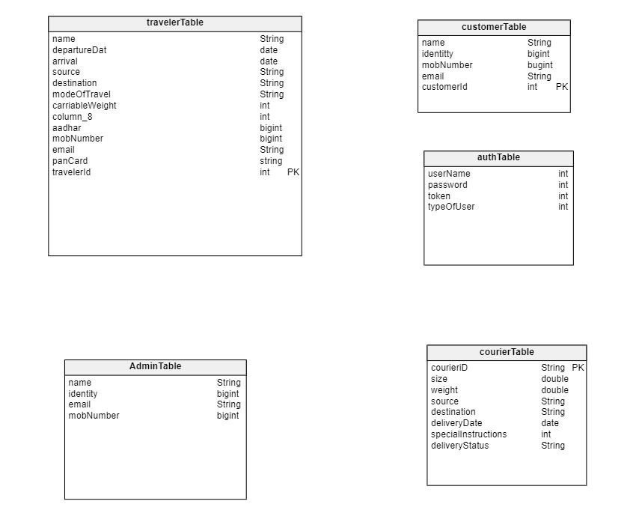

Slide 16

Code presentation

Slide 17

Cloud Architecture

Slide 18
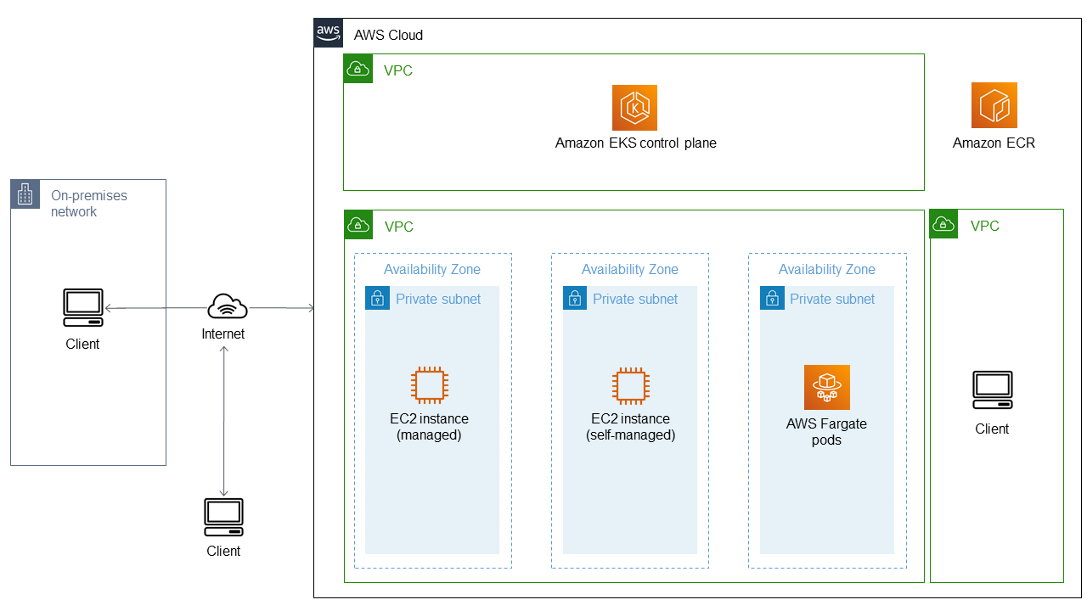

Slide 19
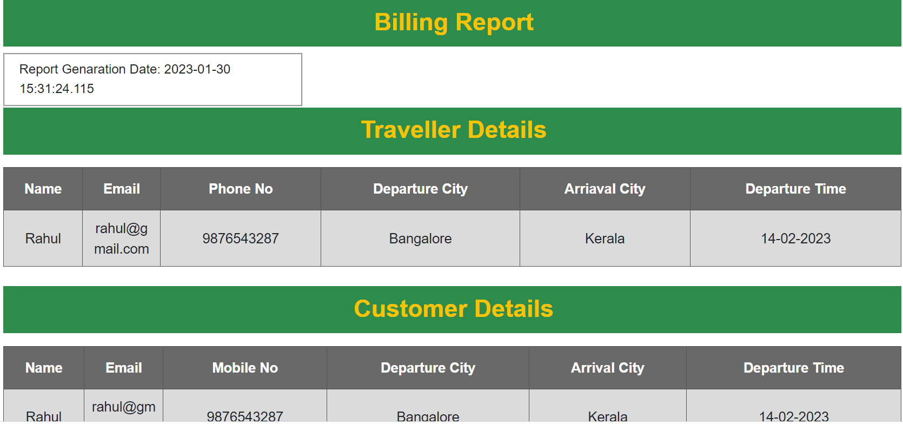
Bill Sample

Slide 20

Challenges
Working with AWS services.​
Achieving optimal code coverage.​
Integrating with the AWS platform.​

Slide 21
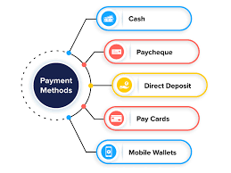



Future Scope

Slide 22

Performance NFRs
Design Documentation
Payment Implemented
1
6
Microservice Response Time
Logging in All Services
2
7
Architecture Implemented
Search Operation
3
8
Secure Access Over HTTP
Booking &Bill Generation
4
9
Eureka Server, Cloud Gateway
Email Notification
5
10

Slide 23

Conclusion

Slide 24
POC Testimonial​
Working with the team was always fun, the team always carried a learning mindset and stayed focused throughout. And these folks have undergone rigorous training and then a product development phase which has developed their problem-solving mindset.

Slide 25
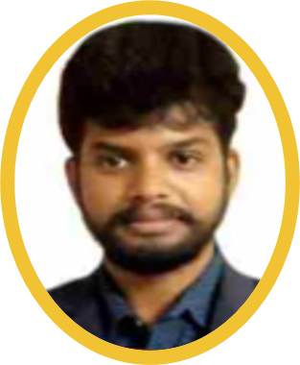
Trainer Testimonials
​Kudos to the team for completion of their Entire Training Program. I have seen aggressiveness and proactiveness to work on the area of improvement whenever needed. Appreciate to the entire team to achieve the Training Goal and expectation together. Each of the team members has developed the different Core values like Inclusive Collaboration, Learning Mindset, Partnering for client impact, Engaging with Openness. Congratulations to each one of you. Proud of you My Team. Best of luck each one of you.

Slide 26
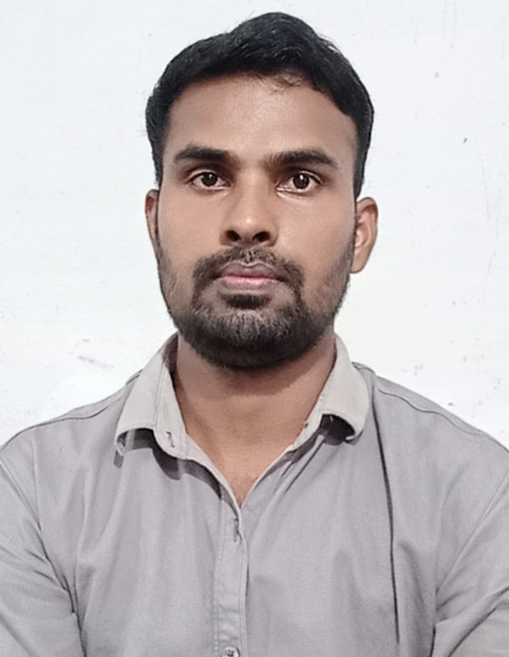

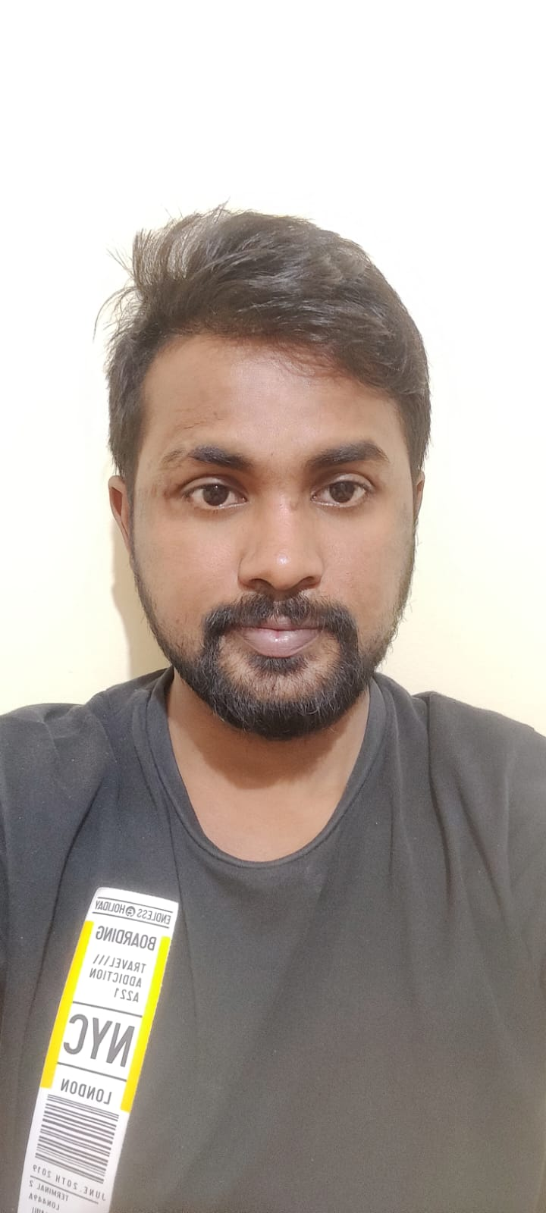
Team Testimonials​
It was a great learning experience. As scrum master I learned about the technologies and the project by coordinating with each team .Thank you to the entire team for the good collaboration during the whole training.​
Overall , It was a great experience . It was challenging journey but learned a lot of new technologies, what are industry standards. and also learnt how real projects works.​
It was a great experience . It was challenging journey but learned lot of new technologies, Kudos to the entire batch for engaging with the whole project. Thank you all.​

Slide 27

Thank You

