Slide 1
AI Research Evidence Analyzer
LOCAL RAG PROTOTYPE · RESEARCH PAPER Q&A
The practical problem
Research papers are long. Readers must locate the relevant evidence and check whether a generated answer is actually supported by the source.
A Local, Evidence-Grounded RAG Prototype for Research Papers
Objective
Build a local prototype that retrieves relevant paper passages and produces traceable, evidence-grounded answers.
Durga Bhavani Pathina
Prepared for University of North Florida research faculty
Question
Retrieved passages
Cited answer or abstention
https://github.com/143durga/AI-Research-Evidence-Analyzer
Notes:
[~1 min] Opening. I'm Durga Bhavani Pathina. This is a small local prototype I built for asking questions about a single research paper and getting answers tied to passages in that paper.
The problem: papers are long, and when a tool generates an answer, a reader needs to know where it came from and whether the source really supports it. The objective is a local prototype that retrieves relevant passages and gives traceable, evidence-grounded answers.
Term to explain: RAG (retrieval-augmented generation) means the system first retrieves relevant text from the paper, then gives that text to the language model as context for its answer.
Framing: this is a research prototype, not a finished product. I'd like to discuss how to evaluate it properly.
Likely questions:
- Why local? Local inference and vector storage avoid paid model API dependencies and keep the indexed paper text on the machine. (First-time setup may still download model and embedding assets, so I don't call it fully offline.)
- Is this novel? No. RAG is established. The value for me is a concrete system to study evidence grounding and its evaluation.

Slide 2
System Architecture
INDEXING · ONCE PER UPLOADED PAPER
Research Paper PDF
PDF Text Extraction
Text Chunking
Local Embeddings
ONNX-based
ChromaDB Vector Store
stored in data/chroma
QUESTION ANSWERING · PER QUERY
Answer with Evidence Citations / Abstention
Local Qwen Model
Qwen2.5-1.5B-Instruct Q4_K_M via llama.cpp
Similarity-Based Retrieval
upload PDF
shown to user
question
Streamlit interface · upload PDF · ask a question · inspect answer and cited passages
How RAG connects the paper to the answer
Caution
The question is matched against indexed passages; the best matches are given to the model as context, so its answer can be traced to cited pages.
A citation shows what an answer drew on. It does not guarantee the answer is correct.
Notes:
[~1.5 min] Walk the diagram. Top row is indexing, done once per uploaded paper: the PDF's text is extracted, split into chunks, converted into embeddings with a local ONNX-based model, and stored in ChromaDB, saved locally under data/chroma.
Bottom row is per question: the question retrieves similar chunks from ChromaDB; those passages go to a local Qwen2.5-1.5B-Instruct model (4-bit quantized, Q4_K_M), run through llama.cpp. The output is either an answer with evidence/page citations, or an abstention if adequate evidence is not retrieved. Streamlit is the user interface.
Terms:
- Chunking: splitting extracted text into passage-sized pieces so they can be searched individually.
- Embedding: a numeric vector representing a passage's meaning; similar text gives nearby vectors.
- Vector store (ChromaDB): a database that finds the nearest vectors to a query.
- Quantization: storing model weights at lower precision (here 4-bit) so a model runs on modest hardware, at some cost in quality.
- llama.cpp: a C/C++ inference engine for running such models locally.
- Abstention: the system declines to answer instead of guessing.
Be explicit: citations do NOT guarantee correctness. A cited passage may not support the claim, and retrieval may miss the right passage.
Likely questions:
- What chunk size, retrieval depth, or abstention threshold? Check the repository for the exact settings before the meeting and state them from the code; I do not quote numbers I haven't verified.
- How does abstention work? It is a designed behavior when adequate evidence isn't retrieved; how reliable it is has not been evaluated (see slide 4).

Slide 3
Implementation and Design Decisions
1
PDF upload and text indexing
2
Chunks and vector retrieval
Engineering trade-off
Extracts paper text and stores it for search
Searchable chunks retrieved by similarity
Small quantized local model
Benefit
No paid model API dependency; local inference
3
Question answering
4
Evidence and page citations
Answers use the retrieved passages as context
Intended to support verification, not to prove correctness
Cost
Limited answer quality and reasoning capability
5
Abstention
6
Local inference and storage
Research prototype. Not production-ready, not security-reviewed, and not shown to eliminate hallucination.
Declines when adequate evidence is not retrieved
Qwen via llama.cpp; vectors kept in data/chroma
Notes:
[~1 min] These are the capabilities that are implemented: PDF upload and text indexing; searchable chunks with vector retrieval; question answering from retrieved passages; evidence and page citations meant to help a reader verify; abstention when adequate evidence is not retrieved; and local model inference with local vector storage.
The main design decision is the trade-off on the right. A small quantized local model avoids paid API dependencies and keeps inference and vector storage local, but it limits answer quality and reasoning. I chose it deliberately for a low-cost, reproducible prototype, and I treat its weaknesses as something to measure, not hide.
Scope statement: this is a prototype. I am not claiming production readiness, comprehensive security, or that hallucination is eliminated. Model and embedding assets may need to be downloaded during first-time setup.
Likely questions:
- Why not a larger model or an API? Cost and local control for this stage. I have not run a controlled comparison across models, so I cannot say how much quality is lost; that is a natural future experiment.
- How do you handle privacy? PDF text and vectors are stored locally in data/chroma. I have not done a security review, so I don't claim comprehensive security.
- What if retrieval returns nothing relevant? The design intent is abstention, but how reliably it does so still needs testing.

Slide 4
Evaluation and Current Findings
70
Passed
05 / 10 / 11
2
automated tests passed
Python compilation check
pilot verifier: papers / questions / page-verified evidence passages
local-model pilot experiments documented in the repository
What these checks show
What they do not show
The code's tests and compilation check pass
Pilot dataset evidence passages are exact and page-verified
Two pilot experiments are documented in the repository
General model accuracy or scientific validity
Citation correctness or answer correctness
Abstention reliability
Validated evidence passages are not independently verified answer quality.
Notes:
[~1.5 min] These are engineering checks and pilot-evaluation results. I want to be careful about what they mean.
Verified results:
- Automated test suite: 70 tests passed.
- Python compilation: passed.
- Pilot dataset verifier: 10 papers, 10 questions, and 11 exact, page-verified evidence passages validated.
- Two local-model pilot experiments are documented in the repository.
What this means: the software behaves as its tests expect, and the pilot dataset's reference evidence passages are exact and verified against the recorded pages. What it does NOT mean: these are not accuracy measurements. I am not reporting accuracy, precision, recall, F1, significance tests, or model comparisons, because I have not run an evaluation designed to produce them. Validating the evidence passages in the dataset is different from independently verifying the quality of the model's answers.
Citation correctness, answer correctness, and abstention reliability each need an appropriately designed evaluation, which is the research direction on the next slide.
Likely questions:
- What is the accuracy? I don't have a defensible number yet, and I'd rather say so than quote one.
- What did the pilot experiments find? Describe only what the repository documents, and treat them as exploratory with a small dataset. Review the repository write-ups before the meeting so you can summarize them accurately.
- Is 10 papers enough? No. It is a pilot dataset for checking the pipeline and the evaluation setup, not for general claims.

Slide 5
Limitations, Future Work, and Research Fit
Current limitations
Future research
Small local model may generate incomplete or incorrect answers
Retrieval may miss relevant passages
Citation presence does not necessarily prove citation support
Pilot datasets and evaluation are limited
Further independent human evaluation is required
Measure retrieval quality and answer correctness with a predefined protocol
Evaluate citation support and unsupported claims
Test abstention on answerable and unanswerable questions
Compare prompting or retrieval strategies under controlled conditions
Improve reproducibility; document experimental limitations
Research interest
I want to study when evidence-grounded language models can be trusted, connecting trustworthy AI, RAG evaluation, software testing, and evidence-grounded generation.
https://github.com/143durga/AI-Research-Evidence-Analyzer
Notes:
[~1 min] Limitations first, stated plainly: the small local model can produce incomplete or incorrect answers; retrieval can miss relevant passages; a citation being present does not prove it supports the claim; the pilot datasets and evaluation are limited; and independent human evaluation is still needed.
Future research is mostly about measurement: define an evaluation protocol in advance and use it to measure retrieval quality and answer correctness; evaluate citation support and unsupported claims; test abstention with both answerable and unanswerable questions; compare prompting or retrieval strategies under controlled conditions; and improve reproducibility while documenting experimental limitations.
Close with research interest: this project connects trustworthy AI, RAG evaluation, software testing, and evidence-grounded language models. I'm looking for opportunities to learn how to evaluate such systems rigorously. The repository link is on the slide. (Do not imply any professor has agreed to supervise you or that an assistantship is in place.)
Likely questions:
- What would your first experiment be? A small labeled set of answerable and unanswerable questions, with human judgments of whether each cited passage actually supports each claim.
- How does software testing relate? The same ideas apply: define expected behavior, build test oracles for non-deterministic outputs, and measure failures systematically.
- What is your own contribution? Describe only what you built and can show in the repository.

Slide 6
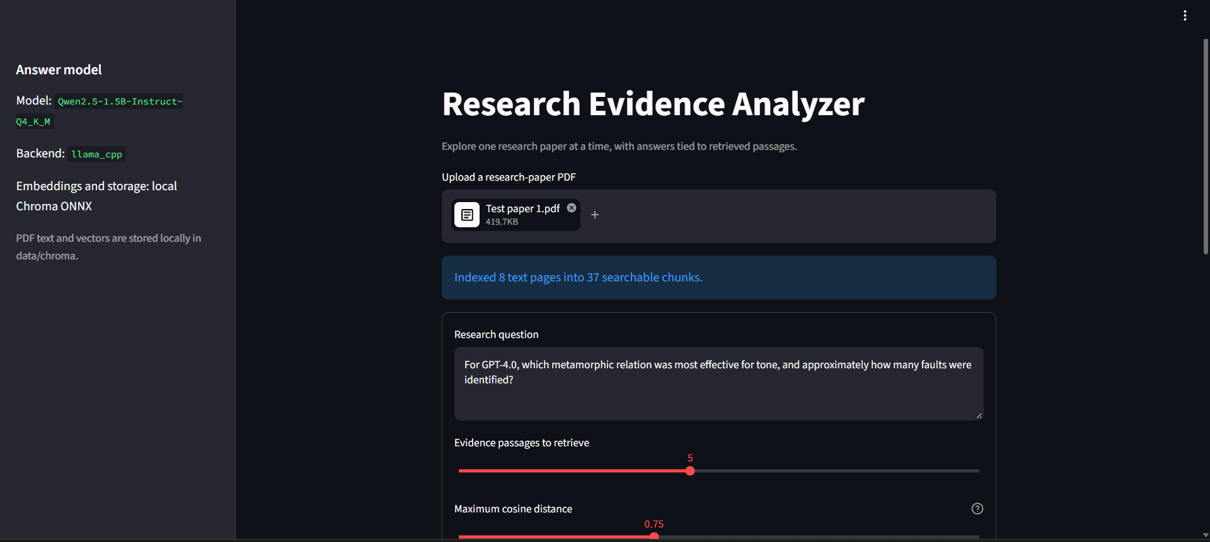

Slide 7
