Slide 1
Operation Leg Day
A Database Project using Gym Membership Model
By Miriam Ekiye, Cody Noack, Jesse Schultz, Yalcin Taf, Zachary Nabors, Johnathan Molina, David Holder, Ethan Bowles, Ederick Mendoza

Slide 2
Overview
Project aims to build a client application to allow new or existing gym members to create, alter, or remove their account from the gym database.
The goal of the project is to make the application effective, easy to use and understand to prevent confusion.

Slide 3
Users Involved
Manager/employee can make changes and edits to the application by;
Adding new member accounts
Changing membership tiers
Search for existing accounts from the database
Members can;
Can delete their account
Change what activities they have access to
Change account information

Slide 4
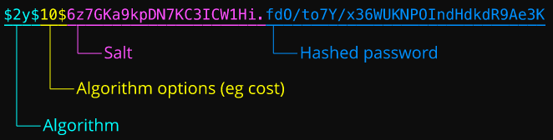
Passwords
Bcrypt – All passwords are hashed in Bcrypt function for security
Bcrypt is a secure hash function with a 184-bit hash value. Bcrypt salts your hashes automatically. You can get different hashes from the same input password because Bcrypt also creates a random string (the salt) to hash along with the input password. Bcrypt can re-hash an attempted password to see if it matches the stored hash, therefore can never be decrypted.

Slide 5
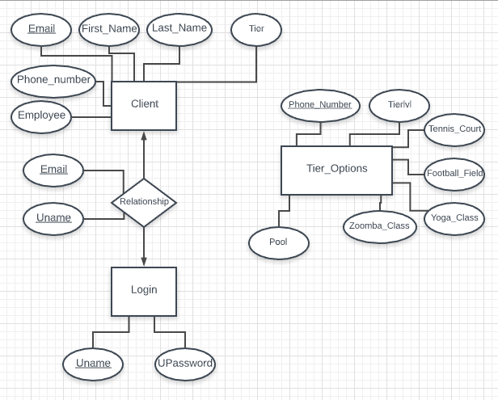
E-R Diagram

Slide 6

Programs Used
PostgreSQL – Relational Database Management System to hold our tables Version 11.6
Code standard: Java (JDK 11.0.5)
Server hosted on Virtual Machine
Design Tool: Eclipse IDE > Java Windowbuilder/Swing Designer

Slide 7
Login Panel

Slide 8
User Update Panel

Slide 9
User Delete

Slide 10
User Selecting Tier Options

Slide 11
Employee Create New User

Slide 12
Employee Search Panel

Slide 13
Work Distribution
Graphical User Interface – Cody and Ederick
Search function – Yalcin and Miriam
Methods of Insertion – Zachary
Updating User Accounts – Jesse and John
Deleting User Accounts – Ethan and David

Slide 14
Future work
Revising ER diagram by setting and changing Prices for tier options
Change the design for the program
Switch to a web-client model
Add an edit function and a deletion function for employees (only available for members)
Users be able to change password
Add a function to record login dates/time
Add an alert to remind members about when they can change their activities

Slide 15
Conclusion
We believe that our project has the necessary features required to effectively run the database smoothly.
We also believe that anyone who uses this program will find it straightforward and simple to operate.
Overall the program came out superb to user/members, even though employees are not required to delete/make changes to user accounts.

Slide 16
Fin
QnA
Anyone?
!!!

