Slide 1


Lexius
By: Anmol Shukla

Slide 2

Lexius: Advanced Legal Advisory AI
Comprehensive software requirements and specifications for Lexius, a transformative legal advisory AI tool designed to empower stakeholders.
By: Anmol Shukla

Slide 3





Anmol Shukla
Backend, Database, Model, Docker, NLP for the application and its configuration.
MEET THE TEAM
Meet the Lexius Team
Your Ai-Legal Advisor Team
Adarsh Pandey
Android application and its configuration.
Abhinandan Shukla
Frontend

Slide 4


WEB APPLICATION PURPOSE
Purpose of Web Application
An Overview of the Objectives and Key Features of the Web Application for Legal Content Exploration
Purpose
1. Advanced Search Functionality
2. Readable Data Display
To provide a robust and accessible platform for users to explore legal content on a wider screen, enhancing readability and research capabilities.
Offers sophisticated search and filter options to help users quickly find relevant legal articles and resources tailored to their needs.
Displays large chunks of data in a visually appealing and organized format, ensuring users can easily navigate through the information.
3. Resource Integration
4. Exporting Data
Integrates with various legal databases and case studies, providing comprehensive research tools to enhance user knowledge and understanding.
Supports features for exporting data or generating reports in formats such as PDFs, allowing users to save and share their findings effortlessly.

Slide 5

ANDROID APPLICATION PURPOSE
Purpose of Android Application
A Portable Solution for Legal Access
1
2
3
4
5
Purpose of the Application
Voice-Based Search
Offline Mode
Notifications for Updates
Lightweight and Optimized UI
The Android application is designed to provide users with convenient and interactive access to legal information while they are on the move. Its primary goal is to enhance accessibility and usability for individuals needing legal resources.
Leveraging advanced AI technology, the app features a voice-based search option, enabling users to quickly find legal information by simply speaking their queries, thus streamlining the research process.
Users can access previously saved legal content without an internet connection, ensuring that critical information is always available, regardless of location, which is especially beneficial in remote areas.
The app provides timely notifications regarding updates on relevant legal topics or changes in case law, allowing users to stay informed and responsive to evolving legal landscapes.
Designed specifically for mobile devices, the application's user interface is lightweight and optimized for performance, ensuring a smooth user experience that facilitates easy navigation and quick access to information.

Slide 6


WEB APP OVERVIEW
Web Application Scope
Exploring the Features, Audience, and Scalability of a Legal Web Application
1
2
3
4
Target Audience
Interactive Search
Cross-Referencing
Detailed Interface
Legal professionals, law students, and researchers seeking reliable legal information. Additionally, individuals looking for personal legal knowledge to navigate everyday legal matters.
Advanced filtering options that allow users to easily search through constitutional articles and legal documents, enhancing efficiency and accuracy.
Organized display of related laws and case precedents, providing users with comprehensive insights into legal contexts and connections.
Optimized for larger screens to facilitate better visualization of complex legal information, ensuring clarity in understanding intricate legal texts.
5
6
7
Collaboration Features
Use Cases
Scalability
Users can save, share, and export legal data in various formats, promoting collaborative work among legal professionals and students.
Quick access to precise legal information for professionals and students, as well as efficient preparation of reports or presentations on legal topics.
The application is designed to manage high traffic and future enhancements, such as integration with external databases and multilingual support, ensuring it grows with user needs.

Slide 7








LEGAL APP OVERVIEW
Android Application Scope
Exploring the Potential of Legal Mobile Solutions
Target Audience
Features
Use Cases
Scalability
Designed for on-the-go users, including legal practitioners and individuals seeking immediate legal assistance.
Key features include voice assistance for easy navigation, offline access for essential legal resources, timely notifications for updates, and a simplified user interface that prioritizes usability.
Ideal for accessing legal information during travel or in courtrooms, and for real-time support regarding urgent legal inquiries.
The app's lightweight architecture ensures compatibility with both older and newer Android devices, and future plans include integrating real-time legal advice through chatbots or direct messaging with attorneys.

Slide 8
Data Flow Diagram

Slide 9

Natural Language Understanding
Utilizes BERT to enhance the accuracy of processing legal queries, allowing users to interact in natural language.

Slide 10
Fast Search & Retrieval
Integrates Elasticsearch for rapid access to legal documents, ensuring users receive timely information.

Slide 11
Cross-Platform Integration
Enables seamless synchronization between the web and Android applications, providing users with flexibility and convenience.

Slide 12
Offline Access (Android)
Offers the ability to save essential legal content for offline use, ensuring access even without internet connectivity.

Slide 13
Frontend Technologies - Web
Developed using Node.js, JavaScript, HTML, and CSS to create a responsive and interactive user interface.

Slide 14
Frontend Technologies - Android
Built with Kotlin to leverage modern Android development practices and enhance user experience.

Slide 15
Backend Framework
Employs Flask API for managing server-side logic and handling requests efficiently.

Slide 16
NLP Tools
Incorporates TensorFlow and BERT for sophisticated natural language processing capabilities.

Slide 17
Search Functionality
Utilizes Elasticsearch to facilitate quick and efficient searches through large volumes of legal data.

Slide 18
Database Management
Stores comprehensive legal information and user data securely, ensuring data integrity and accessibility.

Slide 19

AI LEGAL ASSISTANT
Product Perspective
AI Lawyer Project Overview
1
Natural Language Understanding
2
Fast Search & Retrieval
3
Cross-Platform Integration
4
Offline Access (Android)
5
Frontend (Web)
Built using modern web technologies including Node.js, JavaScript, HTML, and CSS to create an intuitive user interface.
Utilizes BERT, a state-of-the-art NLP model, for precise processing of complex legal queries, enhancing accuracy and user satisfaction.
Incorporates Elasticsearch for rapid access to comprehensive legal documents, ensuring users receive timely and relevant information.
Seamlessly synchronizes data between web and Android platforms, providing a unified experience for users regardless of their device.
Enables users to download and store essential legal content for offline use, making legal information accessible anytime, anywhere.
6
Frontend (Android)
7
Backend
8
NLP Technologies
9
Search Capabilities
10
Database Management
Developed with Kotlin, ensuring a robust and responsive mobile application that enhances user interaction and performance.
Utilizes Flask API for efficient server-side management, ensuring smooth data handling and application performance.
Employs TensorFlow and BERT for advanced natural language processing, allowing for sophisticated understanding of legal terminology.
Leverages Elasticsearch to enhance search capabilities, allowing quick, effective retrieval of legal documents and data.
Incorporates a robust database system to securely store legal content and user data, ensuring efficient access and privacy.

Slide 20
AI LAWYER FEATURES
Product Functions of AI Lawyer Software
An Overview of Key Features
Query Input
Users can input queries in various formats including Act Names, legal or non-legal keywords, case titles, and natural language questions to retrieve relevant legal information efficiently.
Filtration of Data
The software provides advanced filtering options allowing users to narrow search results by judge name, date range, case category, and relevant acts, ensuring precise and relevant information retrieval.
Search Results
Results are organized in a tabular format, displaying crucial details such as list of cases, judgments, judges, acts cited, case categories, and dates of judgments, facilitating easy comparison and analysis.
Get Summarization
Users can access brief summaries of cases or documents in the search results, with a 'Read More' option available for detailed insights, enhancing user comprehension without the need to read full documents.

Slide 21

SOFTWARE ENVIRONMENTS
Operating Environment for AI Lawyer Software
Overview of Software Functionality Across Different Platforms
Web Application
Web Application Requirements
Android Application
The AI Lawyer software is accessible via a web application that operates on Linux OS, supporting browsers like Chrome, Firefox, Safari, and Edge. It utilizes a technology stack that includes HTML, CSS for the frontend, and Flask and Node.js for the backend, with Elasticsearch for efficient legal data retrieval.
Users must have a modern web browser with JavaScript enabled and a stable internet connection for real-time data access, along with SSL encryption to ensure secure interactions.
The Android application functions on Android OS versions 5.0 and above, utilizing Kotlin for development. It integrates Flask and Node.js for backend services and accesses Elasticsearch through API calls.
Android Application Requirements
Development Environment
Network Environment
To fully utilize the app, users need an Android device with version 5.0 or higher, stable internet access, and permissions for microphone and storage for voice input and offline data access.
Developers use a Linux OS environment featuring Python 3.x for backend services, Kotlin for Android development, Node.js for web applications, and Elasticsearch for data indexing and searching.
An internet connection is necessary for dynamic search results and data synchronization between the web and Android platforms. The Android app also supports offline mode for accessing saved legal documents.

Slide 22

SYSTEM ASSUMPTIONS
Assumptions and Dependencies
Understanding the foundational elements for system functionality
1. System Requirements:
3. Internet Connectivity:
The system is designed for a Debian-based Linux distribution, specifically versions 10/11 of Debian or Ubuntu. It is essential that the architecture is 64-bit and that adequate resources (CPU, RAM, and disk space) are available for optimal performance of machine learning models and real-time data queries.
An active internet connection is crucial for the application to retrieve and synchronize legal data, as well as to execute API requests for search results. This connectivity ensures that users have access to the most current information available.
1
3
4. NLP Model Size Assumption:
2. AJAX Communication Assumption:
The system assumes access to pre-trained NLP models like BERT, which require sufficient disk space and memory to function effectively. This assumption is vital for the application’s ability to process and analyze language data accurately.
AJAX technology is employed to facilitate asynchronous HTTP requests from the frontend to the backend, allowing for seamless updates to search queries, filters, and results without page reloads. This mechanism utilizes JavaScript for frontend interactions with a backend API built using Flask or Node.js.
4
2
5. Cross-Platform Communication:
The architecture is designed for seamless interaction between the web application and an Android app, both of which connect to the same backend. The web application utilizes AJAX for real-time communication, while the Android app leverages Retrofit/OkHttp for efficient backend communication.
5

Slide 23
USER INTERFACES
External Interface Requirements
Chapter 3: User Interfaces
1
2
3
User-Friendly Design
Search Box Functionality
Diverse Query Types
The AI Lawyer interface prioritizes user experience, ensuring intuitive navigation and accessibility for all users.
A comprehensive search box allows users to filter results by keywords, date, case type, judge, or category through chatbot prompts.
Users can select from four query types: Act Names, Keywords, Case Title, and Natural Language, enhancing search flexibility.
4
5
6
Instant Results Display
Detailed Case Summaries
Responsive Scrolling Experience
Search results are displayed dynamically and instantly, without the need for page reloads, facilitating quick information retrieval.
Each search result includes a 'Read More' option, providing users with a brief summary of the case for better insights.
Smooth scrolling allows results to load dynamically as users navigate, creating a responsive and interactive browsing experience.

Slide 24


Configuration Time
While the project installation itself may be quick, the configuration process can require significant time investment. Proper planning is essential to streamline this phase.
HARDWARE SETUP
Hardware Interfaces
NVIDIA Graphics Necessity
Utilizing NVIDIA graphics is critical as it simplifies and accelerates the configuration process, ensuring faster performance and compatibility with various software requirements.
Understanding the Importance of Hardware Configuration for Optimal Performance
CPU Configuration Requirements
Since the software version heavily relies on CPU capabilities, ensure that the CPU is configured correctly to avoid compatibility issues and harness full software potential.

Slide 25
SOFTWARE INTERFACES
Software Interfaces
Overview of Web, Mobile, and External Software Integrations
Web Application
External Software Integrations
Utilizes HTML, CSS, JavaScript, and AJAX for a dynamic user interface, while Flask or Node.js powers the backend for efficient API communication. Elasticsearch is employed for legal data storage, alongside SQL/NoSQL databases for managing user and session data.
Integrates with Elasticsearch for legal data management and employs advanced NLP tools like TensorFlow and spaCy to process natural language queries. Secure authentication is facilitated through OAuth and JWT, while cloud services such as AWS and Google Cloud provide necessary storage and backup solutions.
Mobile Application (Android)
Voice Search Capabilities
Developed using Kotlin, the mobile application leverages Retrofit for RESTful API calls and utilizes Room for optional local storage. Firebase is integrated for user authentication, ensuring a seamless experience on mobile devices.
Enhances user interaction by integrating voice search functionalities through APIs from Google Assistant or Amazon Alexa, making legal queries more accessible and user-friendly.
Data Visualization Tools
Utilizes visualization libraries such as Chart.js or D3.js to effectively display legal insights, making complex data comprehensible and visually appealing for better decision-making.

Slide 26
COMMUNICATION INTERFACES
Communication Interfaces
Exploring Various User Interaction Channels
1
2
3
Web Interface
Mobile Interface
Voice Search
Users engage through a web browser utilizing HTML, CSS, JavaScript, and AJAX, creating an interactive and responsive environment for seamless navigation and content delivery.
The mobile application developed for Android uses Kotlin and Retrofit for API calls, providing users with a native experience optimized for mobile devices.
Integration of voice search capabilities with Google Assistant or Amazon Alexa enables users to perform queries hands-free, enhancing accessibility and user experience.
4
5
6
Authentication
Data Sync
Search Results
Utilizing OAuth for secure logins and JWT for session management ensures a robust and secure authentication mechanism, protecting user data and privacy.
Real-time data synchronization is achieved through cloud storage solutions like AWS or Google Cloud, and Firebase, allowing users to access up-to-date information from any device.
AJAX technology facilitates instant search results and updates without the need for page reloads, providing a smoother and faster user experience.

Slide 27
FUNCTIONAL REQUIREMENTS
Functional Requirements
Overview of Query Types, Filters, and Read More Functionality
Query Types
Users can select from four query types: Act Names, Legal/Non-Legal Keywords, Case Titles, and Natural Language Query, facilitating tailored searches.
Date Filter
The date filter allows users to specify a start and end date for their search, ensuring relevant results within a desired timeframe.
Additional Filters
Users can refine their search results by applying filters such as Judge, Category, and Acts, utilizing available placeholders for precision.
Read More Functionality
Each search result appears as a card displaying tabular data. The 'Read More' button reveals a case summary, which can be collapsed back to hide details.

Slide 28




SYSTEM REQUIREMENTS
Performance and Security Requirements
Critical Aspects for System Efficiency and User Data Protection
Performance Requirements
The system must deliver search results within 2 seconds to maintain an optimal user experience, facilitating quick access to information.
Utilization of Technologies
Elasticsearch is implemented for rapid server-side indexing and querying, while Fuse.js improves responsiveness by managing efficient client-side search and filtering.
Security and Privacy Requirements
The system involves minimal privacy concerns due to the absence of sensitive personal information, reducing risks associated with data handling.
Data Protection Measures
To ensure secure user interactions, HTTPS encryption is employed along with JWT for effective session management, safeguarding data integrity during communication.

Slide 29
SYSTEM RELIABILITY
Reliability and Maintainability
Understanding Maintainability, User Feedback, and Reliability in Systems
Maintainability and Extensibility
Accuracy and Relevance
The system is structured for seamless updates and integration of new features, such as additional filters or more advanced analytics capabilities, ensuring minimal disruption to users and operations.
The system prioritizes delivering highly accurate and contextually relevant results, utilizing a threshold-based filtering system that ensures only those results meeting or exceeding a predefined similarity score are displayed.
1
4
Modular Coding Practices
Data Backup Mechanisms
2
By employing modular coding techniques, the system facilitates quick debugging processes and allows for flexibility, enabling it to efficiently adapt to future requirements and enhancements.
To ensure reliability, the system incorporates robust backup mechanisms designed to handle potential data loss scenarios, thereby maintaining consistent availability and protecting user data.
5
User Feedback Mechanism
In situations where users encounter no or low-quality matches, the system is designed to offer alternative query suggestions, enhancing user experience and maintaining engagement with the platform.
3

Slide 30
INSTALLATION STEPS
Installation Instructions Overview
Part II - Chapter 6: Installing dependencies
1
2
3
Environment Setup
Command to Create Environment
Backend Dependencies
Create and activate a virtual environment for the backend, such as 'atlantic_venv', to manage dependencies independently. This isolates project dependencies and avoids conflicts with global packages.
To set up the virtual environment, use the command: ```bash python -m venv atlantic_venv source atlantic_venv/bin/activate ``` This ensures your environment is activated and ready for package installation.
Install all required Python libraries specified in a 'requirements.txt' file. This ensures a consistent setup of dependencies across different systems, facilitating collaboration and deployment.
4
5
Installation Command
Key Dependencies
Run the command below to install the necessary libraries: ```bash pip install -r requirements.txt ``` This command reads the list of packages and installs them accordingly.
The main dependencies include: - TensorFlow for Natural Language Processing (NLP) tasks, enabling advanced machine learning functionalities. - Flask for creating RESTful API services, allowing easy interaction with your application. - Elasticsearch-py for seamless interaction with Elasticsearch, helping in efficient data querying and retrieval.

Slide 31





BACKEND SETUP
Backend Dependencies Installation
Essential packages and installation steps for backend development
Backend Dependencies
Installation Command
Install all required Python libraries using a requirements.txt file to ensure consistent setup across systems.
Execute the following command in your terminal to install dependencies: `pip install -r requirements.txt`.
Key Dependencies
6.1 Aptitude (apt-get) Dependencies
Important libraries include TensorFlow for NLP tasks, Flask for API services, and Elasticsearch-py for interacting with Elasticsearch.
Ensure the following packages are installed to support your Python environment: build-essential, python3-dev, python3-setuptools, python3-pip, curl, and elasticsearch.

Slide 32
FRONTEND DEPENDENCIES
Frontend Dependencies Installation
Comprehensive Guide to Installing Frontend and Pip Dependencies
Frontend Dependencies Overview
Flask Framework
Install essential Node.js packages to ensure the web application's frontend operates smoothly, utilizing npm for package installation.
Flask is a micro web framework for Python that facilitates the creation of web applications, making it an essential dependency.
Installation Command
Boto3 for AWS
Use the command 'npm install' to install all necessary packages for the frontend, which streamlines the setup process.
Boto3 allows Python applications to interact with Amazon Web Services, enabling features like S3 storage and DynamoDB operations.
Fuse.js
Data Handling Libraries
Integrate Fuse.js to provide efficient fuzzy search capabilities, enhancing user experience by allowing flexible search queries.
Libraries such as numpy, scipy, and pandas are vital for data manipulation and scientific computing, enhancing application functionality.
AJAX Functionality
Machine Learning Support
Implement AJAX for real-time updates, allowing the application to communicate asynchronously with the server, improving responsiveness.
Keras and TensorFlow are included for building machine learning models, making the application capable of advanced data processing.
Pip Dependencies Overview
Web Development Tools
A diverse range of pip dependencies is required for backend functionality, ensuring seamless integration with the frontend.
Tools like Jinja2 and Werkzeug support web development by providing templating and request handling, respectively.
pkg-resources
This package helps manage Python package metadata, essential for maintaining the integrity of installed packages.

Slide 33
SOFTWARE SETUP
Starting the Software
A Comprehensive Guide to Initiating the Software Components
1
2
3
4
5
Start Elasticsearch
Start Backend Server
Start Frontend (Web Application)
Start Mobile Application (Android)
Verify and Use
Ensure the Elasticsearch service is running to manage database operations effectively by executing the command: sudo systemctl start elasticsearch # On Linux.
Navigate to the backend directory and activate the virtual environment using: source atlantic_venv/bin/activate # For Linux/Mac, then run the Flask server with: python server.py. The backend API can be accessed at http://localhost:5000.
Change to the frontend directory and initiate the Node.js development server using: npm start. The frontend typically operates on a default port like http://localhost:8081, connecting seamlessly to the backend API.
Open the Android project in Android Studio, connect a physical device or an emulator, and click Run to deploy the application. Ensure the mobile app is configured to point to the backend server's IP address for proper functionality.
After starting all components, open the web application in your browser at http://localhost:8081 or use the Android app. Conduct tests on features like search, filters, and case summaries to confirm that all elements are functioning cohesively.

Slide 34
Chatbot Interface
The Chatbot Interface is the central feature, allowing users to interact with the software to initiate searches effectively.

Slide 35
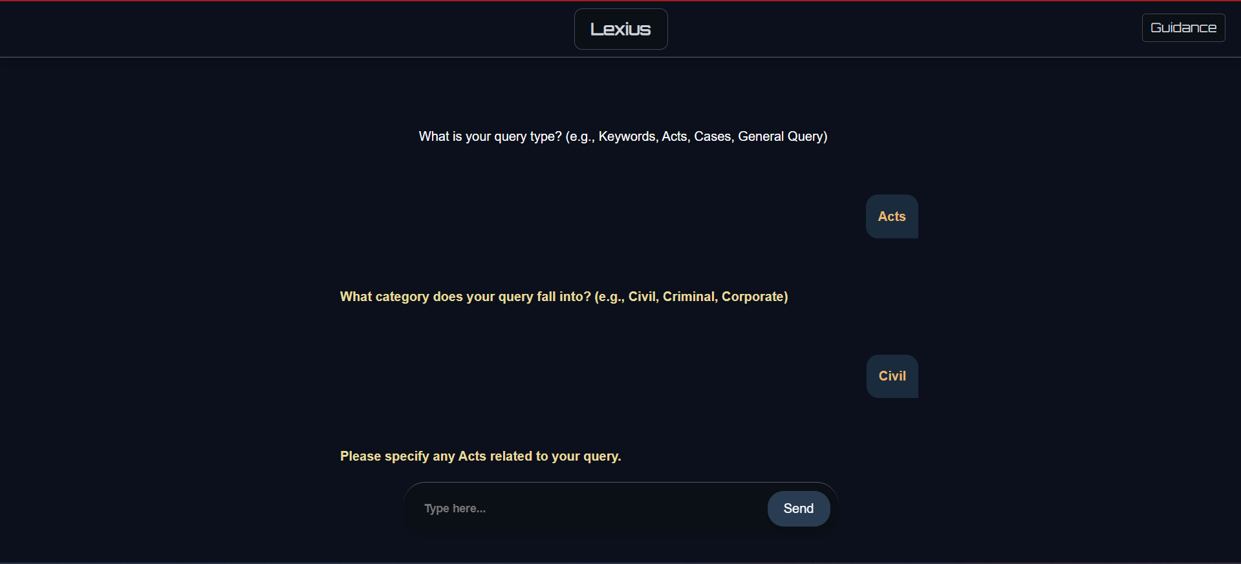

Slide 36
Query Type
Users can select from four query types: Act names, Case titles, Legal/Non-Legal keywords, and Natural Language queries, streamlining their searches.

Slide 37
Search Bar
The main search bar is prominently displayed, inviting users to input their queries across the specified categories for efficient data retrieval.

Slide 38
Query for Filters
Users can refine search results using filters like Date Range, Judge Name, and Case Category, ensuring they find the most relevant information.

Slide 39
Date Range
Users can set a start and end date to narrow down search results to a specific timeframe, making it easier to find pertinent cases.

Slide 40
Judge Name Filter
This filter allows users to search for cases presided over by specific judges, facilitating targeted legal research.

Slide 41
Case Category Selection
Users can choose from predefined categories to quickly locate cases that match their research criteria, enhancing navigation.

Slide 42

SEARCH ALGORITHMS
Algorithms Introduction - Searching
Key Concepts and Elasticsearch
1
2
3
4
5
Introduction to Search Algorithms
Overview of Elasticsearch
Support for JSON Documents
Key Advantages of Elasticsearch
Understanding Search Mechanics
This section focuses on the efficient methodologies used for searching through data, highlighting their significance in algorithm design and application.
Elasticsearch is an open-source, RESTful, distributed search and analytics engine. It is built on Apache Lucene, providing a robust platform for searching and analyzing large datasets efficiently.
Elasticsearch allows users to send data as JSON documents through an API or ingestion tools like Logstash and Amazon Kinesis Firehose, facilitating seamless data integration.
The platform is recognized for its ease of use and powerful functionality, enabling users to start quickly and achieve complex search operations with minimal effort.
Similar to skilled drivers understanding vehicle mechanics, users benefit from comprehending the underlying processes of search engines, which enhances their ability to utilize tools like Elasticsearch effectively.

Slide 43
NLP ALGORITHMS
BERT and RBM Algorithms
Overview of Chapter 10 and Chapter 11
Introduction to BERT
BERT's Methodology
Bert-as-service
Application in Autocomplete
BERT, or Bidirectional Encoder Representations from Transformers, is a groundbreaking method for pre-training language representations, achieving state-of-the-art results across various NLP tasks.
The approach involves training a general-purpose language understanding model on extensive text corpora, which can then be utilized for specific NLP applications, such as question answering.
Bert-as-service enables the use of BERT as a sentence encoder, providing a fast, scalable, and reliable framework that allows users to obtain fixed-length representations of sentences with minimal coding.
In practical applications, such as our project’s autocomplete feature, Bert-as-service delivers highly accurate results by generating vectors for each word, outperforming traditional methods like word2vec.
Introduction to RBM
Types of Text Summarization
Extractive Text Summarization Method
Restricted Boltzmann Machine (RBM) represents a type of unsupervised deep learning model. Unlike supervised learning, RBM works with unlabeled input data to derive meaningful insights.
RBMs can be applied to two types of text summarization: Extractive and Abstractive. This presentation focuses on Extractive Text Summarization, which selects key sentences from the source text.
This method extracts relevant content based on features such as title similarity, term frequency, and sentence ranking, efficiently condensing information into a coherent summary.

Slide 44
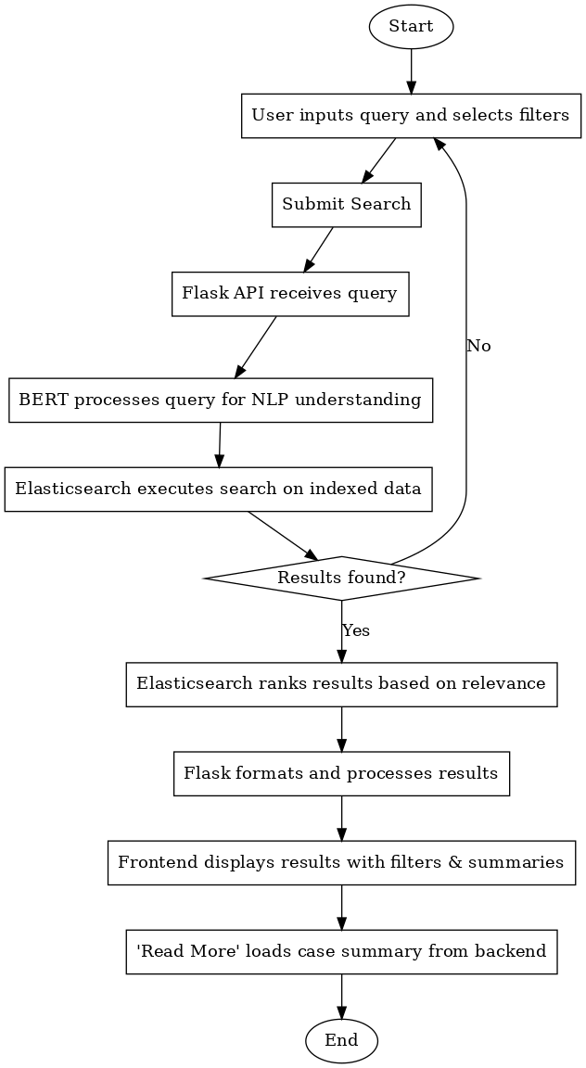
Activity Diagram
Introduction to Activity Diagram
The activity diagram illustrates the AI Lawyer system's flow for handling
user queries, processing them using Natural Language Processing
(NLP) via BERT, and retrieving results through Elasticsearch. It also
includes a loop mechanism to handle cases where no results are found.

Slide 45
Process Overview:
1. User Input:
The process begins when the user enters a query in the search bar
and selects appropriate filters, such as Judge Name, Date Range,
Category, or Acts. The user then submits the search request.
2. Backend Processing:
o The Flask API receives the query and passes it to the BERT
model for NLP processing.
o BERT converts the natural language query into a structured
format, ensuring accurate interpretation.
o The processed query is sent to Elasticsearch to search for
relevant documents in the indexed database.
3. Search Execution:
o Elasticsearch executes the search and checks whether any
results match the query.
o If results are found, they are ranked based on relevance using
Elasticsearch's scoring mechanism.
4. Formatting and Display:
o The Flask API processes the ranked results, formats them, and
sends them back to the frontend.
o The frontend dynamically displays the results in a user-friendly
format, with filters and summaries available for each case.
5. Case Summary:
o Each result has a "Read More" button. Clicking this button
retrieves and displays a concise case summary from the
backend.
o The button toggles to "Read Less," allowing the user to hide the
summary.
6. Handling No Results:
o If no results are found, the system loops back to the user input
stage, prompting the user to refine their query or adjust the
filters.
Activity Diagram
Loop Explanation:
The decision node ("Results found?") ensures the system dynamically
responds to the presence or absence of results:
• If results are found, the workflow proceeds to ranking and display.
• If no results are found, the user is looped back to the query input
stage. This iterative process ensures the user can refine their search
without starting from scratch.

