Slide 1
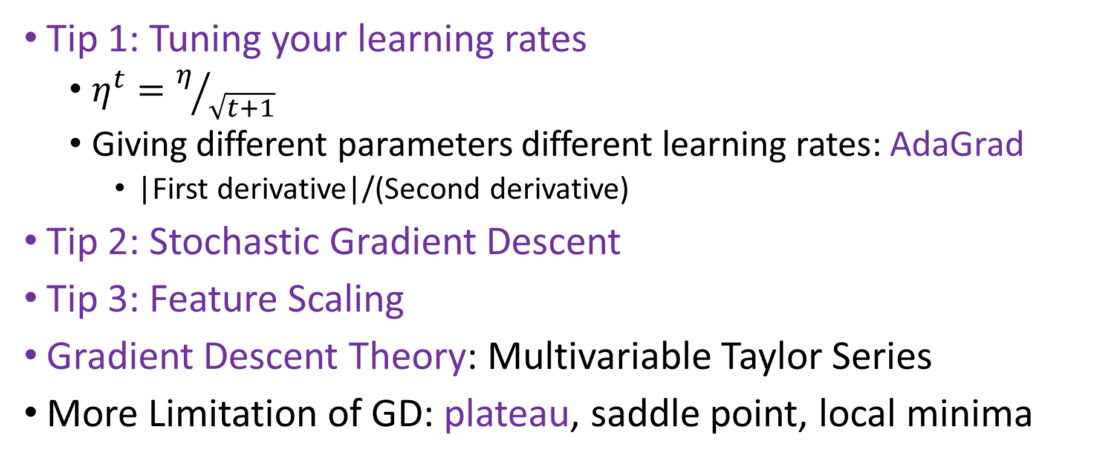
Gradient Descent
Tip 1: Tuning your learning rates
$η^{t}=η/{\sqrt{t+1}}$
Giving different parameters different learning rates: AdaGrad
|First derivative|/(Second derivative)
Tip 2: Stochastic Gradient Descent
Tip 3: Feature Scaling
Gradient Descent Theory: Multivariable Taylor Series
More Limitation of GD: plateau, saddle point, local minima

