Slide 1
Kalman Filter & Application
Weixiong Rao
Tongji U
2017-06-06

Slide 2

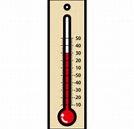
举例: 教室的温度
根据你的经验判断, 这个房间的温度是恒定的, 也就是下一分钟的温度等于现在这一分钟的温度（假设我们用一分钟来做时间单位）
假设你对你的经验不是100%的相信，可能会有上下偏差几度
我们把这些偏差看成是高斯白噪声(White Gaussian Noise), 也就是这些偏差跟前后时间是没有关系的而且符合高斯分配(Gaussian Distribution)
另外, 我们在房间里放一个温度计，但是这个温度计也不准确的，测量值会比实际值偏差。我们也把这些偏差看成是高斯白噪声.
经验判断 (高斯白噪声)
温度计(高斯白噪声)

Slide 3
举例: 教室的温度
现在对于某一分钟我们有两个有关于该房间的温度值：
你根据经验的预测值（系统的预测值）和温度计的值（测量值）。
我们用这两个值结合他们各自的噪声，估算出房间的实际温度值
假如我们要估算k时刻的是实际温度值
首先你要根据k-1时刻的温度值，来预测k时刻的温度
因为你相信温度是恒定的, 所以你会得到k时刻的温度预测值是跟k-1时刻一样的，假设是23度，同时该值的高斯噪声的偏差是5度
5是这样得到的: 如果k-1时刻估算出的最优温度值的偏差是3, 你对自己预测的不确定度是4度, 他们平方相加再开方, 就是5
从温度计那里得到了k时刻的温度值, 假设是25度, 同时该值的偏差是4度。

Slide 4
举例: 教室的温度
经验判断 (高斯白噪声)
温度计(高斯白噪声)
由于我们用于估算k时刻的实际温度有两个温度值, 分别是23 度和25度
究竟实际温度是多少呢？相信自己还是相信温度计呢？
究竟相信谁多一点，我们可以用他们的covariance协方差来判断
因为 Kg^2=5^2/(5^2+4^2)，所以Kg=0.78，我们可以估算出k时刻的实际温度值是：23+0.78*(25-23)=24.56度。
可以看出, 温度计的covariance比较小, 比较相信温度计, 所以估算出的最优温度值偏向温度计的值。

Slide 5
举例: 教室的温度
现在我们已经得到k时刻的最优温度值了
下一步就是要进入 k+1时刻，进行新的最优估算。
到现在为止，好像还没看到什么自回归的东西出现。
在进入k+1时刻之前，要算出k时刻那个最优值（24.56 度）的偏差
算法如下: ((1-Kg)*5^2)^0.5=2.35
这里的5就是上面的k时刻你预测的那个23度温度值的偏差，得出的2.35就是进入 k+1时刻以后k时刻估算出的最优温度值的偏差(对应于上面的3)
就是这样，卡尔曼滤波器就不断的把 covariance递归，从而估算出最优的温度值。他运行的很快，而且它只保留了上一时刻的covariance。上面的Kg，就是卡尔曼增益（Kalman Gain）, 他可以随不同的时刻而改变他自己的值，是不是很神奇！

Slide 6
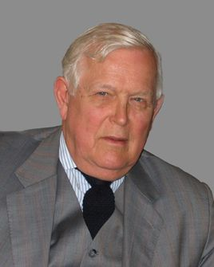
卡尔曼滤波
鲁道夫·卡尔曼（Rudolf Emil Kalman）
匈牙利裔美国数学家，1930年出生于匈牙利首都布达佩斯。
1953年于麻省理工学院获得电机工程学士，翌年硕士学位。
1957年于哥伦比亚大学获得博士学位。
1964年至1971年任职斯坦福大学。
1971年至1992年任佛罗里达大学数学系统理论中心(Center for Mathematical System Theory)主任
1972起任瑞士苏黎世联邦理工学院数学系统理论中心主任直至退休, 先后居住于苏黎世和佛罗里达2009年获美国国家科学奖章。
卡尔曼滤波（Kalman filtering）
一种利用线性系统状态方程，通过系统输入输出观测数据，对系统状态进行最优估计的算法。
由于观测数据中包括系统中的噪声和干扰的影响，所以最优估计也可看作是滤波过程。
斯坦利·施密特(Stanley Schmidt)首次实现了卡尔曼滤波器
卡尔曼在NASA埃姆斯研究中心访问时,发现他的方法对于解决阿波罗计划的轨道预测很有用, 后来阿波罗飞船的导航电脑使用了这种滤波器
关于这种滤波器的论文由Swerling (1958), Kalman (1960)与 Kalman and Bucy (1961)发表。
数据滤波是去除噪声还原真实数据的一种数据处理技术, Kalman滤波在测量方差已知的情况下能够从一系列存在测量噪声的数据中, 估计动态系统的状态.
便于计算机编程实现, 并能够对现场采集的数据进行实时的更新和处理, Kalman滤波是目前应用最为广泛的滤波方法, 在通信, 导航, 制导与控制等多领域得到了较好的应用.
http://www.cs.unc.edu/~welch/kalman/media/pdf/Kalman1960.pdf
https://www.cs.cornell.edu/courses/cs4758/2013sp/materials/kalman_notes.pdf

Slide 7


Kalman Filter Applications
The Kalman filter is a very powerful tool when it comes to controlling noisy systems.
The basic idea of a Kalman filter is: Noisy data in ⇒ hopefully less noisy data out.
The applications of a Kalman filter are numerous:
Tracking objects (e.g., missiles, faces, heads, hands)
Fitting Bezier patches to (noisy, moving, ...) point data
Economics
Navigation
Many computer vision applications
– Stabilizing depth measurements
– Feature tracking
– Cluster tracking
– Fusing data from radar, laser scanner and stereo
-cameras for depth and velocity measurements
– Many more

Slide 8
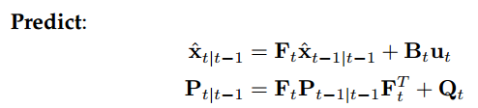
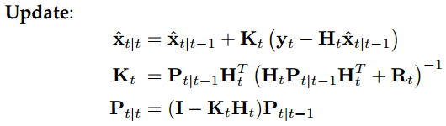
Predict-Update Equations
经验判断 (高斯白噪声)
温度计(高斯白噪声)
F : State transition matrix (i.e., transition between states).
ˆ
B : Control matrix (i.e., mapping control to state variables)
x : Estimated state
u : Control variables.
Q : Process variance matrix (i.e., error due to process).
P : State variance matrix (i.e., error of estimation)
y : Measurement variables.
H : Measurement matrix (i.e., mapping measurements onto state).
K : Kalman gain.
t|t current time period,
t − 1|t − 1 previous time period, and
t|t − 1 are intermediate steps.
R : Measurement variance matrix (i.e., error from measurements)

Slide 9
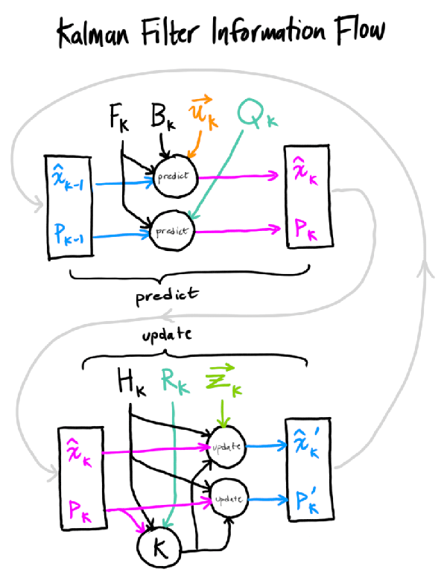
x : Estimated state
y : Measurement variables.
F : State transition matrix (i.e., transition between states).
B : Control matrix (i.e., mapping control to state variables)
u : Control variables.
P : State variance matrix (i.e., error of estimation)
Q : Process variance matrix (i.e., error due to process).
H : Measurement matrix (i.e., mapping measurements onto state).
K : Kalman gain.
R : Measurement variance matrix (i.e., error from measurements)
信息融合的过程

Slide 10
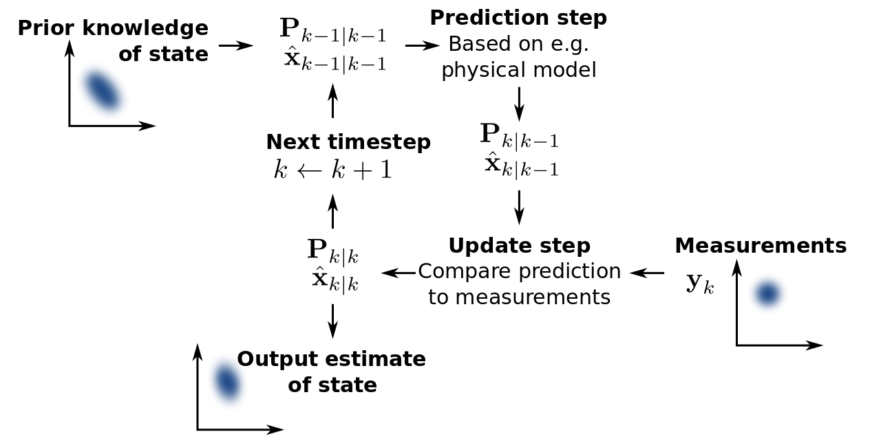
KF精髓在于Kalman gain. Kalman gain本质上是weighted average 的 weight, 你越相信你的prediction, uncertainty越小, observation的weight就越小; 反之你越不相信你的prediction, uncertainty越大, observation的weight越大。
举个例子：在一个陌生地方开车，你越不自信的时候，越信赖你的观察（路标、问路等等）你在熟悉的地方开车时越信赖自己的直觉.
卡尔曼滤波就是预测和测量的结合。
预测来自经验模型，是人对系统的建模推算得来的 另一部分是测量修正，来自外部的测量，是对模型的修正。
观测噪声和测量噪声分别是对模型和测量不确定性的定量描述.
卡尔曼滤波不仅仅是一个滤波，而更多的是一个信息融合的过程。融合的是观测和预测，如果观测更可靠那么我们给观测一个更高的权值，反之则给预测更高的权值

Slide 11
Predict-Update Equations
F : State transition matrix (i.e., transition between states).
ˆ
B : Control matrix (i.e., mapping control to state variables)
x : Estimated state
u : Control variables.
Q : Process variance matrix (i.e., error due to process).
P : State variance matrix (i.e., error of estimation)
y : Measurement variables.
H : Measurement matrix (i.e., mapping measurements onto state).
K : Kalman gain.
t|t current time period,
t − 1|t − 1 previous time period, and
t|t − 1 are intermediate steps.
R : Measurement variance matrix (i.e., error from measurements)

Slide 12
Model Definition Process
The Kalman filter model should be defined as follows:
Understand the situation: Look at the problem. Break it down to the mathematical basics. If you don’t do this, you may end up doing unneeded work.
Model the state process: Start with a basic model. It may not work effectively at first, but this can be refined later.
Model the measurement process: Analyze how you are going to measure the process. The measurement space may not be in the same space as the state (e.g., using an electrical diode to measure weight, an electrical reading does not easily translate to a weight).

Slide 13
Model Definition Process
The Kalman filter model should be defined as follows:
Model the noise: This needs to be done for both the state and measurement process. The base Kalman filter assumes Gaussian (white) noise, so make the variance and covariance (error) meaningful (i.e., make sure that the error you model is suitable for the situation).
Test the filter: Often overlooked, use synthetic data if necessary (e.g., if the process is not safe to test on a live environment). See if the filter is behaving as it should.
Refine filter: Try to tune the noise parameters (filter), as this is the easiest to change. If necessary go back further, you may need to rethink the situation.

Slide 14
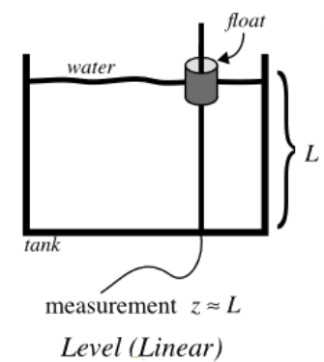
Example: Water level in tank
1. Understanding the situation
We consider a simple situation showing a way to measure the level of water in a tank. This is shown in the figure.
We are trying to estimate the level of water in the tank, which is unknown.
The measurements obtained are from the level of the “float”. This could be an electronic device, or a simple mechanical device.
The water could be:
Filling, emptying or static (i.e., the average level of the tank is increasing, decreasing or not changing).
Sloshing or stagnant (i.e., the relative level of the float to the average level of the tank is changing over time, or is static).
液面晃动
不流动

Slide 15
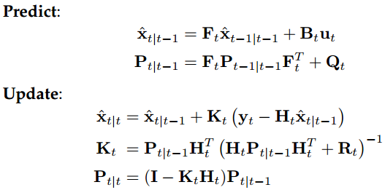
First Option: A Static Model
2. Model the state process
We will outline several ways to model this simple situation, showing the power of a good Kalman filter model.
The first is the most basic model, the tank is level (i.e., the true level is constant L = c).
Using the equations from Page 2, the state variable can be reduced to a scalar (i.e., xˆ = x where x is the estimate of L).
We are assuming a constant model, therefore xt+1 = xt, so A = 0 and Ft = 1, for any t ≥ 0.
Control variables B and u are not used (i.e., both = 0).

Slide 16
First Option: A Static Model
3. Model the measurement process
In our model, we have the level of the float. This is represented by y = y.
The value we are measuring could be a scaled measurement (e.g., a 1 cm measurement on a mechanical dial could actually be about 10 cm in the “true” level of the tank).
Think of your petrol gauge on your car, 1 cm can represent 10 L of petrol!
For simplicity, we will assume that the measurement is the exact same scale as our state estimate x (i.e., H = 1)

Slide 17
First Option: A Static Model
4. Model the noise
For this model, we are going to assume that there is no noise from the measurement (i.e., R = r).
The process is a scalar, therefore P = p. And as the process is not well defined, we will adjust the noise (i.e., Q = q).
We will now demonstrate the effects of changing these noise parameters.
5. Test the filter
You can now see that you can simplify the equations from Page 2. They simplify as follows:

Slide 18

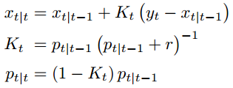
A Static Model
xt+1 = xt
Ft = 1
(B and u = 0)
H = 1
R = r
P = p
Predict:
Update:
x : Estimated state
Q = q
F : State transition matrix (i.e., transition between states).
B : Control matrix (i.e., mapping control to state variables)
y : Measurement variables.
u : Control variables.
P : State variance matrix (i.e., error of estimation)
Q : Process variance matrix (i.e., error due to process).
H : Measurement matrix (i.e., mapping measurements onto state).
K : Kalman gain.
R : Measurement variance matrix (i.e., error from measurements)

Slide 19
Running Example
The filter is now completely defined. Let’s put some numbers into this model. For the first test, we assume the true level of the tank is L = 1.
We initialize the state with an arbitrary number, with an extremely high variance as it is completely unknown: x0 = 0 and p0 = 1000.
If you initialize with a more meaningful variable, you will get faster convergence.
The system noise we will choose will be q = 0. 0001, as we think we have an accurate model. Let’s start this process.

Slide 20
Let’s start this process.
x : Estimated state
y : Measurement variables.
F : State transition matrix (i.e., transition between states).
B : Control matrix (i.e., mapping control to state variables)
u : Control variables.
P : State variance matrix (i.e., error of estimation)
Q : Process variance matrix (i.e., error due to process).
H : Measurement matrix (i.e., mapping measurements onto state).
K : Kalman gain.
R : Measurement variance matrix (i.e., error from measurements)
Predict
x1|0 = 0
p1|0 = 1000 + 0. 0001
The hypothetical measurement we get is y1 = 0. 9 (due to noise). We assume a measurement noise of r = 0. 1.
Update
K1 = 1000. 0001(1000. 0001 + 0. 1) = 0. 9999
x1|1 = 0 + 0. 9999 (0. 9 − 0) = 0. 8999
p1|1 = (1 − 0 . 9999) 1000. 0001 = 0. 1000
−1
The initialization of 0, has been brought close to the true value of the system.
The variance (error) has been brought down to a reasonable value

Slide 21
Let’s do one more step
Predict:
x2|1 = 0. 8999
p2|1 = 0. 1000 + 0. 0001 = 0. 1001
The hypothetical measurement we get this time is y2 = 0. 8 (due to noise)
Update:
K2 = 0. 1001 (0. 1001 + 0. 1) = 0. 5002
x2|2 = 0. 8999 + 0. 5002 (0. 8 − 0 . 8999) = 0. 8499
p2|2 = (1 − 0 . 5002) 0. 1001 = 0. 0500
−1

Slide 22
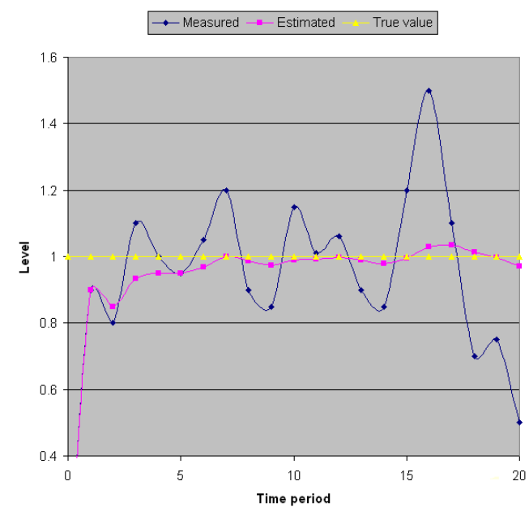
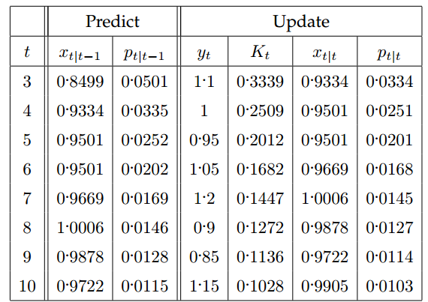
Let’s do one more step
You can notice that the variance is reducing each time. If we continue (with hypothetical yt -values) this we get the following results

Slide 23
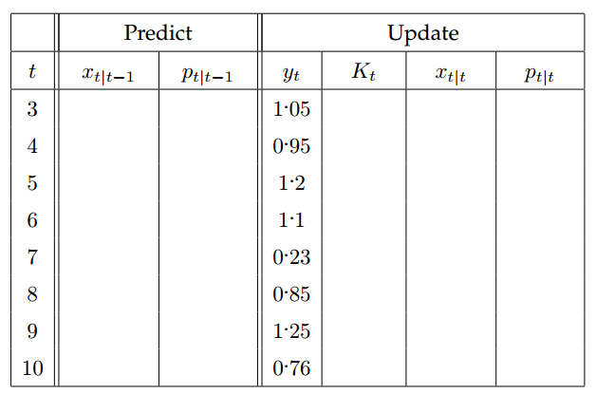
Another reading sequence; try this:

Slide 24
So what have we established so far?
If we create a model based on the true situation, our estimated state will be close to the true value, even when the measurements are very noisy (i.e., a 20% error, only produced a 5% inaccuracy).
This is the main purpose of the Kalman filter.
But what happens if the true situation is different?
We will keep the same model (i.e., a static model).
This time, the true situation is that the tank is filling at a constant rate:
Lt = Lt−1 + f
Let’s assume that the tank is filling at a rate of f = 0. 1 per time frame, and we start with an initialization of L0 = 0.
We will assume that the measurement and process noise remain the same (i.e., q = 0. 001 and r = 0. 1).
system noise
measurement noise

Slide 25
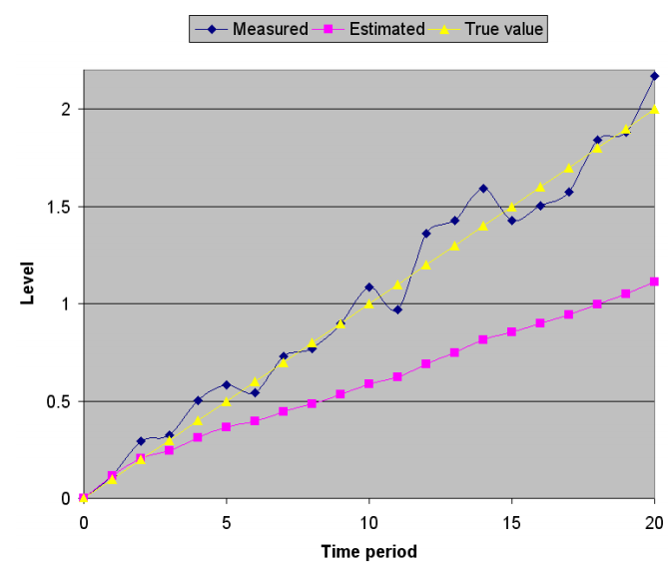
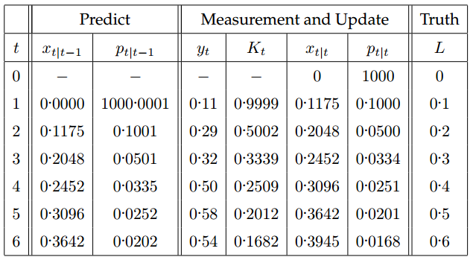
Let’s see what happens here
We can now see that over time the estimated state stabilizes (i.e., the variance gets very low).
Can you see the problem?
The estimated state is trailing behind the true level.
This of course is not desired, as a filter is supposed to remove noise, not give an inaccurate reading.
In this case the estimated state has a much greater error (compared to the truth) than the noise from the measurement process.

Slide 26
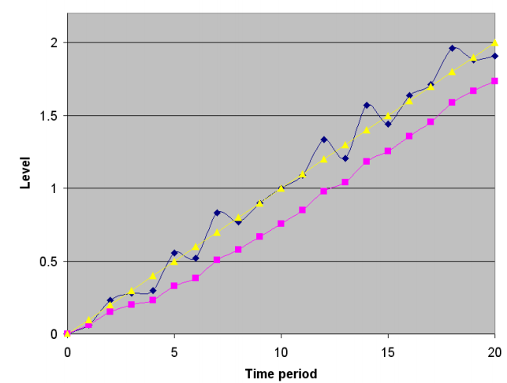
What is causing this?
There are two contributions:
The model we have chosen.
The reliability of our process model (i.e., our chosen q value).
The easiest thing to change is our q value.
What was the reason we chose q = 0. 0001?
It was because we thought our model was a good estimation of the true process.
However, in this case our model was not a good estimator.
So why not relax this? Let’s assume there is a greater error with our process model, and set q = 0. 01
system noise

Slide 27
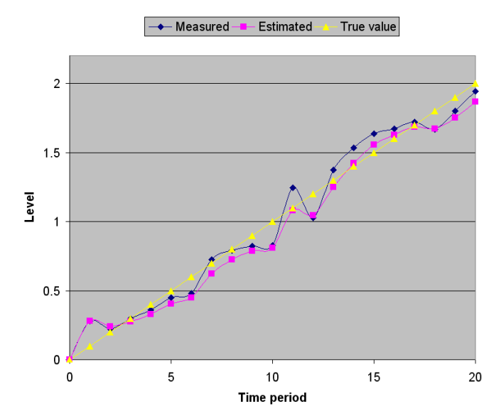
Let q = 0. 1
So the benefits of increasing the error were beneficial. However the estimated state still has more error than the actual noise. Let’s increase this value again! Let q = 0. 1
This is getting close to the true value, and has less error than the measurement noise.

Slide 28
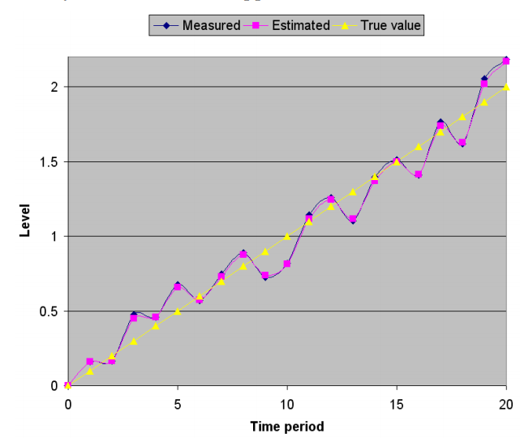
Let’s try q = 1 to see what happens:
Now there is almost no difference to the measured value. There is minor noise removal, but not much. There’s almost no point in having the filter.
So what has been learnt here?
If you have a badly defined model, you will not get a good estimate.
But you can relax your model by increasing your estimated error. This will let the Kalman filter rely more on the measurement values, but still allow some noise removal.
In your own time, try playing with the measurement error r and see what the effect is.

Slide 29
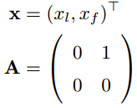

Second Option: A Filling Model
2. Model the state process
To get better results, we need to change our Kalman model. Let’s redefine it then. So, the actual model is: Lt = Lt−1 + f
This translates to a continuous process transition of:
where xl is the level L, and xf = dxl/dt is the estimated filling rate, and A represents the tank continuously filling at rate xf (defined by f and the used time scale)
However, we want a discrete process. So A needs to be made time-discrete. Just apply the infinite (note that Ai is zero in all four components, for all i > 1):
for all t ≥ 0.
We will be ignoring B and u again.

Slide 30

Second Option: A Filling Model
3. Model the measurement process
In this case, we can not measure the filling rate directly, but we will still assume a noisy measurement of L. Therefore we have
Indicating that there is no measurement for filling rate and that y is the estimated measurement of xl

Slide 31
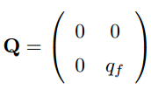

Second Option: A Filling Model
4. Model the noise
The measurement process has not changed, so that means that the noise has not changed (i.e., R = r).
The process has changed, so we need to redefine the noise. Now if we assume the noise is only in the filling part of the process, this would give us the continuous noise model with
where qf is the filling noise.
Now, this continuous process can be approximated by a time-discrete process using:

Slide 32
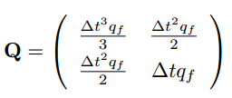


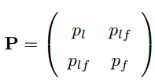
Second Option: A Filling Model
Using this continuous to discrete translation, we can take the continuous A and Q to approximate the discrete Q.
This gives us (after some calculations - to be skipped here; again, apply the infinite sum for the power of e):
For simplicity, we assume a continuous sampling rate of ∆t = 1. Therefore,
Also, the process is no longer scalar, so the covariance matrix is
where the subscript denotes the relating variance and plf is the covariance (which is symmetric, i.e., plf = pfl).

Slide 33
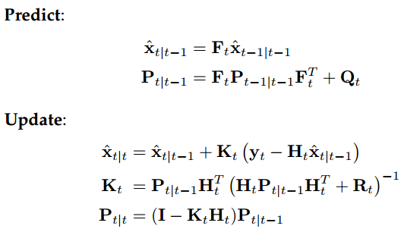
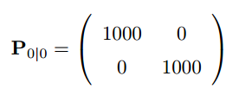
Second Option: A Filling Model
5. Test the filter
This time we have an accurate model of a constant fill rate. We will assume that we have a noise of r = 0. 1, and an accurate process noise of qf = 0. 00001.
We have no idea of the initial state or filling rate, so we will make x0 = (0 , 0) with an initial variance of:
We are assuming we have no idea of either values, and we are assuming that there is little or no correlation between the values.
T

Slide 34
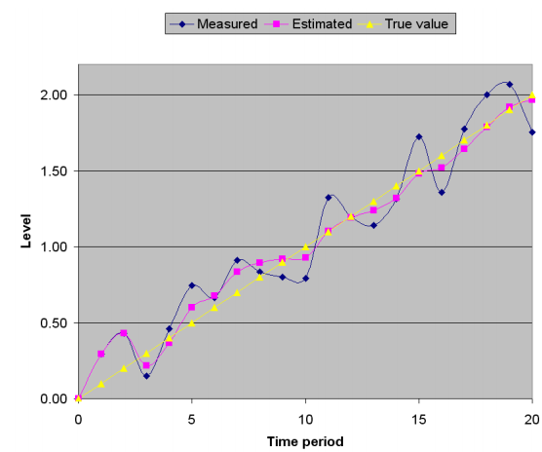
Test these results under different conditions
The first test will be that the model is filling at a constant rate of 0.1 per time frame, with an actual measurement noise of ±0 . 3.
The filter quickly adapts to the true value.
Note that we did not tell the Kalman filter anything about the actual filling rate, and it figured it out all by itself. Even with a bad unsure initialization.
Actually, if you give a Kalman filter a bad initialization, it takes the first measurement as a “good” initialization

Slide 35
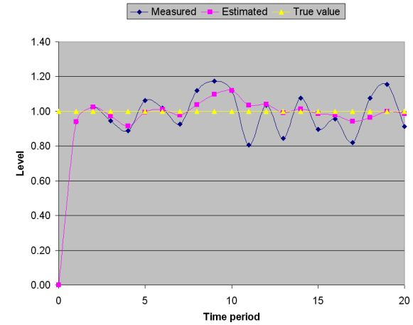
Using a constant level (i.e., no actual filling)
Let’s see what happens if you try to trick the Kalman filter by using a constant level (i.e., there is no actual filling):
The filter stabilizes in the exact same time frame as before. This is because the model stabilizes with a fill rate of 0.

Slide 36

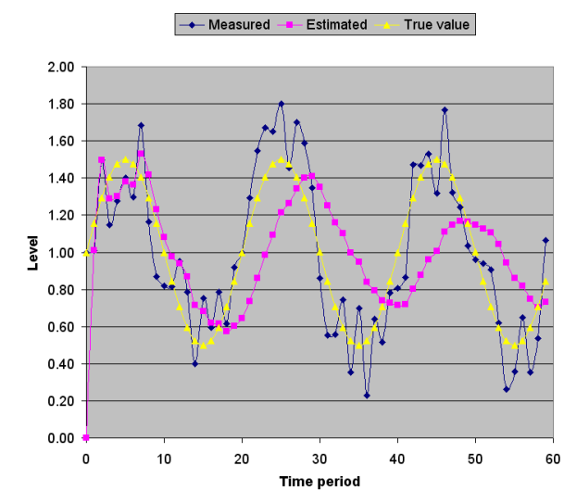
Third Option: Constant, but Sloshing
Now let us test an extreme case.
We will assume that the water is at a constant level, but it is sloshing in the tank. This sloshing can be modeled as a sine wave L = c sin(2π r ∆t) + l
where c is an amplitude scaling factor, r is the cycle rate, and l is the average level (as sin integrates to zero over time).
If we use c = 0. 5, r = 0. 05, and l = 1 we get the following result:

Slide 37
Two things about the Kalman filter:
There are two things you should notice about the Kalman filter:
1. The model is smoother than the noisy measurement, but there is a lag behind the actual value. This is common when filtering a system that is not modelled correctly.
2. The amplitude of the filter is getting smaller and smaller. This is because the model is slowly converging to what it thinks is the truth... a constant level, which is accurate over time.
If you wanted to model the sloshing properly, you would need to use an extended Kalman Filter, which also takes into consideration the non-linearity of the system

Slide 38
Summary of the Three Tank Examples
The main points that you should learn from these examples are:
1. The model for your filter will try to fit the given measurement data to the model you have provided.
This may be undesirable. In the sloshing case, it may be desirable to filter out the sloshing as “noise”, so you can get the average level of the tank.
If you wanted to measure the sloshing, then you need to model it.
2. The initialization and noise components of your filter do effect the results of how the filter operates.
3. You need to think about the outcome of your filter; if you can approximate that the time steps are small enough, then a simple linear model will work, but you will get lag

Slide 39
Coursework
Go to the UNC (University of North Carolina) website with a dedicated Kalman filter learning tool: www.cs.unc.edu/˜welch/kalman/kftool/index.html
Read the document describing the filter: www.cs.unc.edu/˜welch/kalman/media/pdf/kftool_ models.pdf
Then play with the online Java tool. Once you have an understanding you can download the Matlab or Java code to see how it operates.

