Slide 1
Kalman Filter & Application
Weixiong Rao
Tongji U
2017-06-06

Slide 2

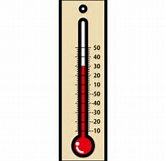
举例: 教室的温度
根据你的经验判断, 这个房间的温度是恒定的, 也就是下一分钟的温度等于现在这一分钟的温度（假设我们用一分钟来做时间单位）
假设你对你的经验不是100%的相信，可能会有上下偏差几度
我们把这些偏差看成是高斯白噪声(White Gaussian Noise), 也就是这些偏差跟前后时间是没有关系的而且符合高斯分配(Gaussian Distribution)
另外, 我们在房间里放一个温度计，但是这个温度计也不准确的，测量值会比实际值偏差。我们也把这些偏差看成是高斯白噪声.
经验判断 (高斯白噪声)
温度计(高斯白噪声)

Slide 3
举例: 教室的温度
现在对于某一分钟我们有两个有关于该房间的温度值：
你根据经验的预测值（系统的预测值）和温度计的值（测量值）。
我们用这两个值结合他们各自的噪声，估算出房间的实际温度值
假如我们要估算k时刻的是实际温度值
首先你要根据k-1时刻的温度值，来预测k时刻的温度
因为你相信温度是恒定的, 所以你会得到k时刻的温度预测值是跟k-1时刻一样的，假设是23度，同时该值的高斯噪声的偏差是5度
5是这样得到的: 如果k-1时刻估算出的最优温度值的偏差是3, 你对自己预测的不确定度是4度, 他们平方相加再开方, 就是5
从温度计那里得到了k时刻的温度值, 假设是25度, 同时该值的偏差是4度。

Slide 4
举例: 教室的温度
经验判断 (高斯白噪声)
温度计(高斯白噪声)
由于我们用于估算k时刻的实际温度有两个温度值, 分别是23 度和25度
究竟实际温度是多少呢？相信自己还是相信温度计呢？
究竟相信谁多一点，我们可以用他们的covariance协方差来判断
因为 Kg^2=5^2/(5^2+4^2)，所以Kg=0.78，我们可以估算出k时刻的实际温度值是：23+0.78*(25-23)=24.56度。
可以看出, 温度计的covariance比较小, 比较相信温度计, 所以估算出的最优温度值偏向温度计的值。

Slide 5
举例: 教室的温度
现在我们已经得到k时刻的最优温度值了
下一步就是要进入 k+1时刻，进行新的最优估算。
到现在为止，好像还没看到什么自回归的东西出现。
在进入k+1时刻之前，要算出k时刻那个最优值（24.56 度）的偏差
算法如下: ((1-Kg)*5^2)^0.5=2.35
这里的5就是上面的k时刻你预测的那个23度温度值的偏差，得出的2.35就是进入 k+1时刻以后k时刻估算出的最优温度值的偏差(对应于上面的3)
就是这样，卡尔曼滤波器就不断的把 covariance递归，从而估算出最优的温度值。他运行的很快，而且它只保留了上一时刻的covariance。上面的Kg，就是卡尔曼增益（Kalman Gain）, 他可以随不同的时刻而改变他自己的值，是不是很神奇！

Slide 6
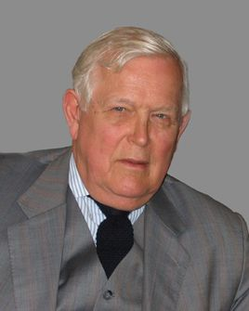
卡尔曼滤波
鲁道夫·卡尔曼（Rudolf Emil Kalman）
匈牙利裔美国数学家，1930年出生于匈牙利首都布达佩斯。
1953年于麻省理工学院获得电机工程学士，翌年硕士学位。
1957年于哥伦比亚大学获得博士学位。
1964年至1971年任职斯坦福大学。
1971年至1992年任佛罗里达大学数学系统理论中心主任
1972起任瑞士苏黎世联邦理工学院数学系统理论中心主任直至退休
2009年获美国国家科学奖章。
卡尔曼滤波（Kalman filtering）
一种利用线性系统状态方程，通过系统输入输出观测数据，对系统状态进行最优估计的算法。
由于观测数据中包括系统中的噪声和干扰的影响，所以最优估计也可看作是滤波过程。
斯坦利·施密特(Stanley Schmidt)首次实现了卡尔曼滤波器
卡尔曼在NASA埃姆斯研究中心访问时,发现他的方法对于解决阿波罗计划的轨道预测很有用, 后来阿波罗飞船的导航电脑使用了这种滤波器
关于这种滤波器的论文由Swerling (1958), Kalman (1960)与 Kalman and Bucy (1961)发表。
数据滤波是去除噪声还原真实数据的一种数据处理技术, Kalman滤波在测量方差已知的情况下能够从一系列存在测量噪声的数据中, 估计动态系统的状态.
便于计算机编程实现, 并能够对现场采集的数据进行实时的更新和处理, Kalman滤波是目前应用最为广泛的滤波方法, 在通信, 导航, 制导与控制等多领域得到了较好的应用.
http://www.cs.unc.edu/~welch/kalman/media/pdf/Kalman1960.pdf
https://www.cs.cornell.edu/courses/cs4758/2013sp/materials/kalman_notes.pdf

Slide 7


Kalman Filter Applications
The Kalman filter is a very powerful tool when it comes to controlling noisy systems.
The basic idea of a Kalman filter is: Noisy data in ⇒ hopefully less noisy data out.
The applications of a Kalman filter are numerous:
Tracking objects (e.g., missiles, faces, heads, hands)
Fitting Bezier patches to (noisy, moving, ...) point data
Economics
Navigation
Many computer vision applications
– Stabilizing depth measurements
– Feature tracking
– Cluster tracking
– Fusing data from radar, laser scanner and stereo
-cameras for depth and velocity measurements
– Many more

Slide 8
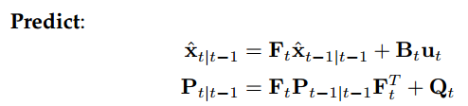
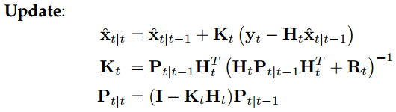
Predict-Update Equations
经验判断 (高斯白噪声)
温度计(高斯白噪声)
F : State transition matrix (i.e., transition between states).
ˆ
B : Control matrix (i.e., mapping control to state variables)
x : Estimated state
u : Control variables.
Q : Process variance matrix (i.e., error due to process).
P : State variance matrix (i.e., error of estimation)
y : Measurement variables.
H : Measurement matrix (i.e., mapping measurements onto state).
K : Kalman gain.
t|t current time period,
t − 1|t − 1 previous time period, and
t|t − 1 are intermediate steps.
R : Measurement variance matrix (i.e., error from measurements)

Slide 9
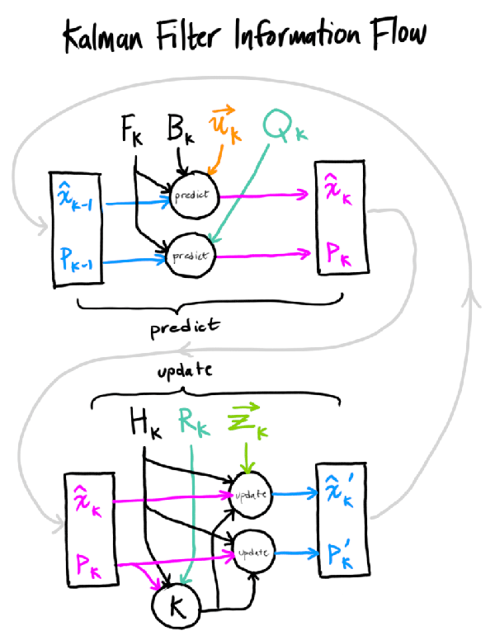
x : Estimated state
y : Measurement variables.
F : State transition matrix (i.e., transition between states).
B : Control matrix (i.e., mapping control to state variables)
u : Control variables.
P : State variance matrix (i.e., error of estimation)
Q : Process variance matrix (i.e., error due to process).
H : Measurement matrix (i.e., mapping measurements onto state).
K : Kalman gain.
R : Measurement variance matrix (i.e., error from measurements)
信息融合的过程

Slide 10
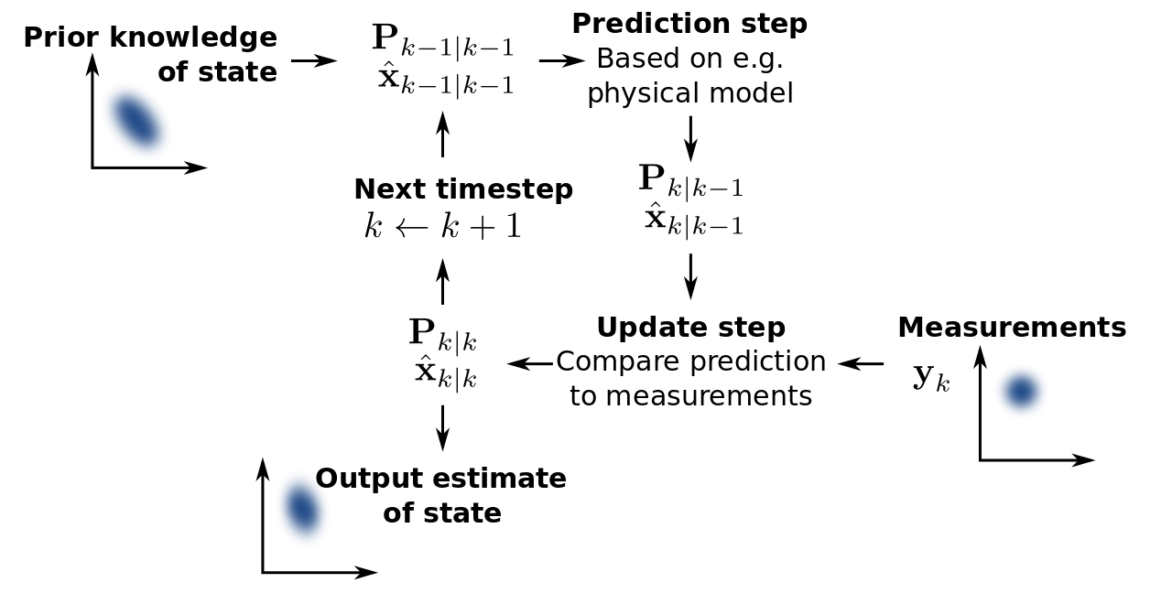
KF精髓在于Kalman gain. Kalman gain本质上是weighted average 的 weight, 你越相信你的prediction, uncertainty越小, observation的weight就越小; 反之你越不相信你的prediction, uncertainty越大, observation的weight越大。
举个例子：在一个陌生地方开车，你越不自信的时候，越信赖你的观察（路标、问路等等）你在熟悉的地方开车时越信赖自己的直觉.
卡尔曼滤波就是预测和测量的结合。
预测来自经验模型，是人对系统的建模推算得来的 另一部分是测量修正，来自外部的测量，是对模型的修正。
观测噪声和测量噪声分别是对模型和测量不确定性的定量描述.
卡尔曼滤波不仅仅是一个滤波，而更多的是一个信息融合的过程。融合的是观测和预测，如果观测更可靠那么我们给观测一个更高的权值，反之则给预测更高的权值

Slide 11
Predict-Update Equations
F : State transition matrix (i.e., transition between states).
ˆ
B : Control matrix (i.e., mapping control to state variables)
x : Estimated state
u : Control variables.
Q : Process variance matrix (i.e., error due to process).
P : State variance matrix (i.e., error of estimation)
y : Measurement variables.
H : Measurement matrix (i.e., mapping measurements onto state).
K : Kalman gain.
t|t current time period,
t − 1|t − 1 previous time period, and
t|t − 1 are intermediate steps.
R : Measurement variance matrix (i.e., error from measurements)

Slide 12
Model Definition Process
The Kalman filter model should be defined as follows:
Understand the situation: Look at the problem. Break it down to the mathematical basics. If you don’t do this, you may end up doing unneeded work.
Model the state process: Start with a basic model. It may not work effectively at first, but this can be refined later.
Model the measurement process: Analyze how you are going to measure the process. The measurement space may not be in the same space as the state (e.g., using an electrical diode to measure weight, an electrical reading does not easily translate to a weight).

Slide 13
Model Definition Process
The Kalman filter model should be defined as follows:
Model the noise: This needs to be done for both the state and measurement process. The base Kalman filter assumes Gaussian (white) noise, so make the variance and covariance (error) meaningful (i.e., make sure that the error you model is suitable for the situation).
Test the filter: Often overlooked, use synthetic data if necessary (e.g., if the process is not safe to test on a live environment). See if the filter is behaving as it should.
Refine filter: Try to tune the noise parameters (filter), as this is the easiest to change. If necessary go back further, you may need to rethink the situation.

Slide 14
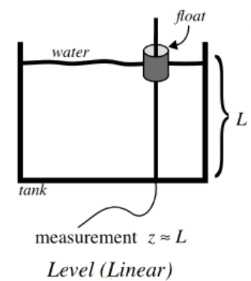
Example: Water level in tank
1. Understanding the situation
We consider a simple situation showing a way to measure the level of water in a tank. This is shown in the figure.
We are trying to estimate the level of water in the tank, which is unknown.
The measurements obtained are from the level of the “float”. This could be an electronic device, or a simple mechanical device.
The water could be:
Filling, emptying or static (i.e., the average level of the tank is increasing, decreasing or not changing).
Sloshing or stagnant (i.e., the relative level of the float to the average level of the tank is changing over time, or is static).
液面晃动
不流动

Slide 15
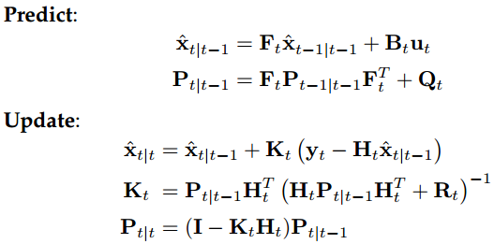
First Option: A Static Model
2. Model the state process
We will outline several ways to model this simple situation, showing the power of a good Kalman filter model.
The first is the most basic model, the tank is level (i.e., the true level is constant L = c).
Using the equations from Page 2, the state variable can be reduced to a scalar (i.e., xˆ = x where x is the estimate of L).
We are assuming a constant model, therefore xt+1 = xt, so A = 0 and Ft = 1, for any t ≥ 0.
Control variables B and u are not used (i.e., both = 0).

Slide 16
First Option: A Static Model
3. Model the measurement process
In our model, we have the level of the float. This is represented by y = y.
The value we are measuring could be a scaled measurement (e.g., a 1 cm measurement on a mechanical dial could actually be about 10 cm in the “true” level of the tank).
Think of your petrol gauge on your car, 1 cm can represent 10 L of petrol!
For simplicity, we will assume that the measurement is the exact same scale as our state estimate x (i.e., H = 1)

Slide 17
First Option: A Static Model
4. Model the noise
For this model, we are going to assume that there is no noise from the measurement (i.e., R = r).
The process is a scalar, therefore P = p. And as the process is not well defined, we will adjust the noise (i.e., Q = q).
We will now demonstrate the effects of changing these noise parameters.
5. Test the filter
You can now see that you can simplify the equations from Page 2. They simplify as follows:

Slide 18

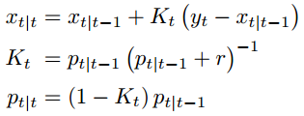
A Static Model
xt+1 = xt
Ft = 1
(B and u = 0)
H = 1
R = r
P = p
Predict:
Update:
x : Estimated state
Q = q
F : State transition matrix (i.e., transition between states).
B : Control matrix (i.e., mapping control to state variables)
y : Measurement variables.
u : Control variables.
P : State variance matrix (i.e., error of estimation)
Q : Process variance matrix (i.e., error due to process).
H : Measurement matrix (i.e., mapping measurements onto state).
K : Kalman gain.
R : Measurement variance matrix (i.e., error from measurements)

Slide 19
Running Example
The filter is now completely defined. Let’s put some numbers into this model. For the first test, we assume the true level of the tank is L = 1.
We initialize the state with an arbitrary number, with an extremely high variance as it is completely unknown: x0 = 0 and p0 = 1000.
If you initialize with a more meaningful variable, you will get faster convergence.
The system noise we will choose will be q = 0. 0001, as we think we have an accurate model. Let’s start this process.

Slide 20
Let’s start this process.
x : Estimated state
y : Measurement variables.
F : State transition matrix (i.e., transition between states).
B : Control matrix (i.e., mapping control to state variables)
u : Control variables.
P : State variance matrix (i.e., error of estimation)
Q : Process variance matrix (i.e., error due to process).
H : Measurement matrix (i.e., mapping measurements onto state).
K : Kalman gain.
R : Measurement variance matrix (i.e., error from measurements)
Predict
x1|0 = 0
p1|0 = 1000 + 0. 0001
The hypothetical measurement we get is y1 = 0. 9 (due to noise). We assume a measurement noise of r = 0. 1.
Update
K1 = 1000. 0001(1000. 0001 + 0. 1) = 0. 9999
x1|1 = 0 + 0. 9999 (0. 9 − 0) = 0. 8999
p1|1 = (1 − 0 . 9999) 1000. 0001 = 0. 1000
−1
The initialization of 0, has been brought close to the true value of the system.
The variance (error) has been brought down to a reasonable value

Slide 21
Let’s do one more step
Predict:
x2|1 = 0. 8999
p2|1 = 0. 1000 + 0. 0001 = 0. 1001
The hypothetical measurement we get this time is y2 = 0. 8 (due to noise)
Update:
K2 = 0. 1001 (0. 1001 + 0. 1) = 0. 5002
x2|2 = 0. 8999 + 0. 5002 (0. 8 − 0 . 8999) = 0. 8499
p2|2 = (1 − 0 . 5002) 0. 1001 = 0. 0500
−1

Slide 22
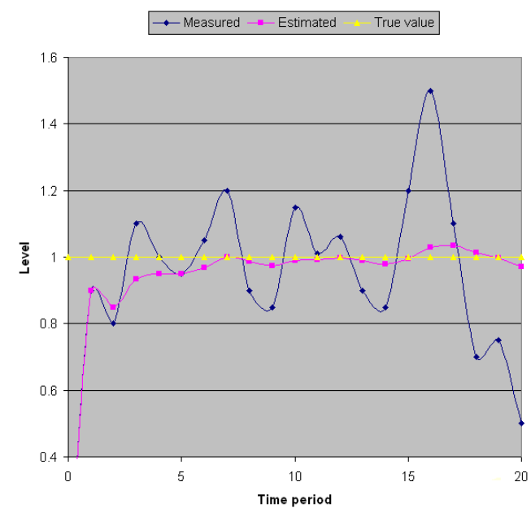
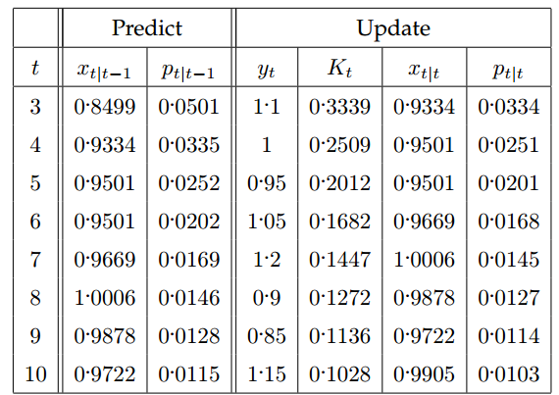
Let’s do one more step
You can notice that the variance is reducing each time. If we continue (with hypothetical yt -values) this we get the following results

Slide 23
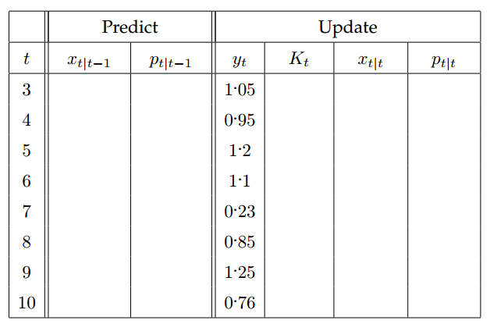
Another reading sequence; try this:

Slide 24
So what have we established so far?
If we create a model based on the true situation, our estimated state will be close to the true value, even when the measurements are very noisy (i.e., a 20% error, only produced a 5% inaccuracy).
This is the main purpose of the Kalman filter.
But what happens if the true situation is different?
We will keep the same model (i.e., a static model).
This time, the true situation is that the tank is filling at a constant rate:
Lt = Lt−1 + f
Let’s assume that the tank is filling at a rate of f = 0. 1 per time frame, and we start with an initialization of L0 = 0.
We will assume that the measurement and process noise remain the same (i.e., q = 0. 001 and r = 0. 1).
system noise
measurement noise

Slide 25
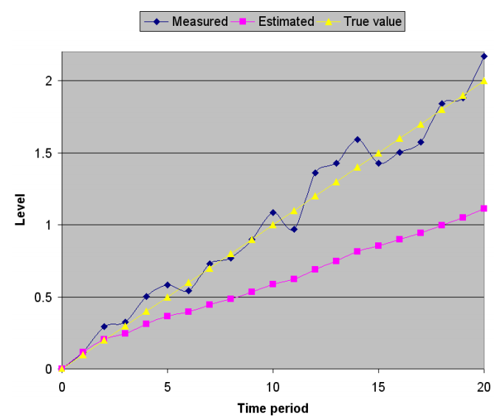
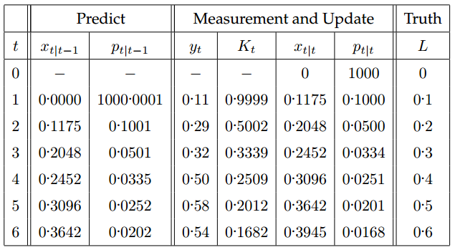
Let’s see what happens here
We can now see that over time the estimated state stabilizes (i.e., the variance gets very low).
Can you see the problem?
The estimated state is trailing behind the true level.
This of course is not desired, as a filter is supposed to remove noise, not give an inaccurate reading.
In this case the estimated state has a much greater error (compared to the truth) than the noise from the measurement process.

Slide 26
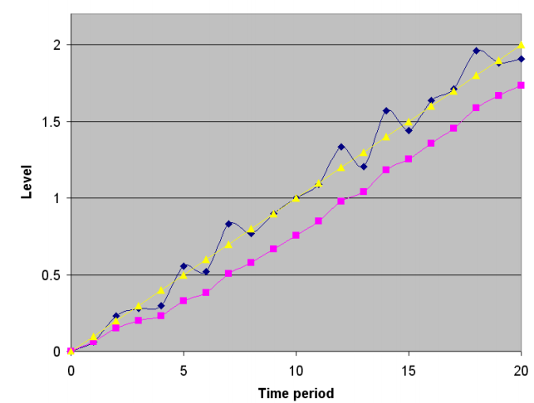
What is causing this?
There are two contributions:
The model we have chosen.
The reliability of our process model (i.e., our chosen q value).
The easiest thing to change is our q value.
What was the reason we chose q = 0. 0001?
It was because we thought our model was a good estimation of the true process.
However, in this case our model was not a good estimator.
So why not relax this? Let’s assume there is a greater error with our process model, and set q = 0. 01
system noise

Slide 27
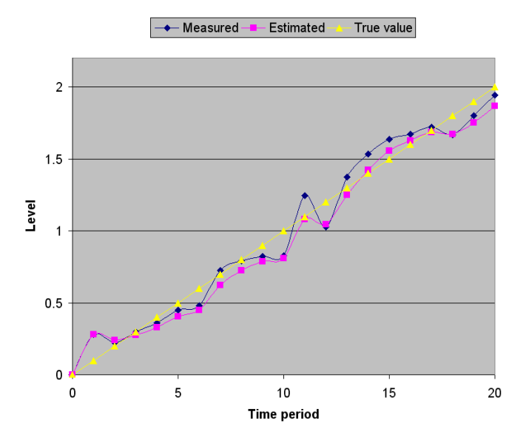
Let q = 0. 1
So the benefits of increasing the error were beneficial. However the estimated state still has more error than the actual noise. Let’s increase this value again! Let q = 0. 1
This is getting close to the true value, and has less error than the measurement noise.

Slide 28
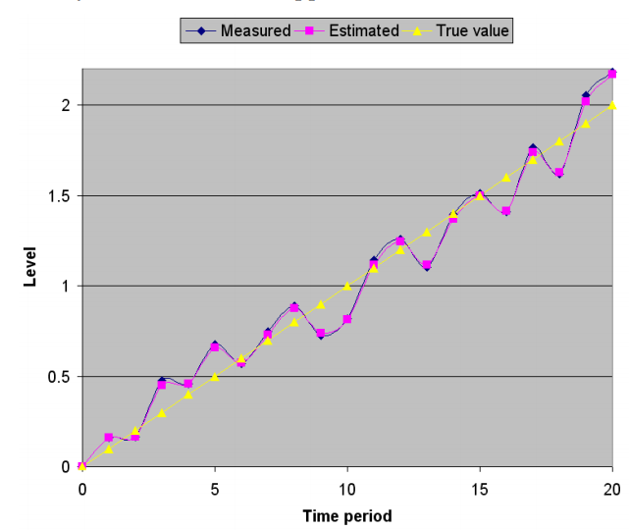
Let’s try q = 1 to see what happens:
Now there is almost no difference to the measured value. There is minor noise removal, but not much. There’s almost no point in having the filter.
So what has been learnt here?
If you have a badly defined model, you will not get a good estimate.
But you can relax your model by increasing your estimated error. This will let the Kalman filter rely more on the measurement values, but still allow some noise removal.
In your own time, try playing with the measurement error r and see what the effect is.

Slide 29
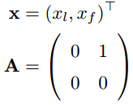

Second Option: A Filling Model
2. Model the state process
To get better results, we need to change our Kalman model. Let’s redefine it then. So, the actual model is: Lt = Lt−1 + f
This translates to a continuous process transition of:
where xl is the level L, and xf = dxl/dt is the estimated filling rate, and A represents the tank continuously filling at rate xf (defined by f and the used time scale)
However, we want a discrete process. So A needs to be made time-discrete. Just apply the infinite (note that Ai is zero in all four components, for all i > 1):
for all t ≥ 0.
We will be ignoring B and u again.

Slide 30

Second Option: A Filling Model
3. Model the measurement process
In this case, we can not measure the filling rate directly, but we will still assume a noisy measurement of L. Therefore we have
Indicating that there is no measurement for filling rate and that y is the estimated measurement of xl

Slide 31
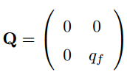

Second Option: A Filling Model
4. Model the noise
The measurement process has not changed, so that means that the noise has not changed (i.e., R = r).
The process has changed, so we need to redefine the noise. Now if we assume the noise is only in the filling part of the process, this would give us the continuous noise model with
where qf is the filling noise.
Now, this continuous process can be approximated by a time-discrete process using:

Slide 32
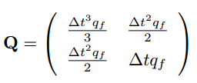


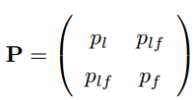
Second Option: A Filling Model
Using this continuous to discrete translation, we can take the continuous A and Q to approximate the discrete Q.
This gives us (after some calculations - to be skipped here; again, apply the infinite sum for the power of e):
For simplicity, we assume a continuous sampling rate of ∆t = 1. Therefore,
Also, the process is no longer scalar, so the covariance matrix is
where the subscript denotes the relating variance and plf is the covariance (which is symmetric, i.e., plf = pfl).

Slide 33
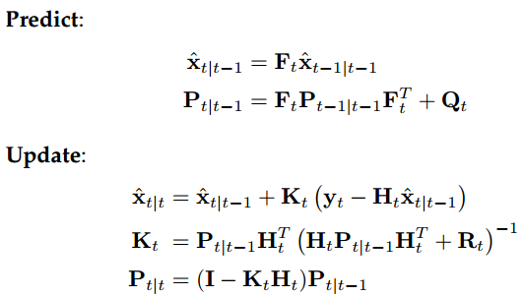
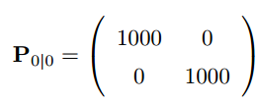
Second Option: A Filling Model
5. Test the filter
This time we have an accurate model of a constant fill rate. We will assume that we have a noise of r = 0. 1, and an accurate process noise of qf = 0. 00001.
We have no idea of the initial state or filling rate, so we will make x0 = (0 , 0) with an initial variance of:
We are assuming we have no idea of either values, and we are assuming that there is little or no correlation between the values.
T

Slide 34
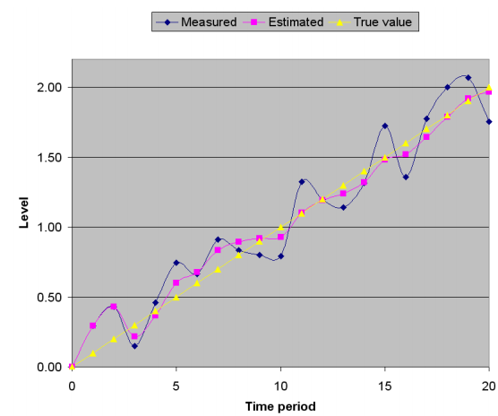
Test these results under different conditions
The first test will be that the model is filling at a constant rate of 0.1 per time frame, with an actual measurement noise of ±0 . 3.
The filter quickly adapts to the true value.
Note that we did not tell the Kalman filter anything about the actual filling rate, and it figured it out all by itself. Even with a bad unsure initialization.
Actually, if you give a Kalman filter a bad initialization, it takes the first measurement as a “good” initialization

Slide 35
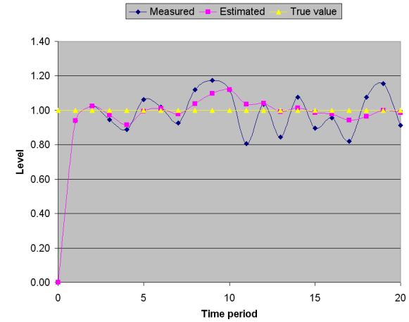
Using a constant level (i.e., no actual filling)
Let’s see what happens if you try to trick the Kalman filter by using a constant level (i.e., there is no actual filling):
The filter stabilizes in the exact same time frame as before. This is because the model stabilizes with a fill rate of 0.

Slide 36

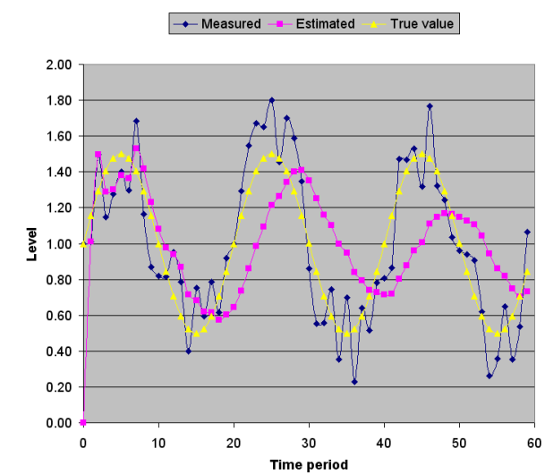
Third Option: Constant, but Sloshing
Now let us test an extreme case.
We will assume that the water is at a constant level, but it is sloshing in the tank. This sloshing can be modeled as a sine wave L = c sin(2π r ∆t) + l
where c is an amplitude scaling factor, r is the cycle rate, and l is the average level (as sin integrates to zero over time).
If we use c = 0. 5, r = 0. 05, and l = 1 we get the following result:

Slide 37
Two things about the Kalman filter:
There are two things you should notice about the Kalman filter:
1. The model is smoother than the noisy measurement, but there is a lag behind the actual value. This is common when filtering a system that is not modelled correctly.
2. The amplitude of the filter is getting smaller and smaller. This is because the model is slowly converging to what it thinks is the truth... a constant level, which is accurate over time.
If you wanted to model the sloshing properly, you would need to use an extended Kalman Filter, which also takes into consideration the non-linearity of the system

Slide 38
Summary of the Three Tank Examples
The main points that you should learn from these examples are:
1. The model for your filter will try to fit the given measurement data to the model you have provided.
This may be undesirable. In the sloshing case, it may be desirable to filter out the sloshing as “noise”, so you can get the average level of the tank.
If you wanted to measure the sloshing, then you need to model it.
2. The initialization and noise components of your filter do effect the results of how the filter operates.
3. You need to think about the outcome of your filter; if you can approximate that the time steps are small enough, then a simple linear model will work, but you will get lag

Slide 39
Coursework
Go to the UNC (University of North Carolina) website with a dedicated Kalman filter learning tool: www.cs.unc.edu/˜welch/kalman/kftool/index.html
Read the document describing the filter: www.cs.unc.edu/˜welch/kalman/media/pdf/kftool_ models.pdf
Then play with the online Java tool. Once you have an understanding you can download the Matlab or Java code to see how it operates.

Slide 40

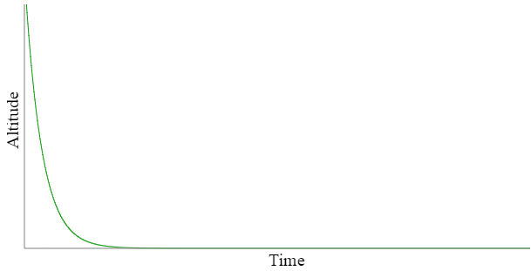
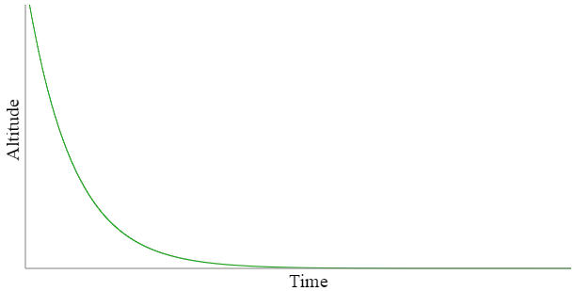
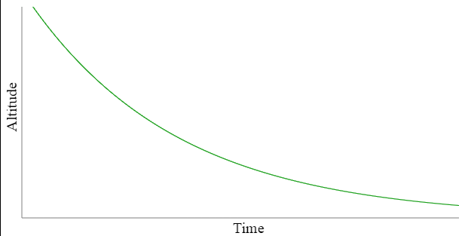
Extended Kalman Filter Part 1: A Simple Example
Imagine a airplane coming in for a landing.
Many things we might worry about
airspeed, fuel, etc., Plane's altitude (height above sea level).
The current altitude as a fraction of the previous altitude.
If the plane loses 2% of its altitude each time we observe it, then its altitude at the current time is 98% of its altitude at the previous time
altitude_{current_time} = 0.98 * altitude_{previous_time}
0.95
0.98
0.995

Slide 41
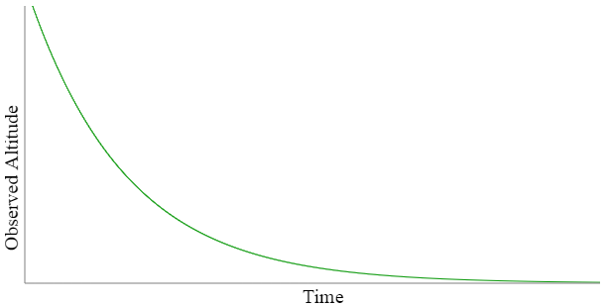
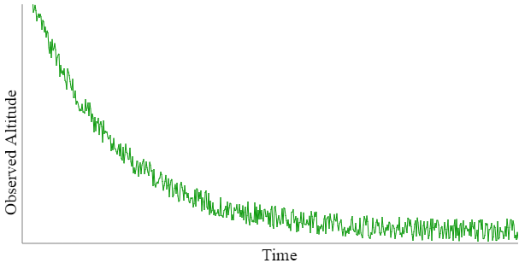
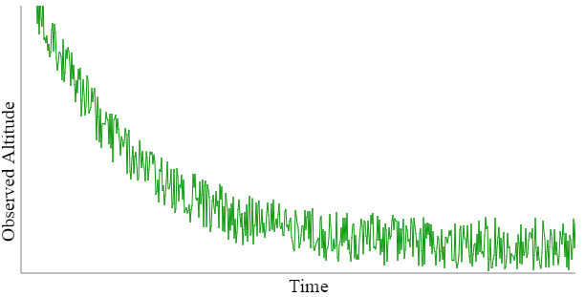
Part 2: Dealing with Noise
Real-world measurements like altitude are obtained from a sensor like a GPS or barometer.
Such sensors offer varying degrees of accuracy.
If the sensor is off by a constant amount, we can simply add or subtract that amount to determine our altitude.
observed_altitude_{current_time} = altitude_{current_time} + noise_{current_time}
0 % noise
10 % noise
20 % noise

Slide 42


Part 3: Putting it Together
now we have two equations describing the state of our airplane:
altitude_{current_time} = 0.98 * altitude_{previous_time}
observed_altitude_{current_time} = altitude_{current_time} + noise_{current_time}
Mathematical equations
Airplanes typically experience a certain amount of turbulence.
This turbulence is by definition noisy, and so can be treated as another noise signal:
xx is the current state of our system
xk−1 is its previous state aa is some constant (0.98 in our example)
zk is our current observation of the system,
vk is the current noise measurement.
altitude_{current_time} = 0.98 * altitude_{previous_time} + turbulence_{current_time}
wk is called the process noise, because, like turbulence, it is an inherent part of the process, and not an artifact of observation or measurement

Slide 43



Part 4: State Estimation
The problem of course is that we don't know the current noise vk: : it is by definition unpredictable.
Fortunately, Kalman had the insight that we can estimate the state by taking into account both the current observation and the previous estimated state.
Engineers use a little caret or “hat” ^ over a variable to show that it is estimated: so x^k is the estimate of the current state.
Then we express the estimate as a tradeoff between the previous estimate and current observation:
gg is a “gain” term expressing the tradeoff
For gk=0, we get
For gk=1 we get

Slide 44


Part 5: Computing the Gain
How do we compute the gain? Answer: indirectly, from the noise.
Recall that each observation is with a particular noise value:
We don't know the individual noise value for an observation, but we typically do know the average noise:
For example, the published accuracy of a sensor tells us approximately how noisy its output is. Call this value r: there is no subscript on it because it does not depend on time, but is instead a property of the sensor. Then we can compute the current gain gk in terms of r :
zk=xk+vk
pk is a prediction error that is computed recursively
On our previous prediction, the error pk−1 = 0. Then our current gain gk = 0/(0+r)=0, and our next state estimate will be no different from our current state estimate . It makes sense, because we shouldn't be adjusting our state estimate if our prediction was accurate.
At the other extreme, pk−1 =1: Then the gain gk = 1/(1+r). If r = 0 i.e., if there is very little noise in our system — then the gain will gk = 1, and our new state estimate xk will be strongly influenced by our observation zk. But as r grows large, the gain can become arbitrarily small. In other words, when the system is noisy enough, a bad prediction will have to be ignored. Noise overcomes our ability to correct bad predictions.

Slide 45

Part 6: Prediction and Update
First, though, you may be wondering what happened to the constant a in our original state equation:
We use the constant a in a prediction of the error as well

Slide 46

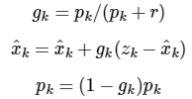
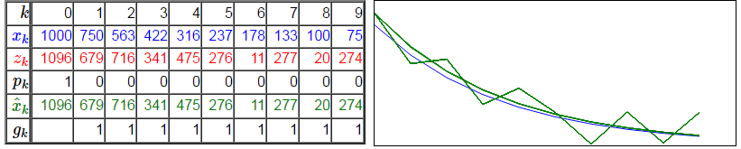
Part 7: Running the Filter
To try out our filter, we'll need:
A sequence of observations zk
An initial value (base case) x^0 for the state estimates. This can just be our first observation z0.
An initial value p0 for the prediction error. It can't be 0, otherwise pk would stay 0 forever by multiplication. So we arbitrarily set it to 1.
Predict:
Update:
We'll fake up some observations based on adding random noise vk in the interval [-200,+200] to the idealized values xk=0.75xk−1 , starting with x0=1000:
x0=100 r=0 a=0.5

Slide 47


Part 8: A More Realistic Model
Recall the two equations describing our system:
where xk is the current state of our system, xk−1 is its previous state, a is some constant, zk is our current observation of the system, and vk is the current noise (inaccuracy) associated with the observation.
For one thing, we have not accounted for the time-varying control that the pilot exercises over the airplane, by (for example) moving the control column forward and back.
To account for the control we introduce another subscripted variable uk, representing the current value of the control signal that the pilot is sending to the airplane.
Just as the previous state xk−1 was scaled by a constant amount a, this control signal can be scaled by a constant amount if we like; call it b.
So our complete equation for the state becomes
In general, any signal other than noise can be scaled by some constant, so our equation for the observation zk can be rewritten thus

Slide 48

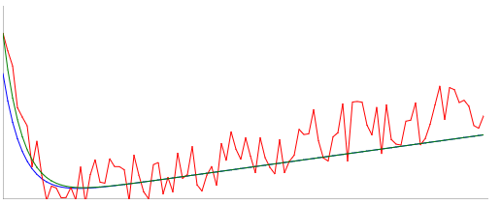


Part 9: Modifying the Estimates
More realistic/general equations for the state & observation variables of our system:
As we might expect, the introduction of these new components into our model requires a corresponding modification to the prediction and update equations:
Predict
Update
a= 0.78
r= 186
b= 0.92
c= 1.5

Slide 49
Part 10: Adding Velocity to the System
Recall our original equation for the altitude of an airplane:
with the more general form:
Altitude, after all, is a kind of distance for which we learned the formula
Can we reconcile these two different ways of thinking about distance? The answer is yes, but it will require us to take two steps.
First, we introduce the concepts current time and previous time into our high-school formula, and think about distance in discrete time steps rather than overall distance:
altitude_{current} = 0.98 * altitude_{previous}
xk=axk−1
distance = velocity * time
distance_{current} = distance_{previous} + velocity_{previous} * (time_{current} - time_{previous})
distance_{current} = distance_{previous} + velocity_{previous} * timestep

Slide 50






Part 11: Linear Algebra
Define a matrix
distance_{current} = distance_{previous} + velocity_{previous} * timestep
Introduce acceleration

Slide 51





Part 12: Prediction and Update Revisited
x is a vector and A is a matrix
Our modified formula for system state:

Slide 52


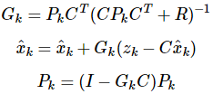

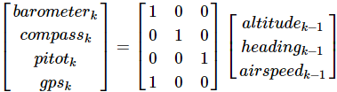
Part 13: Sensor Fusion Intro
(A, C, R)
Now we have a complete set of equations for our Kalman Filter in linear algebra (vector, matrix) form
This seems like an awful lot of work just to be able to add a few extra items to our state variable! In fact, using linear algebra supports an extremely valuable capability of the Kalman Filter, called sensor fusion.
Predict
Model
Update
Both the barometer and the GPS will be affected by altitude.

Slide 53

Part 14: Sensor Fusion Example
(A, C, R)
Lacking a state-transition model for our thermometer, we just assume that the current state is the same as the previous state.
To get a feel for how sensor fusion works, let's restrict ourselves again to a system with just one state.
To simplify things even further, we'll assume we have no knowledge of the state-transition model (A matrix) and so have to rely only on the sensor values
Perhaps we are measuring the temperature outside with two different thermometers. So we'll just set our state-transition matrix to A = 1:
For sensor fusion we will need more than one sensor value in our observation vector zk, which for this example we can treat as the current readings of our two thermometers.
We'll assume that both sensors contribute equally to our temperature estimation, so our C matrix is just a pair of 1's:

Slide 54

Part 14: Sensor Fusion Example
(A, C, R)
We defined r as the variance of the observation noise signal vk;
how much it varies around its mean (average) value
For a system with more than two sensors, R is a matrix containing the covariance between each pair of sensors
The elements on the diagonal of R will be the r value for each sensor, i.e., that sensor's variance with itself
Elements of the diagonal represent how much one sensor's noise varies with another's. For this example, and many real-world applications, we assume that such values are zero.
Let's say that we've observed both our thermometers under climate-controlled conditions of steady temperature, and observed that their values fluctuate by an average of 0.8 degrees; i.e., the standard deviation of their readings is 0.8, making the variance 0.8 * 0.8 = 0.64.
This gives us the R matrix

Slide 55
Part 14: Sensor Fusion Example
(A, C, R)
Now we can also see why Pk and Gk must be matrices
Pk is the covariance of the estimation process at step k
Since Gk is the gain associated with these matrices at each step, Gk must be likewise be a matrix, containing a gain value for each covariance value in these matrices
Size of Pk and Gk
In our present example, the size of Pk is 1×1 (i.e., a single value), because it represents the covariance of the single value estimate value x^k with itself.
The gain Gk is a 1×2 (one row, two column) matrix, because it relates the single state estimate x^k two (the two sensor observations in zk).

Slide 56

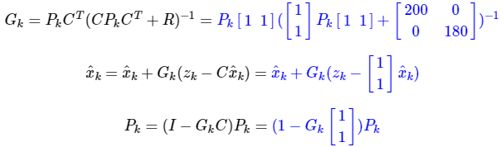
Part 14: Sensor Fusion Example
(A, C, R)
Predict
Update

Slide 57
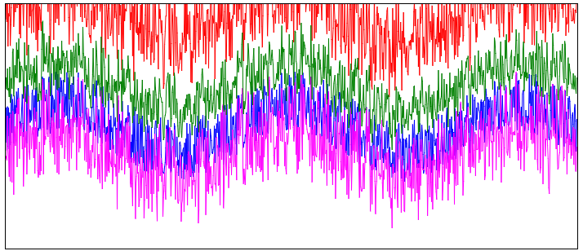
Part 14: Sensor Fusion Example
Sensor 1 Bias = 4.565Sensor 2 Bias = -1
R1 = 0.555 | R2 = 0.515 | Q = 0.5295

Slide 58
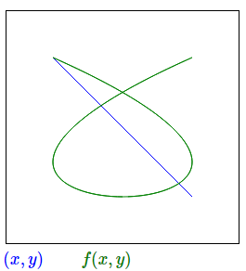
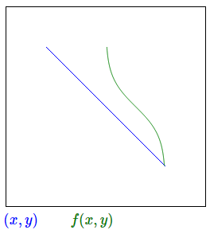
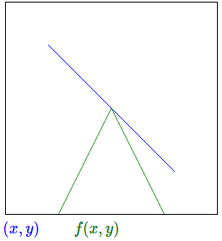



Part 15: Nonlinearity
By now linear algebra is pretty awesome, letting us express a sophisticated algorithm like the Kalman Filter in a very compact form.
Linear algebra is however not the whole story. As its name suggests, linear algebra is limited to representing relationships that are linear, i.e., characterized by a straight line.
Yet, very little in nature is linear

Slide 59
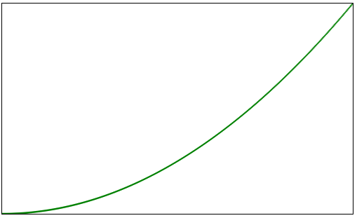
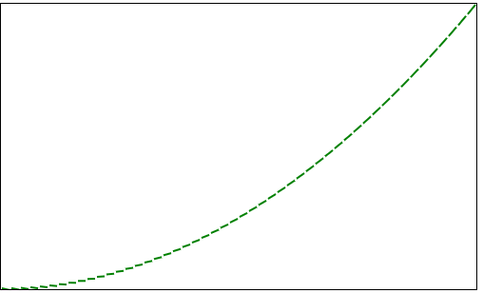
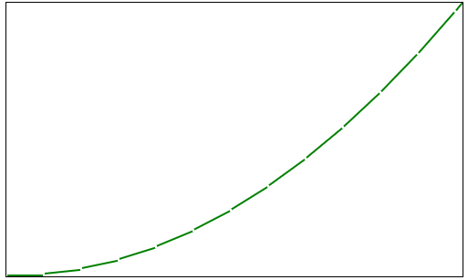
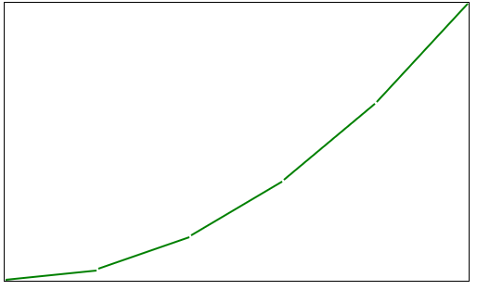
Part 16: Dealing with Nonlinearity
Nonlinearity introduces a whole new world of possible variations into any system, hope is not lost.
The first two demos in the previous demo have a useful property in common:
they are all smoothly curved, as opposed to the final example, which has sharp turnaround.
Mathematicians refer to such smoothly curving functions as differentiable.
As anyone who has studied calculus can attest, differentiable functions (smooth curves) can be modeled to an arbitrary degree of precision by a sequence of successively smaller line segments.
Even without calculus, you can see this in the demo below, which allows you to approximate the function f(x)=x^2 by adjusting the size of the line segment Δx:
Δx = 1
Δx = 10
Δx = 40
Δx = 100

Slide 60
Part 16: Dealing with Nonlinearity (continue)
How does this line-segment trick help handle nonlinear relationships in our Kalman Filter?
Now consider a nonlinear sensor equation
There are no constants a and such that zk=axk+b
The first derivative of a function is really just the best linear (line-segment) approximation to that function at each given point.
A little Googling reveals that the first derivative of log2(x) is approximately 1/0.693x, which makes sense: as x increases, the value of log2(x) goes up more and more gradually.

Slide 61





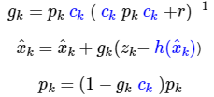
Part 17: A Nonlinear Kalman Filter
Model:
Using a function h to stand in for any nonlinear function (like log2 in our example) , and ck to stand for its first derivative at timestep k
Predict:
Update

Slide 62
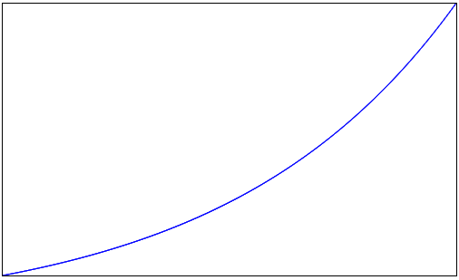
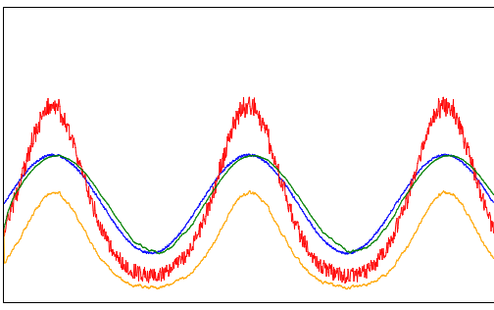
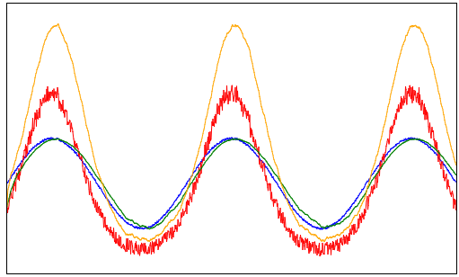

Part 17: A Nonlinear Kalman Filter
h(x)
Sensor Fusion Demo
Linear approximation c = 1.79
Linear approximation c = 0.72
Linear approximation c = 1.00

Slide 63



Part 18: Computing the Derivative
If you've made it this far, you are in a very good position to understand the Extended Kalman Filter. There are just two more things to consider:
How to compute the first derivative from an actual signal, without knowing its underlying function.
To answer the first question, we note that the first derivative of a function is defined as the limit of the difference between successive values of that function, divided by the timestep, as the timestep approaches zero:
How to generalize our single-valued nonlinear state/observation model to the multi-valued systems we've been considering.
If one signal (like sensor value zk) is a function of another signal (like state xk), we can divide successive differences of the first signal by successive differences of the second signal.

Slide 64
Part 19: The Jacobian
How to generalize our single-valued nonlinear state/observation model to a multi-valued systems
Previously we use the matrix and linear algebra for linear systems
For non-linear systems,
partial derivative
the matrix of such derivatives they call the Jacobian

