Slide 1
Big Data Analysis and Mining
Lecture 7: Recommendation System
Weixiong Rao 饶卫雄
Tongji University 同济大学软件学院
2017 Fall
wxrao@tongji.edu.cn
  *Some of the slides are from Dr Jure Leskovec’s and Prof. Zachary G. Ives

Slide 2


Example: Recommender Systems
Customer X ▪
  Buys Metallica CD
  Buys Megadeth CD
Customer Y ▪
  Does search on Metallica
  Recommender system suggests Megadeth from data collected about customer X

Slide 3
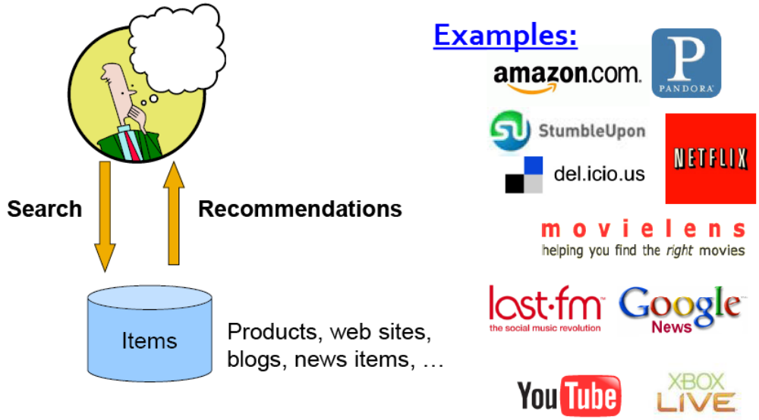
Recommendations

Slide 4
From Scarcity to Abundance
Shelf space is a scarce commodity for traditional retailers ▪
  Also: TV networks, movie theaters,…
Web enables near-zero-cost dissemination of information about products ▪
  From scarcity to abundance
More choice necessitates better filters
  Recommendation engines
  How Into Thin Air made Touching the Void a bestseller: http://www.wired.com/wired/archive/12.10/tail.html

Slide 5
Types of Recommendations
Editorial and hand curated ▪
  List of favorites
  Lists of “essential” items
Simple aggregates ▪
  Top 10, Most Popular, Recent Uploads
Tailored to individual users ▪
  Amazon, Netflix, …

Slide 6


Slide 7
Formal Model
X = set of Customers
S = set of Items
Utility function u : X × S → R ▪
  R = set of ratings
  R is a totally ordered set
  e.g., 0-5 stars, real number in [0,1]

Slide 8
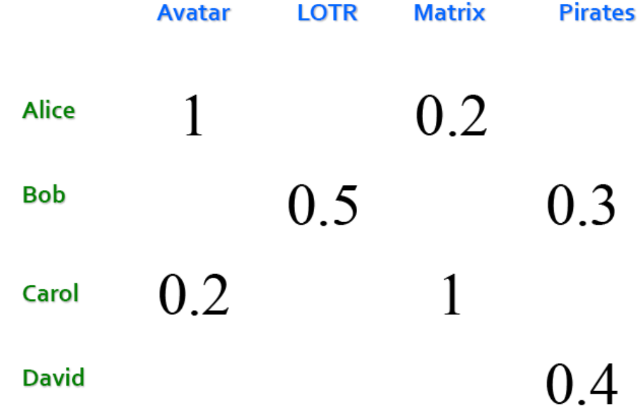
Utility Matrix

Slide 9
Key Problems
(1) Gathering “known” ratings for matrix ▪
  How to collect the data in the utility matrix
(2) Extrapolate unknown ratings from the known ones ▪
  Mainly interested in high unknown ratings ▪
    We are not interested in knowing what you don’t like but what you like
(3) Evaluating extrapolation methods ▪
  How to measure success/performance of recommendation methods

Slide 10
(1) Gathering Ratings
Explicit ▪
  Ask people to rate items
  Doesn’t work well in practice
    People can’t be bothered
Implicit ▪
  Learn ratings from user actions ▪
    E.g., purchase implies high rating
  What about low ratings?

Slide 11
(2) Extrapolate Utilities
Key problem: Utility matrix U is sparse
  Most people have not rated most items
  Cold start: ▪
    New items have no ratings
    New users have no history
Three approaches to recommender systems:
  1) Content-based
  2) Collaborative

Slide 12
Content-based Recommender System

Slide 13
Content-based Recommendations
Main idea:
  Recommend items Y to customer x similar to previous items Y’ rated highly by x
    Y is similar to Y’, and Y’ is highly rated by x.
Example:
  Movie recommendations ▪
    Recommend movies with same actor(s), director, genre, …
Websites, blogs, news ▪
  Recommend other sites with “similar” content

Slide 14
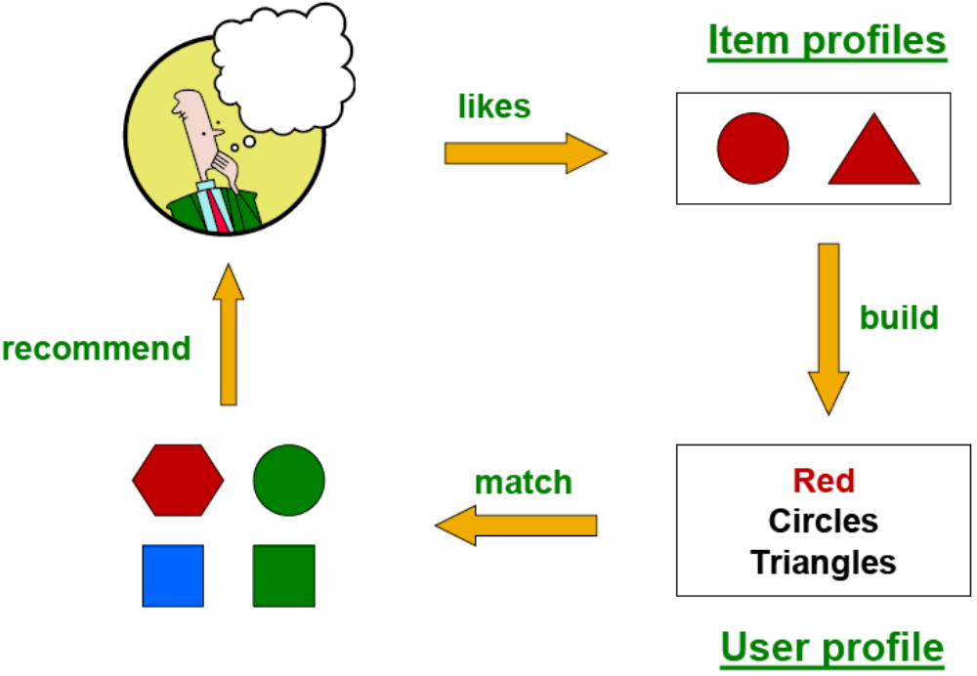
Plan of Actions
X
Y
Y’

Slide 15
Item Profiles
For each item, create an item profile
Profile is a set (vector) of features ▪
  Movies: author, title, actor, director,…
  Text: Set of “important” words in document
How to pick important features? ▪
  Usual heuristic from text mining is TF-IDF
      (Term frequency * Inverse Doc Frequency) ▪
    Term … Feature
    Document … Item

Slide 16
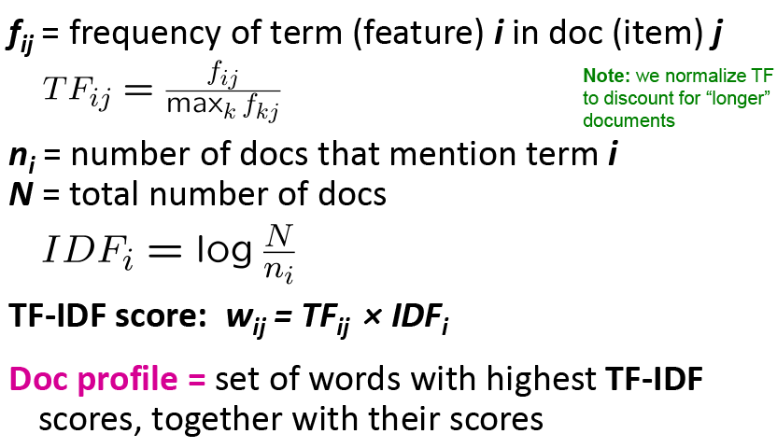
Backup Note: TF*IDF

Slide 17
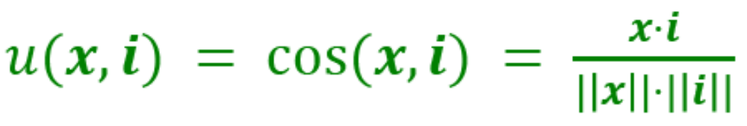
User Profiles and Prediction
User profile possibilities: ▪
  Weighted average of rated item profiles
  Variation: weight by difference from average rating for item
  …
Prediction heuristic: ▪
  Given user profile x and item profile i, estimate

Slide 18
Pros of the content-based approach
+: No need for data on other users ▪
  No cold-start or sparsity problems
+: Able to recommend to users with unique tastes
+: Able to recommend new & unpopular items ▪
  No first-rater problem
+: Able to provide explanations ▪
  Can provide explanations of recommended items by listing content-features that caused an item to be recommended

Slide 19
Cons of the Content-based Approach
–: Finding the appropriate features is hard
  E.g., images, movies, music
–: Recommendations for new users ▪
  How to build a user profile?
–: Overspecialization ▪
  Never recommends items outside user’s content profile
  People might have multiple interests
  Unable to exploit quality judgments of other users

Slide 20
Collaborative Filtering
Harnessing quality judgement of other users

Slide 21
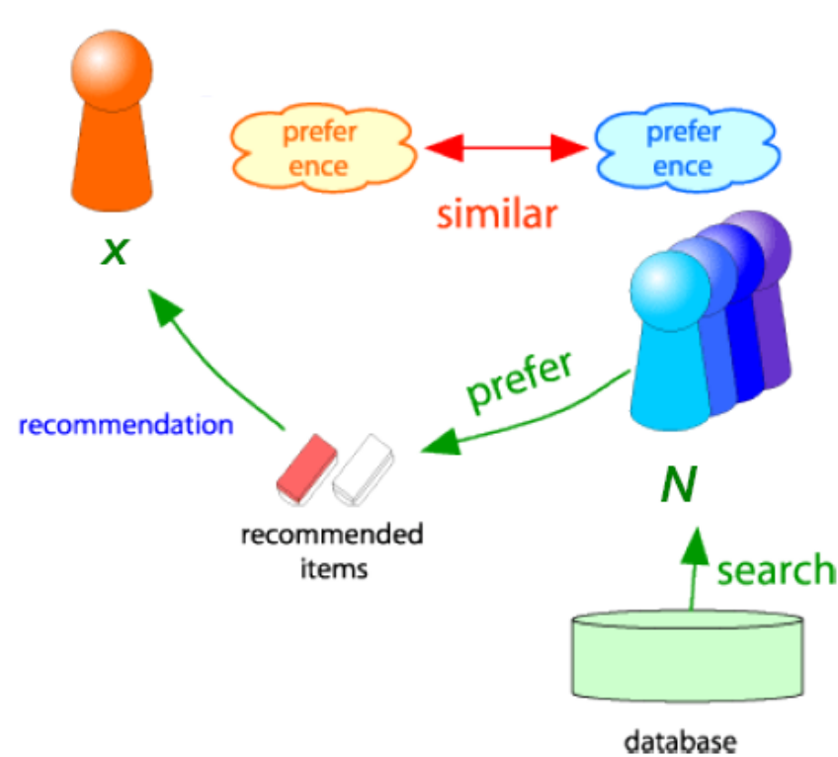
Collaborative Filtering
Consider user x
Find set N of other users whose ratings are “similar” to x’s ratings
Estimate x’s ratings based on ratings of users in N

Slide 22
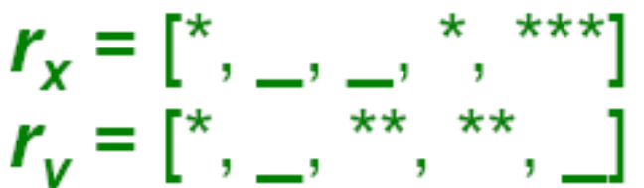
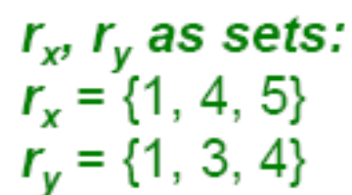
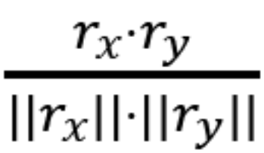
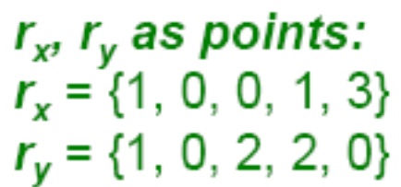
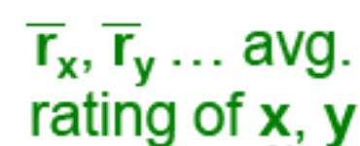
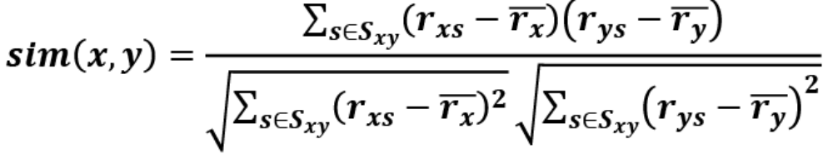
Finding Similar Users
Let rx be the vector of user x’s ratings
  Jaccard similarity measure ▪
    Problem: Ignores the value of the rating
Cosine similarity measure ▪
  sim(x, y) = cos(rx, ry) =
  Problem: Treats missing ratings as “negative”
Pearson correlation coefficient ▪
  Sxy = items rated by both users x and y

Slide 23
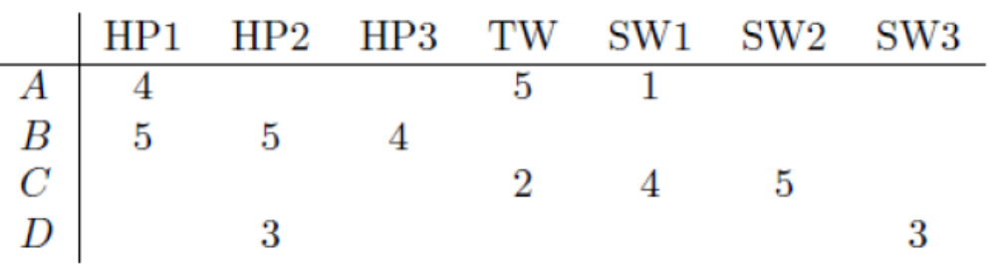
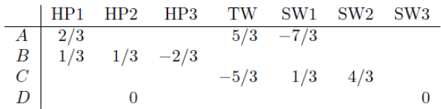
Similarity Metric
Intuitively we want: sim(A, B) > sim(A, C)
Jaccard similarity: 1/5 < 2/4
Cosine distance: 0.386 > 0.322 ▪
  Considers missing ratings as “negative”
  Solution: Normalization (subtract the row mean)
sim A,B vs. A,C: 0.092 > -0.559

Slide 24
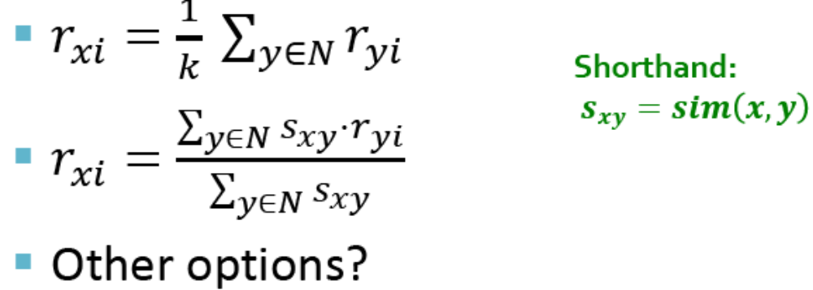
Rating Predictions
From similarity metric to recommendations:
  Let rx be the vector of user x’s ratings
  Let N be the set of k users most similar to x who have rated item i
  Prediction for item i of user x:

Slide 25
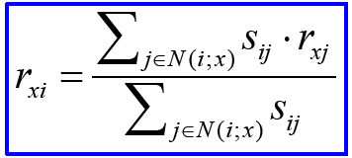
Item-item Collaborative Filtering
So far: User-user collaborative filtering
Another view: Item-item ▪
  For item i, find other similar items
  Estimate rating for item i based on ratings for similar items
  Can use same similarity metrics and prediction functions as in user-user model
sij… similarity of items i and j
rxj…rating of user u on item j
N(i;x)… set items rated by x similar to i

Slide 26
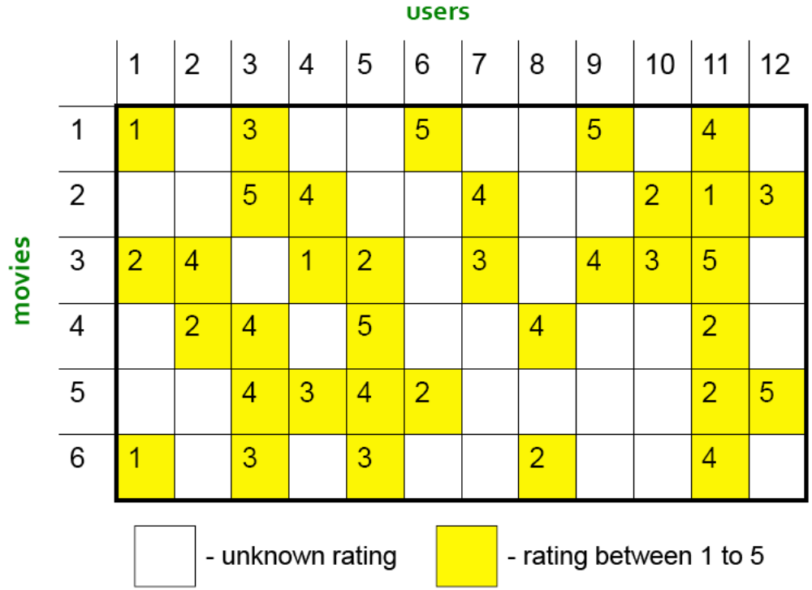
Item-item CF (|N|=2)

Slide 27


Item-item CF (|N|=2)

Slide 28
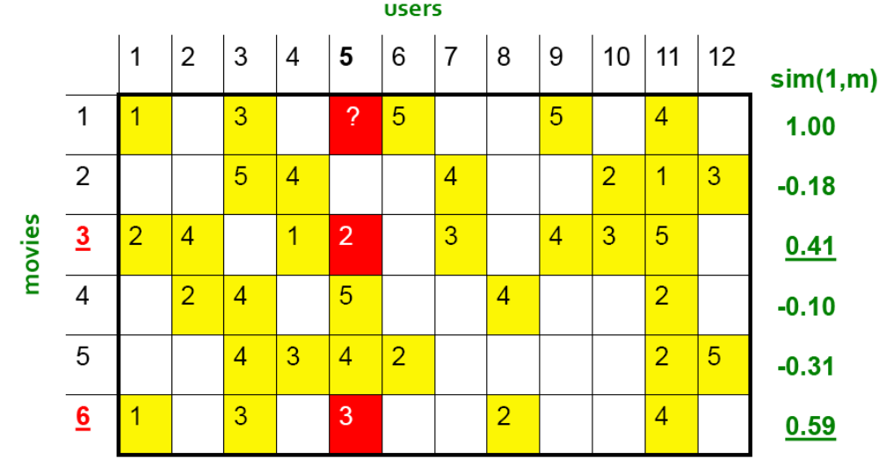
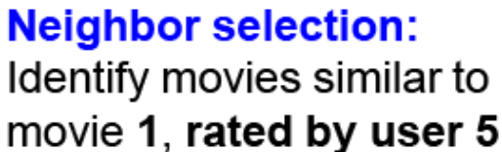
Item-item CF (|N|=2)
Here we use Pearson correlation as similarity:
Subtract mean rating mi from each movie i
m1 = (1+3+5+5+4)/5 = 3.6
row 1: [-2.6, 0, -0.6, 0, 0, 1.4, 0, 0, 1.4, 0, 0.4, 0]
2) Compute cosine similarities between rows

Slide 29
Item-item CF (|N|=2)
Compute similarity weights:
s1,3=0.41,
s1,6=0.59

Slide 30
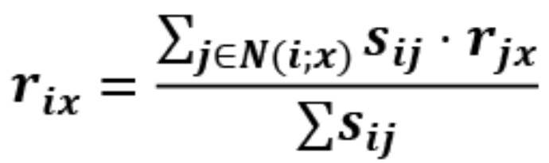
Item-item CF (|N|=2)
2.6
Predict by taking weighted average:
r1.5 = (0.41*2 + 0.59*3) / (0.41+0.59) = 2.6

Slide 31
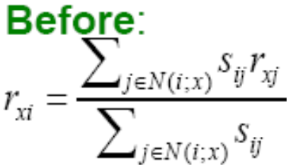
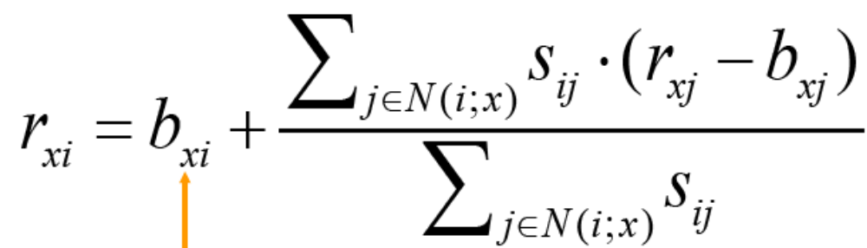

CF: Common Practice
Define similarity sij of items i and j
Select k nearest neighbors N(i; x)
  Items most similar to i, that were rated by x
Estimate rating rxi as the weighted average:
2.6
baseline estimate for rxi
○μ = overall mean movie rating
○bx = rating deviation of user x
= (avg. rating of user x) – μ
○bi = rating deviation of movie i

Slide 32
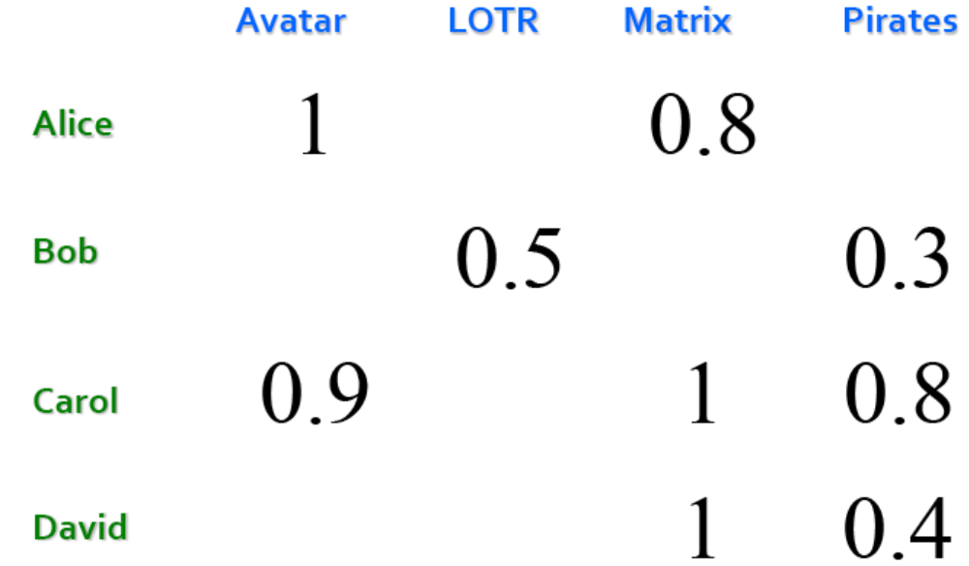
Item-Item vs. User-User
In practice, it has been observed that item-item often works better than user-user
Why? Items are simpler, users have multiple tastes

Slide 33
Pros/Cons of CF
+ Works for any kind of item ▪
  No feature selection needed
- Cold Start: ▪
  Need enough users in the system to find a match
- Sparsity: ▪
  The user/ratings matrix is sparse
  Hard to find users that have rated the same items
- First rater: ▪
  Cannot recommend an item that has not been previously rated
  New items, Esoteric items
- Popularity bias: ▪
  Cannot recommend items to someone with unique taste
  Tends to recommend popular items

Slide 34
Hybird Methods
Implement two or more different recommenders and combine predictions
  Perhaps using a linear model
Add content-based methods to collaborative filtering ▪
  Item profiles for new item problem
  Demographics to deal with new user problem

Slide 35
Remarks & Practical Tips
- Evaluation
- Error metrics
- Complexity / Speed

Slide 36
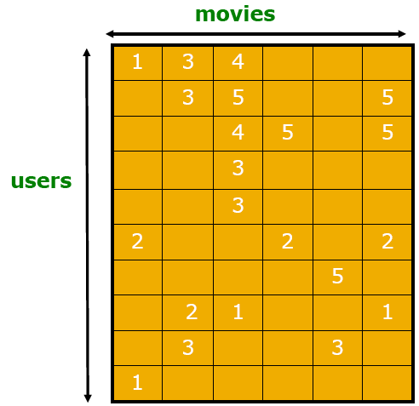
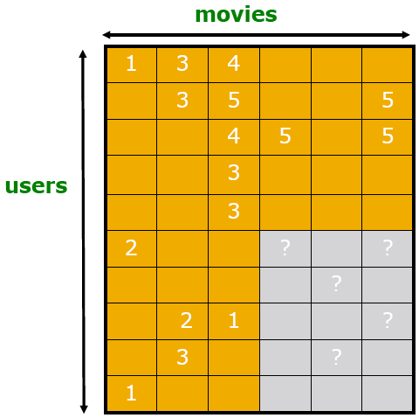
Evalution
Test Data Set

Slide 37
Evaluating Predictions
Compare predictions with known ratings ▪
  Root-mean-square error (RMSE) ▪
  Precision at top 10: ▪
    % of those in top 10
  Rank Correlation: ▪
    Spearman’s correlation between system’s and user’s complete rankings
Another approach: 0/1 model ▪
  Coverage: ▪
    Number of items/users for which system can make predictions
  Precision: ▪
    Accuracy of predictions
  Receiver operating characteristic (ROC) ▪
    Tradeoff curve between false positives and false negatives

Slide 38
CF: Complexity
Expensive step is finding k most similar customers: O(|X|)
Too expensive to do at runtime ▪
  Could pre-compute
Naïve pre-computation takes time O(k ·|X|)
  X … set of customers
We already know how to do this! ▪
  Near-neighbor search in high dimensions (LSH)
  Clustering (due to the very sparse matrix)
  Dimensionality reduction → Next lecture
    Transform the sparse matrix into the product of two long, thin matrices

Slide 39
Tip: Add Data
Leverage all the data ▪
  Don’t try to reduce data size in an effort to make fancy algorithms work
  Simple methods on large data do best
Add more data ▪
  e.g., add IMDB data on genres
More data beats better algorithms http://anand.typepad.com/datawocky/2008/03/more-data-usual.html

Slide 40
Netflix Prize
Training data ▪
  100 million ratings, 480,000 users, 17,770 movies
  6 years of data: 2000-2005
Test data ▪
  Last few ratings of each user (2.8 million)
  Evaluation criterion: root mean squared error (RMSE)
  Netflix Cinematch RMSE: 0.9514
Competition ▪
  2700+ teams
  $1 million prize for 10% improvement on Cinematch

Slide 41
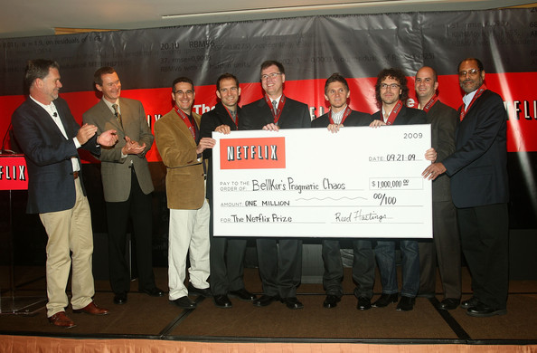
BellKor's Pragmatic Chaos is the winner of the $1 Million Netflix Prize!!!!!
Y. Koren, "The BellKor Solution to the Netflix Grand Prize", (2009).
A. Töscher, M. Jahrer, R. Bell, "The BigChaos Solution to the Netflix Grand Prize", (2009).
M. Piotte, M. Chabbert, "The Pragmatic Theory solution to the Netflix Grand Prize", (2009).

