Slide 1
Big Data Analysis and Mining
K-means & EM & DBScan & Validity
Weixiong Rao 饶卫雄
2017 Fall

Slide 2
Partitioning Algorithms
Partitioning method: Construct a partition of n data into a set of K clusters
Given: a set of data and the number K
Find: a partition of K clusters that optimizes the chosen partitioning criterion
  Globally optimal
    Intractable for many objective functions
    Ergo, exhaustively enumerate all partitions
  Effective heuristic methods: K-means and K-medoids algorithms

Slide 3
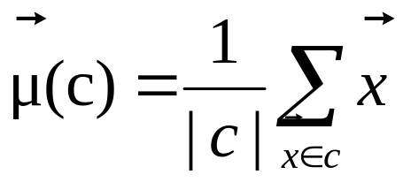
K-Means
Assumes data points are real-valued vectors.
Clusters based on centroids (aka the center of gravity or mean) of points in a cluster, c:
Reassignment of instances to clusters is based on distance to the current cluster centroids.
  (Or one can equivalently phrase it in terms of similarities)

Slide 4
K-Means Algorithm
Select K random data {c₁, c₂ ,… c_{K}} from data {x₁, x₂ ,… x_{N}} as seeds.
Until clustering converges (or other stopping criterion):
//partitioning
For each point x_{i}:
Assign x_{i} to the cluster c_{j} such that dist(x_{i}, c_{j}) is minimal.
//Next, update the centroid of each cluster
For each cluster c_{j}
c_{j} = μ(c_{j})

Slide 5
K Means Example (K=2)
Pick seeds
Reassign clusters
Compute centroids
Reassign clusters
x
x
x
Compute centroids
x
x
x
Reassign clusters
Converged!

Slide 6



Example
10
10
9
9
8
8
7
7
6
6
5
5
4
Assign each objects to most similar center
Update the cluster means
4
3
3
2
2
1
1
0
0
0
1
2
3
4
5
6
7
8
9
10
0
1
2
3
4
5
6
7
8
9
10
reassign
reassign
K=2
Arbitrarily choose K object as initial cluster center
Update the cluster means

Slide 7
Termination conditions
Several possibilities, e.g.,
  A fixed number of iterations.
  data partition unchanged.
  Centroid positions don’t change.
Does this mean that the data in a cluster are unchanged?

Slide 8
Convergence
Why should the K-means algorithm ever reach a fixed point?
  A state in which clusters don’t change.
K-means is a special case of a general procedure known as the Expectation Maximization (EM) algorithm.
  EM is known to converge.
  Number of iterations could be large.
      But in practice usually isn’t

Slide 9
Time Complexity
Computing distance between two data points is O(D) where D is the dimensionality of the vectors.
Reassigning clusters: O(KN) distance computations, or O(KND).
Computing centroids: Each point gets added once to some centroid: O(ND).
Assume these two steps are each done once for I iterations: O(IKND).

Slide 10

Strengths of K-means clustering
Relatively scalable in processing large data sets
Relatively efficient: O(tkn), where n is # objects, k is # clusters, and t is # iterations. Normally, k, t << n.
Often terminates at a local optimum; the global optimum may be found using techniques such as genetic algorithms

Slide 11

Weaknesses of K-means clustering
Applicable only when the mean of objects is defined
Need to specify k, the number of clusters, in advance
Unable to handle noisy data and outliers
Not suitable to discover clusters with non-convex shapes, or clusters of very different size

Slide 12
Model based clustering
Algorithm optimizes a probabilistic model criterion
Clustering is usually done by the Expectation Maximization (EM) algorithm
  Gives a soft variant of the K-means algorithm
  Assume k clusters: {c₁, c₂,… c_{k}}
  Assume a probabilistic model of categories that allows computing P(c_{i} | E) for each category, c_{i}, for a given example, E.
  Parameters θ = {P(c_{i}), P(w_{j} | c_{i}): i∈{1,…k}, j∈{1,…,|V|}}

Slide 13
最大似然估计
(Maximum likelihood estimation: MLE)
The data is coming from a known probability distribution
The probability distribution has some parameters that are unknown to you
  Example: data is distributed as Gaussian y_{i} ~ N(μ, σ²),
  so the unknown parameters here are θ = (μ, σ²)
MLE is a tool that estimates the unknown parameters of the probability distribution from data
“模型已定，参数未知”
给定观察数据来评估模型参数的方法

Slide 14
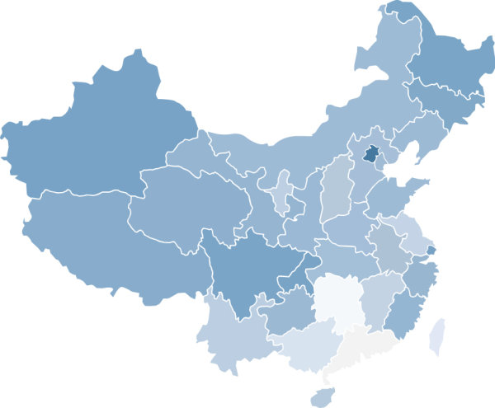

最大似然估计:举例
统计全国人口的身高
假设身高服从服从高斯分布，但是该分布的均值与方差未知
没有人力与物力去统计全国每个人的身高
最大似然估计
估计该分布的参数
(均值和方差)
采样
重要的假设:
所有的采样都是独立分布的

Slide 15



MLE: Recapitulation
独立同分布的采样
Assume observation data x_{i} are independent
假定我们已知的为 ,而θ未知→模型已定, 参数未知
故似然定义为
实际应用中常用的是两边取对数，得到Log-likelihood:
To find out the unknown parameter values, maximize the log-likelihood with respect to the unknown parameters:
θ为模型参数,f为我们所使用的模型
参数为θ的模型f产生上述采样可表示为
平均对数似然
最大似然估计的求解过程：
（1） 写出似然函数；
（2） 似然函数取对数，并整理；
（3） 求导数 ；
（4） 解似然方程

Slide 16











MLE:举例1
盒子里面有绿球和紫球两种，但是不知道其数量和比例
想知道罐中绿球和紫球的比例，
但不能把罐中的球全部拿出来数
?
?
可以每次任意从已经摇匀的罐中拿一个球出来，记录球的颜色，然后把拿出来的球 再放回罐中。
这个过程可以重复，我们可以用记录的球的颜色来估计罐中绿紫球的比例
假如在前面的一百次重复记录中，有七十次是白球，请问罐中白球所占的比例最有可能是多少？70%!
p
1-p
在一百次抽样中，七十次是白球的概率是P(Data | M)
Data = (x1,x2,…,x100), M是所给模型，表示每次抽出来的球是绿色概率为p
P(Data | M) = P(x1,x2,…,x100|M)
= P(x1|M)P(x2|M)…P(x100|M)
= p^70(1-p)^30.
Max P(Data |M)：
将p^70(1-p)^30对p求导，并其等于零
70p^69(1-p)^30-p^70*30(1-p)^29=0
p=0.7

Slide 17


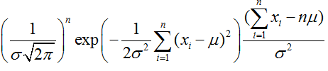
MLE:举例2
有一组连续变量的采样值(x1,x2,…,xn), 已知数据服从高斯分布和标准差
  问这个正态分布的期望值为多少时, 产生这个已有数据的概率最大？
P(Data | M) = ？
对μ求导
最大似然估计的结果为μ=(x1+x2+…+xn)/n

Slide 18
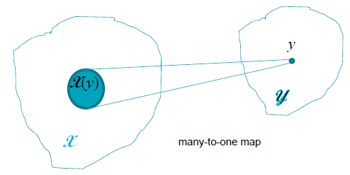


EM算法
EM是一种迭代算法，它试图找到一系列的估计参数θ⁽⁰⁾,θ⁽¹⁾,θ⁽²⁾,....使得训练数据的marginal likelihood不断增加的
ML parameter estimation when
  Direct access to all the data x = {y, z} necessary for estimation is not possible.
  Observations provide data for estimation.
  Statistical model of the process is available.
Known data
Missing data

Slide 19
Key Idea
If data needed for parameter estimation is unknown but their distribution is known, use the expected value of the unknown data given
  An initial estimate of the parameters.
  The known data.
Obtain the maximum likelihood estimate of the parameters given the complete set of data (known data + estimate of unknown data)
Iterate till the estimate converges.

Slide 20
EM 算法步骤
E(xpectation): obtain expected values for the missing data using an initial parameter estimate.
M(aximization): obtain the maximum likelihood estimate of the parameters using the estimated data.
Repeat till estimate converges.

Slide 21
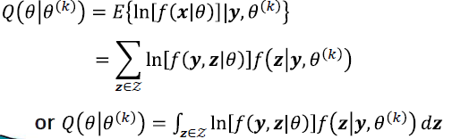
E-step
At time k with parameter estimate θ ^{(k)}, compute the Q(auxiliary) function.
Q = expected value of the log-likelihood of the complete data x = {y, z}, given the current parameter estimate and the measurements y.

Slide 22

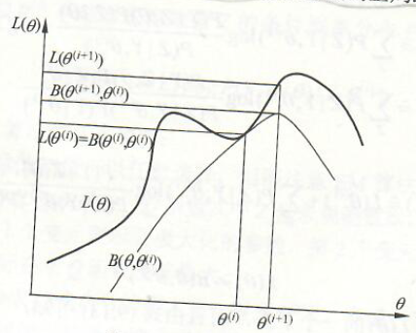
M-step
Obtain the updated maximum likelihood parameter estimate using the function
在迭代过程中，不断对下界的极大值求解，对数似然函数极大化的过程

Slide 23
EM Algorithm: Summary
Augment the original data space by latent/hidden/missing data
Frame a suitable probability model for the augmented data space
In EM iterations, first assume initial values for the parameters
Iterate the Expectation and the Maximization steps
In the Expectation step, find the expected values of the latent variables (here you need to use the current parameter values)
In the Maximization step, first plug in the expected values of the latent variables in the log-likelihood of the augmented data. Then maximize this log-likelihood to reevaluate the parameters
Iterate last two steps until convergence

Slide 24
Applications of EM
  Mixture models
  Clustering
  HMMs
  PCA
  Latent variable models
  Missing data problems
  many computer vision problems
  …

Slide 25
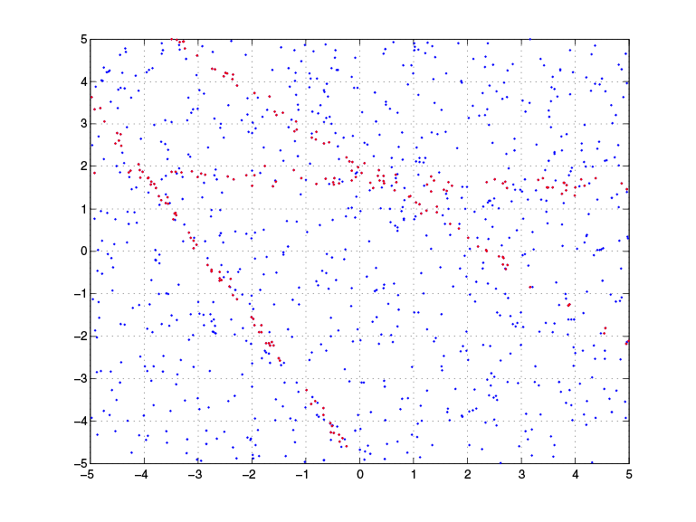
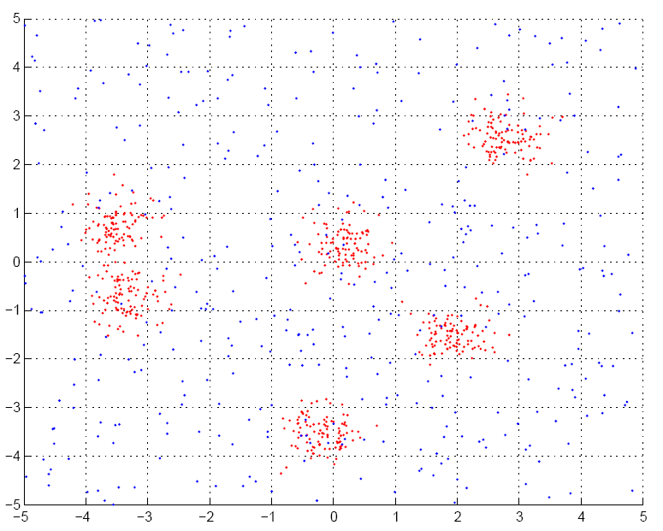
Applications of EM (1)
Fitting mixture models

Slide 26
Applications of EM (2)
Probabilistic Latent Semantic Analysis (pLSA)
  Technique from text community
P(w,d)
P(w|z)
P(z|d)
Z
W
W
D
D
Z

Slide 27
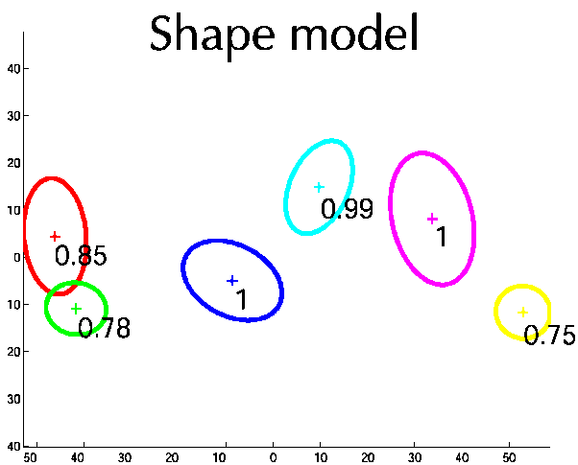
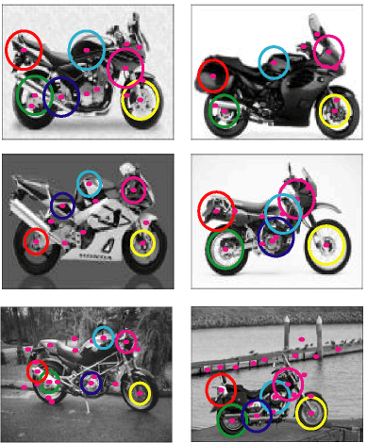
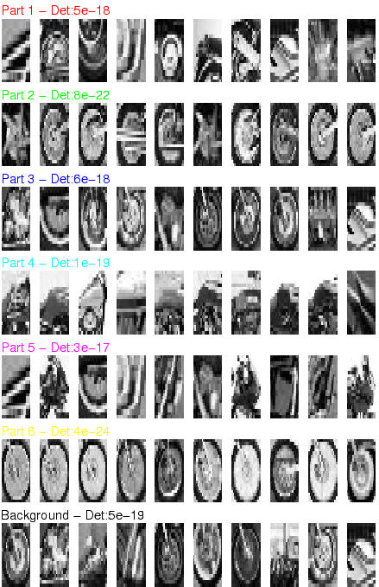
Applications of EM (3)
Learning parts and structure models

Slide 28
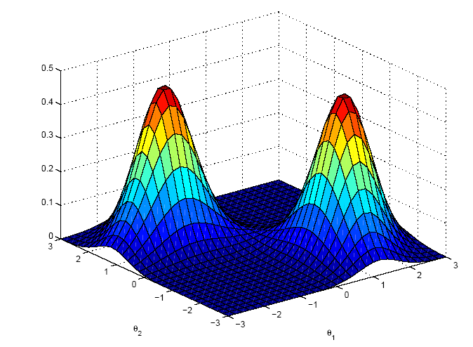



Likelihood function
Likelihood is a function of parameters, θ
Probability is a function of r.v. x

Slide 29



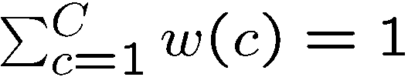



Motivating example
Data:
-4
-3
-2
-1
0
1
2
3
4
5
OBJECTIVE: Fit mixture of Gaussian model with C=2 components
Model:
where
Parameters:
P(x|θ)
keep
fixed
i.e. only estimate
x

Slide 30
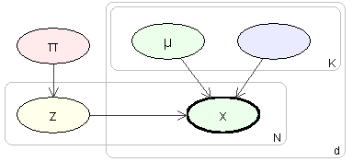
Probabilistic model
Imagine model generating data
Need to introduce label, z, for each data point
Label is called a latent variable
also called hidden, unobserved, missing
σ
c
-4
-3
-2
-1
0
1
2
3
4
5
Simplifies the problem:
if we knew the labels, we can decouple the components as estimate parameters separately for each one

Slide 31
Intuition of EM
E-step: Compute a distribution on the labels of the points, using current parameters
M-step: Update parameters using current guess of label distribution.
E
M
E
M
E

Slide 32
Theory

Slide 33
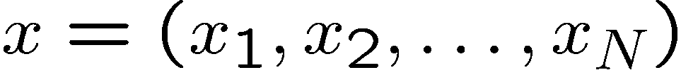


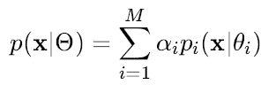
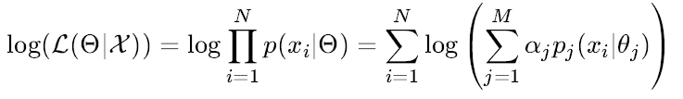




Some definitions
Observed data
Continuous I.I.D
Latent variables
Iteration index
Probabilistic model:
Log-likelihood [Incomplete log-likelihood (ILL)]
Complete log-likelihood (CLL)
Q function

Slide 34


EM Algorithm
The EM Algorithm alternates the E-step and the M-step. Each iteration is guaranteed to increase the log-likelihood and the algorithm. The algorithm is guaranteed to converge to a local maximum of likelihood function.
E-Step
M-Step

Slide 35



Estimates of the new parameters
The equations perform both the expectation step and the maximization step simultaneously.

Slide 36
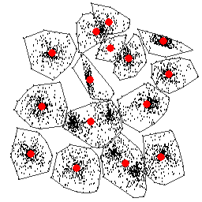
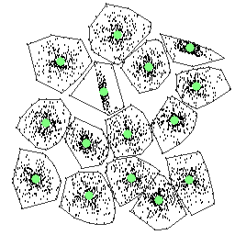
Kmeans V.S. EM
Local optimal
k-means:
Preferred input data structure: spherical (MSE)
Parameter: the number of clusters
Output cluster structure: centroid, partition
Initialization -> local optimal
Optimal

Slide 37



1140km
2160m
1864m
HuangShan Mountain
HuaShan Mountain
Notes:
An illustration on the local optimal problem of EM algorithm.
HuangShan Mountain is in the same province as where the conference holds and HuaShan Mountain is 1140 km away from HuangShan moutain.
Considering maximization estimation problem as climbing mountain to find the highest mountain in China. With a starting point in HuangShan, we can reach the highest point of Huangshan (1864m), which could be considered as a local optimal in EM algorithm. However, there is a higher point (2160m) in HuaShan Mountain, which is 1140 km away. If there is a hand of god (random swap) put you at somewhere in HuaShan mountain, then it’s easily to get the higher point (better local optimal) on HuaShan mountain.

Slide 38
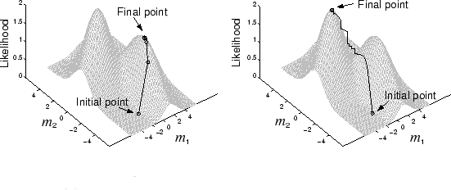
Local Optimal

Slide 39
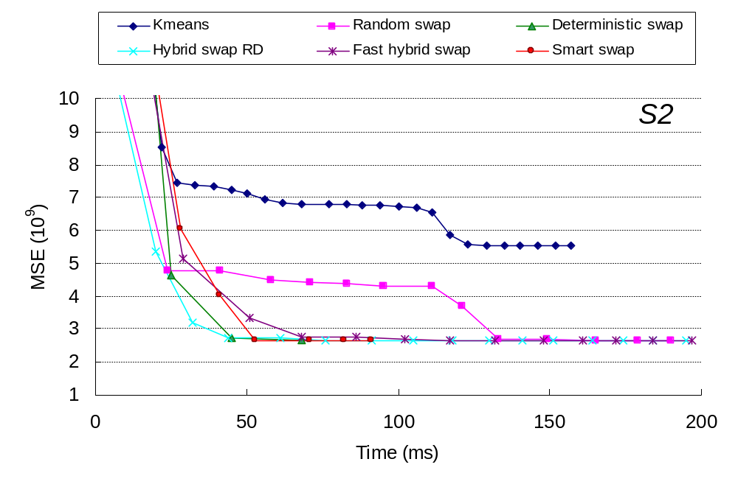
Comparison

Slide 40
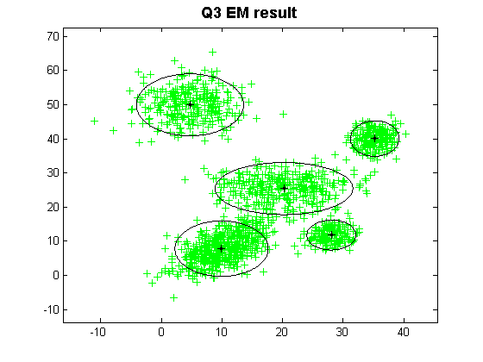
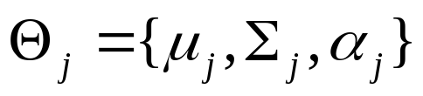
Kmeans V.S. EM
EM (Expectation-Maximization):
Preferred input data structure: Gaussian
Parameter: the number of clusters
Output cluster structure: model parameter
Initialization -> local optimal
不能保证全局最优

Slide 41
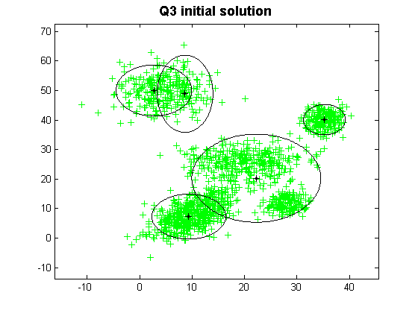

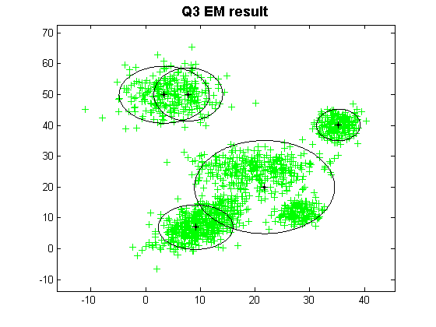
Initialization Effect in EM
对初始值敏感
Initialization and Result(1)
Initialization and Result(2)

Slide 42
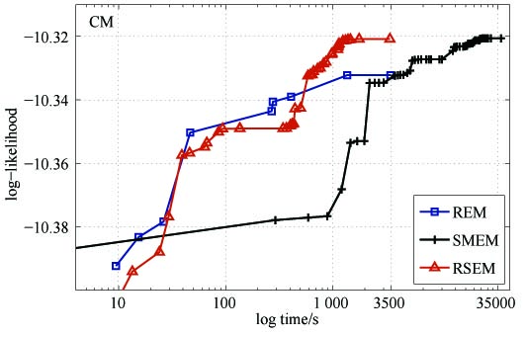
Comparisons
Data set: CM
Methods: REM, SMEM, RSEM

Slide 43
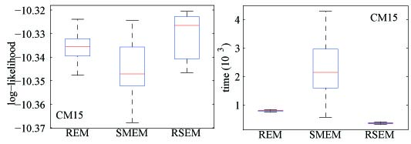
Comparisons
Data set: CM with K = 15
Methods: REM, SMEM, RSEM
50 repetitions

Slide 44
EM: Important Issues
Is the convergence of the algorithm guaranteed?
Does the outcome of EM depend on the initial choice of the parameter values?
How about the speed of convergence?
How easy or difficult could it be to compute the expected values of the latent variables?
P(y|Ɵ)必须有上界，保证收敛
是的
较慢

Slide 45
References
The EM Algorithm and Extensions by Geoffrey J. MacLauchlan, Thriyambakam Krishnan
For a non-parametric density estimate by EM look at: http://bioinformatics.uchc.edu/LectureNotes_2006/Tools_EM_SA_2006_files/frame.htm

Slide 46
Density-Based Clustering Methods
Clustering based on density (local cluster criterion), such as density-connected points
Major features:
  Discover clusters of arbitrary shape
  Handle noise
  One scan
  Need density parameters as termination condition
Several interesting studies:
  DBSCAN: Ester, et al. (KDD’96)
  OPTICS: Ankerst, et al (SIGMOD’99).
  DENCLUE: Hinneburg & D. Keim (KDD’98)
  CLIQUE: Agrawal, et al. (SIGMOD’98) (more grid-based)

Slide 47
Density-Based Clustering: Basic Concepts
Two parameters:
  Eps: Maximum radius of the neighbourhood
  MinPts: Minimum number of points in an Eps-neighbourhood of that point
N_{Eps}(q): {p belongs to D | dist(p,q) ≤ Eps}
Directly density-reachable: A point p is directly density-reachable from a point q w.r.t. Eps, MinPts if
  p belongs to N_{Eps}(q)
  core point condition:
  |N_{Eps} (q)| ≥ MinPts
p
MinPts = 5
Eps = 1 cm
q

Slide 48
Density-Reachable and Density-Connected
Density-reachable:
  A point p is density-reachable from a point q w.r.t. Eps, MinPts if there is a chain of points p₁, …, p_{n}, p₁ = q, p_{n} = p such that p_{i+1} is directly density-reachable from p_{i}
Density-connected
  A point p is density-connected to a point q w.r.t. Eps, MinPts if there is a point o such that both, p and q are density-reachable from o w.r.t. Eps and MinPts
p
p₁
q
p
q
o

Slide 49
DBSCAN: Density-Based Spatial Clustering of Applications with Noise
Relies on a density-based notion of cluster: A cluster is defined as a maximal set of density-connected points
Discovers clusters of arbitrary shape in spatial databases with noise
Eps = 1cm
MinPts = 5
Outlier
All points not reachable from any other point are outliers.
Border
A point q is reachable from p if there is a path p₁... p_{n} with p₁ = p and p_{n} = q, where each p_{i+1} is directly reachable from p_{i} (all the points on the path must be core points, with the possible exception of q).
Core
A point p is a core point if at least minPts points are within distance Eps

Slide 50
DBSCAN: The Algorithm
Arbitrary select a point p
Retrieve all points density-reachable from p w.r.t. Eps and MinPts
If p is a core point, a cluster is formed
If p is a border point, no points are density-reachable from p and DBSCAN visits the next point of the database
Continue the process until all of the points have been processed
If a spatial index is used, the computational complexity of DBSCAN is O(nlogn), where n is the number of database objects. Otherwise, the complexity is O(n²)

Slide 51
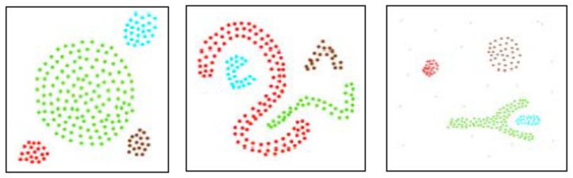

Slide 52
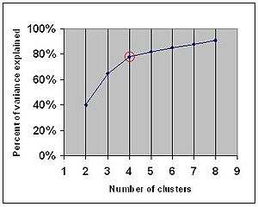
Determine the Number of Clusters
Empirical method
  # of clusters: k ≈√n/2 for a dataset of n points, e.g., n = 200, k = 10
Elbow method
  Use the turning point in the curve of sum of within cluster variance w.r.t the # of clusters
Cross validation method
  Divide a given data set into m parts
  Use m – 1 parts to obtain a clustering model
  Use the remaining part to test the quality of the clustering
    E.g., For each point in the test set, find the closest centroid, and use the sum of squared distance between all points in the test set and the closest centroids to measure how well the model fits the test set
  For any k > 0, repeat it m times, compare the overall quality measure w.r.t. different k’s, and find # of clusters that fits the data the best
https://en.wikipedia.org/wiki/Elbow_method_(clustering)

Slide 53
Measuring Clustering Quality
3 kinds of measures: External, internal and relative
External: supervised, employ criteria not inherent to the dataset
  Compare a clustering against prior or expert-specified knowledge (i.e., the ground truth) using certain clustering quality measure
Internal: unsupervised, criteria derived from data itself
  Evaluate the goodness of a clustering by considering how well the clusters are separated, and how compact the clusters are, e.g., Silhouette coefficient
Relative: directly compare different clusterings, usually those obtained via different parameter settings for the same algorithm
https://en.wikipedia.org/wiki/Silhouette_(clustering)

Slide 54
Measuring Clustering Quality: External Methods
Clustering quality measure: Q(C, T), for a clustering C given the ground truth T
Q is good if it satisfies the following 4 essential criteria
  Cluster homogeneity: the purer, the better
  Cluster completeness: should assign objects belong to the same category in the ground truth to the same cluster
  Rag bag: putting a heterogeneous object into a pure cluster should be penalized more than putting it into a rag bag (i.e., “miscellaneous” or “other” category)
  Small cluster preservation: splitting a small category into pieces is more harmful than splitting a large category into pieces

Slide 55
Some Commonly Used External Measures
Matching-based measures
  Purity, maximum matching, F-measure
Entropy-Based Measures
  Conditional entropy, normalized mutual information (NMI), variation of information
Pair-wise measures
  Four possibilities: True positive (TP), FN, FP, TN
  Jaccard coefficient, Rand statistic, Fowlkes-Mallow measure
Correlation measures
  Discretized Huber static, normalized discretized Huber static
Ground truth partitioning T₁
T₂
Cluster C₁
Cluster C₂

Slide 56
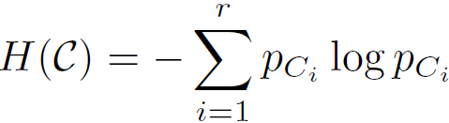

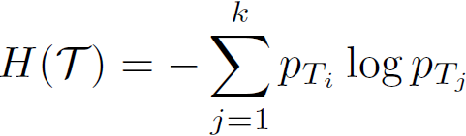
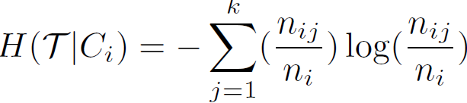
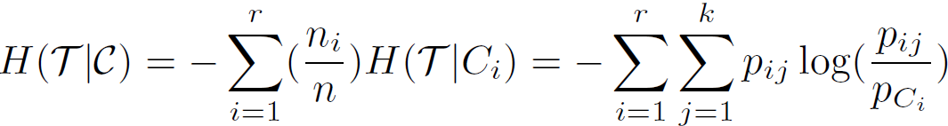

Entropy-Based Measure (I): Conditional Entropy
Entropy of clustering C:
Entropy of partitioning T:
Entropy of T w.r.t. cluster C_{i}:
Conditional entropy of T
  w.r.t. clustering C:
  The more a cluster’s members are split into different partitions, the higher the conditional entropy
  For a perfect clustering, the conditional entropy value is 0, where the worst possible conditional entropy value is log k

Slide 57
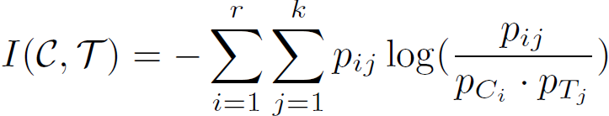

Entropy-Based Measure (II): Normalized mutual information (NMI)
Mutual information: quantify the amount of shared info between the clustering C and partitioning T:
  It measures the dependency between the observed joint probability p_{ij} of C and T, and the expected joint probability p_{Ci} * p_{Tj} under the independence assumption
  When C and T are independent, p_{ij} = p_{Ci} * p_{Tj}, I(C, T) = 0. However, there is no upper bound on the mutual information
Normalized mutual information (NMI)
    Value range of NMI: [0,1]. Value close to 1 indicates a good clustering
https://nlp.stanford.edu/IR-book/html/htmledition/evaluation-of-clustering-1.html

