Slide 1
Big Data Analysis and Mining
Decision Tree
Weixiong Rao 饶卫雄
wxrao@tongji.edu.cn
2017 Fall

Slide 2

Illustrating Classification Task
学区房
面积
价格
是否成交

Slide 3
Classification: Definition
Given a collection of records (training set )
  Each record contains a set of attributes, one of the attributes is the class.
Find a model for class attribute as a function of the values of other attributes.
Goal: previously unseen records should be assigned a class as accurately as possible.
  A test set is used to determine the accuracy of the model.
  Usually, the given data set is divided into training and test sets, with training set used to build the model and test set used to validate it.

Slide 4




Examples of Classification Task
Predicting tumor cells as benign or malignant
Classifying credit card transactions
as legitimate or fraudulent
Classifying secondary structures of protein
as alpha-helix, beta-sheet, or random
coil
Categorizing news stories as finance,
weather, entertainment, sports, etc
α螺旋
β折叠

Slide 5
What is a Decision Tree?
An inductive learning task
  Use particular facts to make more generalized conclusions
A predictive model based on a branching series of Boolean tests
  These smaller Boolean tests are less complex than a one-stage classifier
Let’s look at a sample decision tree…

Slide 6

Example – Tax cheating
categorical
categorical
continuous
class
Splitting Attributes
Refund
Yes
No
NO
MarSt
Single, Divorced
Married
TaxInc
NO
< 80K
> 80K
NO
YES
Training Data
Model: Decision Tree

Slide 7
Example – Tax cheating
categorical
categorical
continuous
class
MarSt
Single, Divorced
Married
NO
Refund
Yes
No
NO
TaxInc
< 80K
> 80K
NO
YES
There could be more than one tree that fits the same data!

Slide 8

Decision Tree Classification Task
Decision Tree

Slide 9

Apply Model to Test Data
Test Data
Start from the root of tree.
Refund
Yes
No
NO
MarSt
Single, Divorced
Married
TaxInc
NO
< 80K
> 80K
NO
YES

Slide 10
Apply Model to Test Data
Test Data
Refund
Yes
No
NO
MarSt
Single, Divorced
Married
TaxInc
NO
< 80K
> 80K
NO
YES

Slide 11

Apply Model to Test Data
Test Data
Refund
Yes
No
NO
MarSt
Single, Divorced
Married
TaxInc
NO
< 80K
> 80K
NO
YES

Slide 12
Apply Model to Test Data
Test Data
Refund
Yes
No
NO
MarSt
Single, Divorced
Married
TaxInc
NO
< 80K
> 80K
NO
YES

Slide 13

Apply Model to Test Data
Test Data
Refund
Yes
No
NO
MarSt
Single, Divorced
Married
TaxInc
NO
< 80K
> 80K
NO
YES

Slide 14
Apply Model to Test Data
Test Data
Refund
Yes
No
NO
MarSt
Single, Divorced
Married
Assign Cheat to “No”
TaxInc
NO
< 80K
> 80K
NO
YES

Slide 15
Example - Predicting Commute Time
Leave At
If we leave at 10 AM and there are no cars stalled on the road, what will our commute time be?
10 AM
9 AM
8 AM
Stall?
Accident?
No
Yes
Long
No
Yes
Short
Long
Medium
Long

Slide 16
Inductive Learning
In this decision tree, we made a series of Boolean decisions and followed the corresponding branch
  Did we leave at 10 AM?
  Did a car stall on the road?
  Is there an accident on the road?
By answering each of these yes/no questions, we then came to a conclusion on how long our commute might take

Slide 17
Decision Trees as Rules
We did not have represented this tree graphically
We could have represented as a set of rules. However, this may be much harder to read…
if hour == 8am
commute time = long
else if hour == 9am
if accident == yes
commute time = long
else
commute time = medium
else if hour == 10am
if stall == yes
commute time = long
else
commute time = short

Slide 18
How to Create a Decision Tree
We first make a list of attributes that we can measure
  These attributes (for now) must be discrete
We then choose a target attribute that we want to predict
Then create an experience table that lists what we have seen in the past

Slide 19
Sample Experience Table
Example | Attributes |  |  |  | Target
 | Hour | Weather | Accident | Stall | Commute
D1 | 8 AM | Sunny | No | No | Long
D2 | 8 AM | Cloudy | No | Yes | Long
D3 | 10 AM | Sunny | No | No | Short
D4 | 9 AM | Rainy | Yes | No | Long
D5 | 9 AM | Sunny | Yes | Yes | Long
D6 | 10 AM | Sunny | No | No | Short
D7 | 10 AM | Cloudy | No | No | Short
D8 | 9 AM | Rainy | No | No | Medium
D9 | 9 AM | Sunny | Yes | No | Long
D10 | 10 AM | Cloudy | Yes | Yes | Long
D11 | 10 AM | Rainy | No | No | Short
D12 | 8 AM | Cloudy | Yes | No | Long
D13 | 9 AM | Sunny | No | No | Medium

Slide 20
Tree Induction
Greedy strategy.
  Split the records based on an attribute test that optimizes certain criterion.
Issues
  Determine how to split the records
    How to specify the attribute test condition?
    How to determine the best split?
  Determine when to stop splitting

Slide 21
Tree Induction
Greedy strategy.
  Split the records based on an attribute test that optimizes certain criterion.
Issues
  Determine how to split the records
    How to specify the attribute test condition?
    How to determine the best split?
  Determine when to stop splitting

Slide 22
How to Specify Test Condition?
Depends on attribute types
  Nominal
  Ordinal
  Continuous
Depends on number of ways to split
  2-way split
  Multi-way split

Slide 23
Splitting Based on Nominal Attributes
Multi-way split: Use as many partitions as distinct values.
Binary split: Divides values into two subsets.
Need to find optimal partitioning.
CarType
Family
Luxury
Sports
CarType
OR
CarType
{Sports, Luxury}
{Family,
Luxury}
{Family}
{Sports}

Slide 24
Splitting Based on Ordinal Attributes
Multi-way split: Use as many partitions as distinct values.
Binary split: Divides values into two subsets.
Need to find optimal partitioning.
What about this split?
Size
Small
Large
Medium
Size
Size
{Small, Medium}
OR
{Medium,
Large}
{Large}
{Small}
Size
{Small, Large}
{Medium}

Slide 25
Splitting Based on Continuous Attributes
Different ways of handling
  Discretization to form an ordinal categorical attribute
    Static – discretize once at the beginning
    Dynamic – ranges can be found by equal interval bucketing, equal frequency bucketing
    (percentiles), or clustering.
  Binary Decision: (A < v) or (A ≥ v)
    consider all possible splits and finds the best cut
    can be more compute intensive

Slide 26
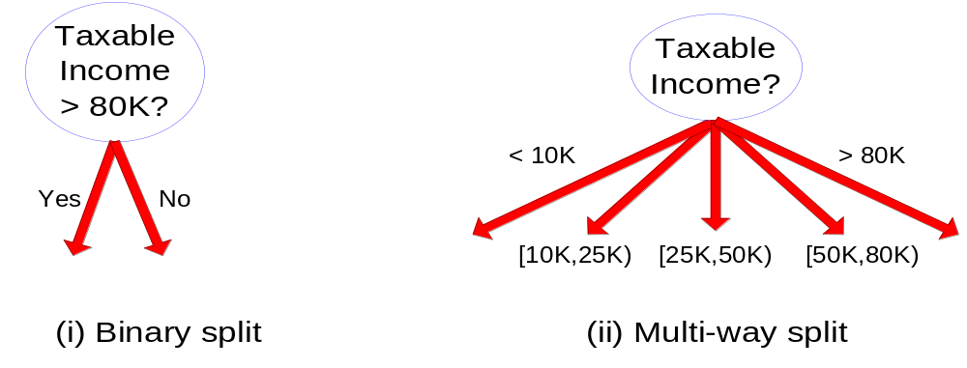
Splitting Based on Continuous Attributes

Slide 27

Choosing Attributes
Notice that not every attribute has to be used in each path of the decision.
As we will see, some attributes may not even appear in the tree.
The previous experience decision table showed 4 attributes: hour, weather, accident and stall
But the decision tree only showed 3 attributes: hour, accident and stall
Why is that?
Methods for selecting attributes (which will be described later) show that weather is not a discriminating attribute
We use the principle of Occam’s Razor: Given a number of competing hypotheses, the simplest one is preferable

Slide 28
Identifying the Best Attributes
Refer back to our original decision tree
Leave At
10 AM
9 AM
8 AM
Stall?
Accident?
Long
No
Yes
No
Yes
Short
Long
Medium
Long
How did we know to split on leave at and then on stall and accident and not weather?

Slide 29
Tree Induction
Greedy strategy.
  Split the records based on an attribute test that optimizes certain criterion.
Issues
  Determine how to split the records
    How to specify the attribute test condition?
    How to determine the best split?
  Determine when to stop splitting

Slide 30
Entropy or Purity
Impurity/Entropy (informal)
  Measures the level of impurity in a group of examples

Slide 31
Entropy or Purity
Very impure group
Less impure
Minimum
impurity

Slide 32
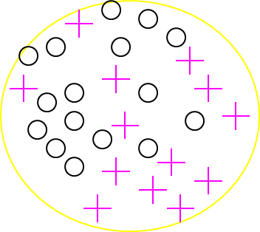
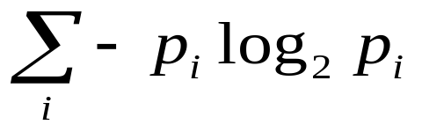
Entropy: a common way to measure impurity
Entropy =
  p_{i} is the probability of class i
  Compute it as the proportion of class i in the set.
Entropy comes from information theory. The higher the entropy the more the information content.

Slide 33
Information
“Information” answers questions.
The more clueless I am about a question, the more information
the answer to the question contains.
Example – fair coin → prior <0.5,0.5>
By definition Information of the prior (or entropy of the prior):
I(P1,P2) = - P1 log₂(P1) –P2 log₂(P2)
= I(0.5,0.5) = -0.5 log₂(0.5) – 0.5 log₂(0.5) = 1
We need 1 bit to convey the outcome of the flip of a fair coin.
Why does a biased coin have less information?
(How can we code the outcome of a biased coin sequence?)
Scale: 1 bit = answer to Boolean question with prior <0.5, 0.5>
Huffman coding?

Slide 34
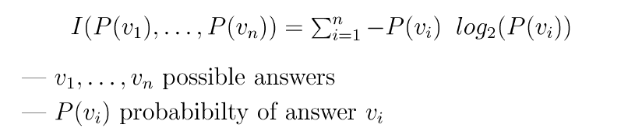
Information or Entropy or Purity
Information in an answer given possible answers v₁, v₂, … v_{n}:
(Also called entropy of the prior.)
Example – biased coin → prior <1/100, 99/100>
I(1/100,99/100) = -1/100 log₂(1/100) –99/100 log₂(99/100)
= 0.08 bits (so not much information gained from “answer.”)
Example – fully biased coin → prior <1, 0>
I(1,0) = -1 log₂(1) – 0 log₂(0) = 0 bits
0 log₂(0) =0
i.e., no uncertainty left in source!

Slide 35
Shape of Entropy Function
Roll of an unbiased die
1
0
0
1/2
1
p
The more uniform the probability distribution,
the greater is its entropy.

Slide 36

Splitting based on information
Information Gain:
    Parent Node, p is split into k partitions;
    n_{i} is number of records in partition i
  Measures Reduction in Entropy achieved because of the split. Choose the split that achieves most reduction (maximizes GAIN)
  Used in ID3 and C4.5
  Disadvantage: Tends to prefer splits that result in large number of partitions, each being small but pure.

Slide 37
Decision Tree Algorithms
The basic idea behind any decision tree algorithm is as follows:
  Choose the best attribute(s) to split the remaining instances and make that attribute a decision node
  Repeat this process for recursively for each child
  Stop when:
    All the instances have the same target attribute value
    There are no more attributes
    There are no more instances

Slide 38
Entropy
Entropy is minimized when all values of the target attribute are the same.
  If we know that commute time will always be short, then entropy = 0
Entropy is maximized when there is an equal chance of all values for the target attribute (i.e. the result is random)
  If commute time = short in 3 instances, medium in 3 instances and long in 3 instances, entropy is maximized

Slide 39
Entropy
Calculation of entropy
  Entropy(S) = ∑_{(i=1 to l)}-|S_{i}|/|S| * log₂(|S_{i}|/|S|)
    S = set of examples
    S_{i} = subset of S with value v_{i} under the target attribute
    l = size of the range of the target attribute

Slide 40
ID3
ID3 splits on attributes with the lowest entropy
We calculate the entropy for all values of an attribute as the weighted sum of subset entropies as follows:
  ∑_{(i = 1 to k)} |S_{i}|/|S| Entropy(S_{i}), where k is the range of the attribute we are testing
We can also measure information gain (which is inversely proportional to entropy) as follows:
  Entropy(S) - ∑_{(i = 1 to k)} |S_{i}|/|S| Entropy(S_{i})

Slide 41
ID3
Given our commute time sample set, we can calculate the entropy of each attribute at the root node
Attribute | Expected Entropy | Information Gain
Hour | 0.6511 | 0.768449
Weather | 1.28884 | 0.130719
Accident | 0.92307 | 0.496479
Stall | 1.17071 | 0.248842

Slide 42
Problems with ID3
ID3 is not optimal
  Uses expected entropy reduction, not actual reduction
Must use discrete (or discretized) attributes
  What if we left for work at 9:30 AM?
  We could break down the attributes into smaller values…

Slide 43
Problems with Decision Trees
While decision trees classify quickly, the time for building a tree may be higher than another type of classifier
Decision trees suffer from a problem of errors propagating throughout a tree
  A very serious problem as the number of classes increases

