Slide 1
Plagiarism Detection
Contents
Introduction to Plagiarism Detection Algorithm
Python Code for Plagiarism Detection
Result

Slide 2
Introduction
Basically, a plagiarism detection algorithm is a computational method designed to identify instances where written content has been copied or closely paraphrased from existing sources without appropriate citation. This algorithm works by analyzing the input text and comparing it to a comprehensive database that includes academic publications, literary works, online content, and other reference materials. When it detects significant similarities or matches between the input and the database entries, it highlights these sections as potential cases of plagiarism. This process plays a vital role in maintaining the integrity of original work and ensuring that proper credit is given to the original authors and sources.

Slide 3
2. Python code
The second chapter focuses on Python programming and is divided into 2 main sections: the coding segment and the explanatory segment. The first section presents the actual Python code. The second section provides a detailed explanation of the code. Together, these sections aim to provide both practical implementation and theoretical comprehension of Python programming concepts.

Slide 4

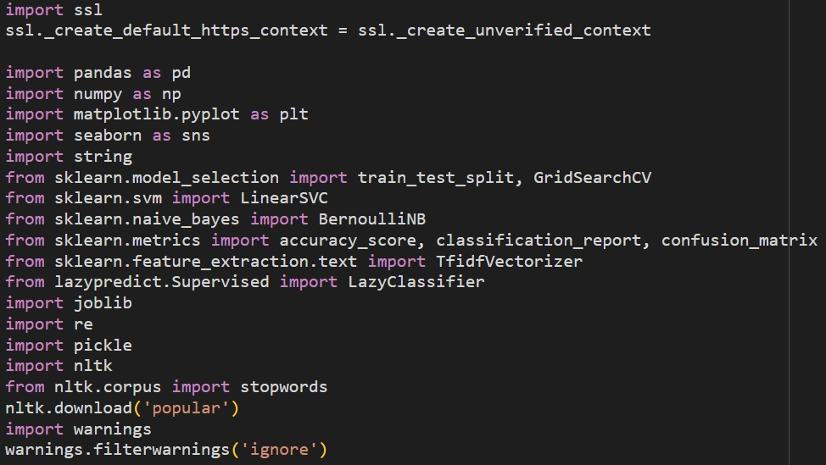
CODE
Initially, we should import necessary libraries.

Slide 5
EXPLANATION
SSL (Secure Sockets Layer): it is responsible for handling encrypted network connections, such as HTTPS requests.
pandas: for data manipulation and analysis.
numpy: provides numerical operations.
sklearn: for machine learning:
1. train_test_split: Splits data into training and testing sets.
2. GridSearchCV: performs hyperparameter tuning.
3. Standard scaler: Standardizes features by scaling them.
4. Accuracy score: measures classification accuracy.
5. Classification report: provides precision, recall, and F1-score.
6. Confusion matrix: displays classification performance in matrix form.
7. TfidfVectorizer: converts text into numerical features using TF-IDF.
8. BernoulliNB: it is a variation of the Naive Bayes algorithm used for binary/boolean features.

Slide 6
EXPLANATION
matplotlib, seaborn: for visualization.
string: provides string manipulation utilities.
lazypredict (autoML): quickly compares multiple ML models for classification and regression.
joblib: saves and loads machine learning models.
re: provides support for regular expressions (regex). It allows you to search, match, and manipulate strings based on patterns.
pickle: for saving and loading models or data.
nltk: natural language processing toolkit.
stopwords: provides common words to remove from text.
2. nltk.download('popular'): downloads common NLP datasets and models.
warnings: manages warnings.
1. warnings.filterwarnings('ignore'): suppresses warning messages.

Slide 7
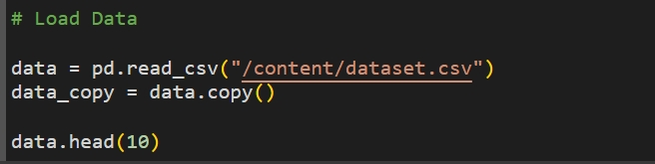
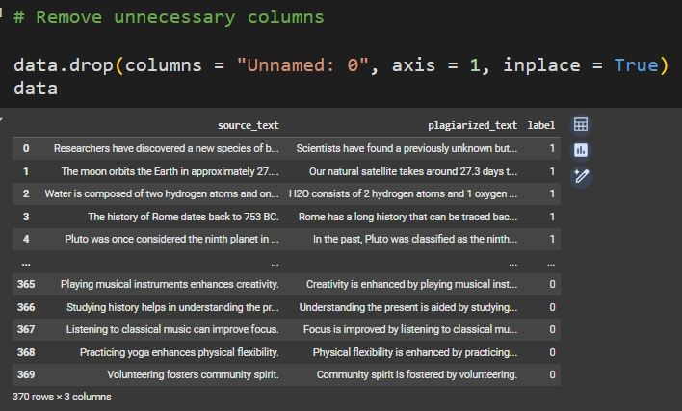
CODE

Slide 8
EXPLANATION
pd.read_csv(“ “): it loads a CSV (Comma-Separated Values) file into a Pandas DataFrame.
data.copy(): it creates a copy of the original data. In addition, it is pretty useful when performing data preprocessing, transformations, or EDA (exploratory data analysis) while keeping the original dataset unchanged.
data.head(10): The .head(n) function returns the first n rows of the data.
data.drop(columns="Unnamed: 0", axis=1, inplace=True): It removes columns from the DataFrame.
data.info(): The function provides a summary of the dataset.

Slide 9
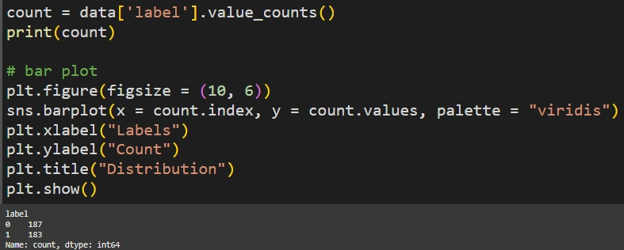
CODE

Slide 10
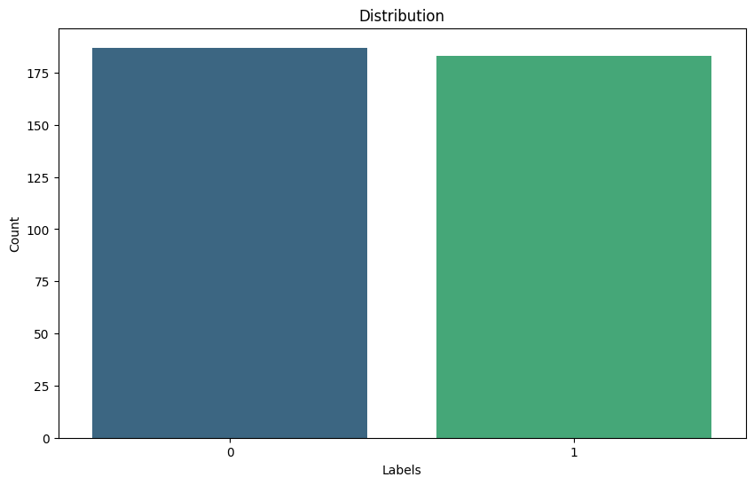
EXPLANATION
- data['label'].value_counts(): counts the occurrences of each unique value in the 'label' column.
- sns.barplot(): draws a bar plot with labels on the x-axis and their counts on the y-axis.
- count.index: uses unique labels as the x-axis values.
- count.values: uses label counts as the y-axis values.

Slide 11
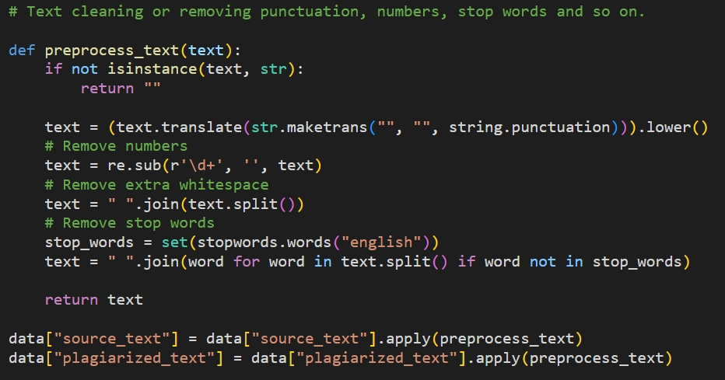
CODE

Slide 12
EXPLANATION
First, the function checks whether the input is a string; if not, it returns an empty string to prevent errors.
re.sub(r'\d+', '', text): removes all numbers from the text.
stopwords.words("english"): loads a list of common stopwords, and removes stopwords by filtering out words that appear in the stopwords list.
str.maketrans(" ", " ", st.punctuation): removes all punctuation from the text.

Slide 13
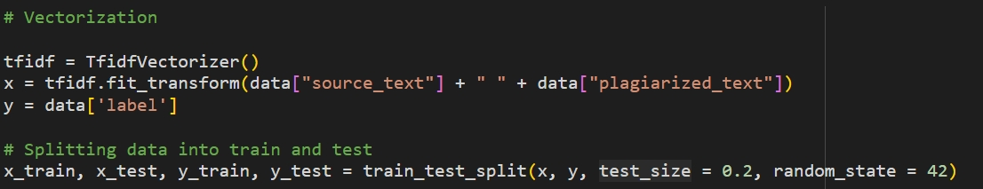
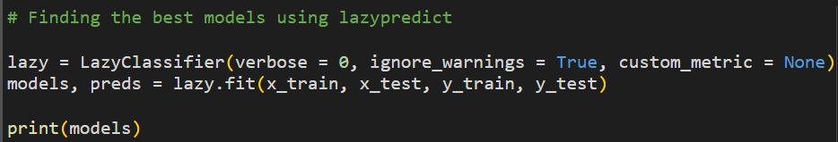
CODE

Slide 14
EXPLANATION
TfidfVectorizer(): converts text into numerical features by assigning weights to words based on their importance in the document.
train_test_split(x, y, test_size=0.2, random_state=42): it is used to split the dataset into training and testing subsets.
lazy.fit(x_train, x_test, y_train, y_test): fits multiple classification models to the training data (x_train, y_train). As a reslt, it returns two outputs:
models: a summary table of model performance.
preds: predictions made by each model.

Slide 15
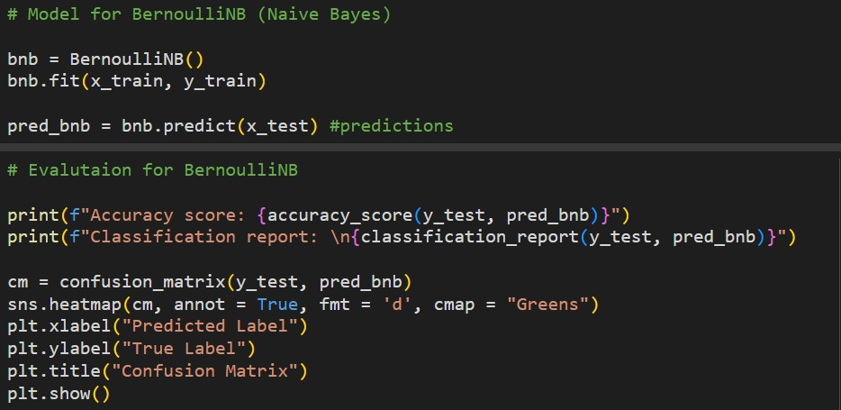
CODE

Slide 16
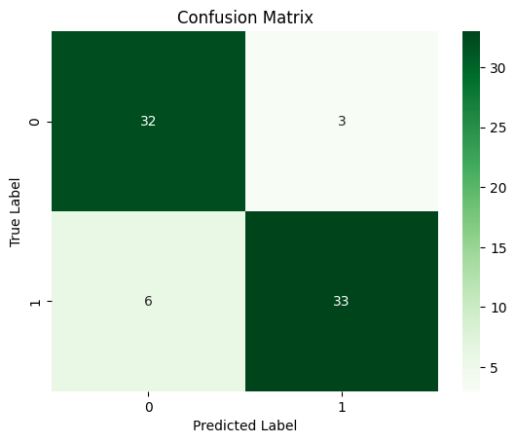
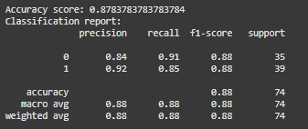
EXPLANATION
BernoulliNB(): a Naive Bayes classifier suitable for binary features. After trains the classifier using the training dataset, and predicts labels for the test set.
accuracy_score(): measures the proportion of correctly classified instances.
classification_report(): displays precision, recall, and F1-score for each class.
confusion_matrix(): creates a confusion matrix to analyze classification errors.
sns.heatmap(cm, annot=True, fmt='d', cmap="Greens"): creates a heatmap of the confusion matrix.

Slide 17
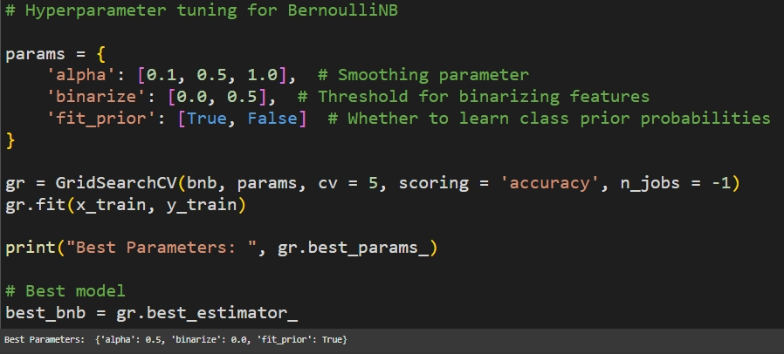
CODE

Slide 18
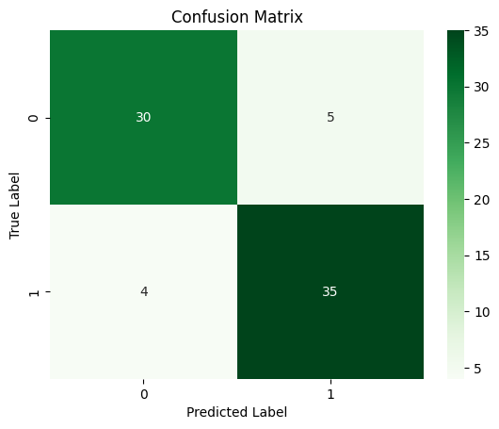
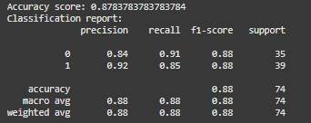
EXPLANATION
Hyperparameter : {alpha: controls Laplace smoothing (used to handle zero probabilities), binarize: converts values into binary, fit_prior: determines whether to learn class priors.
Grid Search Cross-Validation: {cv: uses 5-fold cross-validation to evaluate different parameter combinations, scoring='accuracy': selects the best model based on accuracy, n_jobs = -1: usees all available CPU cores for faster computation}.

Slide 19
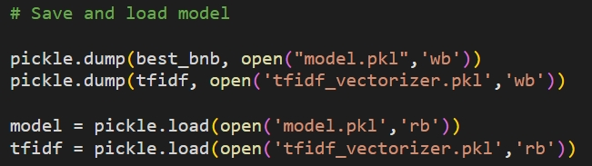
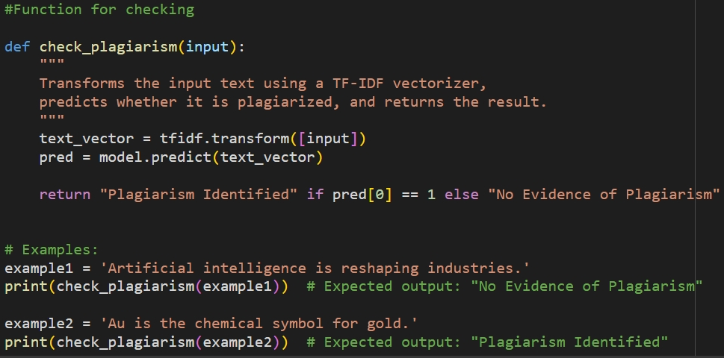
CODE

Slide 20
EXPLANATION
pickle.dump(object, file): serializes the python object, and saves it to a file.model.pkl:
pickle.load(file): deserializes the saved objects ,and loads them back into the program for use.
check_plagiarism(input): takes the input text (which is a string of text to be checked for plagiarism).
tfidf.transform([input]): converts the input text into a TFIDF feature vector.
model.predict(text_vector): predicts whether the input text is plagiarized or not using the previously trained model.
pred[0] == 1: it returns "Plagiarism Identified".
pred[0] == 0: it returns "No Evidence of Plagiarism".

Slide 21
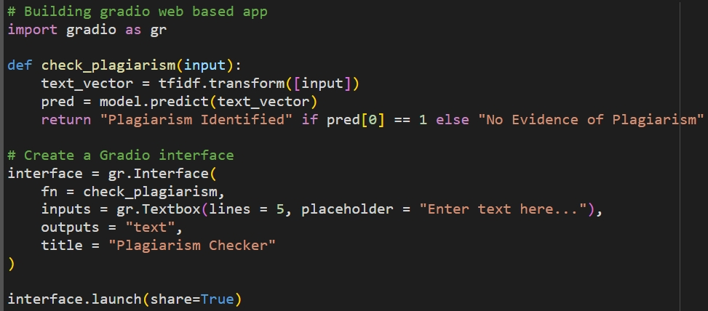
CODE

Slide 22
EXPLANATION
GRADIO is a Python library used for building web-based applications for machine learning models.
gr.Interface(): creates a simple web interface for users to interact with the plagiarism checker. {fn = : calls the function when the user submits text, inputs = : provides a textbox where users enter text, outputs = : displays the result as text, title = : adds a title to the interface.title = "Plagiarism Checker": The title that will appear at the top of the web app}
interface.launch(share=True): launches the gradio interface and makes it available via a public link that you can share.

Slide 23
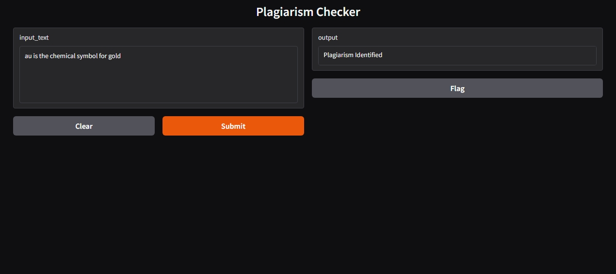
Example results 1

Slide 24
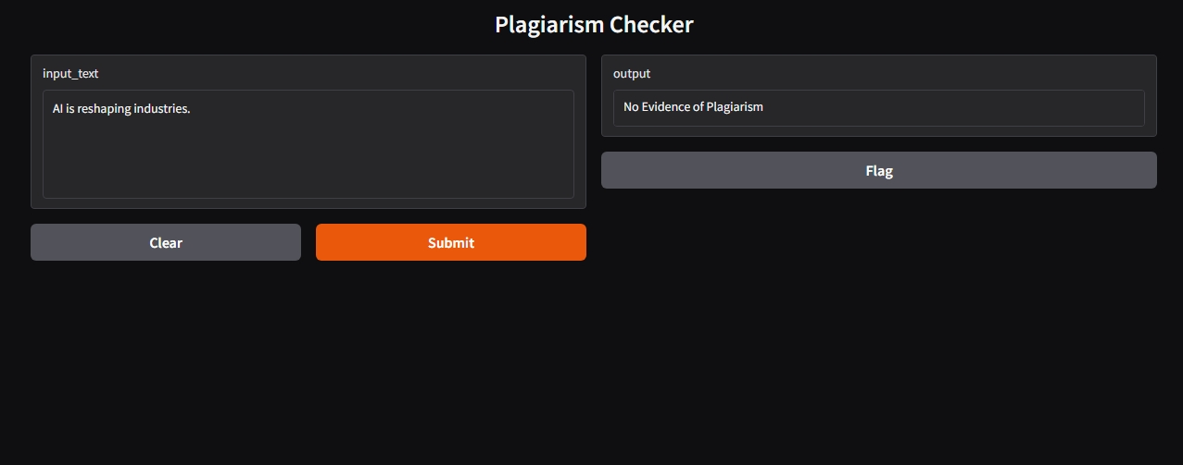
Example results 2

Slide 25
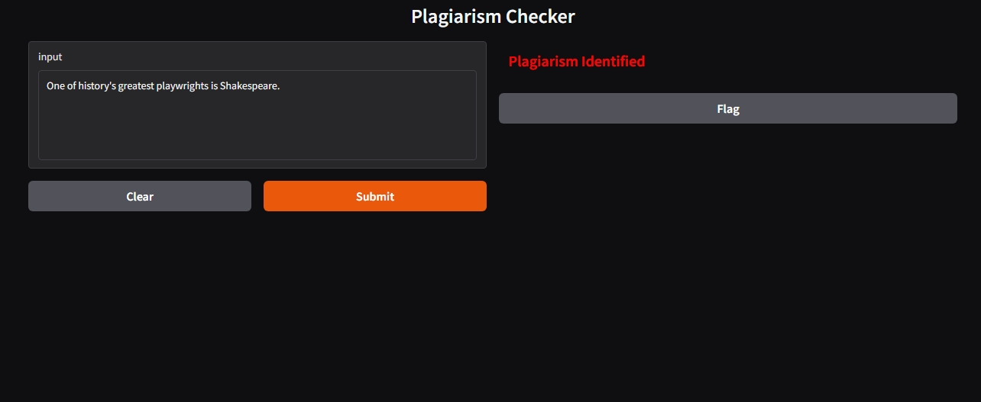
Example results 3

Slide 26
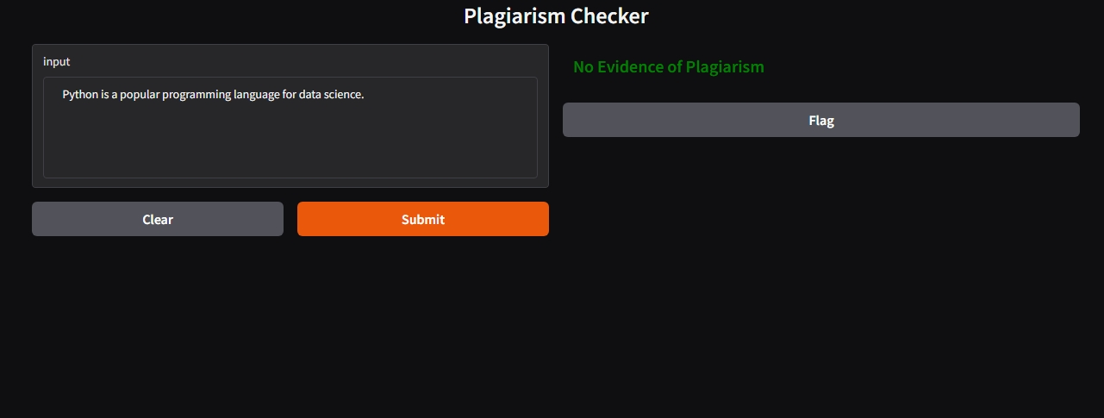
Example results 4

Slide 27
3. Result
In conclusion, a plagiarism detection model was developed using the Bernoulli Naive Bayes (BNB) classifier and a TF-IDF vectorizer to identify potential cases of plagiarism in text. The model was trained on a dataset containing labeled examples of both plagiarized and non-plagiarized text. As a result, the performance of the trained Bernoulli Naive Bayes (BNB) model was evaluated using accuracy metrics and confusion matrix analysis. The model achieved an accuracy score of 88%, indicating its ability to correctly classify text as either plagiarized or not plagiarized. The confusion matrix provided insight into the model's performance, showing the number of true positives, false positives, true negatives, and false negatives.

