Slide 1
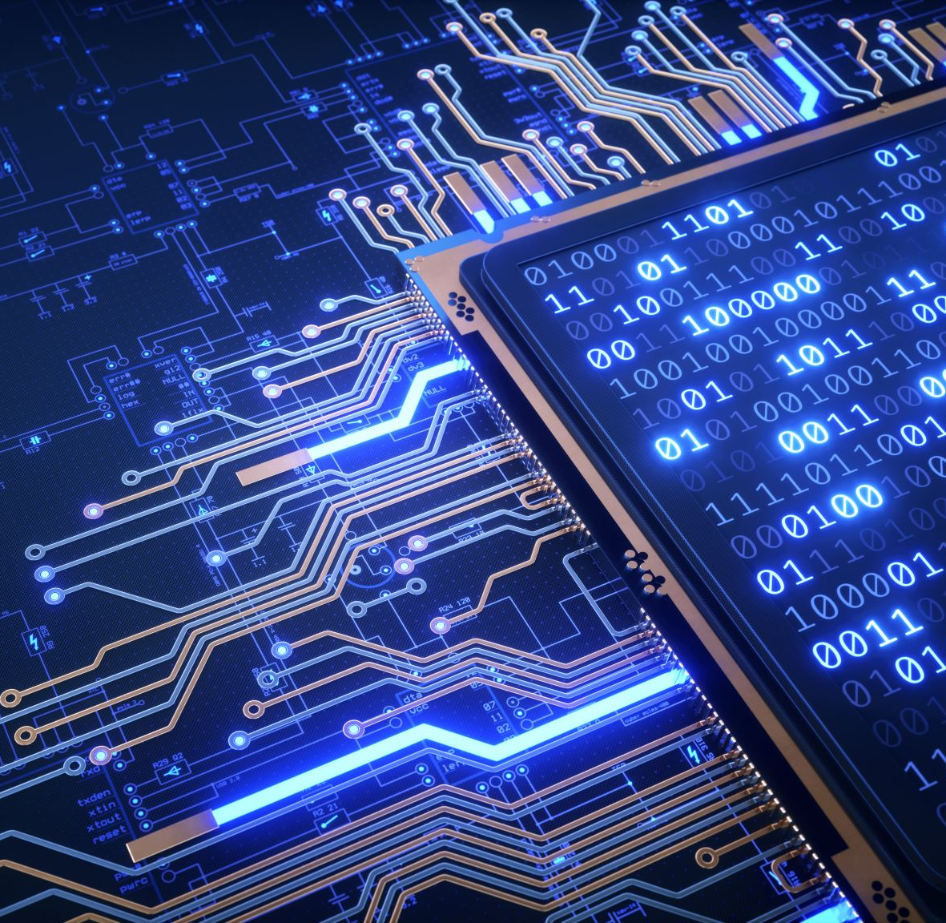
Quantum Computing
Jamal Brown
Dominic Mash
Aditya Mishra

Slide 2

What is quantum computing?
Quantum computing is the method of computation that utilizes the properties of quantum states to carry out operations.
Note that a quantum state can be encoded from something (i.e., a physical attribute) that can be measured from a system.

Slide 3
Here’s a bit of history.
In 1980, physicist Paul Beinoff devised a “quantum” version of the Turing Machine.
Later, quantum computing was suggested to be a superior alternative to classical computing to better simulate quantum systems.
Peter Shor, in 1994, devised a quantum algorithm that would tackle integer factorization.

Slide 4
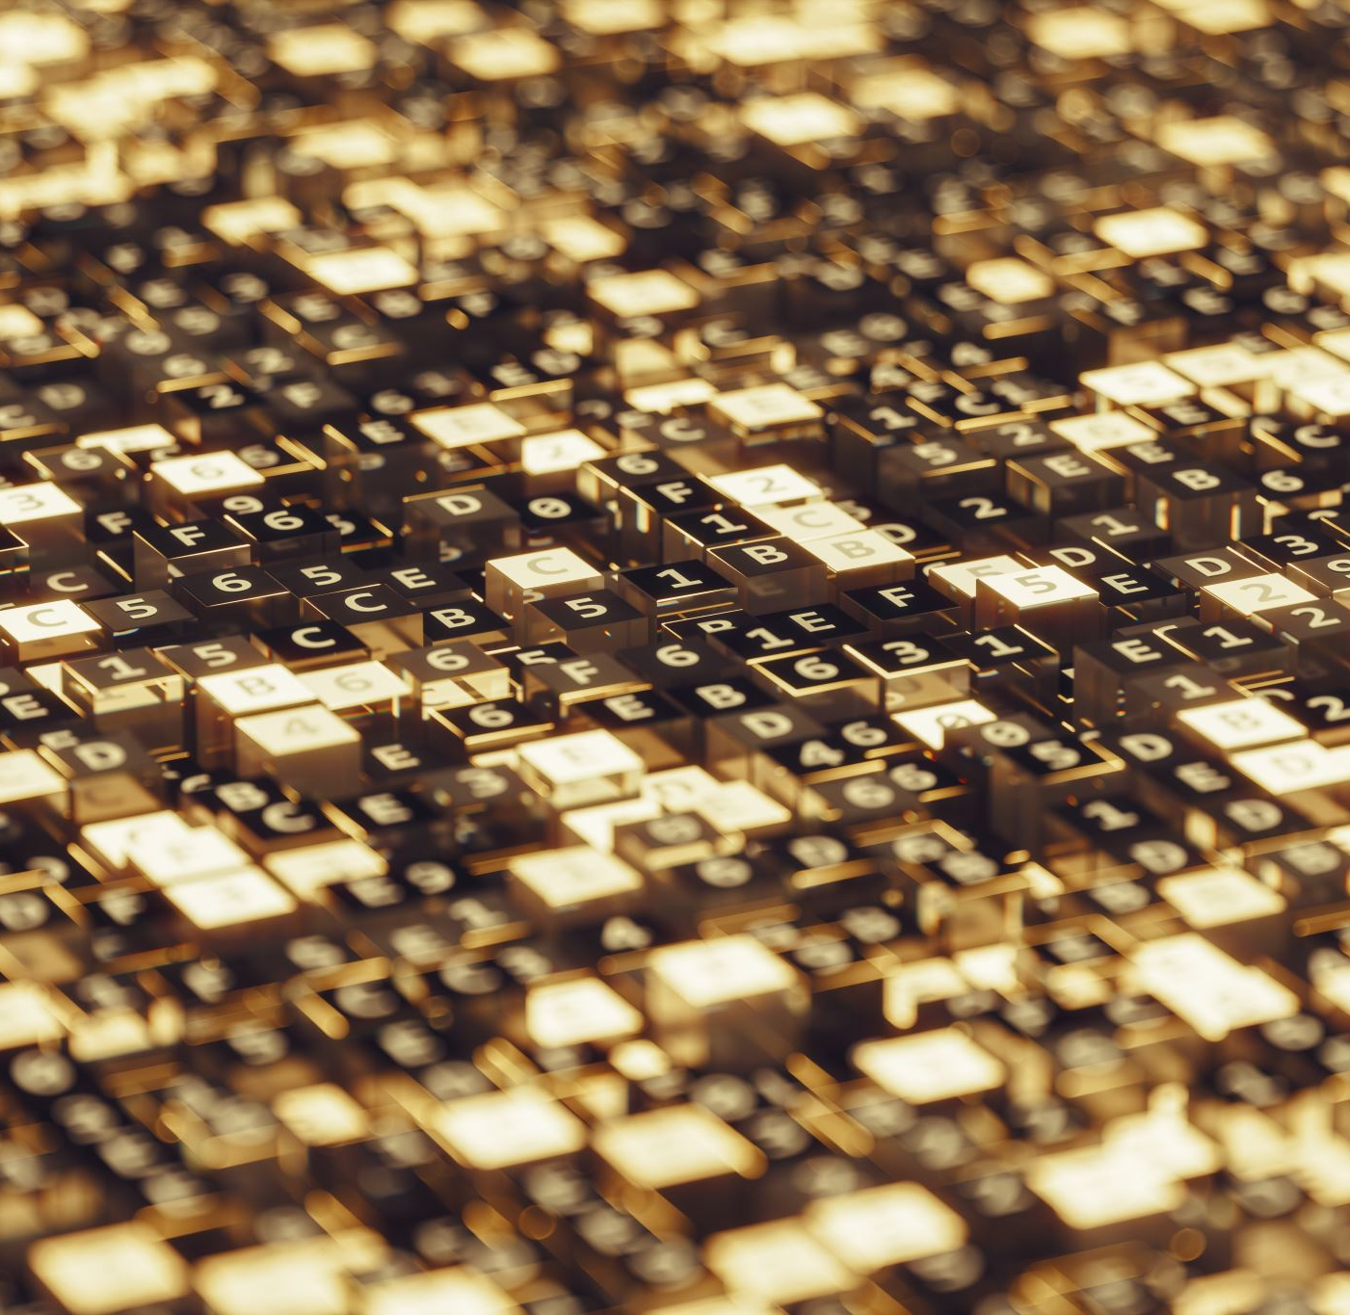
Bit
The most basic unit of information in classical computation.

Slide 5
A bit can be taken as one of two states.
1
0
or

Slide 6
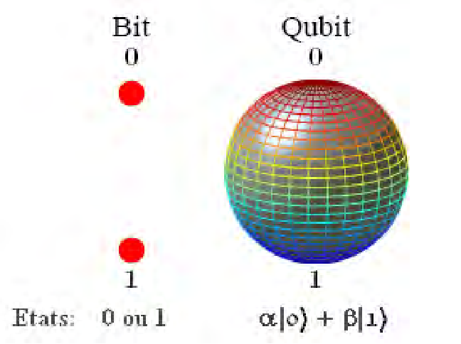
Qubit
A two-state quantum system; a superposition of both 1 and 0.

Slide 7
An unmeasured qubit exists in a superposition of two states.
1
0
Emphasis on the “unmeasured” part.

Slide 8


Qubits are probabilistic.
A qubit’s state $|ψ⟩$ is in a superposition of two basis states, $|0⟩$ and $\left|1\right\rangle$:
$\left|ψ\right\rangle =α\left|0\right\rangle +β|1⟩$,
where the complex numbers $α$ and $β$ represent the probability amplitudes of their respective basis states.

Slide 9
Mechanics of Quantum Computing
Two main parts:
Quantum software.
Quantum hardware.

Slide 10
Quantum Software
Software that are used to process an instruction or commands in quantum computer are quantum software.
Generally, Python is the most used programming language in quantum computers.
For example: Qiskit, a software development tool kit in python.
Free courses available: On IBM cloud, Microsoft Azure.
(links:https://qiskit.org/textbook-beta/course/introduction-course?learnLevel=All%20resources)

Slide 11
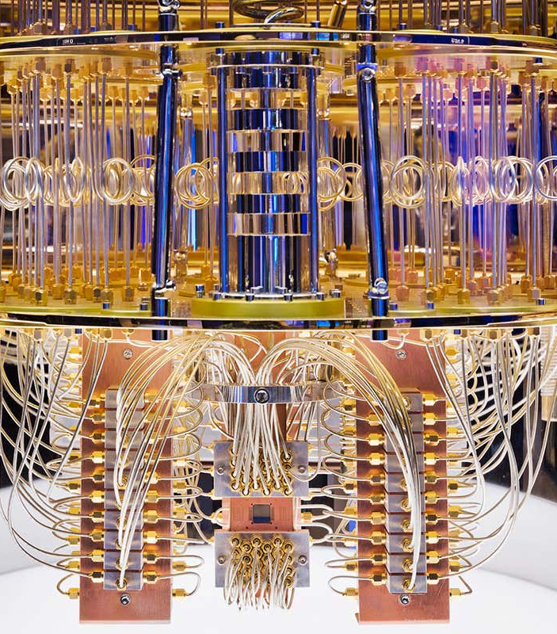
Quantum Hardware
A quantum computer has three primary parts:
An area that houses the qubits
A method for transferring signals to the qubits
A classical method to run programs and send instructions.
There are a lot of materials and mechanism used inside quantum hardware and software:
Superfluids
Superconductors
Control
Superposition
Entanglement

Slide 12
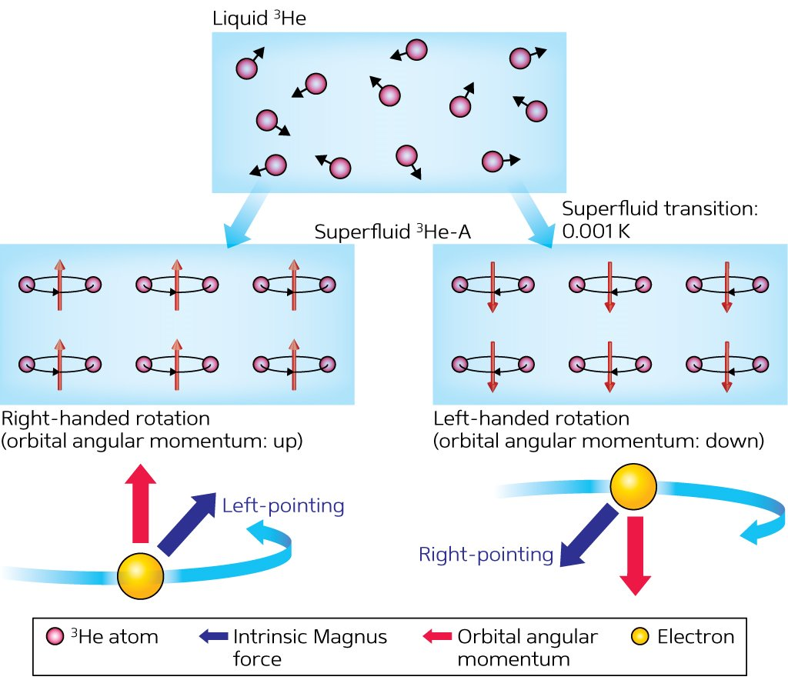
Superfluids
Superfluids are liquids used in cooling process (supercooling) the superconductors.
General temperature of the superfluids are about a hundredth of a degree Celsius above absolute zero: the theoretical lowest temperature allowed by the laws of physics.
It has low to zero viscosity with constanr Kinetic Energy
Examples: helium-3( or ³He) and helium-4 or ( or ⁴He)

Slide 13
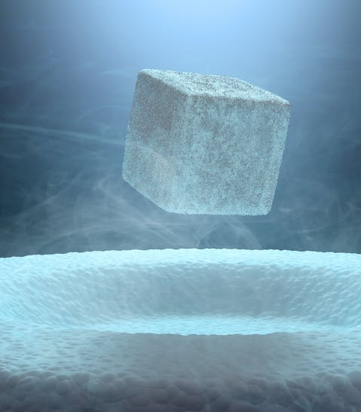
Superconductors
A material that can conduct electricity or transport electrons from one atom to another with no resistance i.e. no heat, sound or any other form of energy would be released from the material when it will reach superconductive.
When we put electrons through superconductors, they pair up into something called Cooper pairs that quantum tunnel through something called a Josephson junction.

Slide 14
Control
We can control superconducting qubit by firing photons at the qubits.
We can control its behavior and get it to hold, change, read out information.
It helps us to control the flow of information or instruction while computing.

Slide 15
Superposition
Ability of a quantum system to be in multiple states at the same time until it is measured.
A qubit itself isn’t very useful. However, by creating many and connecting them in a state called superposition we can create vast computational spaces. We then represent complex problems in this space using programmable gates.

Slide 16
Entanglement
Quantum entanglement allows qubits, which behave randomly, to be perfectly correlated with each other. Using quantum algorithms that exploit quantum entanglement, specific complex problems can be solved more efficiently than on classical computers.

Slide 17
Applications of Quantum Computers
Quantum computers have the capability to be in multiple states at the same time and perform tasks using all possible permutations simultaneously
As qubits capacity grows and error corrections are improved, the limits and abilities of quantum computers are endless, bringing on the idea of “Quantum Supremacy”
“Quantum Supremacy”-the goal of demonstrating that a programmable quantum device can solve a problem that no computer can solve in any feasible amount of time

Slide 18
Applications of Quantum Computers
Improving Cancer Treatments
Optimizing Traffic Flow
Portfolio Optimization
Simulate Molecules
Make AI More Human Like
Forecasting Weather

Slide 19
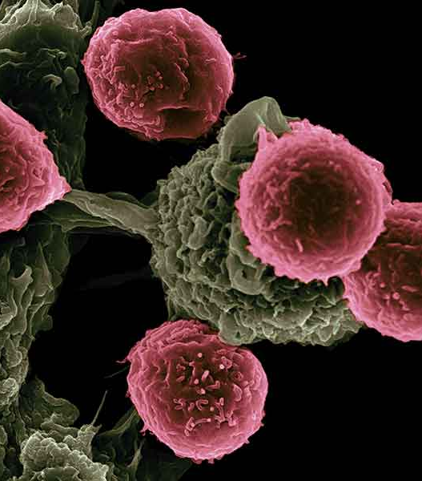
Applications of Quantum Computers
Improving Cancer Treatments
Using quantum calculations to help determine cancerous cells, and eliminate with minimizing effects to healthy cells

Slide 20

Applications of Quantum Computers
Optimization of traffic Flows
Better Routes for Air travel
Logistics for ground travel

Slide 21
Applications of Quantum Computers
Stimulation of Chemical Reactions

Slide 22
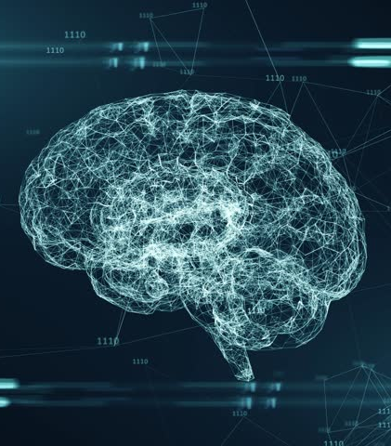
Applications of Quantum Computers
AI improvements
More Human Like
multiple factors at one time

Slide 23

Applications of Quantum Computers
Weather Forecasting

Slide 24
Prime Factorization
Quantum computers can solve for prime factors.
Shor algorithm-is significant because it implies that public key cryptography might easily be broken given a large enough quantum computer
IBM Eagle-127 q-bits- 27 to 65 active qubits
China companies claim to built an active 66-qubit programmable system

Slide 25
Issues with Quantum Computers
Decoherence
Fabrication
Verification
Architecture

