Slide 1
tRNA research 四个子项目资料汇报
基于 PubMed 与 GitHub 的资料筛选、文献高亮、图像证据与研究路线整合
白底黑字版 | 2026-05-23 | 中文主讲
四个文件夹：结构功能、工具算法、修饰指纹数据库、湿实验

Slide 2
资料筛选策略
PubMed literature plus GitHub resources
PubMed：每个主题保留 15 篇 2020-2026 年候选文献，优先高影响力期刊；不足时按题名/摘要相关性补齐。
GitHub：按文件夹主题关键词检索仓库，保存 stars、语言、更新时间、许可证与链接；去除了 transformation/transformer 等拼写噪音。
图像：优先抓取开放 PMC 文章页中的原始 figure 图像；每张图均在 PPT 里标注 PMID/PMCID/期刊来源。
限制：未调用 Clarivate JCR 官方数据库，因此“影响因子最高”在本资料包中体现为高影响力期刊代理排序。

Slide 3
四个文件夹形成一条 tRNA 研究链路
From folders to an integrated tRNA research workflow
1. 结构/功能 定义生物问题
2. 工具/算法 把测序与注释转成可比较数据
3. 修饰数据库 沉淀位点、条件和证据等级
4. 湿实验 验证机制并校准数据偏差
>
>
>
建议把四个子项目视为一个闭环：文献提出假设，工具产生特征，数据库固化证据，湿实验验证因果。
PPT 中所有原始图均来自 PMC 开放页面或保存的文章图像文件，并在图下标出来源。

Slide 4
tRNA 的生物功能与结构特征
Biological functions and structural characteristics of tRNA
中文阐述
English explanation
tRNA 不只是“接头分子”，而是连接遗传密码、翻译速度、细胞应激、免疫防御和疾病治疗的调控节点。
结构层面从三叶草二级结构、L 型三级结构、修饰核苷到氨酰化/核糖体复合物共同决定读取精度。
近期高影响力研究集中在 suppressor tRNA、tRNA 尾部切割、tRNA 片段和 tRNA 结构互作组。
tRNA functions as more than an adaptor: it links genetic decoding, translation kinetics, stress response, immunity, and therapeutic engineering.
Its cloverleaf secondary structure, L-shaped tertiary fold, modified nucleosides, and aminoacylation state jointly determine decoding fidelity.
Recent high-impact work emphasizes suppressor tRNAs, tRNA-tail cleavage, tRNA-derived fragments, and in vivo tRNA structurome/interactome maps.
本页目的：先把文件夹命名转成研究问题，再把文献、代码资源和实验/数据库路线接到同一个框架中。

Slide 5
生物功能与结构：最新高影响力文献清单
Top recent high-impact PubMed records
#
题名
期刊/年份
PMID/DOI
1
RNA-triggered Cas12a3 cleaves tRNA tails to execute bacterial immunity.
Nature / 2026
41501459 10.1038/s41586-025-09852-9
2
A virally encoded tRNA neutralizes the PARIS antiviral defence system.
Nature / 2024
39111359 10.1038/s41586-024-07874-3
3
tRNA modifications tune m6A-dependent mRNA decay.
Cell / 2025
40311619 10.1016/j.cell.2025.04.013
4
An engineered UGA suppressor tRNA gene for disease-agnostic AAV delivery.
Nature biotechnology / 2026
41555020 10.1038/s41587-025-02982-5
5
AAV-delivered UGA suppressor tRNA for disease-agnostic in vivo gene therapy.
Nature biotechnology / 2026
41629463 10.1038/s41587-026-02999-4
6
tRNA as an assembly chaperone for a macromolecular transcription-processing complex.
Nature structural & molecula / 2025
40908366 10.1038/s41594-025-01653-y
7
Structural basis of tRNA recognition by the m3C RNA methyltransferase METTL6 in complex wi
Nature structural & molecula / 2024
38918637 10.1038/s41594-024-01341-3
8
A methyltransferase-independent role for METTL1 in tRNA aminoacylation and oncogenic trans
Molecular cell / 2025
39892392 10.1016/j.molcel.2025.01.003
9
Translational regulation by oxidative desulfuration of tRNA modifications.
Nature communications / 2026
41807381 10.1038/s41467-026-70126-7
10
Structure of fungal tRNA ligase Trl1 with RNA reveals conserved substrate-binding principl
Nature structural & molecula / 2025
40563009 10.1038/s41594-025-01589-3
完整 15 篇及摘要字段见各子文件夹 downloaded_resources/pubmed_literature_selected.csv

Slide 6
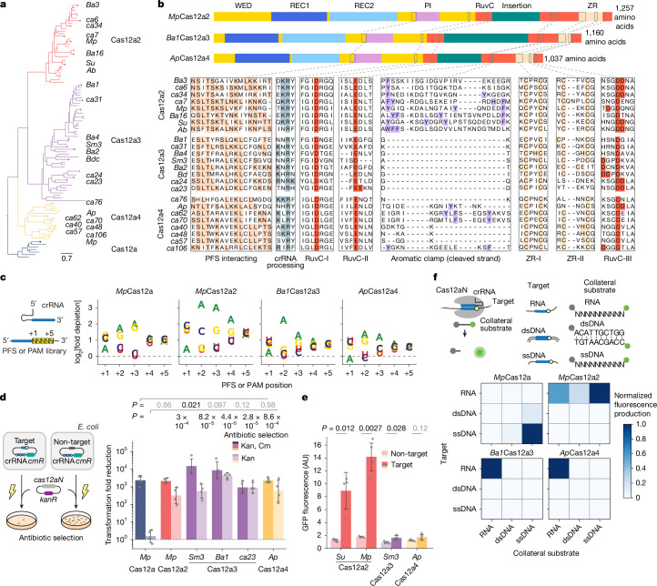
生物功能与结构：文章图像证据
Representative figure from screened literature
这张图作为本主题的视觉锚点，用于解释研究设计、关键机制或技术路线。
汇报时建议只讲图中与本文件夹主题直接相关的 1-2 个结论，避免逐 panel 读图。
原始科学数据未被重绘；这里只做缩放嵌入。
Source: RNA-triggered Cas12a3 cleaves tRNA tails to execute bacterial immunity.; Nature, 2026; PMID 41501459; PMCID PMC12851939

Slide 7
生物功能与结构：GitHub 与可复用资源
GitHub repositories and reusable assets
仓库
stars
语言
用途判断
junchaoshi/sports1.1
57
Perl
Small non-coding RNA annotation Pipeline Optimized for rRNA- and tRNA-Derived Smal
UCSC-LoweLab/tDRnamer
2
Python
Standardized naming for tRNA-derived RNAs
使用建议：先复现 README 中的最小示例，再把输入/输出字段映射到本项目的 tRNA 坐标、修饰位点或实验批次。
保存路径：每个子文件夹的 downloaded_resources/ 下包含 CSV、JSON、图像 manifest 与可追溯链接。

Slide 8
tRNA 分析工具与算法
tRNA analysis tools and algorithms
中文阐述
English explanation
算法核心难点来自 tRNA 的短序列、多拷贝、强修饰、结构相似性以及测序逆转录停顿/错配。
工具链通常包括基因识别、参考库构建、读段比对、修饰信号建模、表达定量和可视化解释。
tRNAscan-SE、mim-tRNAseq、nanopore direct tRNA sequencing 等代表了从注释到定量修饰的关键路线。
Algorithmic challenges arise from short length, multi-copy genes, heavy modification, structural similarity, and modification-induced RT stops or mismatches.
A practical toolchain covers gene detection, reference construction, read alignment, modification-signal modeling, abundance quantification, and visualization.
tRNAscan-SE, mim-tRNAseq, and direct nanopore tRNA sequencing represent major routes from annotation to quantitative modification profiling.
本页目的：先把文件夹命名转成研究问题，再把文献、代码资源和实验/数据库路线接到同一个框架中。

Slide 9
工具与算法：最新高影响力文献清单
Top recent high-impact PubMed records
#
题名
期刊/年份
PMID/DOI
1
RNA-triggered Cas12a3 cleaves tRNA tails to execute bacterial immunity.
Nature / 2026
41501459 10.1038/s41586-025-09852-9
2
AAV-delivered suppressor tRNA overcomes a nonsense mutation in mice.
Nature / 2022
35322228 10.1038/s41586-022-04533-3
3
Design, construction, and functional characterization of a tRNA neochromosome in yeast.
Cell / 2023
37944512 10.1016/j.cell.2023.10.015
4
Quantitative analysis of tRNA abundance and modifications by nanopore RNA sequencing.
Nature biotechnology / 2024
37024678 10.1038/s41587-023-01743-6
5
Quantifying tRNA abundance by sequencing.
Nature genetics / 2023
37173525 10.1038/s41588-023-01404-z
6
High-resolution quantitative profiling of tRNA abundance and modification status in eukary
Molecular cell / 2021
33581077 10.1016/j.molcel.2021.01.028
7
A ligation-independent sequencing method reveals tRNA-derived RNAs with blocked 3' termini
Molecular cell / 2024
39096899 10.1016/j.molcel.2024.07.008
8
A pro-metastatic tRNA fragment drives Nucleolin oligomerization and stabilization of its b
Molecular cell / 2022
35654044 10.1016/j.molcel.2022.05.008
9
Deciphering tRNA repertoires and translation coordination during mouse early embryogenesis
Nature communications / 2026
42062277 10.1038/s41467-026-72603-5
10
In vivo structure profiling reveals human cytosolic and mitochondrial tRNA structurome and
Nature communications / 2025
40447571 10.1038/s41467-025-59435-5
完整 15 篇及摘要字段见各子文件夹 downloaded_resources/pubmed_literature_selected.csv

Slide 10
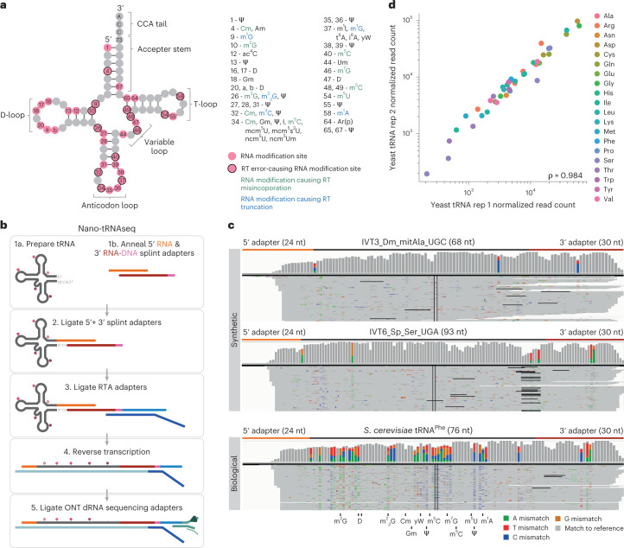
工具与算法：文章图像证据
Representative figure from screened literature
这张图作为本主题的视觉锚点，用于解释研究设计、关键机制或技术路线。
汇报时建议只讲图中与本文件夹主题直接相关的 1-2 个结论，避免逐 panel 读图。
原始科学数据未被重绘；这里只做缩放嵌入。
Source: Quantitative analysis of tRNA abundance and modifications by nanopore RNA sequencing.; Nature biotechnology, 2024; PMID 37024678; PMCID PMC10791586

Slide 11
工具与算法：GitHub 与可复用资源
GitHub repositories and reusable assets
仓库
stars
语言
用途判断
UCSC-LoweLab/tRNAscan-SE
89
C
A program for detection of tRNA genes
nedialkova-lab/mim-tRNAseq
24
Scheme
Modification-induced misincorporation tRNA sequencing
merenlab/tRNA-seq-tools
11
Python
无描述
rnabioco/tRNA004
8
Python
Nanopore direct tRNA sequencing method refinement and RNA modification benchmarkin
rnabioinfor/TRAC-Seq
5
HTML
Single-nucleotide resolution profiling of m7G tRNA modifications
UCSC-LoweLab/tDRnamer
2
Python
Standardized naming for tRNA-derived RNAs
使用建议：先复现 README 中的最小示例，再把输入/输出字段映射到本项目的 tRNA 坐标、修饰位点或实验批次。
保存路径：每个子文件夹的 downloaded_resources/ 下包含 CSV、JSON、图像 manifest 与可追溯链接。

Slide 12
tRNA 修饰指纹数据库
tRNA mod-fingerprint database
中文阐述
English explanation
tRNA 修饰指纹把“哪一种 tRNA、哪个位点、哪类修饰、在哪个条件下变化”组织为可查询的证据结构。
数据库建设需要统一 tRNA 坐标、修饰命名、物种来源、实验技术、置信度和可视化字段。
MODOMICS、RNAcentral 及测序/质谱分析项目可作为设计本地数据库的外部锚点。
A tRNA modification fingerprint organizes which tRNA, which position, which modification, and which condition into a queryable evidence model.
Database design requires harmonized tRNA coordinates, modification nomenclature, species metadata, experimental technology, confidence scores, and visualization fields.
MODOMICS, RNAcentral, and sequencing/mass-spectrometry projects can anchor a local database schema.
本页目的：先把文件夹命名转成研究问题，再把文献、代码资源和实验/数据库路线接到同一个框架中。

Slide 13
修饰指纹数据库：最新高影响力文献清单
Top recent high-impact PubMed records
#
题名
期刊/年份
PMID/DOI
1
tRNA modifications tune m6A-dependent mRNA decay.
Cell / 2025
40311619 10.1016/j.cell.2025.04.013
2
Alanyl-tRNA synthetase, AARS1, is a lactate sensor and lactyltransferase that lactylates p
Cell / 2024
38653238 10.1016/j.cell.2024.04.002
3
A cholesterol-responsive hepatic tRNA-derived small RNA regulates cholesterol homeostasis
Nature communications / 2025
41398161 10.1038/s41467-025-67387-z
4
Transfer RNA modifications and cellular thermotolerance.
Molecular cell / 2024
38181765 10.1016/j.molcel.2023.11.041
5
NAT10 promotes cancer metastasis by modulating p300/CBP activity through chromatin-associa
Molecular cell / 2025
41344331 10.1016/j.molcel.2025.11.010
6
tRNA as an assembly chaperone for a macromolecular transcription-processing complex.
Nature structural & molecula / 2025
40908366 10.1038/s41594-025-01653-y
7
A ligation-independent sequencing method reveals tRNA-derived RNAs with blocked 3' termini
Molecular cell / 2024
39096899 10.1016/j.molcel.2024.07.008
8
Structural basis of tRNA recognition by the m3C RNA methyltransferase METTL6 in complex wi
Nature structural & molecula / 2024
38918637 10.1038/s41594-024-01341-3
9
Structures of the ribosome bound to EF-Tu-isoleucine tRNA elucidate the mechanism of AUG a
Nature structural & molecula / 2024
38538914 10.1038/s41594-024-01236-3
10
tRNA renovatio: Rebirth through fragmentation.
Molecular cell / 2023
37802077 10.1016/j.molcel.2023.09.016
完整 15 篇及摘要字段见各子文件夹 downloaded_resources/pubmed_literature_selected.csv

Slide 14
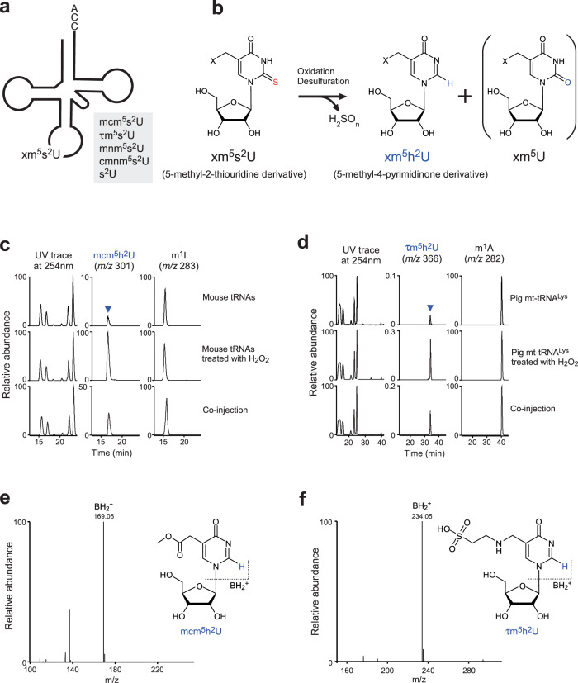
修饰指纹数据库：文章图像证据
Representative figure from screened literature
这张图作为本主题的视觉锚点，用于解释研究设计、关键机制或技术路线。
汇报时建议只讲图中与本文件夹主题直接相关的 1-2 个结论，避免逐 panel 读图。
原始科学数据未被重绘；这里只做缩放嵌入。
Source: Translational regulation by oxidative desulfuration of tRNA modifications.; Nature communications, 2026; PMID 41807381; PMCID PMC12976133

Slide 15
修饰指纹数据库：GitHub 与可复用资源
GitHub repositories and reusable assets
仓库
stars
语言
用途判断
junchaoshi/sports1.1
57
Perl
Small non-coding RNA annotation Pipeline Optimized for rRNA- and tRNA-Derived Smal
nedialkova-lab/mim-tRNAseq
24
Scheme
Modification-induced misincorporation tRNA sequencing
rnabioco/tRNA004
8
Python
Nanopore direct tRNA sequencing method refinement and RNA modification benchmarkin
rnabioinfor/TRAC-Seq
5
HTML
Single-nucleotide resolution profiling of m7G tRNA modifications
jfallmann/tRNA_ngs_mod_map_call_galaxy
3
NA
Tool collection for identification of tRNA modifications from NGS data galaxy work
monimaanam/Modomics_Decoder
1
Python
Annotates modomics RNA sequences for easy viewing of RNA modifications and nucleot
AteeshaNegi/nanopore-2Read-trna-pipeline
0
NA
Oxford Nanopore 2-Read Genome Wide tRNA Modification Analysis Pipeline - RNA Epitr
FlorianPichot/tRNA_reference_construction
0
R
无描述
使用建议：先复现 README 中的最小示例，再把输入/输出字段映射到本项目的 tRNA 坐标、修饰位点或实验批次。
保存路径：每个子文件夹的 downloaded_resources/ 下包含 CSV、JSON、图像 manifest 与可追溯链接。

Slide 16
tRNA 相关湿实验
tRNA-related wet-lab experiments
中文阐述
English explanation
湿实验围绕样本质量、tRNA 富集、修饰保真、氨酰化状态保护和测序/质谱平台兼容性展开。
常见实验包括 Northern blot、氨酰化测定、LC-MS/MS、去修饰/酶处理、small RNA-seq 与 nanopore direct RNA sequencing。
关键质控包括 spike-in、去氨酰化对照、酶切效率、RT-stop/mismatch 校准以及 tRNA 片段与成熟 tRNA 的区分。
Wet-lab work depends on sample integrity, tRNA enrichment, modification preservation, aminoacylation protection, and platform compatibility.
Common assays include Northern blotting, aminoacylation assays, LC-MS/MS, demodification/enzyme treatment, small RNA-seq, and direct nanopore RNA sequencing.
Key controls include spike-ins, deacylation controls, enzyme-efficiency checks, RT-stop/mismatch calibration, and discrimination between tRNA fragments and mature tRNAs.
本页目的：先把文件夹命名转成研究问题，再把文献、代码资源和实验/数据库路线接到同一个框架中。

Slide 17
湿实验路线：最新高影响力文献清单
Top recent high-impact PubMed records
#
题名
期刊/年份
PMID/DOI
1
RNA-triggered Cas12a3 cleaves tRNA tails to execute bacterial immunity.
Nature / 2026
41501459 10.1038/s41586-025-09852-9
2
AAV-delivered suppressor tRNA overcomes a nonsense mutation in mice.
Nature / 2022
35322228 10.1038/s41586-022-04533-3
3
Design, construction, and functional characterization of a tRNA neochromosome in yeast.
Cell / 2023
37944512 10.1016/j.cell.2023.10.015
4
Quantitative analysis of tRNA abundance and modifications by nanopore RNA sequencing.
Nature biotechnology / 2024
37024678 10.1038/s41587-023-01743-6
5
An engineered UGA suppressor tRNA gene for disease-agnostic AAV delivery.
Nature biotechnology / 2026
41555020 10.1038/s41587-025-02982-5
6
Quantifying tRNA abundance by sequencing.
Nature genetics / 2023
37173525 10.1038/s41588-023-01404-z
7
Translational regulation by oxidative desulfuration of tRNA modifications.
Nature communications / 2026
41807381 10.1038/s41467-026-70126-7
8
RelA-SpoT Homolog toxins pyrophosphorylate the CCA end of tRNA to inhibit protein synthesi
Molecular cell / 2021
34174184 10.1016/j.molcel.2021.06.005
9
A ligation-independent sequencing method reveals tRNA-derived RNAs with blocked 3' termini
Molecular cell / 2024
39096899 10.1016/j.molcel.2024.07.008
10
tRNA m1A modification regulate HSC maintenance and self-renewal via mTORC1 signaling.
Nature communications / 2024
38977676 10.1038/s41467-024-50110-9
完整 15 篇及摘要字段见各子文件夹 downloaded_resources/pubmed_literature_selected.csv

Slide 18
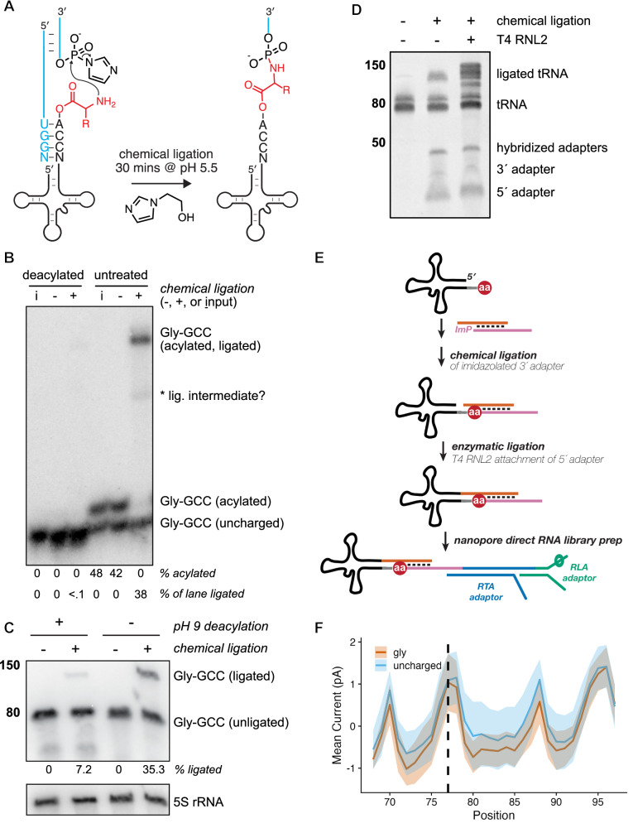
湿实验路线：文章图像证据
Representative figure from screened literature
这张图作为本主题的视觉锚点，用于解释研究设计、关键机制或技术路线。
汇报时建议只讲图中与本文件夹主题直接相关的 1-2 个结论，避免逐 panel 读图。
原始科学数据未被重绘；这里只做缩放嵌入。
Source: Nanopore sequencing of intact aminoacylated tRNAs.; Nature communications, 2025; PMID 40835813; PMCID PMC12368100

Slide 19
湿实验路线：GitHub 与可复用资源
GitHub repositories and reusable assets
仓库
stars
语言
用途判断
nedialkova-lab/mim-tRNAseq
24
Scheme
Modification-induced misincorporation tRNA sequencing
merenlab/tRNA-seq-tools
11
Python
无描述
rnabioco/tRNA004
8
Python
Nanopore direct tRNA sequencing method refinement and RNA modification benchmarkin
rnabioinfor/TRAC-Seq
5
HTML
Single-nucleotide resolution profiling of m7G tRNA modifications
rnabioco/aa-tRNA-seq
2
Python
Public-facing repo for aa-tRNA-seq pre-print
trypchromics/trnaExpCodAdapt
0
R
tRNA Expression-Codon Adaptation
使用建议：先复现 README 中的最小示例，再把输入/输出字段映射到本项目的 tRNA 坐标、修饰位点或实验批次。
保存路径：每个子文件夹的 downloaded_resources/ 下包含 CSV、JSON、图像 manifest 与可追溯链接。

Slide 20
综合结论：四个子项目应合并为证据闭环
Integrated conclusion
结构功能主题提供生物学假设：哪些 tRNA、修饰或片段可能改变翻译、免疫或疾病表型。
工具算法主题把高通量数据转成可比较特征：丰度、错配、RT-stop、修饰概率、结构互作与片段谱。
修饰指纹数据库主题负责证据沉淀：统一位点坐标、文献来源、实验方法、置信度和查询接口。
湿实验主题负责验证：通过 LC-MS/MS、Northern、氨酰化测定和定向测序校准算法输出。

Slide 21
后续建议
Suggested next steps
如果要继续深化，建议先确定一个核心物种/疾病/实验条件，否则四个主题会很容易扩散。
数据库字段优先级：tRNA ID、isoacceptor/isodecoder、修饰位点、修饰类型、检测技术、PMID、样本条件、置信度。
实验优先级：先做可重复的 tRNA abundance/modification profiling，再针对关键位点做验证实验。
文献更新：建议每月按相同脚本刷新 PubMed 与 GitHub，避免综述和工具版本过期。

