Slide 1


Restormer: Efficient Transformer for High-Resolution Image Restoration
Proceedings of the IEEE/CVF Conference on Computer Vision and Pattern Recognition (CVPR), 2022, pp. 5728-5739
Oral

Slide 2
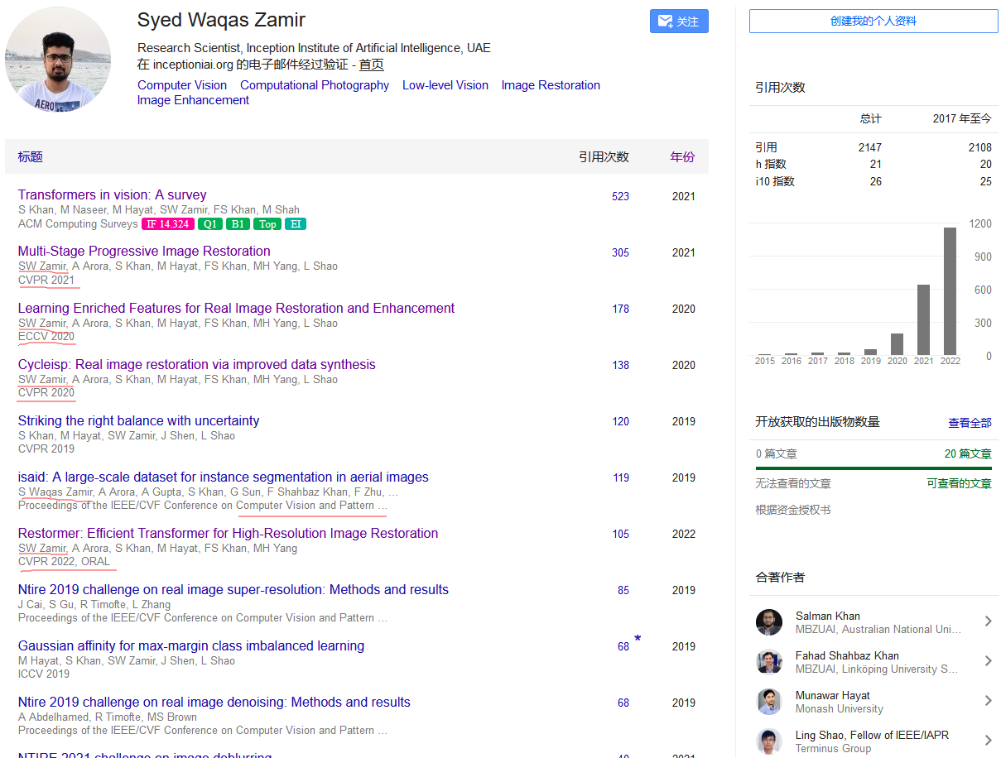


Slide 3
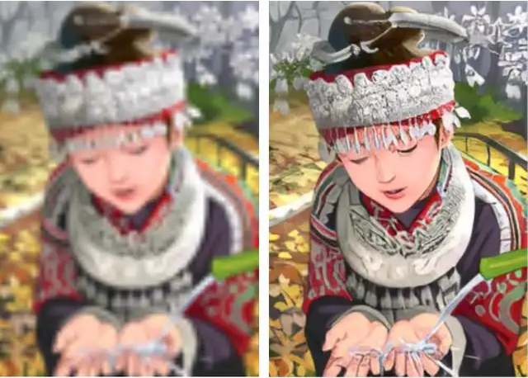
Restoration
1
知行合一、经世致用
自强不息 厚德载物
Central South University

Slide 4
Motivation
2
CNNs Conv( 局部连接[有限的感受野,计算复杂度低] and 平移等变性)
- 优点: 计算复杂度低、平移等变性
- 缺点: 有限的感受野
Transformers Attention(全局连接[长程相互作用 ,计算复杂度高(O(W²H²))])
- 优点: 长程相互作用
- 缺点: 计算复杂度高(O(W²H²)), 无平移等变性
无法用在高分辨率图像恢复
Restormer
设计一种高效的Transformer模型，可以用于高分辨率图像恢复任务。
知行合一、经世致用
自强不息 厚德载物
Central South University

Slide 5
Transformer（Self-Attention）时间复杂度分析
2
(B,C,H,W)
ViT:(B,C,H,W)
->(B,C*16*16,H/16,W/16)
->(B,C*16*16,H/16*W/16)
->(B,d,n)
->(B,n,d)
Q(B,n,d)
K(B,n,d)
V(B,n,d)
Q@K的复杂度：(1,n,d)@(1,n,d)^{T}
矩阵乘法的复杂度：A(n*m),B(m*n) O(n*m*n)
(1,n,d)@(1,n,d)^{T} -> O(n²d)->O((H/16*W/16)² C*16*16)->O(H²W²C)
知行合一、经世致用
自强不息 厚德载物
Central South University

Slide 6
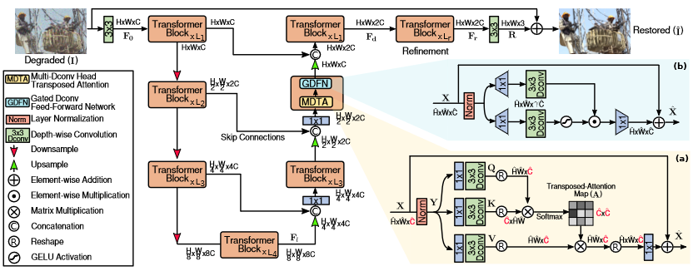
Restormer
3
知行合一、经世致用
自强不息 厚德载物
Central South University

Slide 7
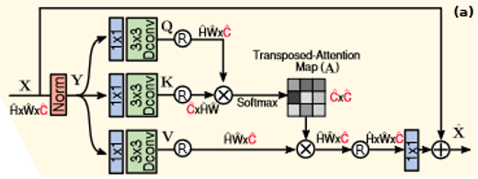

MDTA
4
1 DW引入空间局部语义
2 它确保了在计算基于协方差的注意力图时，像素之间的上下文全局关系被隐含地模拟出来。
C
C
HW
C₁₁
C₁₂
C₁₃
C₁₄
C
HW
C₂₁
C
C₃₁
pixel
pixel
C₄₁
知行合一、经世致用
自强不息 厚德载物
Central South University

Slide 8
MDTA时间复杂度分析
2
(B,C,H,W)
Q (B,C,H*W)
K (B,C,H*W)
V (B,C,H*W)
K@Q的复杂度：(1,C,H*W)@(1,C,H*W)^{T}
矩阵乘法的复杂度：A(n*m),B(m*n) O(n*m*n)
(1,C,H*W)@(1,C,H*W)^{T} -> O(C²HW)
知行合一、经世致用
自强不息 厚德载物
Central South University

Slide 9
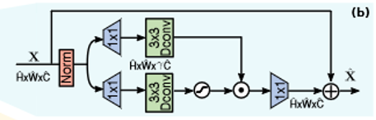

GDFN
5
1 同样强调空间语义
2 GDFN中的门控机制，控制哪些补充特征应该向前流动，并允许网络层次结构中的后续层专门关注更精细的图像属性，从而产生高质量的输出。
Dauphin Y N, Fan A, Auli M, et al. Language modeling with gated convolutional networks[C]//International conference on machine learning. PMLR, 2017: 933-941.
知行合一、经世致用
自强不息 厚德载物
Central South University

Slide 10
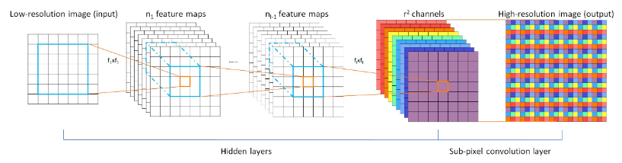
PixelShuffle
6
Shi W, Caballero J, Huszár F, et al. Real-time single image and video super-resolution using an efficient sub-pixel convolutional neural network[C]//Proceedings of the IEEE conference on computer vision and pattern recognition. 2016: 1874-1883.
知行合一、经世致用
自强不息 厚德载物
Central South University

Slide 11
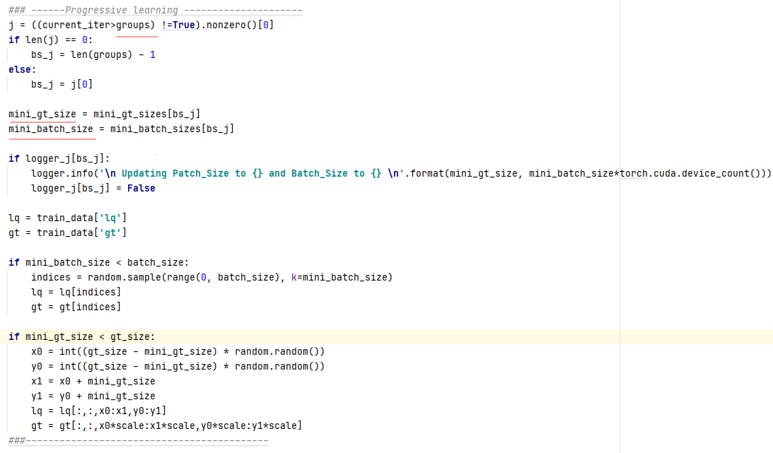
Progressive Learning Strategy
7
n this process, the network is trained
on small patches and large batches in early epochs, and on
gradually large image patches and small batches in later
epochs. This training strategy helps Restormer to learn con-
text from large images, and subsequently provides qual-
ity performance improvements at test time.
CNN-based restoration models are usually trained on
fixed-size image patches. However, training a Transformer
model on small cropped patches may not encode the global
image statistics, thereby providing suboptimal performance
on full-resolution images at test time
知行合一、经世致用
自强不息 厚德载物
Central South University

Slide 12
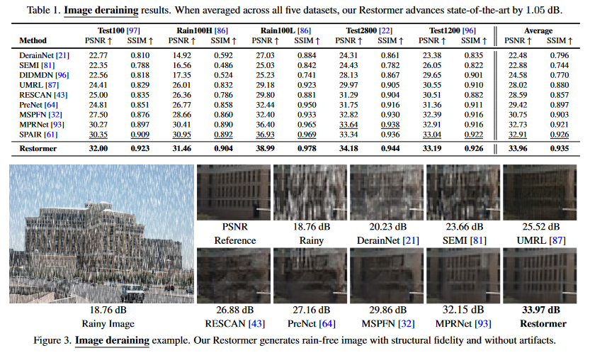
Experiments
8
知行合一、经世致用
自强不息 厚德载物
Central South University

Slide 13
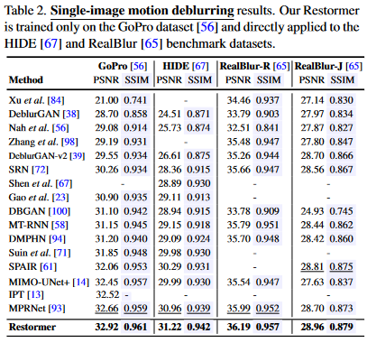
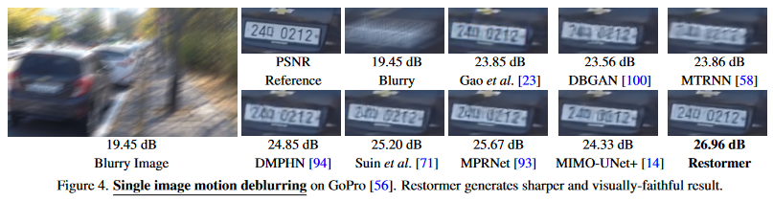
Experiments
9
知行合一、经世致用
自强不息 厚德载物
Central South University

Slide 14
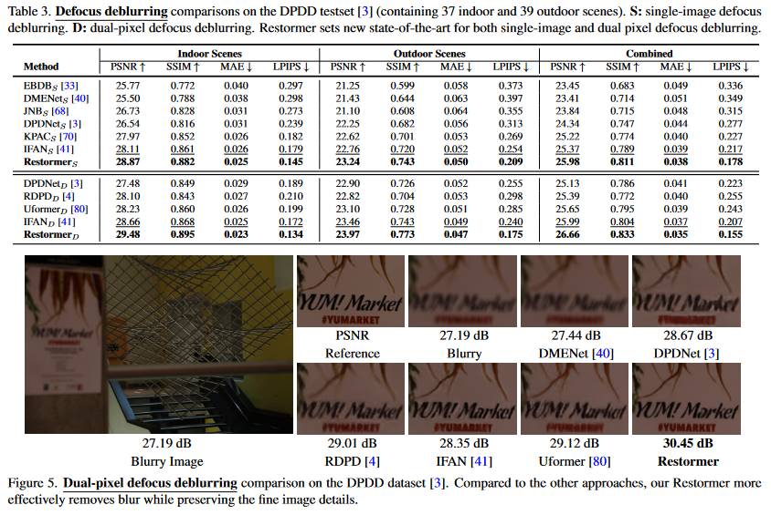
Experiments
10
知行合一、经世致用
自强不息 厚德载物
Central South University

Slide 15
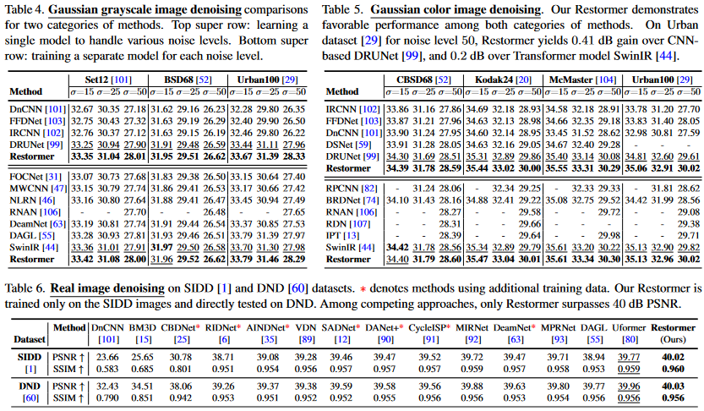
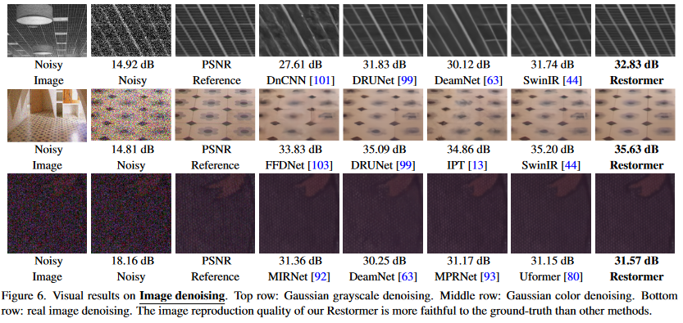
Experiments
11
知行合一、经世致用
自强不息 厚德载物
Central South University

Slide 16
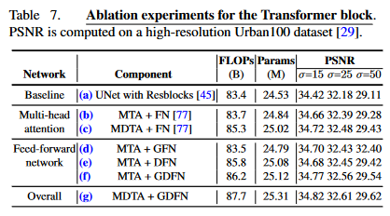
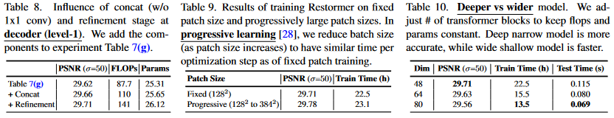
Ablation Studies
12
知行合一、经世致用
自强不息 厚德载物
Central South University

