Slide 1
PROJECT OVERVIEW
Speech Recognition System
Motivation: hands-free voice interaction through spoken-name recognition
Recognising 20 spoken names
using MFCC and a 2D CNN
20
name classes
400
development recordings
One speaker • Isolated names • 2-second audio at 16 kHz
100
independent test recordings
SYSTEM PIPELINE
MICROPHONE
→
MFCC
→
2D CNN
→
PREDICTION
2-second recording
199 × 13 matrix
trained classifier
1 of 20 names
Project scope: 20 predefined names, not general continuous speech recognition.
CMP-6026A / CMP-706A • ASSESSMENT 001
1

Slide 2
SPEECH TO FEATURES
1. Feature Extraction
Manually implemented MFCC • compact short-time speech features
01
02
03
04
05
06
07
FRAME
›
WINDOW
›
FFT
›
POWER
›
MEL
›
LOG
›
DCT
25 ms / 10 ms
Hamming
512 points
Spectrum
26 filters
Energies
13 MFCCs
PSEUDOCODE
OUTPUT SHAPE
Load WAV → frame signal → Hamming → FFT → power spectrum
→ 26 Mel filters → log energy → DCT → first 13 coefficients
199 × 13
time frames × coefficients
Each 2-second recording contains 32,000 samples (16,000 samples per second).
2

Slide 3
MODEL DEVELOPMENT
2. Feature and Model Selection
Fixed stratified split: 320 training recordings and 80 validation recordings
FEATURE COMPARISON — VALIDATION
SELECTED CNN ARCHITECTURE
Linear rectangular
62.50%
Input
199 × 13 × 1
50/80
Conv2D + MaxPool
16 filters • 2 × 2 pooling
Mel triangular
61.25%
49/80
Conv2D + MaxPool
32 filters • 2 × 2 pooling
MFCC
81.25%
Dense + Dropout
64 units • 0.3
65/80
Softmax
20 name classes
MFCC selected: best validation accuracy
Adam optimiser • learning rate 0.001 • batch size 16 • best epoch 16 (lowest validation loss)
3

Slide 4
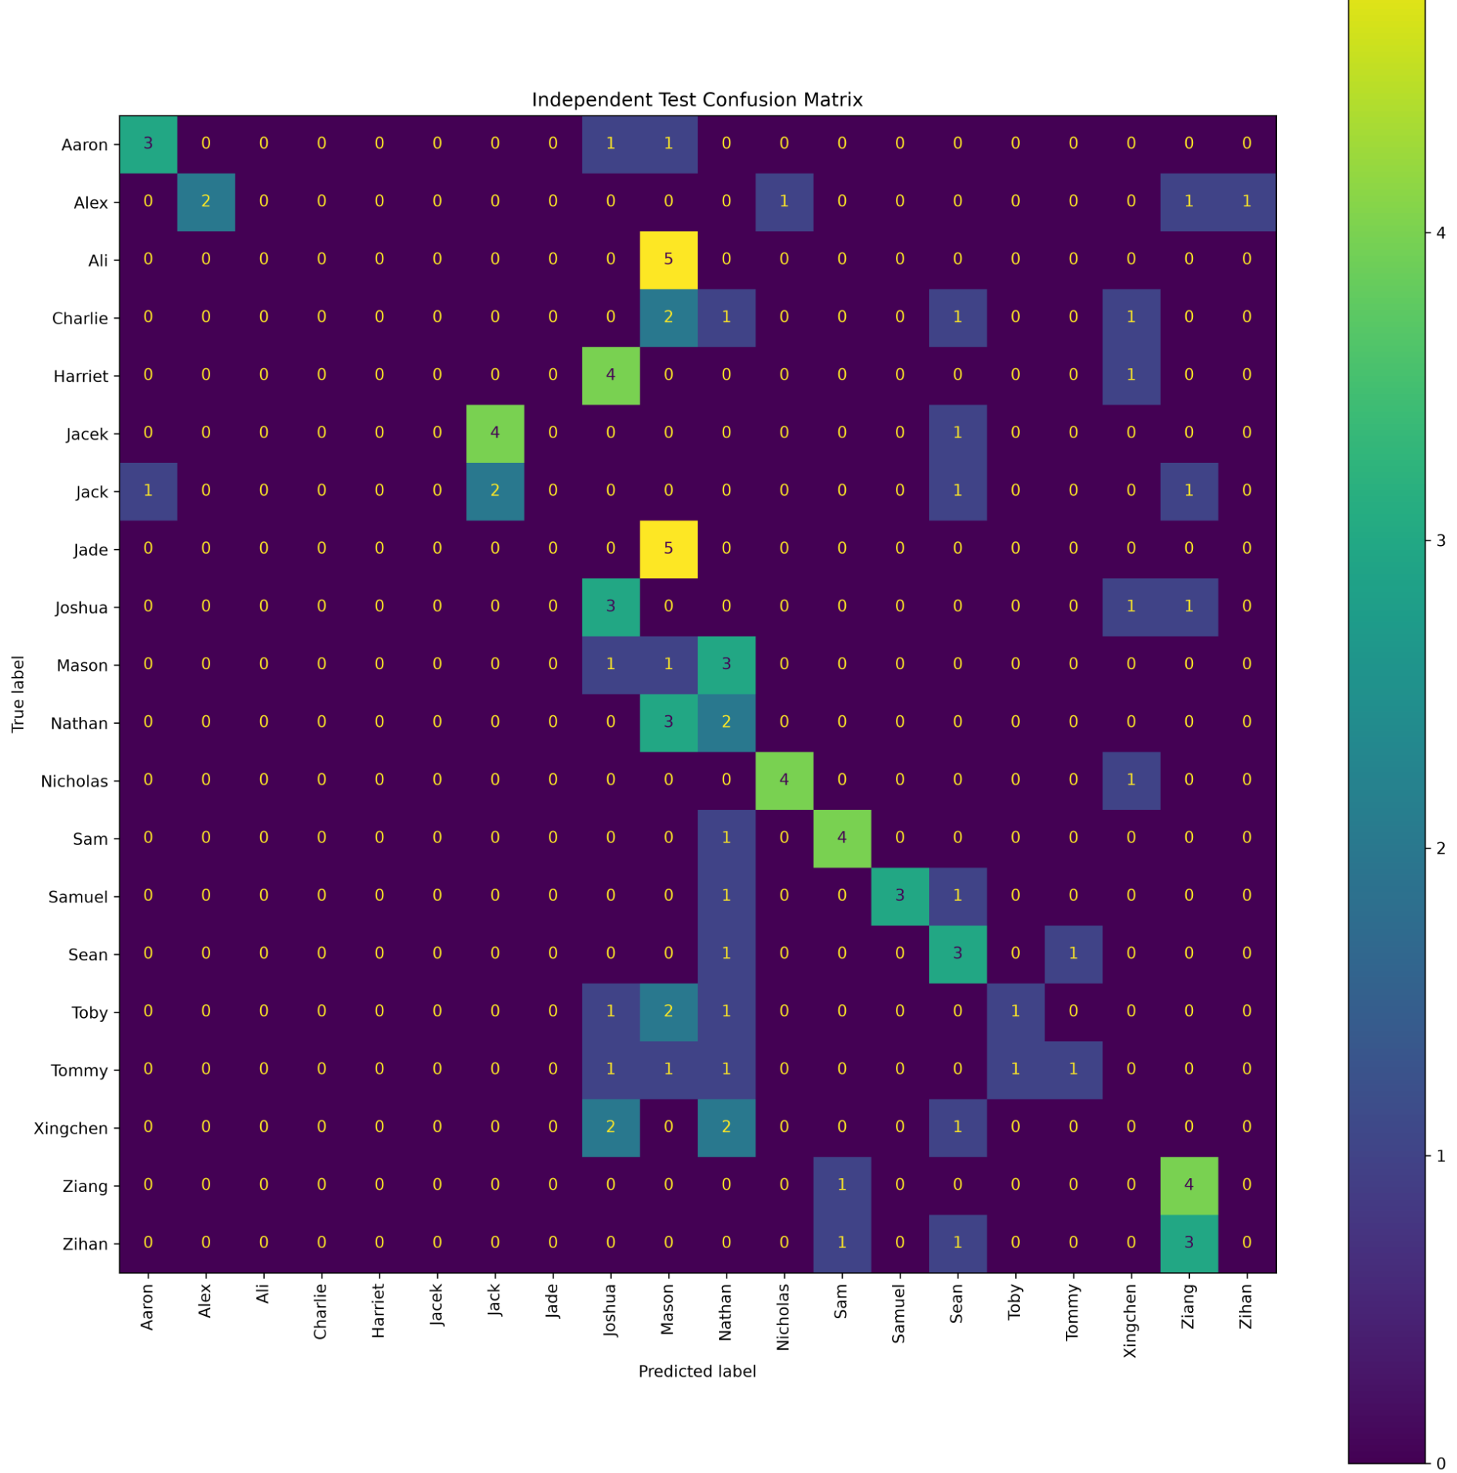
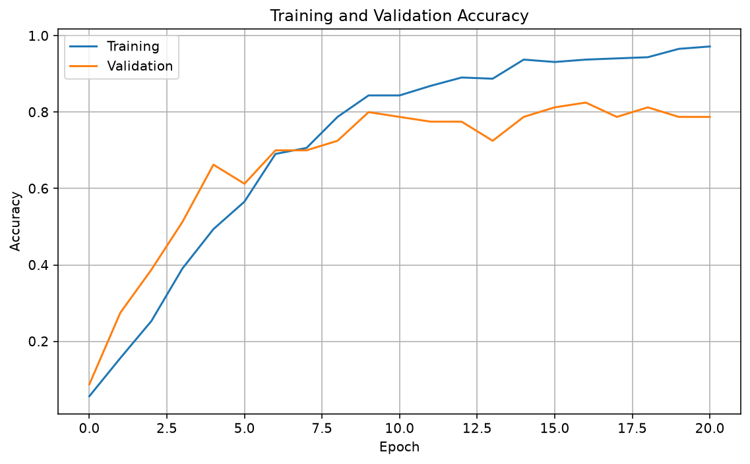
RESULTS
3. Independent Test Evaluation
Final CNN: retrained on 400 development recordings • tested on 100 new recordings
VALIDATION ACCURACY
81.25%
65 / 80 correct
INDEPENDENT TEST ACCURACY
33.00%
33 / 100 correct
KEY FINDING
Poor generalisation to new recordings
POSSIBLE CAUSES
Limited data
Pronunciation shift
Timing variation
Actual 20-class confusion matrix • rows: true names • columns: predicted names
4

Slide 5
CONCLUSIONS
4. Limitations, Improvements and Live Demo
Key issue: performance drops across recording sessions
LIMITATIONS
FUTURE IMPROVEMENTS
Only 20 recordings per name
More recordings across sessions
Pronunciation and timing variation
Vary speaking style and microphone distance
Fixed 2-second input window
Explore augmentation and VAD
LIVE MICROPHONE DEMO
1. Select microphone
→
2. Record 2 seconds
→
3. Extract MFCC
→
4. Normalise
→
5. CNN prediction
Live demo = inference with the saved CNN (no retraining)
Version control: Private GitHub repository
5

