Slide 1
FPS-demo
Ziwen Ren

Slide 2
Discribtion
The project a FPS game developed based on Unity 6 HDRP.
Basic function of this game are
- Player Movement
- Camera Tracking
- Bullet System
- Enemy Health System
- Healthbar
6 Scripts totally
Uses Polyperfect Universal Pack as a resource art pack for the visual elements.
Sound playback system not completed yet : ( :( :( :( :(
Many functions not achieved yet T.T

Slide 3
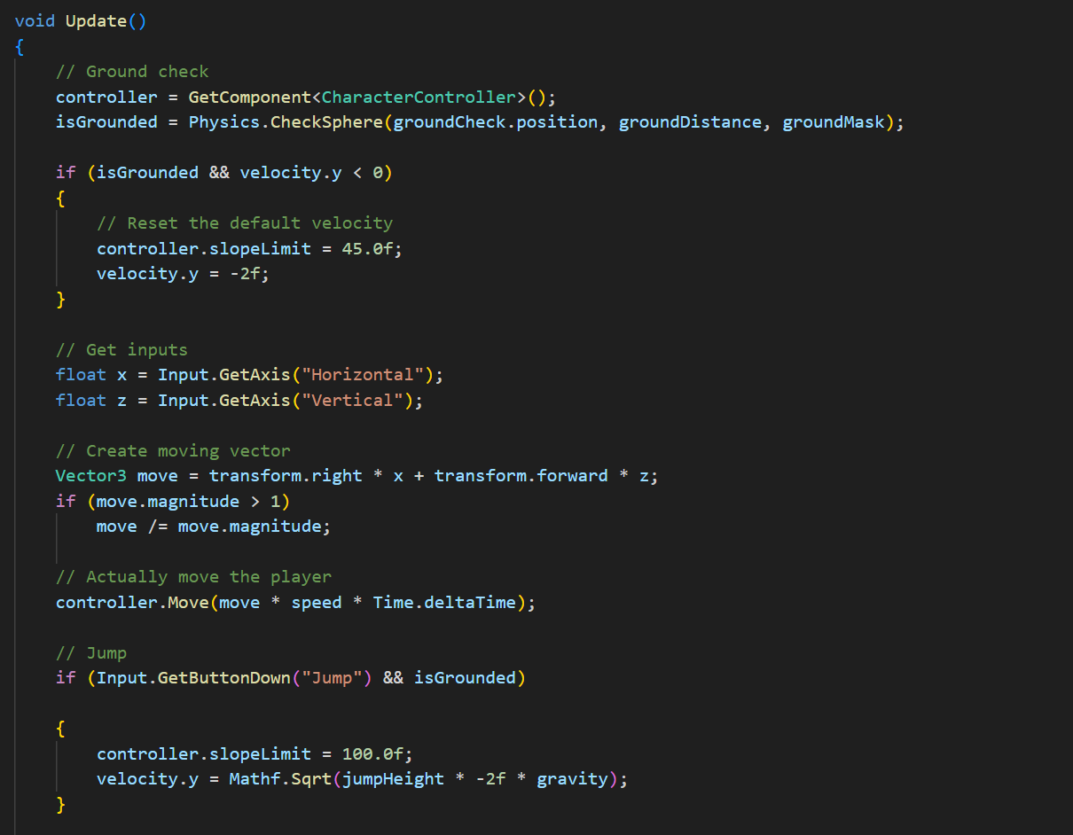
Some important Scripts
PlayerMovement

Slide 4
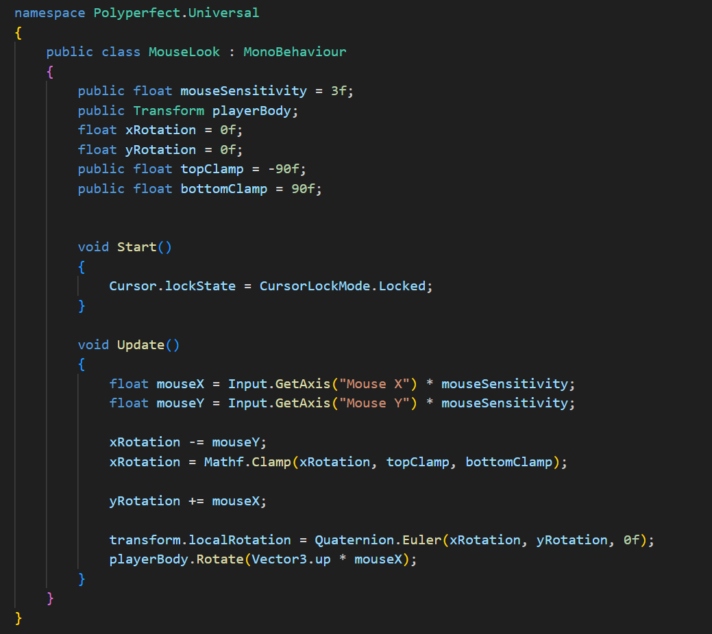
Some important Scripts
MouseLook

Slide 5
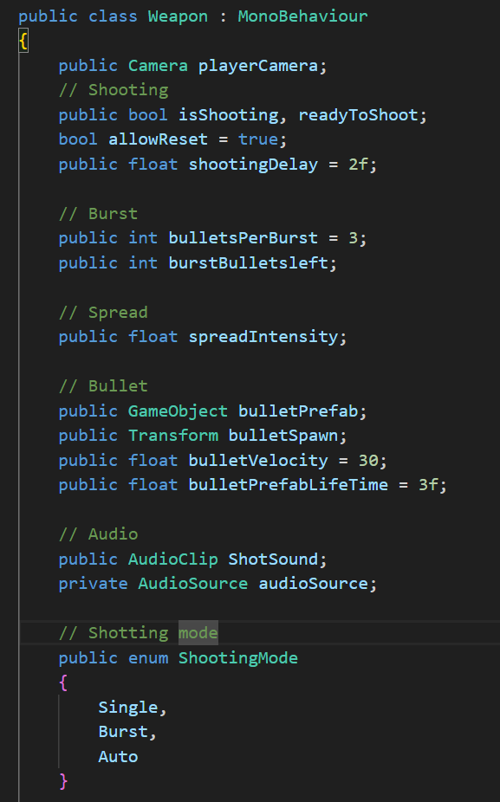
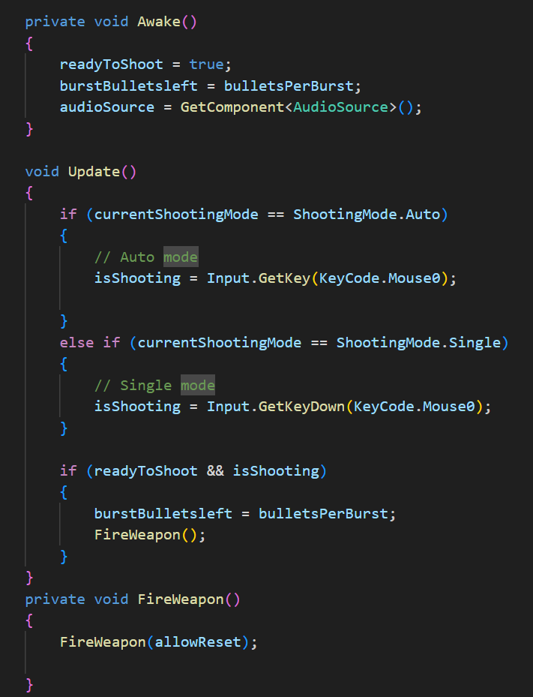
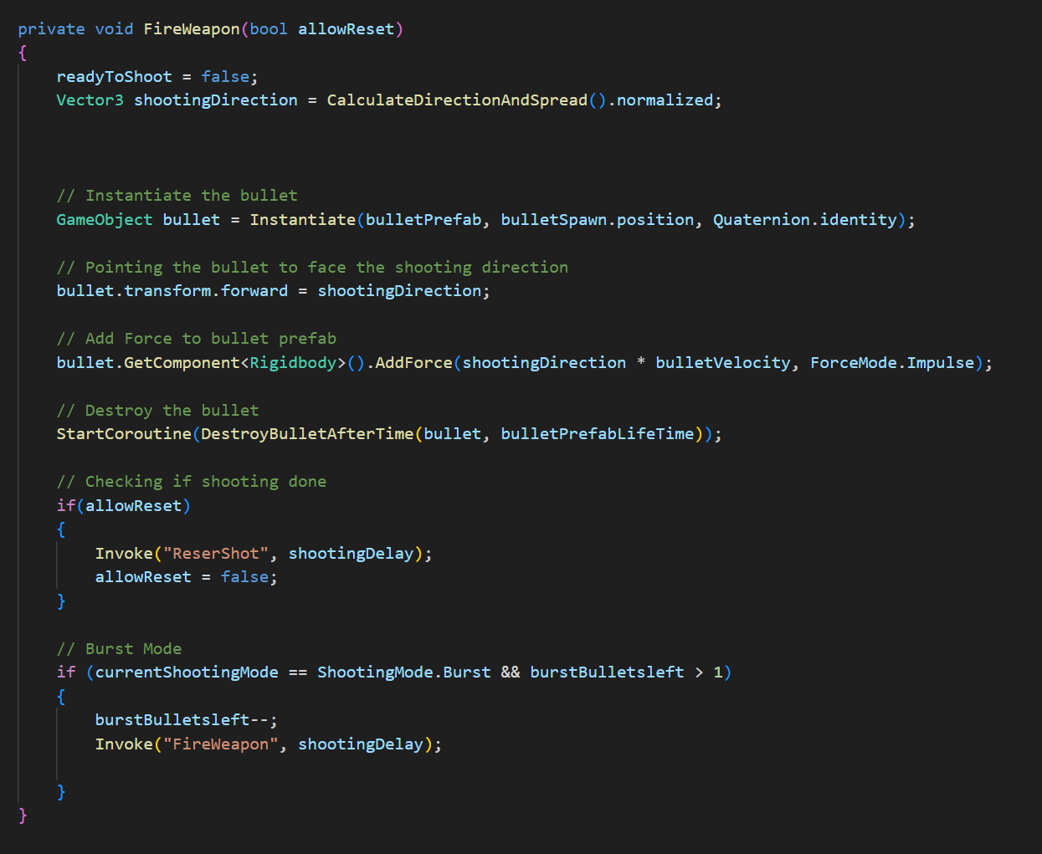
Some important Scripts
Weapon

Slide 6
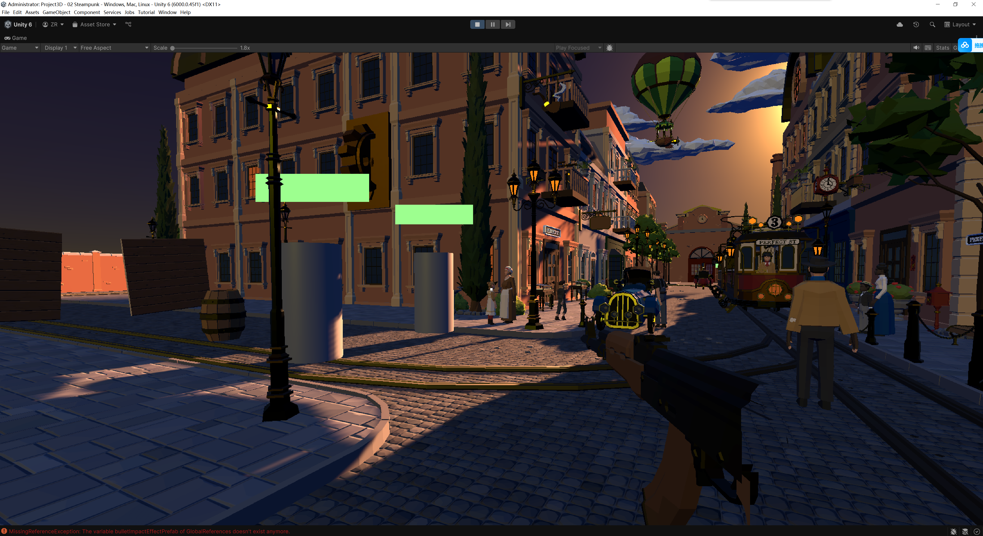
Play Game Time!(probably have some bugs)

Slide 7
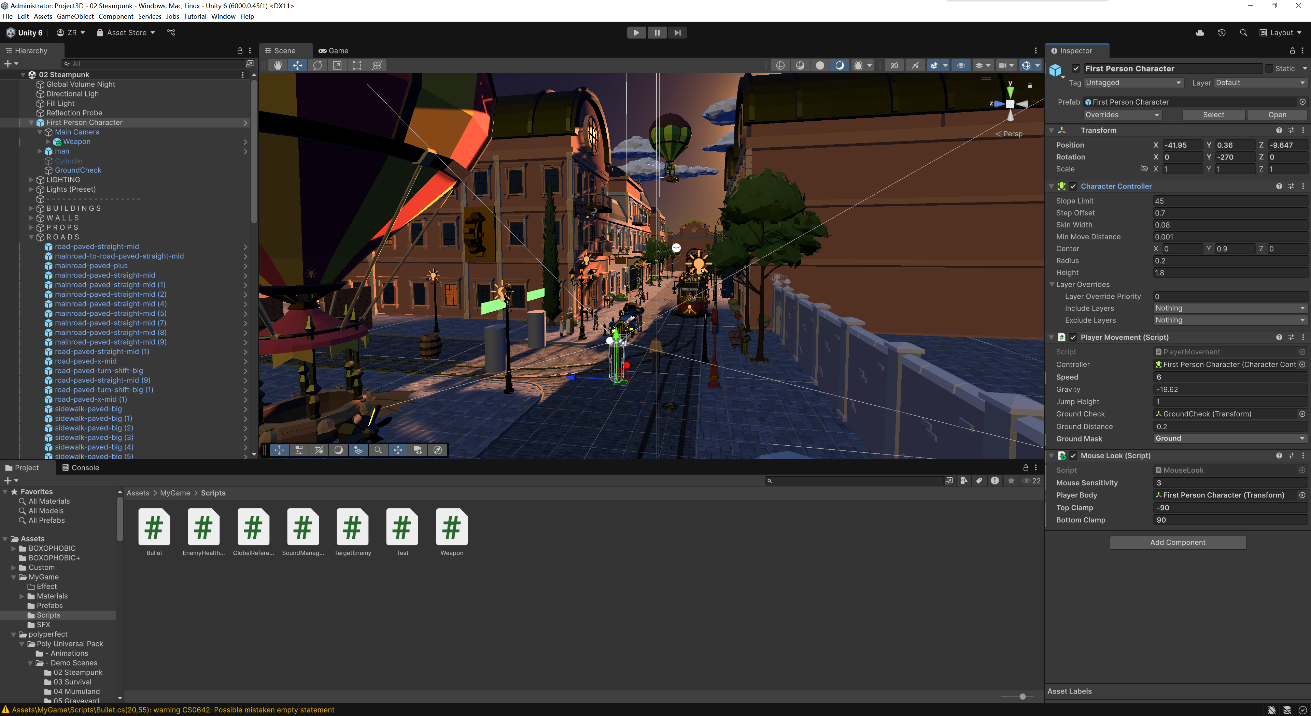
MainPage

Slide 8
Thanks

