Slide 1
Code Smells

Slide 2
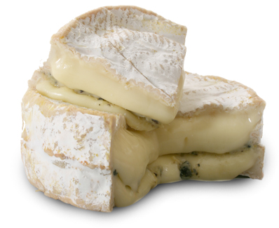
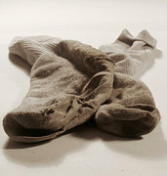
vs.
Notes:
Difference between sour socks and fancy, ripe cheese.

Slide 3
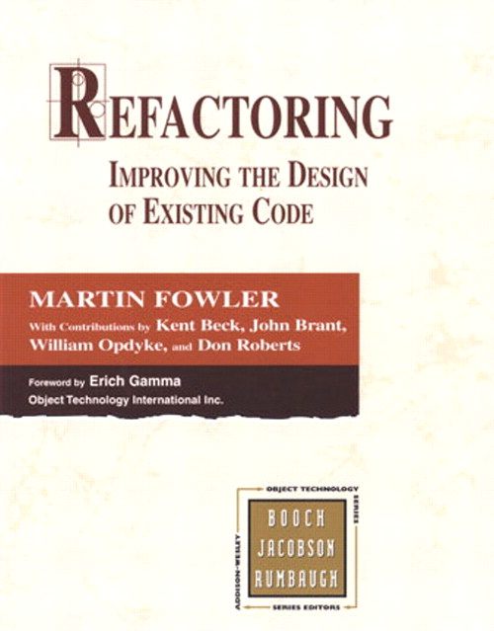

Slide 4
S.O.L.I.D
Single responsibility principle
Open/Closed principle
Liskovs substitution principle
Interface segregation principle
Dependency inversion principle
Notes:
Principles for separating code!
Single responsibility principle – each class has ONE responsibility (fewer and more concise classes)
Open Closed Principle – open to expansion, closed for modification

Slide 5
Duplicated code
Copy/paste
Different parts of the code needing to do the same thing
Different algorithms, same result
Collect into a single place, and ahdere to the Single Responsibility Principle
Notes:
Bugs bugs bugs in multiple locations

Slide 6
Long method/ Large class
Growing functionality over time
Line count is one measure, # of execution paths is a better measure
Split into smaller methods. Make sure each does only one thing. Split into several classes, make sure each class has a Single Responsibility
Notes:
The longer it is, the harder it is to understand and debug.

Slide 7
Long parameter list
function doStuff(param1, param2, param3, param4, param5, param6, param7, …)
- Chances are, you’re doing Too Much Stuff.
Pass in objects with properties. Shorten method.
Consider inlining method.

Slide 8
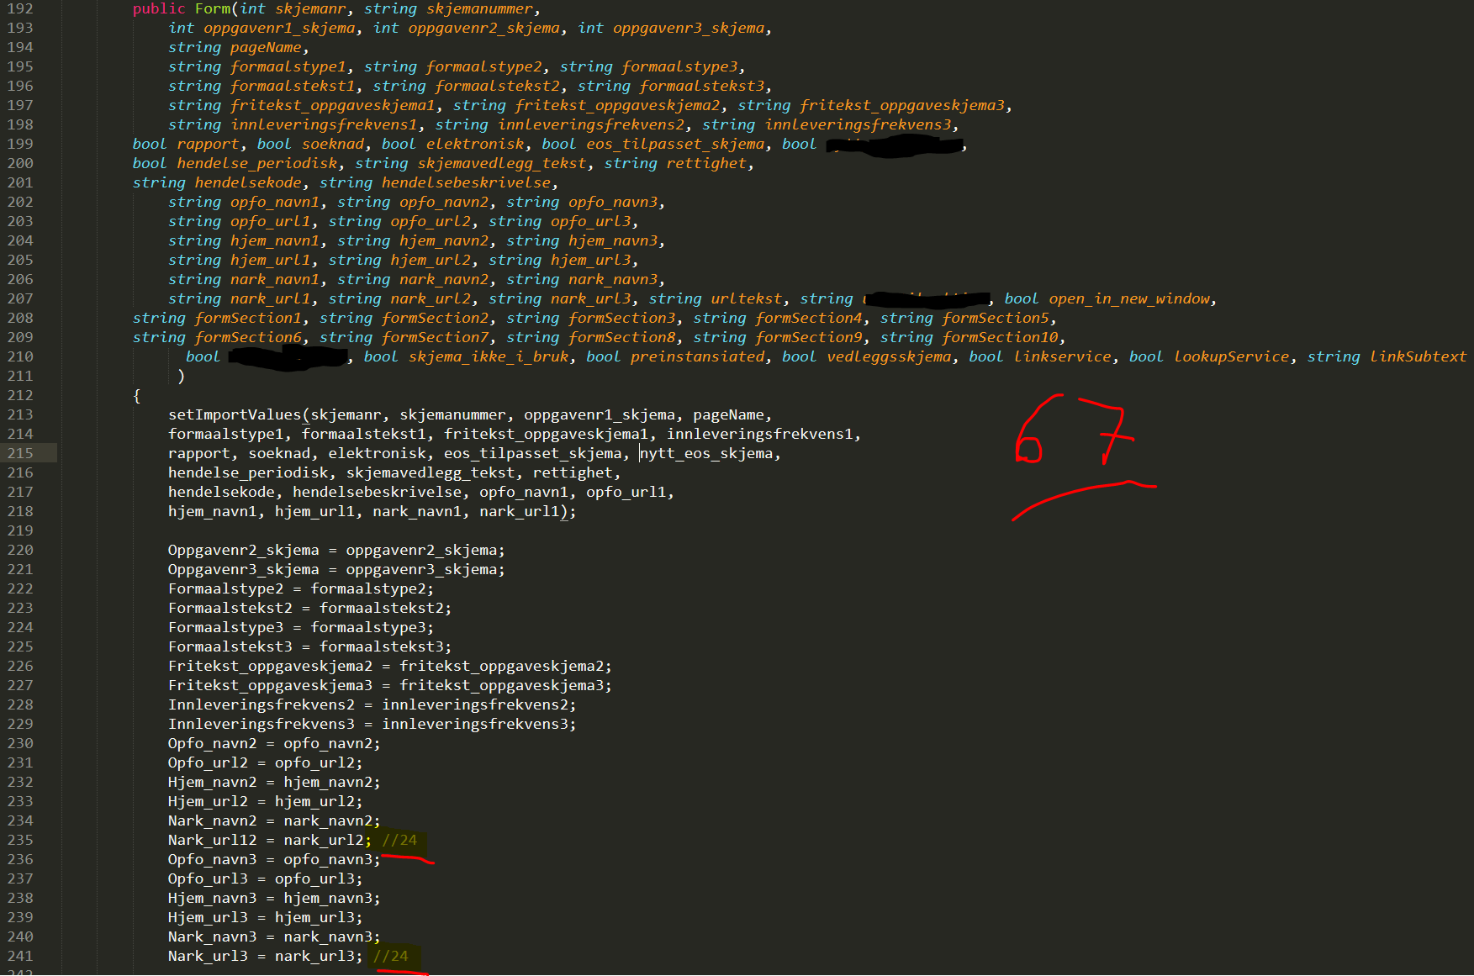

Slide 9
Data clumps
A specific type of duplication
The same or similar group of fields can be spotted in different classes.
Extract the clump into a class with the methods from the different classes.

Slide 10
Data class (anemic object)
All fields and no functionality makes the object a dull quiet thing.
Look around the code for functionality that naturally belongs with the fields and move it into the class.
Notes:
Note: this is sometimes intended behaviour (DTO), often found around interfaces between services and different layers

Slide 11
Shotgun surgery
Changing one small thing idea-wise ends up changing lots of similar changes all over the code.
Chances are, you are missing an object. Introduce one, so that changes to the idea can be expressed in a single place.
Notes:
Often something that happens several times before you really smell it.

Slide 12
Feature envy (inappropriate intimacy)
A method is doing operations entirely on an object or values outside the current class.
Classes are reaching into each other for values.
The functionality is in the wrong place, move it to the object with the values it wants to be with. You may need to move it to a new class, or merge classes.

Slide 13
Primitive obsession
A programmer who thinks it’s too much overhead to use an object for just a few simple values
public class Form {
public String title;
public String description;
public byte[] attachmentBytes;
public String attachmentFileName;
public String attachmentFileExtension;
}
Actually, this is what OO and compilers are for. Just do it.
Notes:
Does this look anemic to you? In the real world, most of these little super-simple classes end up having little super simple methods, like toString.

Slide 14
Switch statements / Multiple if/else
Switching on an object property to do different things often means that property has meaning, not just a simple value.
Consider replacing switch statement with polymorphism – make each value of the switching property determine a new subclass.
Notes:
Sometimes a cheese!

Slide 15
Speculative generality
The creation of a solution that will solve that whole class of problems, and all their varieties.
You Aint Gonna Need It. Take it out. Simple code is always better.
Notes:
Be pragmatic.
Do Test Driven Development in the strictest sense, no code writing unless a test forces it.

Slide 16
Comments
//add two numbers
var sum = a * b
Comments lie. Make your code expressive enough to tell the truth instead, by paying attention to good naming.
Notes:
Lies, damn lies, statistics and then.. there are comments. Just don’t do it.

Slide 17
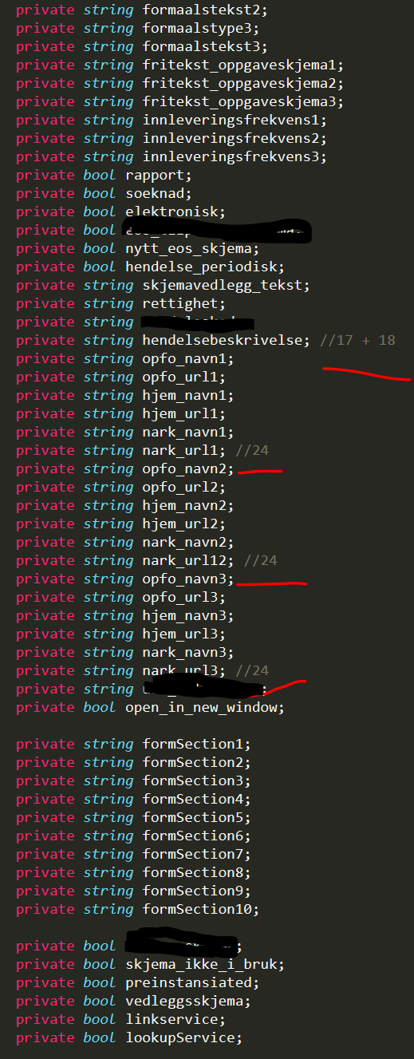
Notes:
Lies, damn lies, statistics and then.. there are comments. Just don’t do it.

Slide 18
Assignment
https://github.com/nerdschoolbergen/code-smells
Fix the stink in the provided code
Make code with some specific smells

Slide 19
Next workshop!
Clean code and refactoring
16. february
http://www.meetup.com/Bergen-Nerdschool/events/228237872/

