Slide 1
Time Series Boot Camp
Day 2
Notes:
https://www.ssc.wisc.edu/~bhansen/390/390Lecture25.pdf

Slide 2
Day 2 – What are we doing today?
Univariate Analysis Exercise
Let’s practice some of what we learned from yesterday to code! This will help us as we proceed with the multivariate analysis.
Multivariate Analysis
An analysis of multiple time series
Vector Autoregression
Grainger Causality
(Bonus: Impulse Response Functions)

Slide 3
Univariate Analysis Exercise
Load the tseries and forecast package
Download the one of the datasets in the exercise_day2 folder
Determine if the data has a unit root
(hint: tseries::kpss.test // tseries::adf.test)
Use auto.arima() to find the optimal ARIMA(p,d,q)
Forecast the next 5-10 days
Plot the time series!
Notes:
tseries documentation - https://cran.r-project.org/web/packages/tseries/tseries.pdf
Forecast documentation - https://cran.r-project.org/web/packages/tidyr/vignettes/tidy-data.html

Slide 4
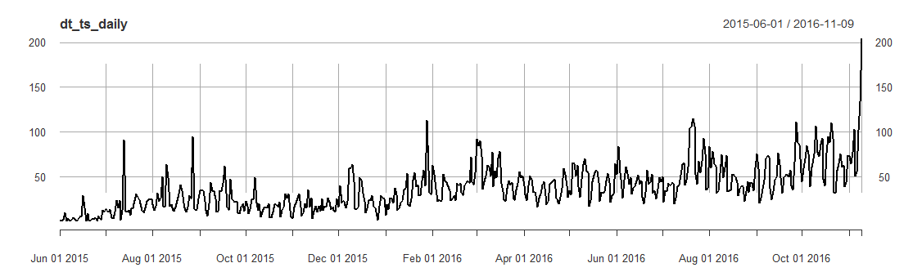
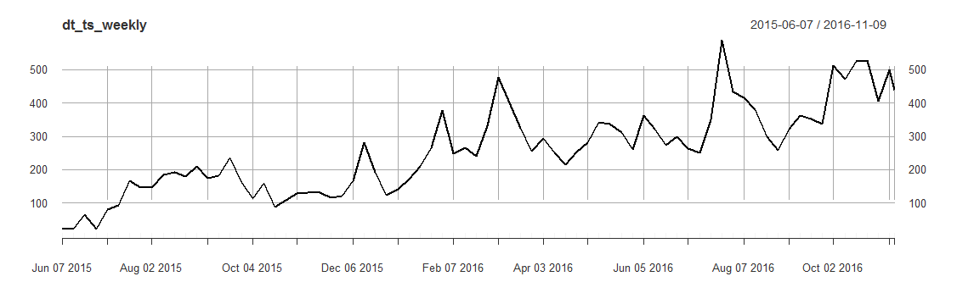

Slide 5
ARIMA for daily vs. weekly time series?
Daily: ARIMA(3,1,2)
Weekly: ARIMA(0,1,0)
Daily with Seasonal: ARIMA(1,1,1)(0,0,2)[7]

Slide 6
Multivariate Time Series!

Slide 7
Multivariate Time Series
Many different methods that look at many types of relationships
We will focus on one frequently used model, but keep in mind that there are many other models that may be useful (a few will be listed at the end)

Slide 8
A note about time and causality
Time-order is only one prerequisite of causality
Time series analysis allows you to establish temporal precedence, but does not actually prove causality.
This is important for writing results
However, experiments often have short-term temporal precedence. Because of the data required for time series, more complex temporal relationships can be identified through these techniques

Slide 9
Vector AutoRegression (VAR)
Sims, Christopher A. "Macroeconomics and reality." Econometrica: journal of the Econometric Society (1980): 1-48.
Build on the Autoregressive model (the AR in ARIMA)
Highly inductive approach
This is built on the idea that each variable in a VAR can be modeled as a combination of the variable’s past values + past values of other variables + white noise.
VAR(p) → p is the lag
Notes:
Cool other links about VAR:
https://www.ssc.wisc.edu/~bhansen/390/390Lecture25.pdf
https://newonlinecourses.science.psu.edu/stat510/node/79/
This model is publishable at top-tier journals

Slide 10
VAR(p) vs. Structural Equation
VAR
Structural Equation Model
Theoretically-independent model (in terms of structure)
Requires time series data
NOT CAUSAL
Reliance on theory to determine functional form
Does not require time series
NOT CAUSAL

Slide 11



VAR “Math”
Let’s say, you think Russian, U.S. and Chinese relationships are all related to one another.
These relationships can be modeled using SEM or VAR!

Slide 12
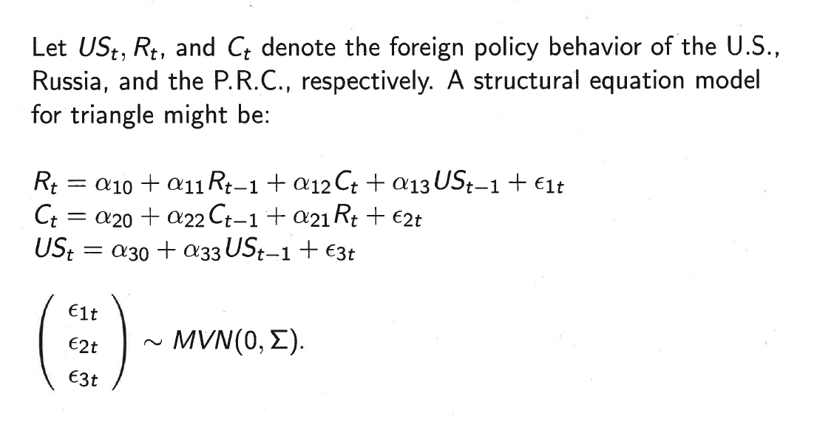
Let’s see this in SEM form!
Notes:
Lots of priors required

Slide 13
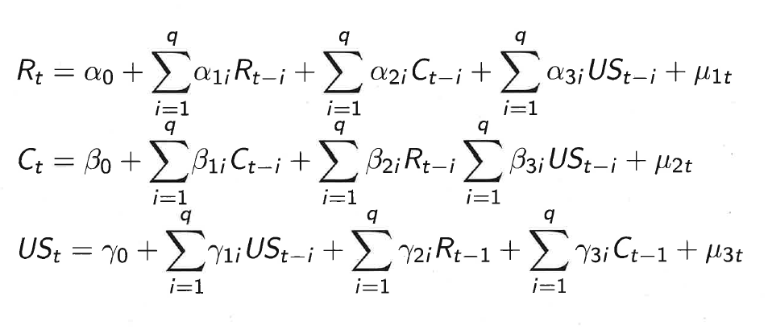
Let’s see this in VAR form!
White Noise
Past values
Past values of other variables
Notes:
variable’s past values + past values of other variables + error.

Slide 14
Pro’s and Con’s of a VAR Model
Pro’s
Con’s
Inductive (a-theoretical)
Great forecasting capabilities
Handles exogenous and endogenous variables
Fixed lag for whole model
Cannot be used for panel data
Not good for simultaneous relationships
Requires uniform level of time series aggregation

Slide 15
Preconditions of a VAR
All variables are stationary
At least 40 data points are needed (100+ is optimal)
Uniform data aggregation
Your time series must be continuous (regularly spaced)
You must be able to construct a “tidy” data structure (tidy time!)
Notes:
Checking the number of days or minutes of your time span: https://www.wolframalpha.com [Easter egg: Ask it “What is the answer to life?”]
Search the following: days between 6/1/2015 to 11/9/2016 [Wolfram Alpha will tell you how many days are in between your window of time, inclusive of those dates]
Also useful for time zone differences, and for converting UNIX time stamps to something readable (another tool: https://www.unixtimestamp.com/ )

Slide 16
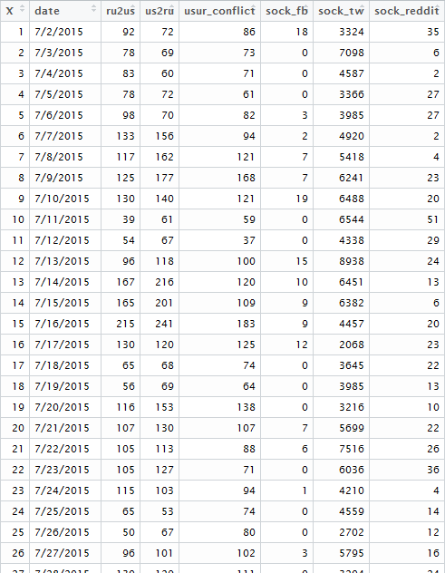
Tidy time!
One value, per variable, per time point
(observation = time point)
No duplicate time points
No missing time points (continuous)

Slide 17
Steps to a VAR Analysis
Model specification | Construction | Analysis and Model Checking
First-difference any integrated univariate time series
Determine order, and endogenous/exogenous variable
Identify the optimal lag
Construct a VAR model
Run Granger Causality Tests
Run Impulse Response Functions
Check residuals of model

Slide 18


Exogenous vs. Endogenous Variables
Endogenous – A variable that can be explained by the relationship of other variables in a model
Exogenous – A variable that is cannot be explained by the relationship of other variables in a model
It may be explained by things outside of the model, but it’s not explained by things in the model.
GDP
Notes:
https://www.investopedia.com/terms/e/endogenous-variable.asp

Slide 19
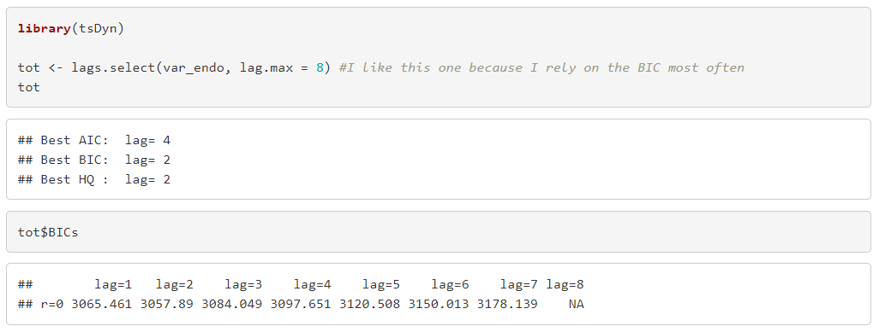
Determining an appropriate lag
Use information criteria (AIC or BIC) to determine the appropriate lag
Select the lag with the largest number
Dataset of VAR variables
Tests for 1-8 lags
(Shows BIC for models with lags of 1 to 8)
A lower number is better

Slide 20
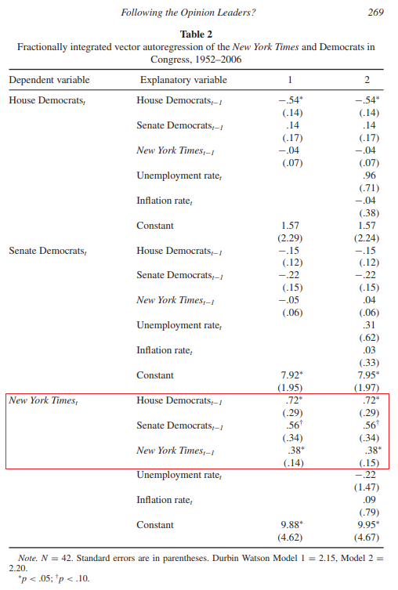
VAR Results
In this [fractionally integrated] VAR, Habel focuses on The New York Times as the dependent variable. He notes, “the Times responds to the Democratic party median in the House and the Senate at a statistically significant level” (p. 270)
Habel, P. D. (2012). Following the opinion leaders? The dynamics of influence among media opinion, the public, and politicians. Political Communication, 29(3), 257-277.
Notes:
VAR Results here

Slide 21
Why do people gloss over the VAR model?
VAR model results are in a reduced form, so the coefficients are difficult to interpret (the coefficient is only one part of the model—there is also a function for each endogenous variable)
VAR models are long (the more variables you include, the longer your chart gets)

Slide 22
What do people use instead?
Granger Causality
Impulse Response Functions

Slide 23
Granger Causality
Granger, C. W. (1969). Investigating causal relations by econometric models and cross-spectral methods. Econometrica: Journal of the Econometric Society, 424-438.
Relies on the VAR model
When X “granger causes” Y, it means Y can be better predicted (or forecasted) with the inclusion of X than by Y itself (Diebold, 2001)
Granger causality is NOT causality
Because this is not an experiment, we cannot control “everything.” Therefore, omitted variables could still affect the causality hypothesis
Notes:
Mathy stuff - http://www.scholarpedia.org/article/Granger_causality
More on Granger causality
https://www.r-bloggers.com/chicken-or-the-egg-granger-causality-for-the-masses/
T-Y procedure: https://davegiles.blogspot.com/2011/04/testing-for-granger-causality.html (Granger Causality, but you don’t first-difference)
Diebold, F. X., & Inoue, A. (2001). Long memory and regime switching. Journal of Econometrics, 105(1), 131-159.

Slide 24
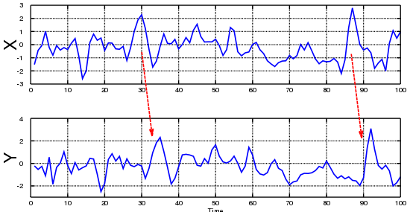
Source: https://blog.projectpiglet.com/2018/01/limits-of-granger-causality/
Notes:
Finding this pattern is obviously not inherently causal—it’s more like it proves the temporal order prerequisite i

Slide 25
Limits of Granger Causality Tests
Granger causality tests are really focused on time-lagged relationships. In other words, things that occur simultaneously cannot be “teased out” to see if one Granger causes another.
Both X and Y have to be endogenous variables

Slide 26
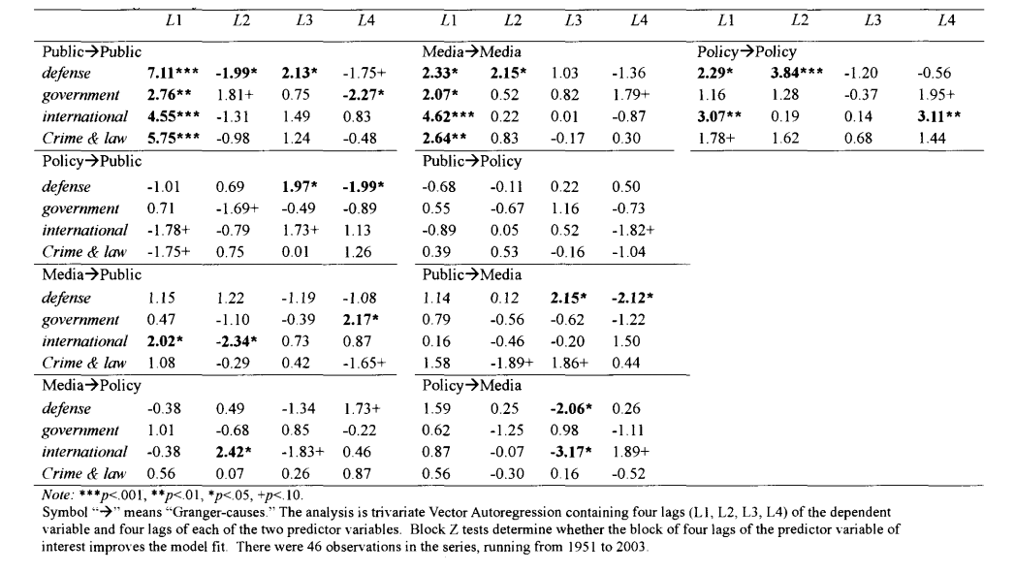
Granger Causality Results
Tan, Y., & Weaver, D. H. (2007). Agenda-setting effects among the media, the public, and congress, 1946–2004. Journalism & Mass Communication Quarterly, 84(4), 729-744.

Slide 27
Granger Causality and Mass Comm
Agenda setting
Tan, Y., & Weaver, D. H. (2007). Agenda-setting effects among the media, the public, and congress, 1946–2004. Journalism & Mass Communication Quarterly, 84(4), 729-744.
Meraz, S. (2011). Using time series analysis to measure intermedia agenda-setting influence in traditional media and political blog networks. Journalism & Mass Communication Quarterly, 88(1), 176-194.
Content + secondary data
Groshek, J. (2011). Media, instability, and democracy: Examining the Granger-causal relationships of 122 Countries from 1946 to 2003. Journal of Communication, 61(6), 1161-1182.

Slide 28
Impulse Response Functions
Used to identify what happens to one variable (Y) when another variable in the model (X) is “shocked”
Both X and Y have to be endogenous variables
Allows you to see how long a shock in one variable influences another variable (across a longer period of time)
In mass comm research, these are less common compared to VARs and Granger Causality tests

Slide 29
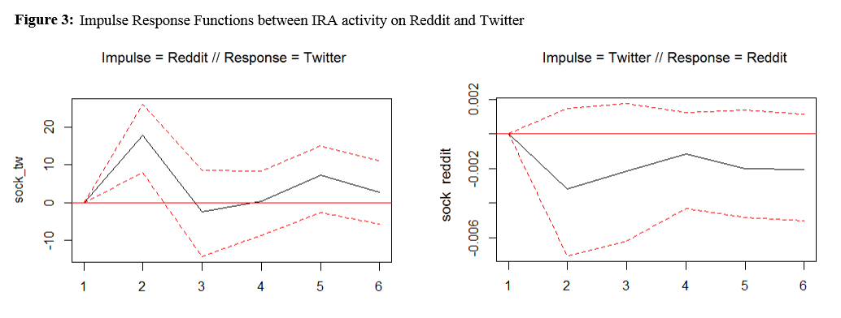
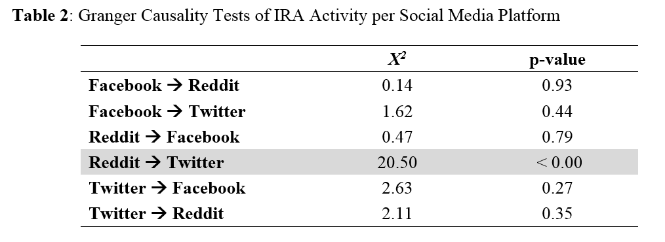
IRF Example

Slide 30
Other Multivariate Models
Error Correction Models
A different way of dealing with integrated time series (sometimes necessary)
ARCH/GARCH
Accounts for change in variance over time
Dynamic Conditional Correlations
Notes:
On cointegration: http://www.eco.uc3m.es/~jgonzalo/teaching/EconometriaII/cointegration.HTM
ECM Paper: Soroka, S. N., Stecula, D. A., & Wlezien, C. (2015). It's (change in) the (future) economy, stupid: economic indicators, the media, and public opinion. American Journal of Political Science, 59(2), 457-474.
Dynamic Conditional Correlations: Lebo, M. J., & Box‐Steffensmeier, J. M. (2008). Dynamic conditional correlations in political science. American Journal of Political Science, 52(3), 688-704.

Slide 31
Plan for tomorrow (Coding Day!)
In addition to re-applying some of our new ARIMA skills to new data, we will be focusing on the following topics:
Jordan & Jo’s favorite packages for time series analysis
A bit on data wrangling for VAR
Constructing a VAR model (+ Granger causality tests and IRFs)
Post-hoc Univariate and Multivariate Model Checking
Data visualization (static and interactive)

