Slide 1
COVID-19 X-ray Classification
Anita K. Rao, Ilker Yaramis, Sukru C. Sezer
Team8_Covid19

Slide 2

Problem Statement
The focus of this work is on early detection of the virus, using chest X-ray images.
Accurately classify X-ray images for COVID-19, Pneumonia, Normal cases
Visualize the deep learning models decision process,

Slide 3
Proposed Solution
The main focus in our analysis was on multinomial classification of the COVID-19 chest X-ray image dataset into the following categorical values:
COVID Positive
Pneumonia
No Findings
Our approach considered both machine learning and deep learning classification algorithms

Slide 4
Datasets
Two databases are utilized for model training:
ChestX-ray8 dataset
Normal and pneumonia images
1054 Normal images
1845 pneumonia images
COVID-19 X-ray image database developed by Cohen J. P.
COVID Cases
930 COVID x-ray images
Perform stratified sampling without replacement on the dataset with a test set percentage of 20% to get 5 pairs of training/test sets.

Slide 5
Feature Engineering
Feature Extraction using Convolutional Neural Networks (CNN)
Image classification pipelines traditionally consisted of two elements: a static feature extractor, and a classifier.
Static extractors require exhaustive parameter search and fine tuning
Solution: Learning best feature extractors simultaneously along classifier parameters
Pre-processing
Input images are standardized by resizing to 128 by 128
Random augmentations are applied to obtain a scale, translation, rotation and brightness invariant classifier:
Rotation/Shear
Width/Height Shift
Horizontal/Vertical Flip
Brightness

Slide 6
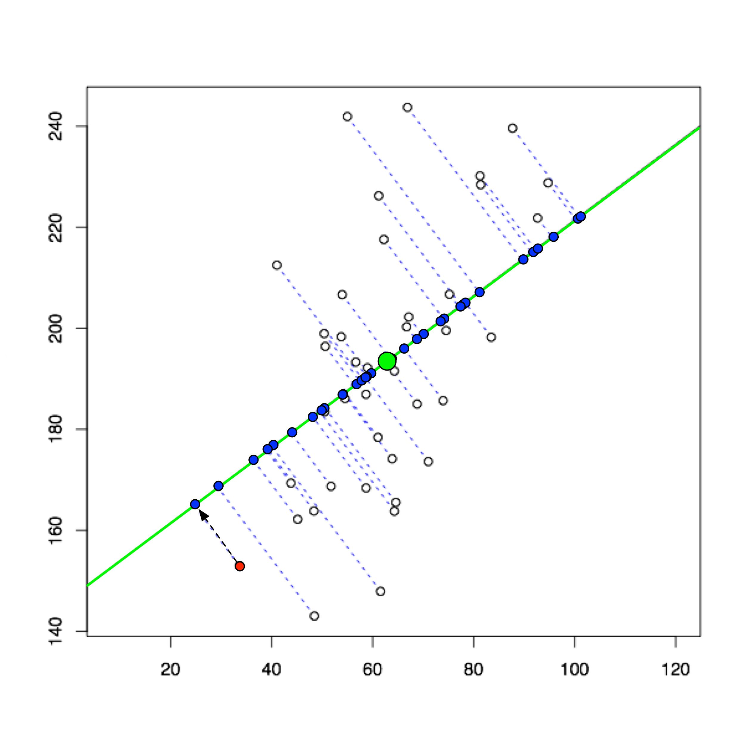
Feature Engineering contd.
Dimensionality Reduction using Principal Component Analysis
Orthogonal linear transformation used to reduce the dimensionality of a feature space; can be particularly useful for input images
Reduced the CPU processing time in Spark by 10x
Principal Components = 40

Slide 7
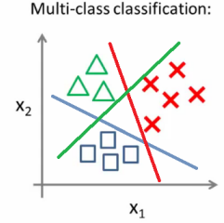
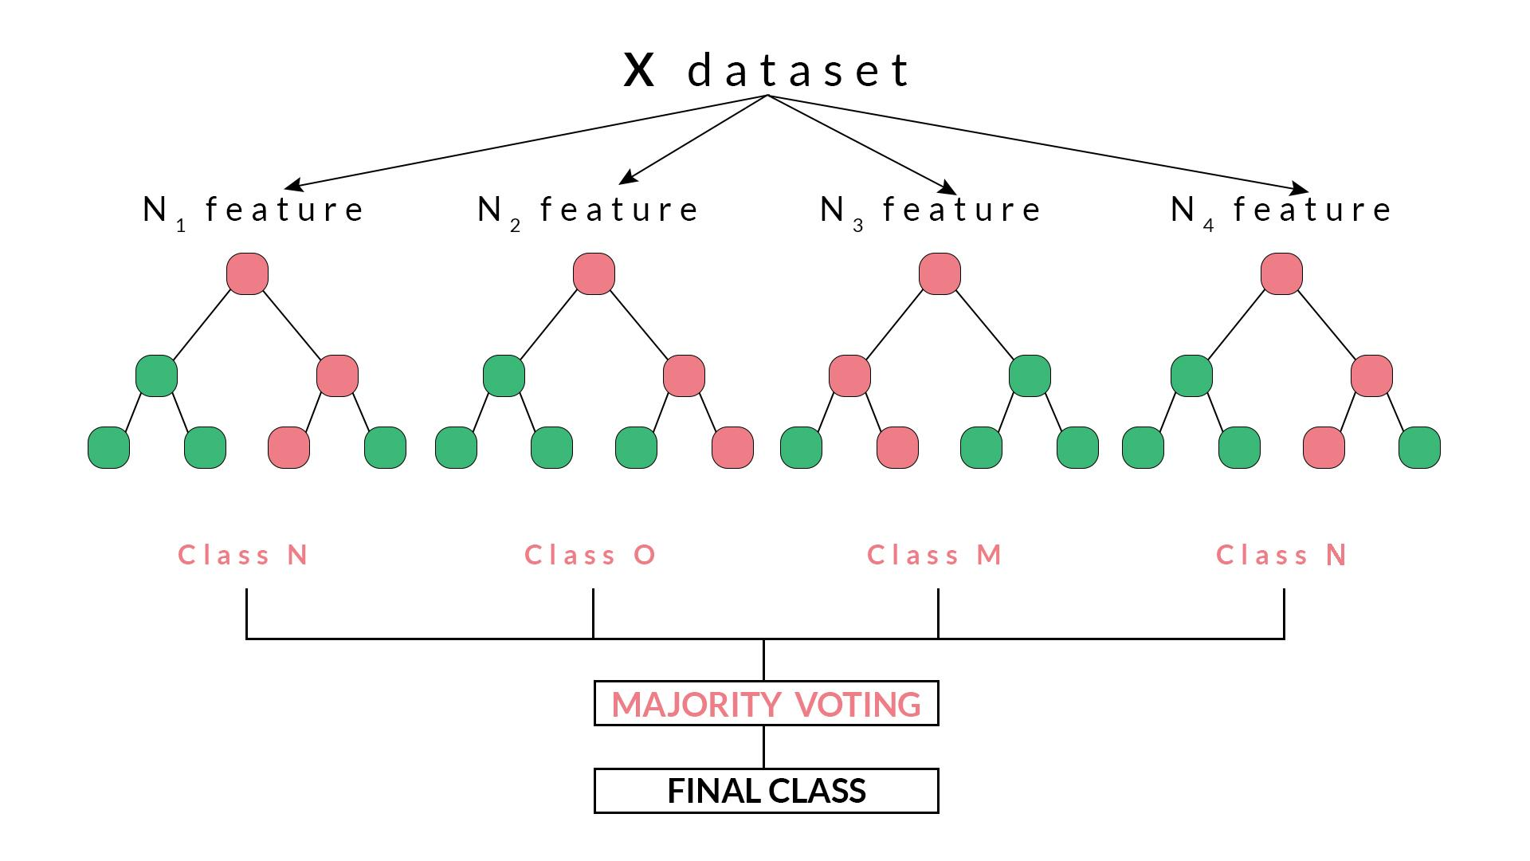
Machine Learning Models
Logistic Regression
Linear kernel space-based model
Hyperparameters
Max Iterations = 10
L2 Regularization Parameter = 0.3
Random Forest
Tree-based model
Hyperparameters
# Trees = 10
Max Depth = 6

Slide 8
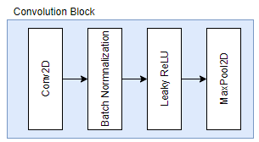
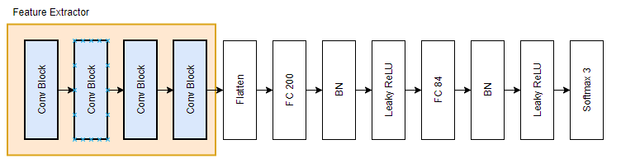
Deep Learning Model
CNN architecture:
4 blocks of 3x3 convolutional layers used with leaky ReLU activation and batch normalization for feature extraction.
Total number of parameters: - - 945,183

Slide 9
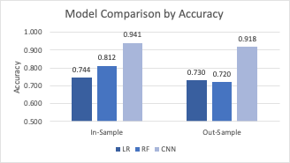
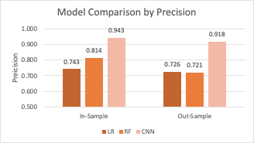
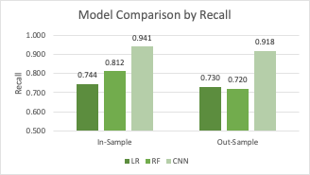
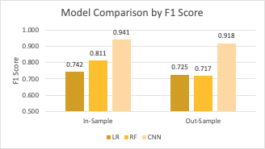
Model Evaluation & Comparison

Slide 10
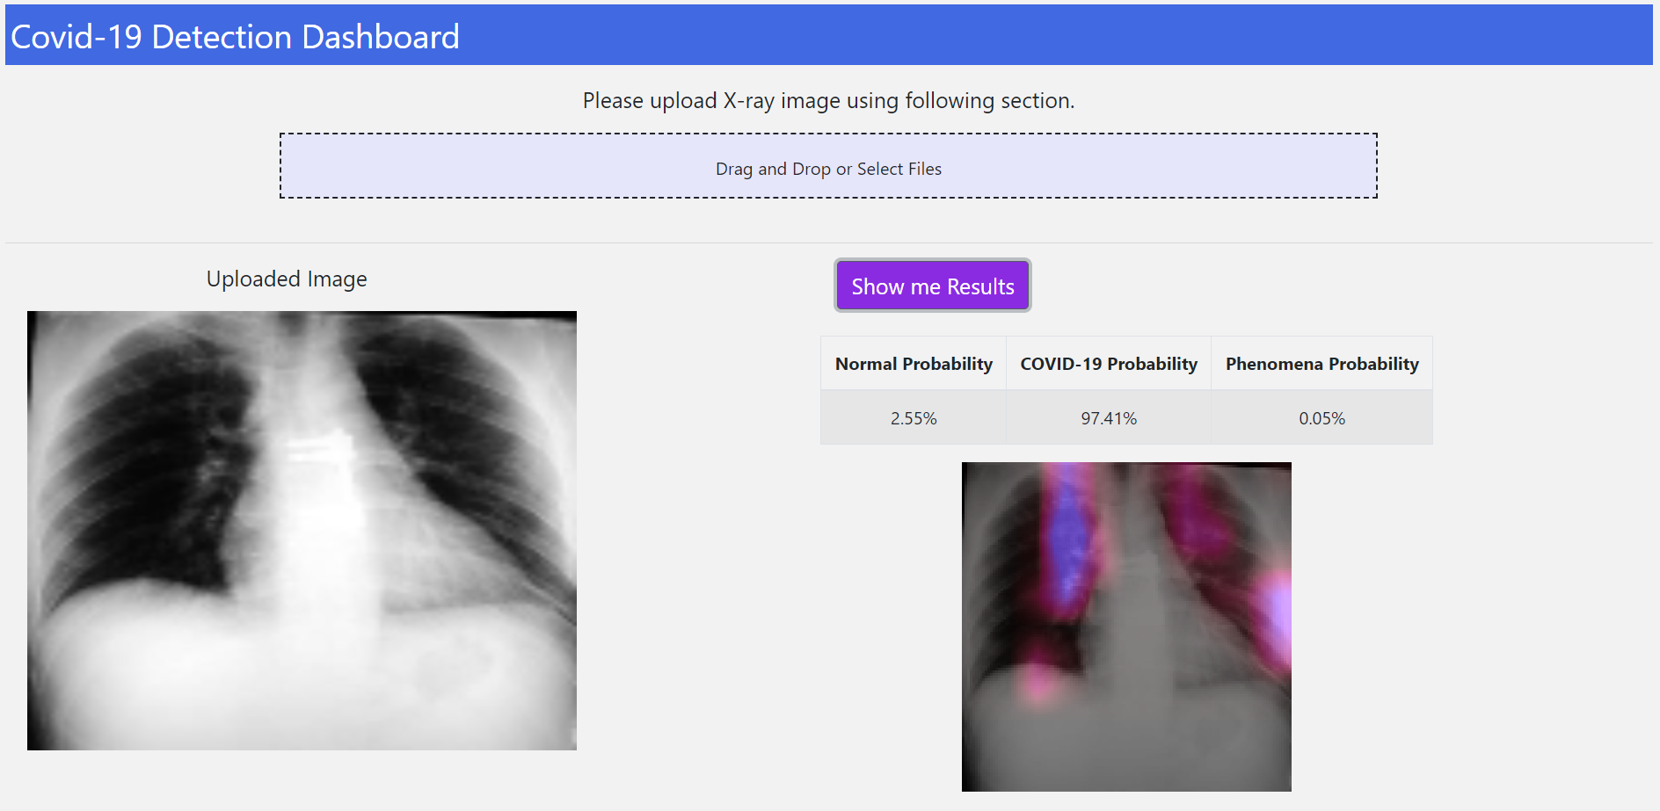
COVID-19 Detection App

Slide 11
Conclusion
Using larger neural network with augmented data (rotation, shear, brightness) improved CNN performance and reduced overfitting
CNN outperformed LR and RF across all evaluation metrics for in-sample and out-sample data
COVID-19 Detection App aids in visually identifying critical components of X-ray image for diagnosis
Future Optimizations
Train the model to identify bounding box and disease class indicators (i.e. right or left lung)

Slide 12
References
https://utkuufuk.com/2018/06/03/one-vs-all-classification/
https://blog.quantinsti.com/random-forest-algorithm-in-python/
https://liorpachter.wordpress.com/2014/05/26/what-is-principal-component-analysis/

Slide 13
Thank You

