Slide 1


Final Year Project
Re-Wear
Upgrading Sustainable Fashion
Supervised By: Sir Ahmad Nawaz (Lecturer)

Slide 2
Project Team
Muhammad Talha Masood (29423)
Sfwan Ali (13408)

Slide 3
Table of Content
Opportunity & Stakeholders
Problem Statement
Solution
Progress Report Summary
Requirements
Software System (Design + Implementation + Testing)
Endeavour (Team + Work + Way of Working)
Work Break Down

Slide 4
Opportunity & Stakeholders

Slide 5
Opportunity
We aims that Re-Wear is an innovative website that connects buyers, sellers, and tailors to create a one-stop shop for vintage clothing and tailoring services. In addition to providing specific stitching and alterations for a wide range of clothing items, including bridal gowns, groom apparel, shirts, pants, sarees, shoes, accessories, and more, tailors can display and market their expertise. Vendors may post their gently used or new clothing products, giving consumers the opportunity to buy premium, sustainable apparel at moderate costs. To make things even more accessible, customers can choose to pay for their purchases in installments. This special fusion of vintage clothing and custom tailoring guarantees that each item can be precisely tailored to the buyer's measurements, increasing the purchase value and satisfaction overall.

Slide 6
Opportunity & Stakeholders
Stakeholders
Administrators: They will have the opportunity and authority to manage the user and products
Buyer: They are individuals who want to be stylish without harming their pocketbook by searching for affordable, trendy clothing.
Seller: Users who want to earn money from gently used items can sort through their wardrobes with Rewear.
Tailor: These are the individuals who the site offers to help close the gap between perfectly fitting garments and gently used items. These individual can showcase their work

Slide 7
Problem Statement

Slide 8
Problem Statement
Elements | Description
The Problem of | Lack of Visibility for New Tailors on online platform
Affects | Tailor
The Result of Which | Amateur tailors find it difficult to draw in customers and make money on Online platforms
Benefits | Attract customers Generate income

Slide 9
Problem Statement
Elements | Description
The Problem of | The cost of traditional wedding gowns and grooms might be exorbitant.
Affects | Buyer
The Result of Which | Due of the high expense, some individuals who cannot afford to attend weddings or other significant cultural and personal events may not be able to fully participate.
Benefits | Providing an affordable and comprehensive solution Facilitating easier access to the essential groom and bride attire for formal occasions.

Slide 10
Solution
ReWear is not like other apparel platforms. It's a one-stop store for tailors and environmentally aware shoppers alike. This is the idea:
At incredibly low costs, explore a treasure trove of pre-owned apparel, including designer items like groom and wedding gowns.
With our comprehensive tailoring service, you may give your old clothing a new lease on life or discover the ideal fit for gently used items. Skillfully competing for your bids, tailors guarantee skilled changes and competitive pricing.

Slide 11
PROGRESS REPORT Summary

Slide 12
Requirements
Elicitation Techniques
Online Survey
Brain Storming Technique

Slide 13
Requirements
Functional Requirements – 45
Tailor – 15 requirements
Buyer – 10 requirements
Admin – 9 requirements
Seller – 7 requirements
Non – Functional Requirements – 1
Security – 1 requirements

Slide 14
Design
Detailed Design
UML Diagrams
Use Case Diagrams
Activity Diagrams
Component Diagram
Deployment Diagram
Schema Diagram

Slide 15
Implementation
List Development Tools & Technologies
React
Express
Node JS
Boot Strap
MongoDB
VS Code
Draw.io
Figma
Git

Slide 16
Implementation
List Best Practices / Coding Standards
React
Use props
Use Hooks
Node JS
Keep Database Clean
Use the latest version
Define Models

Slide 17
Testing
Requirements Testing
Defect identification
Checklist inspection
Defect detection
Black box test case design

Slide 18
Testing
Design Testing
Defect detection
Black box test case design
Code Testing
Defect detection
White box test case design

Slide 19
Endeavour

Slide 20
Endeavour
Describe roles of your team members
Name & Sap Id | Roles
Muhammad Talha Masood (29423) | Team Lead Documentation Graphic Designer UI/UX Designer Backend Developer
Sfwan Ali (13408) | Frontend & Backend Developer

Slide 21
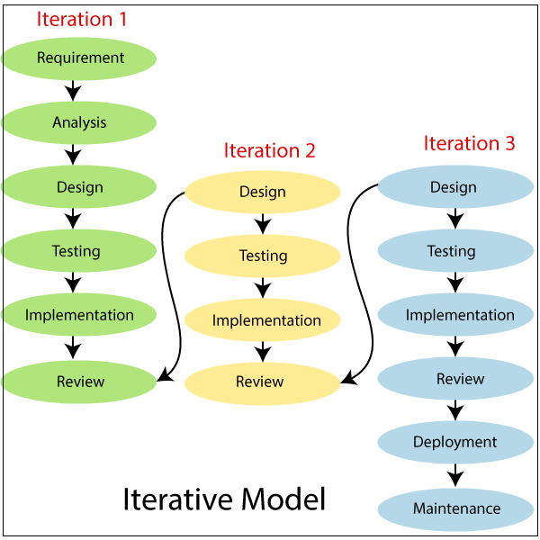
Endeavour
Describe your software development process
We employ an Iterative approach

Slide 22
Endeavour
Describe your way of working as a team
Weekly half-minutes meetings with the supervisor to review project progress and share updates.
Each team member specializes in their designated area.
Progress was discussed daily.
Daily basis Task will assigned by team Lead.

Slide 23
Work Break Down

Slide 24
Work Breakdown Structure (List of all Deliverables / Strikethrough Completed Deliverables)
Report / Documentation
Teams Members Declaration
Initial Project Proposal
Project Proposal Document
Opportunities and Stakeholders
Existing Systems
Problem Statement
Proposed Solution
Project Scope
Admin
Buyer
Seller
Tailor
Project Plan
Change Record
List of faculties proposed changes
Work Breakdown Structure
Roles and Responsibility Matrix
Scheduling Documentation

Slide 25
Work Breakdown Structure (List of all Deliverables / Strikethrough Completed Deliverables)
Progress Report FYP -1
Chapter 1: Introduction
Chapter 2: Literature
Online Survey
Brain Storming
Chapter 3: Requirements Analysis
Functional Requirements
Non-Functional Requirements
SQA Activities
Defect identification through checklist inspection
Defect detection through black box test case design
Chapter4: System Design
Architectural Design
Software Architecture Diagram
Detailed Design
Use Case Diagrams
Fully Dressed use cases
Activity Diagrams
Component Diagram
Schema diagram
Prototype
SQA Activities

Slide 26
Work Breakdown Structure (List of all Deliverables / Strikethrough Completed Deliverables)
Defect detection through black box test case design
Chapter 5: Implementation
Endeavour (Team + Work + Way of Working)
Components, Libraries, Web Services and stubs
IDE, Tools and Technologies
Best Practices / Coding Standards
Software Engineering Practices
Development Practices & Standards
Deployment Environment
Deployment diagram
SQA activities: Defect Detection
Test Case Design (White Box)
System
Development Environment
IDE vs Code
Version Control -. git
Server - localhost
Database – MongoDB
Website
Buyer Module
Authentication
Register
Login

Slide 27
Work Breakdown Structure (List of all Deliverables / Strikethrough Completed Deliverables)
Rule and regulation
Dashboard
Header
Footer
Profile Management
Change Password
Edit Profile
Update Profile
Seller Module
Product Managements
Delete Product
Edit Product
List product
Dashboard
Weekly sales
Total Order
Visit and Sales Statistics
Profile Management
Profile Verification
Edit Profile
Update Profile
Tailor Module
Admin Module

Slide 28
Report

Slide 29
Report
Chapter 1: Introduction
Chapter 2: Literature / Market Survey
Chapter 3: Requirement Analysis
Chapter 4: System Design
Chapter 5: Implementation

