Slide 1
Title slide

Slide 2
JMI Questions to Answer

Slide 3
Background
MIC values: drug’s effectiveness against bacteria
Each drug has a high and low MIC value threshold
If MIC value is:
high then bacteria Resistant (R)
Low then bacteria is Susceptible (S)
Notes:
Mic values are drug’s effectiveness used for a species

Slide 4

Data

Slide 5
Tasks
Preprocess data into X and Y

Slide 6
X and Y values
ESBL, Carbapanese, Both, or Neither (0, 1, 2, 3)
Number of genes for that group above
Drug Id
Na, Resistant, Intermediate, Susceptible (0, 1, 2, 3)

Slide 7
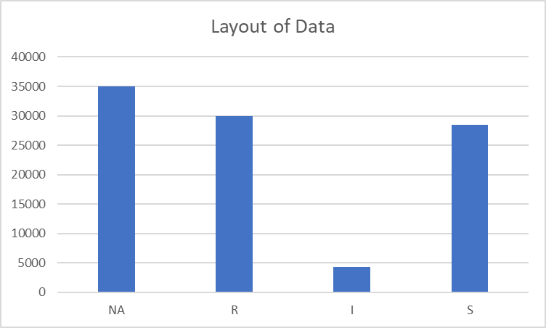

Slide 8
Tasks
Preprocess data into X and Y
Make predictions

Slide 9
Model
layers: 1000, 2000, 2000, 10000
dropout: 0.2
learning rate: 0.001
Batch normalization as each layer

Slide 10
F1 Score

Slide 11
Testing model
Validation accuracy: 90%
Validation ...
Test accuracy: 69%
Test ...

Slide 12
Tasks
Preprocess data into X and Y
Make predictions
Analyze demographic data with ISR values

Slide 13
Demographic variables to test

Slide 14
Testing for dependency

Slide 15
Correlations

Slide 16
Tasks
Preprocess data into X and Y
Make predictions
Analyze demographic data with ISR values
Add correlated variables to model

Slide 17
Model

Slide 18
Results

Slide 19
Conclusion

Slide 20
Questions?

