Slide 1
MIC Prediction using Gene Annotation
By: Cory Kromer-Edwards

Slide 2
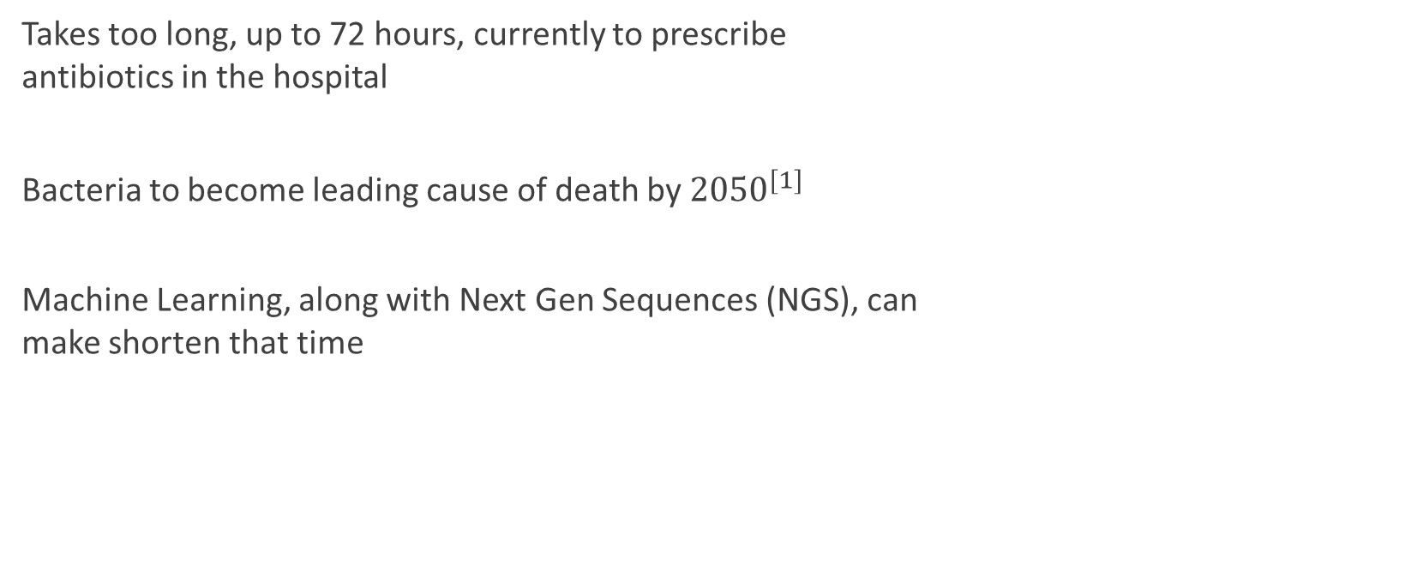
Intro
Takes too long, up to 72 hours, currently to prescribe antibiotics in the hospital
Bacteria to become leading cause of death by ${2050}^{[1]}$
Machine Learning, along with Next Gen Sequences (NGS), can make shorten that time

Slide 3
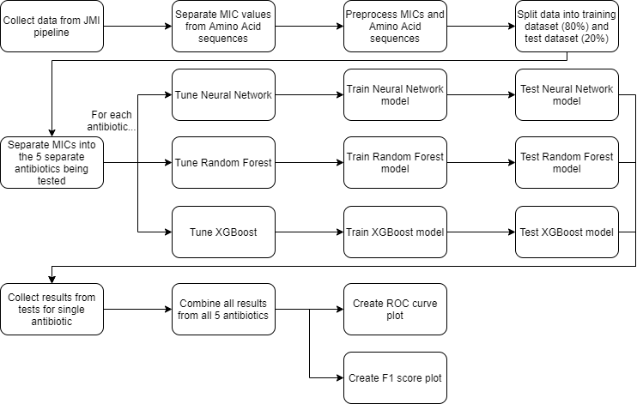

Slide 4
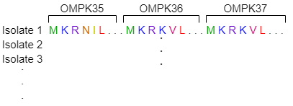
Data
Input:
Annotated Amino Acid (AA) sequences for 3 Outer Membrane Protein (OMP) genes OMPK35, OMPK36, OMPK37
Species genes were retrieved from: Klebsiella Pneumoniae (KPN)
Notes:
2,864 isolates used
Species genes were retrieved from: Klebsiella Pneumoniae (KPN)
Outer Membrane Protein (OMP) genes OMPK35, OMPK36, OMPK37

Slide 5
Notes:
Training was evaluated with 5-fold CV

Slide 6
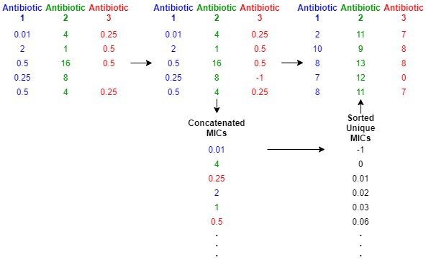
Preprocessing
AA sequences:
AA characters were converted to integers by index
EX: let a species have AA’s [A: 0, B: 1, C: 2], then the AA sequence “ACBCCA” would become “021220”
MIC values*:

Slide 7
Notes:
Training was evaluated with 5-fold CV

Slide 8
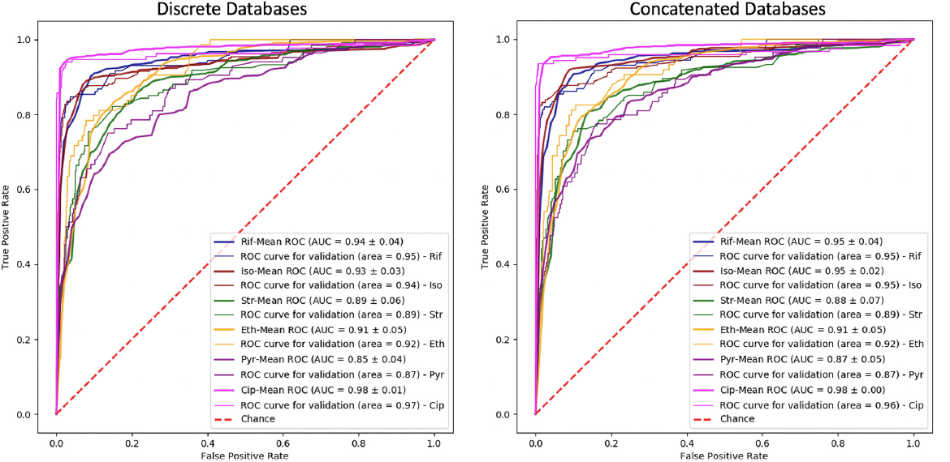
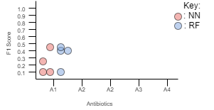
Graphs to reproduce
Plot showing the individual F1 scores for each MIC value by algorithm/antibiotic pair
Receiver Operating Characteristic (ROC) Curve plots

Slide 9
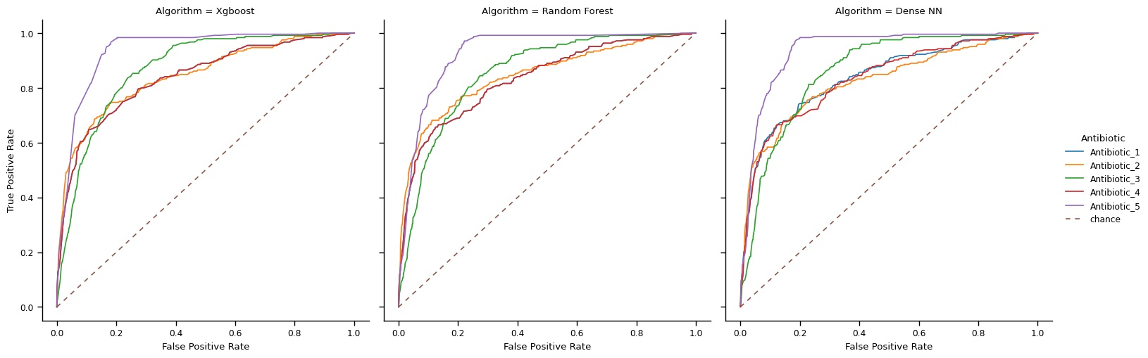
Graphs & Results

Slide 10
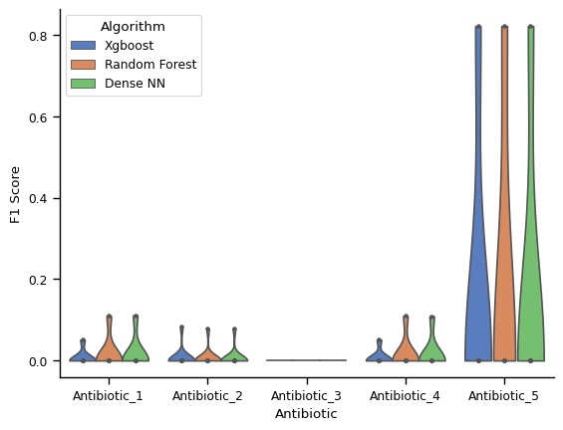
Graphs & Results cont.
Antibiotic 5 performed best
Antibiotic 3 could not predict any MIC value with all F1 scores being 0.0
All antibiotics could only perform well on a single MIC value. All other MICs had F1 score of 0.
Looking at ROC plots, all algorithms seemed to perform well, but plot with F1 scores shows different story

Slide 11
Discussion
Challenges:
Late getting data
Reproducibility challenges:
Data and pipeline are not public, so it would be hard for anyone to reproduce results

Slide 12
Acknowledgements
All data was obtained from JMI Laboratories
Pipeline made, and used, to get data was made in collaboration with JMI Laboratories

